Slide 1
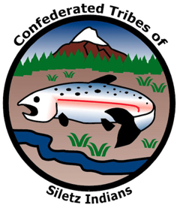
GRADE 2 Cultural Burning

Slide 2
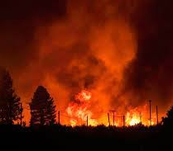
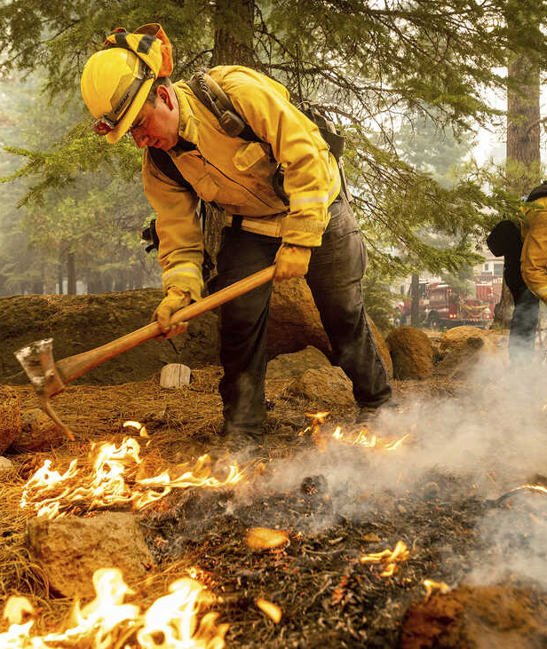
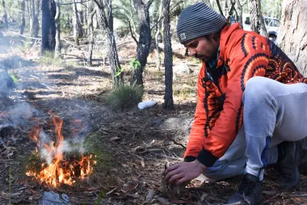
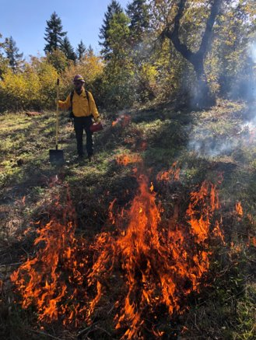
Match the term to the image
Wildfire
Fire suppression
Cultural fire
Notes:
First, let’s play a little game to help remember what we’ve talked about so far. Let’s
look at these pictures and see if we can match these terms to the images. I would like
you to first take a silent moment to yourself and think about which term matches
which picture. Then, we will share with our think-pair-share partners, or shoulder
partners, about which term matches which image. I am going to read the terms out
loud. As I read them, think about which image matches each term.
First term: “wildfire.” Now, think silently about which image is showing a wildfire.
Second term: “fire suppression.” Think silently about which image is showing fire
suppression. Third term: “cultural fire.” Think silently about which image or images show
cultural fire.
Now, share with your shoulder partner which term matches which image and
explain why you think so. When you and your partner have come to an agreement,
find another pair to share your answers and reasoning with. If you have different
answers, explain your reasoning and talk it out. After sharing, find another partner
pair you haven’t shared with yet. Repeat this process until you have talked with
three partner pairs.
Now I’m going to read each term again. When I call on your pair, please tell me
which image matches the term and explain your reasoning.
Picture 1 (top left): wildfire, California, United States- 2021/08/16: Flames from the Dixie fire approaches powerlines. Photo by Ty O’neil/SOPA Images/Light Rocket via Getty Images https://www.theverge.com/2022/1/5/22868298/pge-utility-power-line-responsible-dixie-fire
Picture 2 (top right): Firefighters Erick Padilla (left) and Joe Young extinguish hot spots last week while protecting Lake Almanor West homes from the Dixie Fire in California’s Plumas County. https://www.npr.org/2021/08/09/1026078606/dixie-fire-california-only-21-percent-contained
Picture 3 (bottom left): Burning medicine (sage) Photo credit: @DoD News, Flickr https://www.movingtowardspeace.com/mtpblog/the-ancient-art-of-burning-sage.html
Picture 4 (bottom right): A Siletz Tribal member (holding a drip torch) starts participates in a prescribed burn in western Oregon. Photo credit: CTSI

Slide 3
Video questions
How did the peoples of the Confederated Tribes of Siletz Indians use fire to maintain their environment?
What is the consequence of not using cultural burning practices?
Notes:
First question: How did the peoples of the Confederated Tribes of Siletz Indians use fire to maintain their environment?
Second question: What is the consequence of not using cultural burning practices?
Again, please think silently about your response and then share your response with
your shoulder partner.

Slide 4
Figure 9
Notes:
The study that this data is from is actually a little more complicated. It measures
both the time spent gathering and the number of sticks found. This is more complicated
math that kids typically learn in older grades, but I want to show it so you can
see a more complex way of showing information. The yellow line shows us what
happens in areas where cultural fire is used. You can see that weavers can find lots
of good sticks really quickly. The red line shows us what happens after a wildfire
that severely burns all plants and trees. Although it takes a longer time to regrow
due to the bad burns, weavers can eventually gather the same number of hazel
sticks in these areas—it just takes longer. And the green line shows us that when
we suppress fires, there is hardly any growth for the basketry sticks. No matter how
long weavers search, they never find as many usable sticks as in the other areas.

