Slide 1
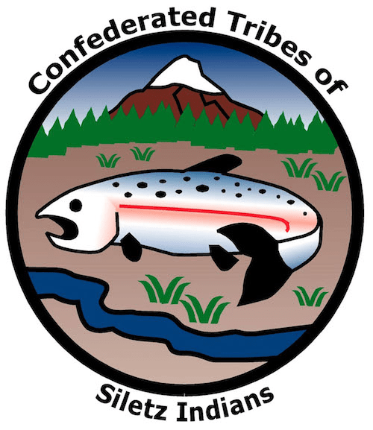

GRADE 4
Mapping Our Lands

Slide 2
Confederated Tribe
A confederated Tribe is composed of multiple Tribes and bands.
The Confederated Tribes of Siletz Indians includes dozens
of bands of Native Americans from western Oregon, northern California, and southwest Washington.
The Confederated Tribes of Siletz Indians have lived on this land since time immemorial.
The Confederated Tribes of Siletz were removed from their ancestral homelands and forcibly moved on to a reservation
in the mid-1850s.
Notes:
A confederated Tribe is composed of multiple Tribes or bands. The Confederated Tribes of Siletz Indians includes dozens of Tribes of Native Americans from Western Oregon, Northern California, and Southwest Washington. The Confederated Tribes of Siletz Indians have lived on this landscape since time immemorial. In the mid 1850s, the U.S. government forcibly removed these people from their ancestral homelands to a reservation on the central Oregon Coast.

Slide 3
Ancestral Territory
The Confederated Tribes of Siletz Indians have lived on this landscape since time immemorial.
Before removal, Native people organized themselves in hundreds of villages across the region.
Today, many Siletz Tribal members continue to identify as both members of the Confederated Tribes of Siletz and as descendants of these original villages.
Notes:
The peoples of the Confederated Tribes of Siletz Indians have lived on this landscape since time immemorial. Before removal, Native people organized themselves in hundreds of villages across the region. These villages were interconnected by trade, language, and family ties but were also separate entities that each managed their local homelands. Today, many Siletz Tribal members continue to identify as both members of the Confederated Tribes of Siletz and as descendants of these original villages.

Slide 4
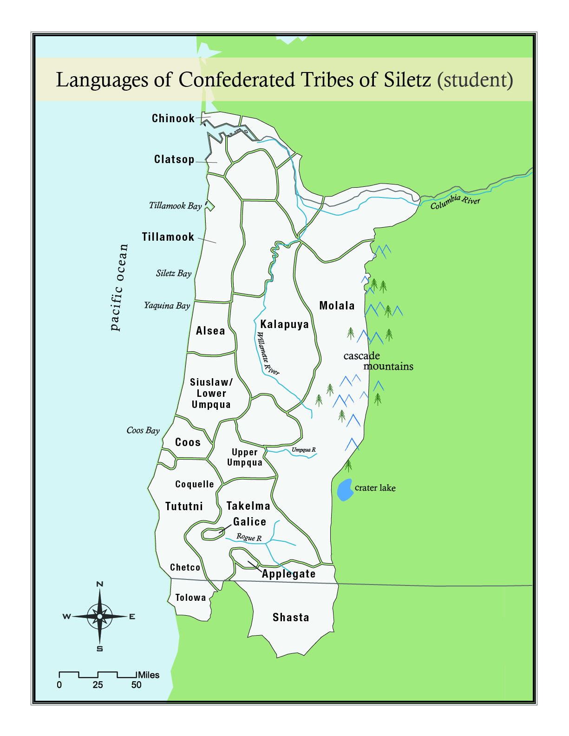
Our People
Notes:
The map on this slide shows the ancestral homelands of many different peoples that make up the Confederated Tribes of Siletz Indians. These groups were forced together in the 1850s when the U.S. government forced Native people in Western Oregon to leave their homes and live on reservations at Siletz and Grand Ronde. Because these peoples had different languages and deep understandings of their own history and territory, it is impossible to give more than a summary in a single lesson. But today we’ll start to learn just a little bit about each of the groups that make up the Confederated Tribes of Siletz Indians.

Slide 5
Our Languages
Each of the Tribes and bands within the Confederated Tribes of Siletz has a unique individual history and culture.
The ancestors of the Confederated Tribes of Siletz speak at least 10 different base languages.
Notes:
It is essential to understand that each of the Tribes within the Confederated Tribes of Siletz Indians has a unique individual history, culture, and oftentimes, language.

Slide 6
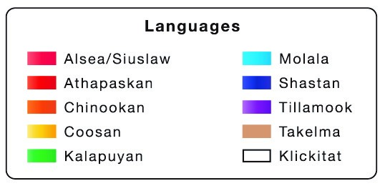
Map Activity 1
Notes:
In fact, the ancestors of Siletz people spoke languages from 10 different languages families! In our first activity, we will work together as a class to identify where each of the languages/language families was spoken before people were forced onto the reservation.

Slide 7
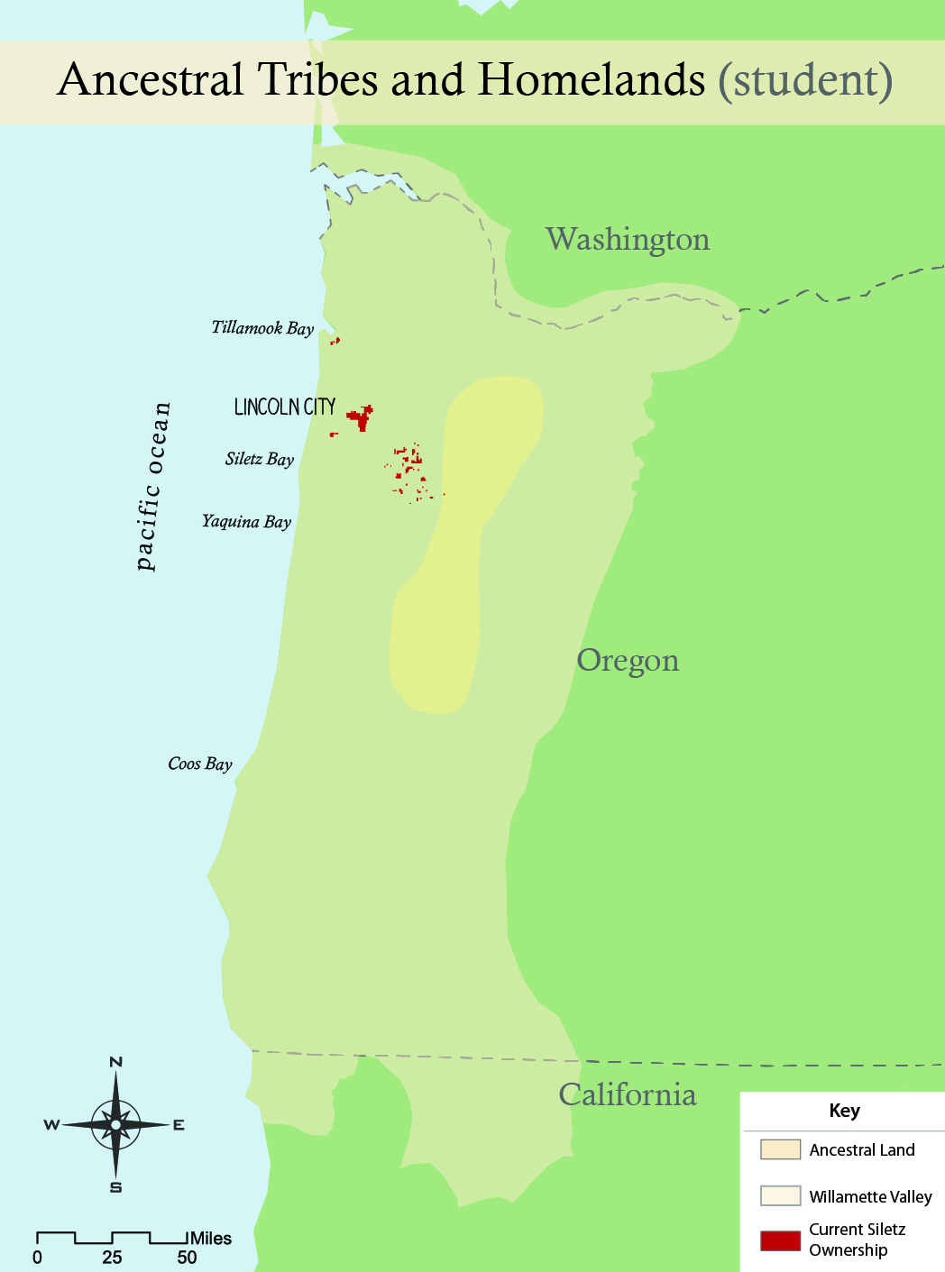
Map Activity 2
Notes:
As discussed in our previous activity, prior to the arrival of settlers, Native people had been living in what we now call Oregon since time immemorial. For this activity, you will be creating a physical map that will allow you to identify key landscape features of the ancestral territories of the different Tribes that make up the Confederated Tribes of Siletz today. This will help us understand how the natural environment influenced their ways of living.

