Slide 1
GRADE 11 Whose Lens?: Photography and Representation

Slide 2
F. A. Rinehart Portrait of "Clear," a Sioux Indian (1900)
Rinehart, F. A. (1900). Portrait of "Clear," a Sioux Indian [Photograph]. Framing the Frontier: Photographers & the American West, 1850-1920. https://framingthefrontier.omeka.net/items/show/34
Notes:
Are you ready? Let’s look at this portrait taken by F.A. Rinehart in 1900 titled “Portrait of Clear, a Sioux Indian.” Please write down your observations and thoughts about this portrait.

Slide 3
Edward Curtis Portrait of Bick Juna, Zuni Man (1903)
Curtis, E. S. (1903). Portrait of Bick Juna, Zuni Man [Photograph]. Framing the Frontier: Photographers & the American West, 1850-1920. https://framingthefrontier.omeka.net/items/show/35
Notes:
Ok, let’s look at the next portrait. This portrait of Bick Juna, a member of the Zuni Nation, was taken by photographer Edward S. Curtis in 1903.
Next, I would like you to compare your observations of both images. What is your analysis of differences, similarities, or representation you observe in the portraits? Do you see similar or different meanings conveyed through these two images? What do you think is the photographer's purpose in taking these photographs? What story are these photographers trying to tell about Native people?

Slide 4
Thomas C. Jackson
Photo source: CTSI Cultural Collections. Photo enhanced from a portrait taken with other Siletz Tribal members.
Notes:
One of the earliest Native photographers in the United States is a man named Thomas C. Jackson, commonly known as Tom or T.C. Jackson was a member of the Confederated Tribes of Siletz Indians. His family was Alsea and came from a village near modern-day Waldport. His ancestors inhabited the area that became the Coast (Siletz) Reservation in western Oregon since the beginning of the world. Born within a decade of the creation of the reservation (around 1864), Jackson lived through much of the upheaval of the early reservation times, marrying twice and raising four children while retaining his knowledge of his language and culture. As a child, Jackson was taken from his home to the Siletz boarding school where education focused on manual labor. However, he also received a traditional
cultural education from his family, learning the histories and traditions of his people. Jackson would later collaborate with ethnographers working in Siletz in the early 20th century, helping to collect and translate stories passed down for generations by Alsea people. Like many of his generation, throughout his life Jackson had to find different ways to make a living, including fishing for commercial canners, logging, traveling outside the area for temporary jobs, taking on seasonal work like picking hops, and even organizing pickers from Siletz and Grand Ronde for hop-picking contracts. He also served in the agency police force and was an active member of county politics.
In 1891, already in his mid-twenties, Jackson enrolled himself at Chemawa Indian School in Salem where he learned about photography. By 1893, he had returned to Siletz and set himself up as one of the earliest Native photographers in United States, operating a well-known studio in the Siletz area and becoming a fixture in the community with his camera. Though he continued working other jobs, over
the next decades Jackson took hundreds of photographs—a mixture of individual and family portraits, scenes of community life, and landscapes from the Siletz reservation. Many of these survived in Siletz Tribal archives after Jackson’s death in 1929. Some of Jackson’s photographs even made their way east for exhibition, eventually ending up in the possession of Princeton University.

Slide 5
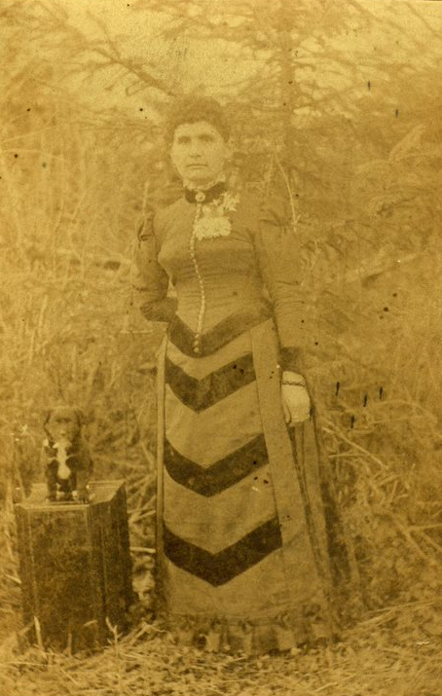
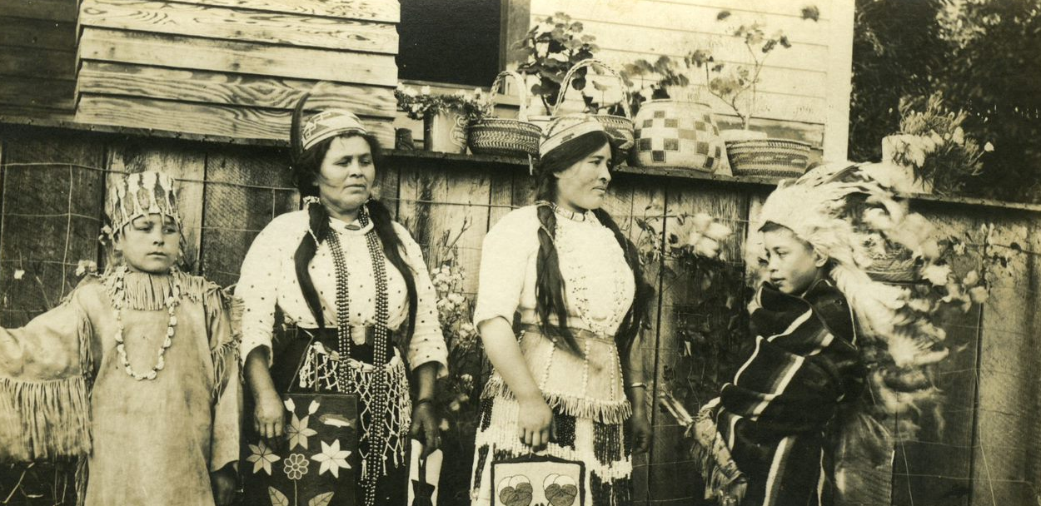
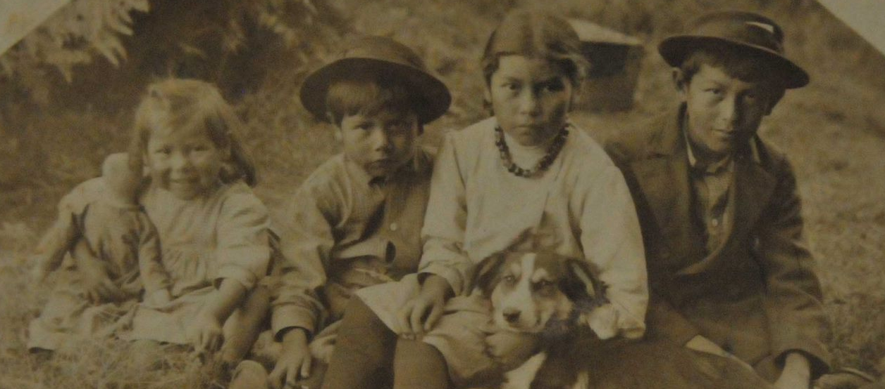
Images source: CTSI Cultural Collections
Notes:
Next, we are going to look at some of Jackson’s photographs. Jackson’s work gives us an opportunity to see the ways that Native people sought to portray their own world at the turn of the century and the stories that they sought to tell each other and the outside world. As you look at these images, I want you to jot down some notes and observations for each photo. As we go through the photographs, you can label the heading with the title of the photograph.

Slide 6
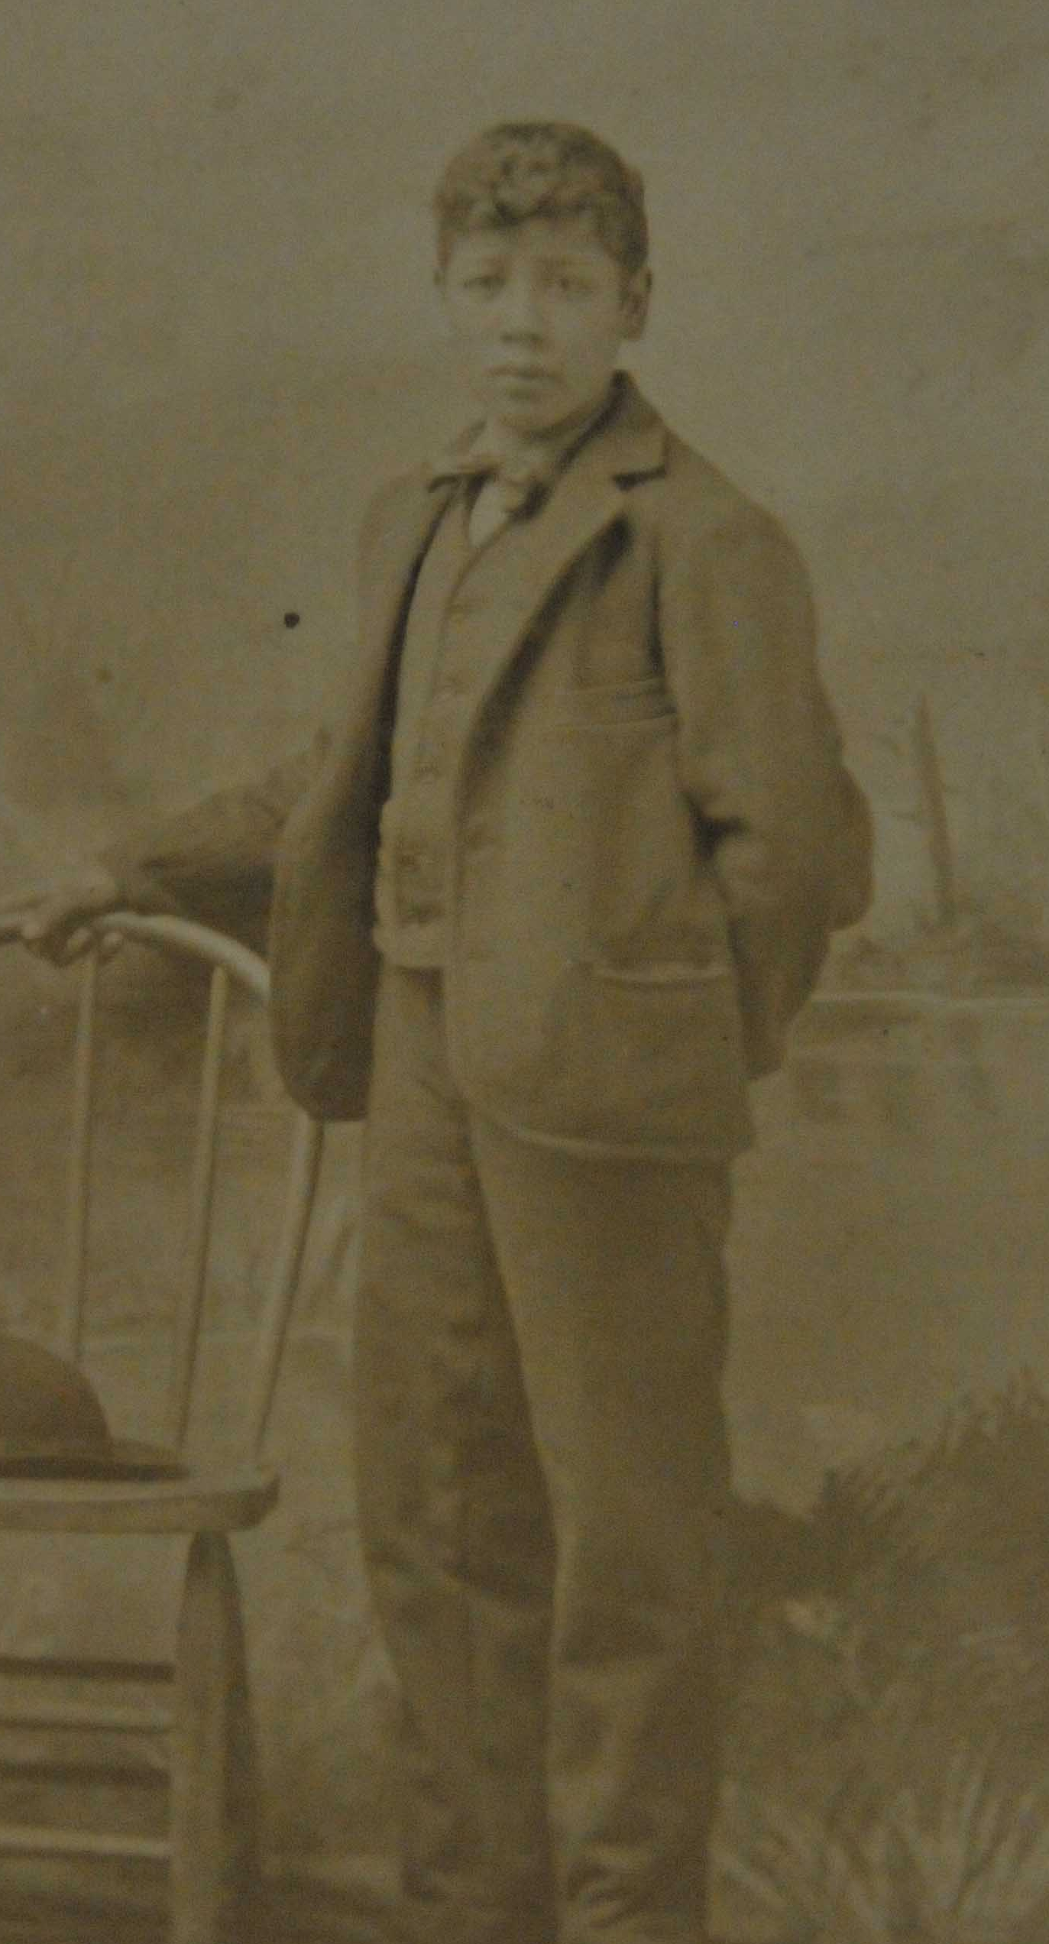
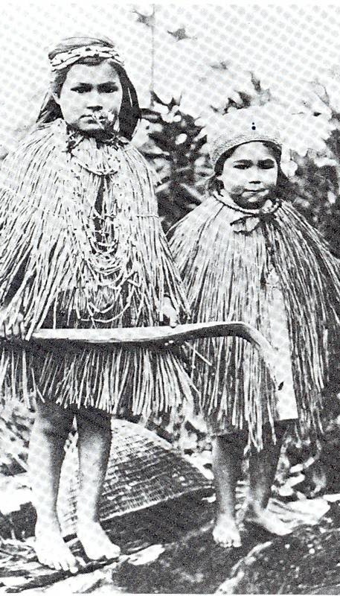
Images source: CTSI Cultural Collections

Slide 7
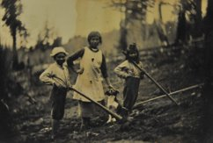
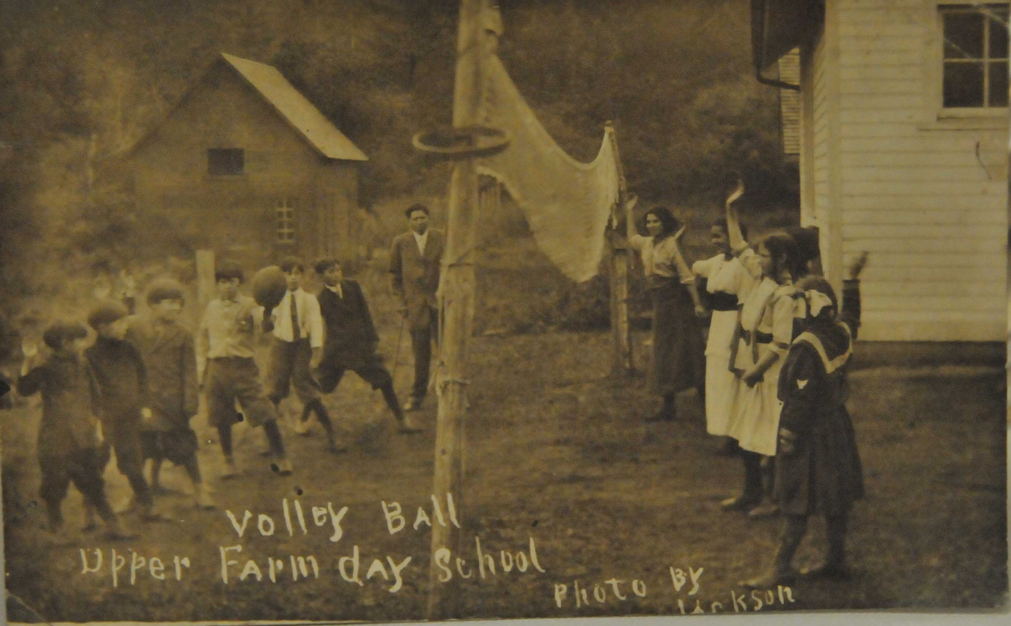
Images source: CTSI Cultural Collections

Slide 8
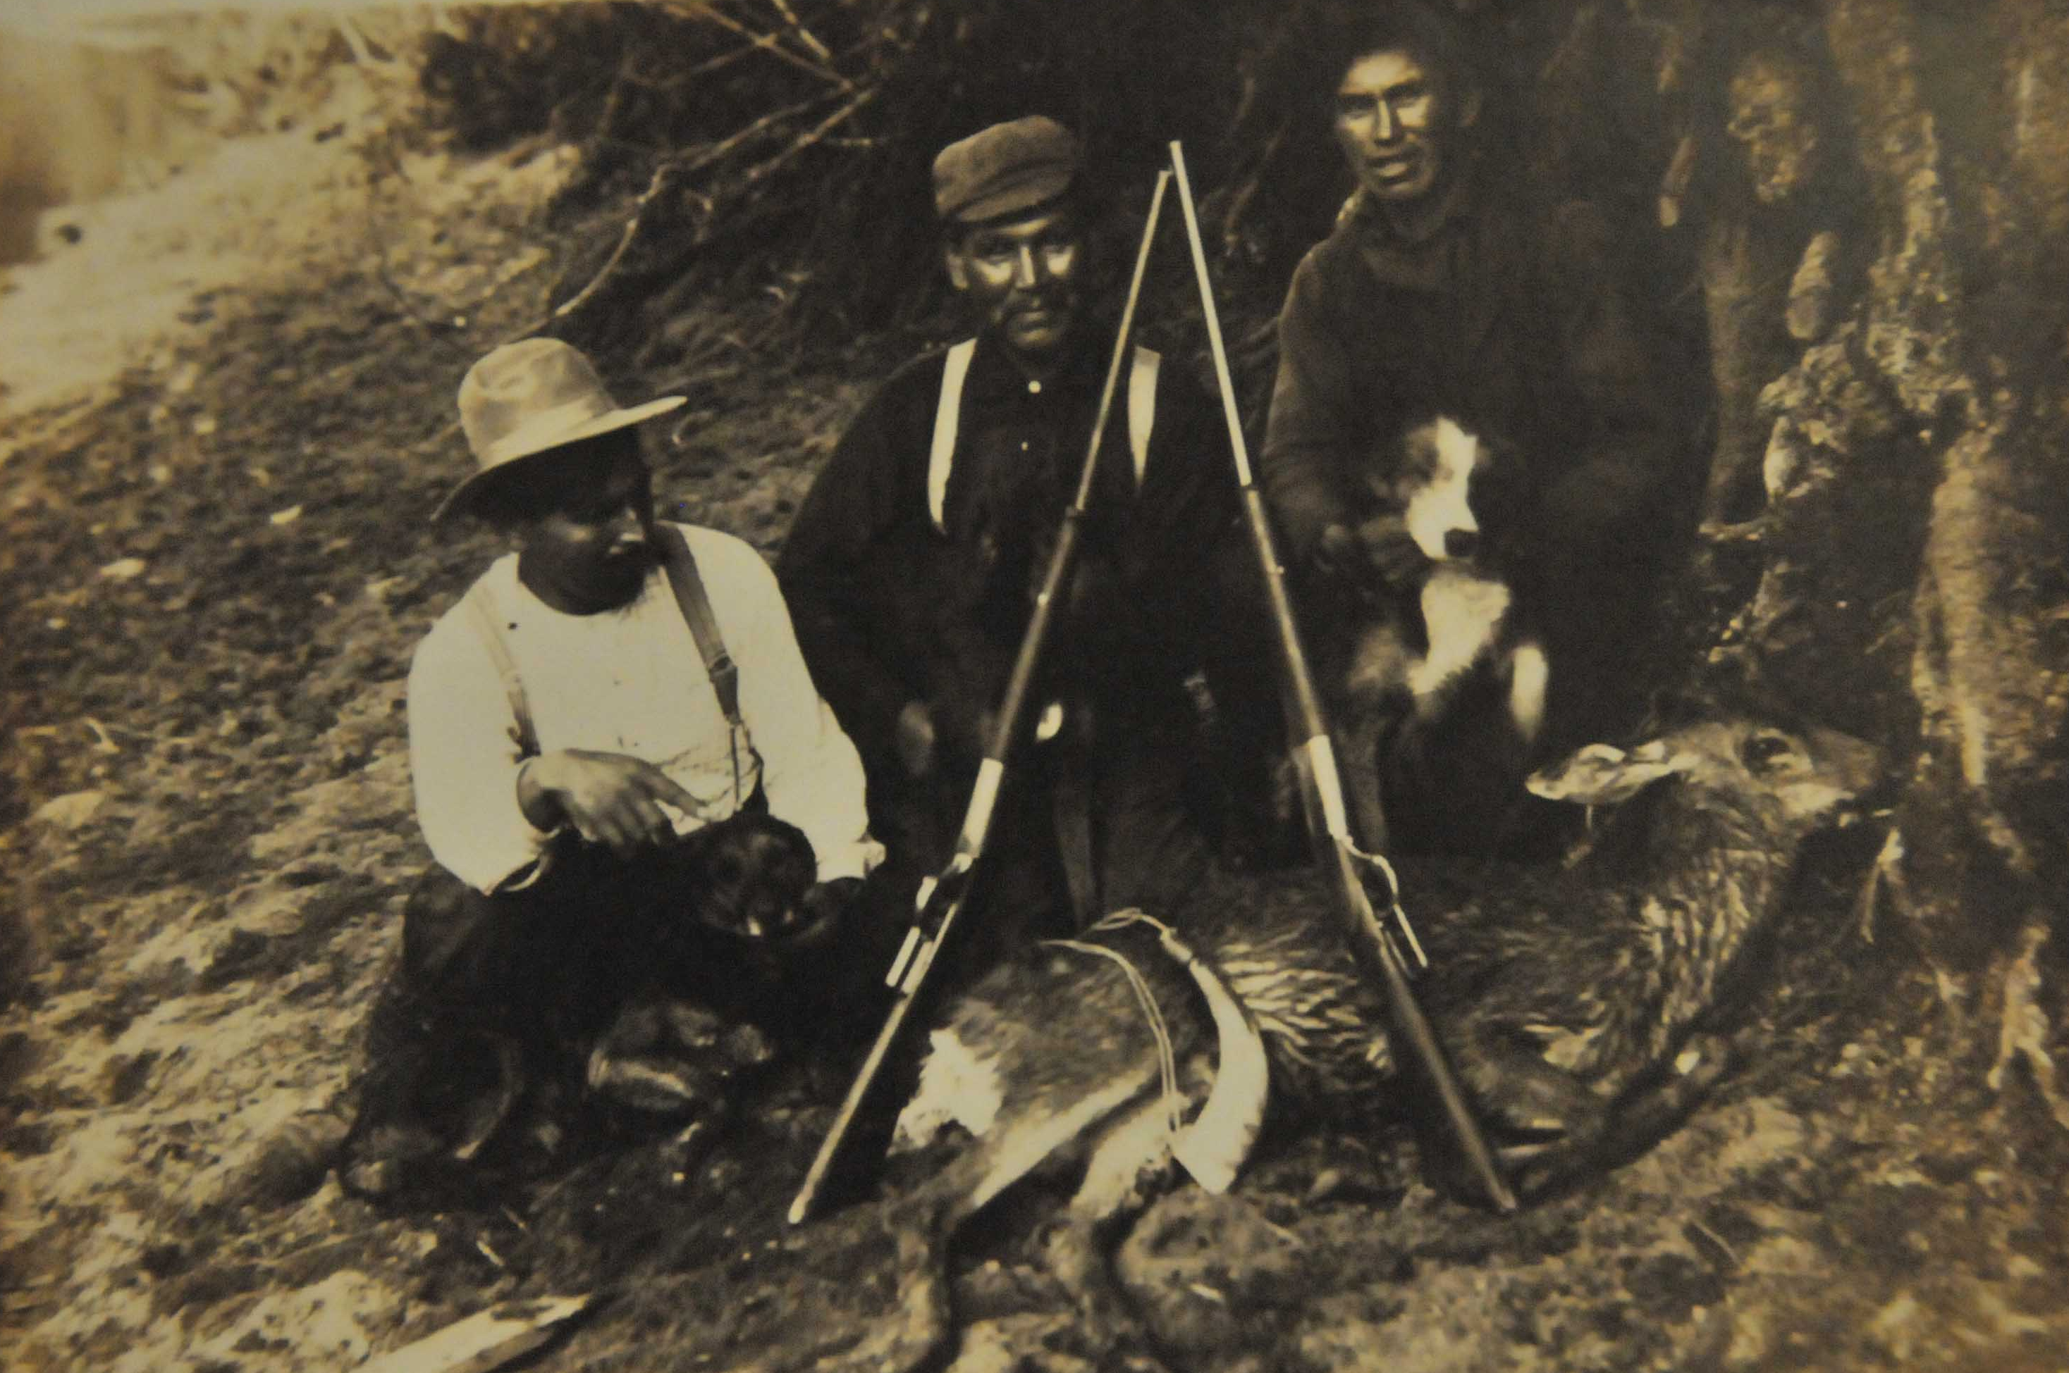
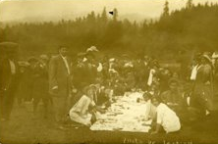
Images source: CTSI Cultural Collections

Slide 9
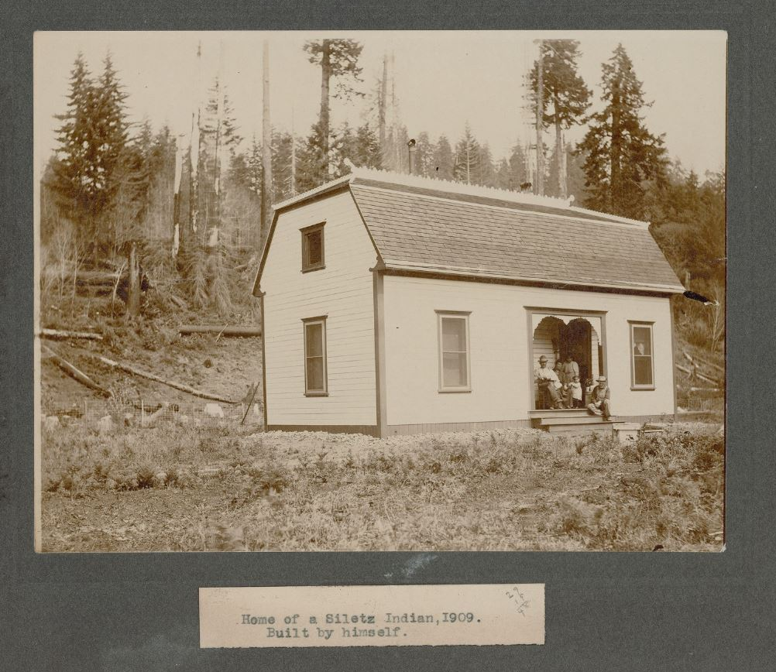
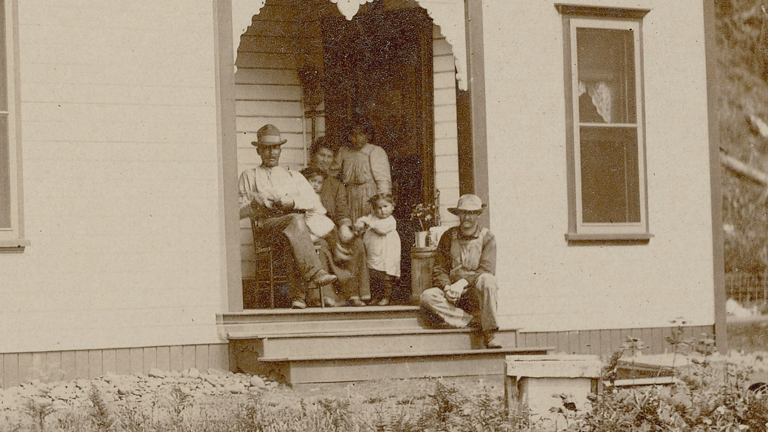
Images source: CTSI Cultural Collections

Slide 10
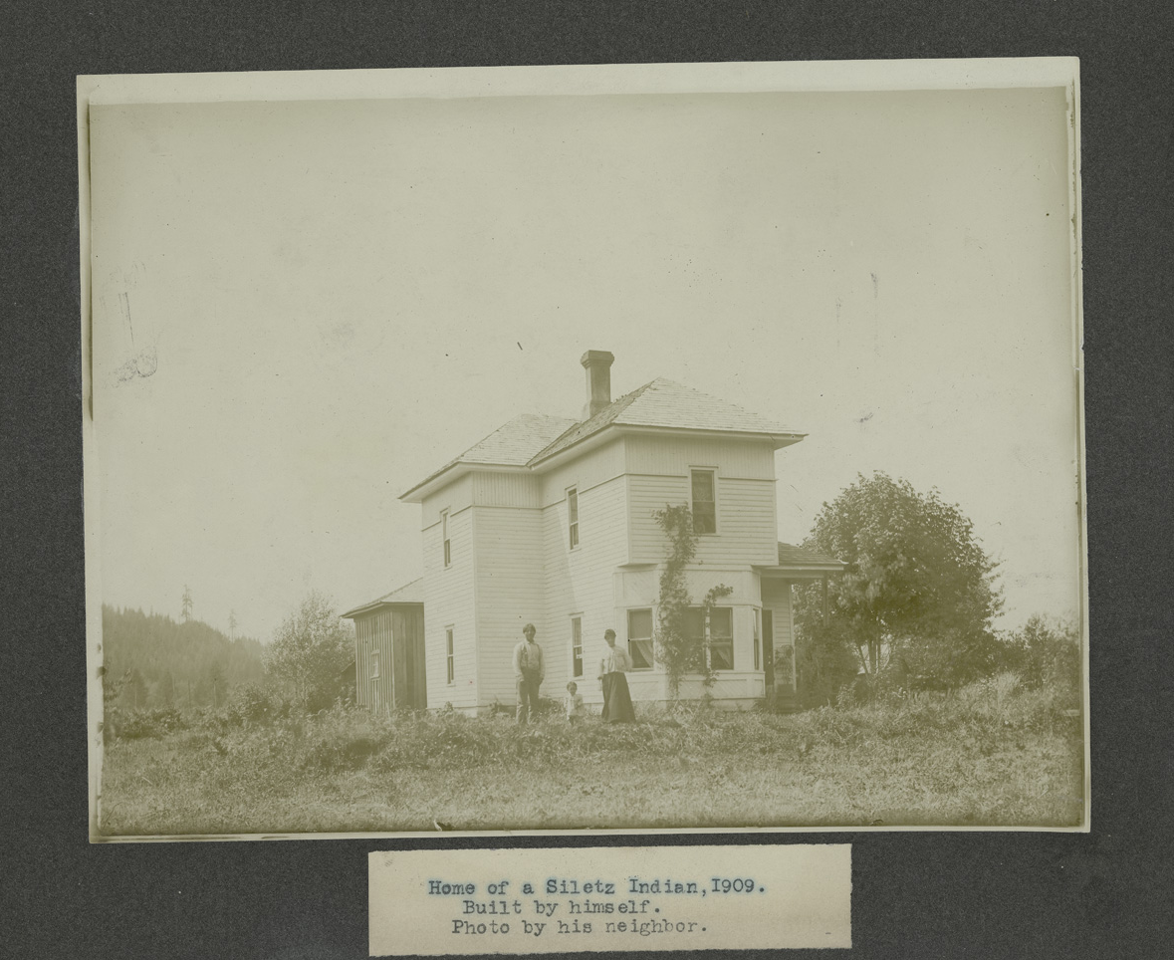
Images source: CTSI Cultural Collections
Notes:
Now that you have seen a sample of Tom Jackson’s photographs, how do his photographs differ from the first two photographs we viewed taken by non-Native photographers? What message about Native life does Jackson convey with his pictures? What stories were important for Jackson to tell? How would the audience have interpreted Jackson’s photographs? How does what you see in the images connect to the background information of Siletz Indians we listed in the beginning of the lesson? Explain.

