Slide 1
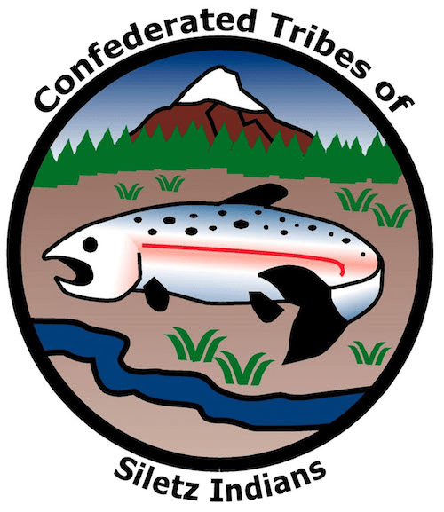
GRADE 10 Reservation Reductions

Slide 2
Warm Up
Did you ever learn something about history that made you question your understanding of what you were previously taught or helped you see it in a new light?
When studying history, what can you do to make sure you are getting the “full story”?

Slide 3
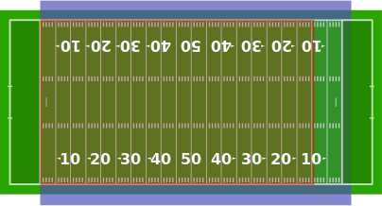
What is an acre?
A measure of an area of land that equals:
“1 furlong by 1 chain” (660 feet x 66 feet) [land survey measurement terms]
4,046.86 square meters
4,840 square yards
43,560 square feet
1/640th of a square mile
Almost as big as a football field (green) or soccer pitch (blue)
As big as 16 tennis courts
As big as 18, 2,400 square-ft houses
Image sources: a) “Acre Superimposed Over Football Fields.” Jc3s5h via Wikimedia Commons. en.wikipedia.org/wiki/Acre#/media/File:Acre_superimposed_over_football_fields.svg. b) “Eye View Diagram Outline.” Clker Free Vector Images via Pixabay. pixabay.com/images/id-40326. c) “House Icon Symbol Architecture.” janjf93 via Pixabay. pixabay.com/vectors/house-icon-symbol-architecture-2492054.

Slide 4
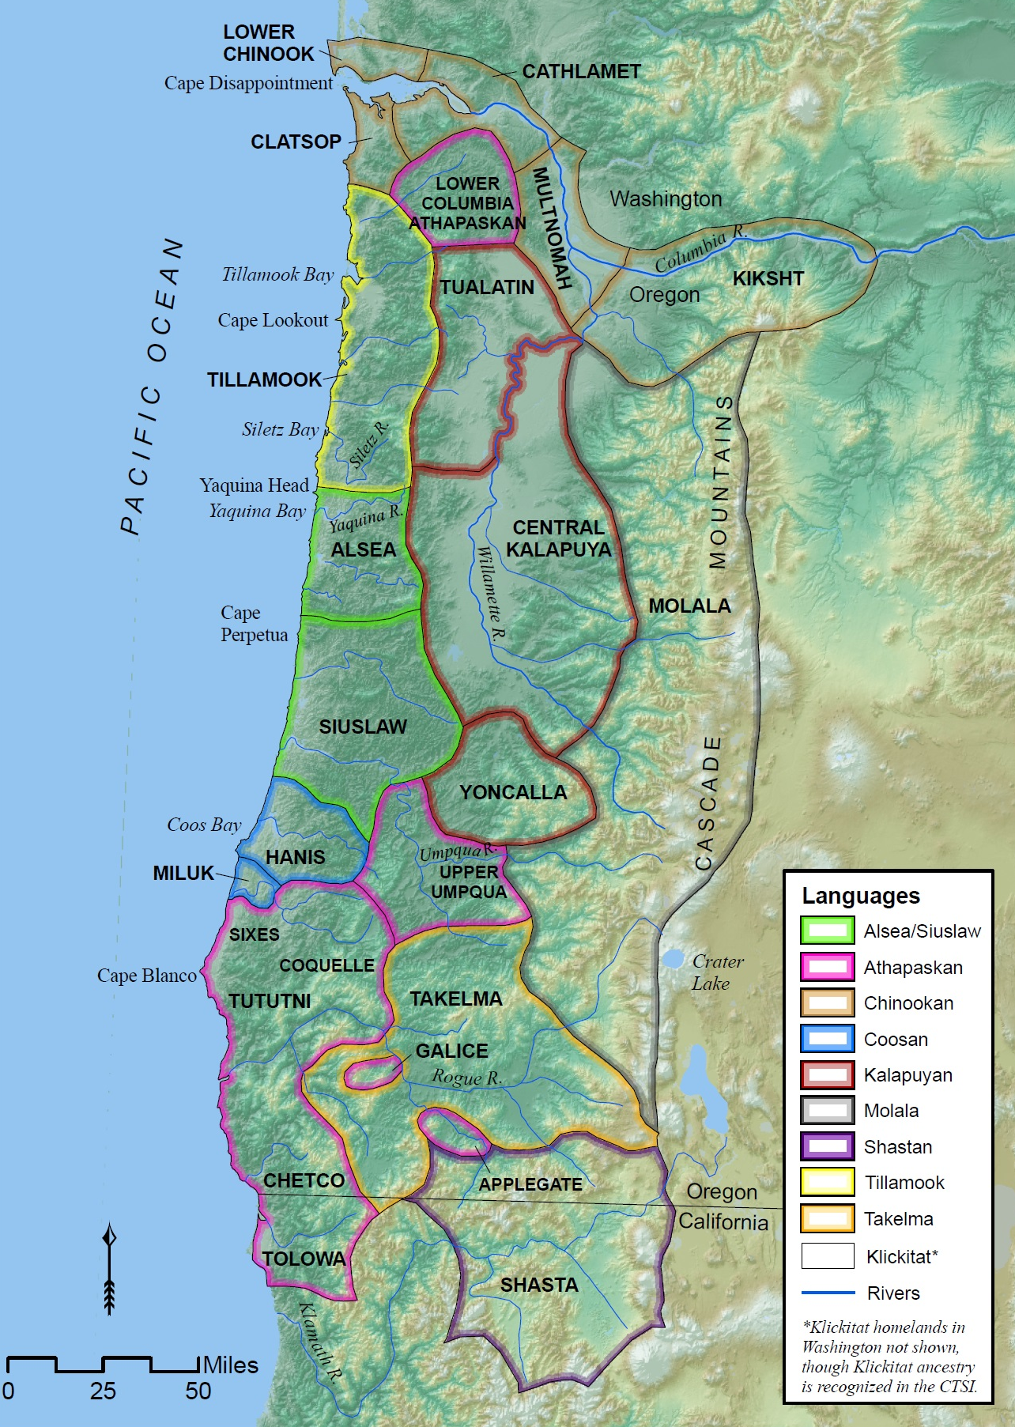
Siletz ancestral homelands and languages
Image source: Wilkinson, C. (2010). The people are dancing again: The history of the Siletz Tribe of Western Oregon. University of Washington Press.
Notes:
Say: This slide of Siletz ancestral homelands and languages shows the ancestral areas of Western Oregon inhabited by multiple Tribes and bands of Siletz ancestors prior to contact with Euro-Americans and the languages and dialects they spoke.

Slide 5
Siletz ancestral areas and 1855 reservation boundaries
Image source: Confederated Tribes of Siletz Indians.
Notes:
Say: This slide of the Siletz ancestral areas and 1855 reservation boundaries shows the ancestral areas of the Western Oregon Tribes and bands as well as the original boundaries of the Siletz Coast Reservation as established in 1855.

Slide 6
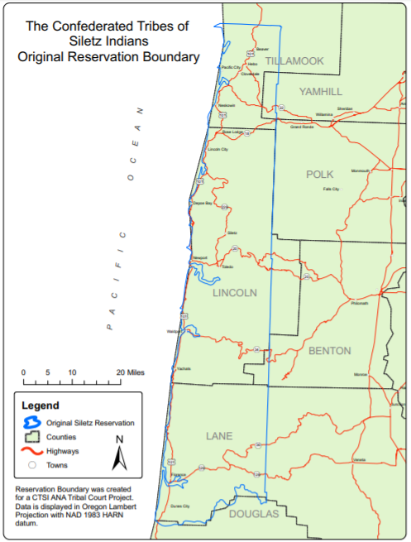
Original Siletz Coast Reservation (1855)
Conceived of and advocated for by Joel Palmer, Superintendent of Indian Affairs of the Oregon Territory
Established by executive order of President Franklin Pierce on November 9, 1855
1.1 million acres, from Cape Lookout to Siltcoos River (a third of the entire Oregon coastline)
Members of dozens of Native American bands living in Western Oregon were forcibly relocated to the reservation beginning in 1856
Image source: Confederated Tribes of Siletz Indians.
Notes:
Say: This slide of the Original Siletz Coast Reservation (1855) shows the 1855 boundaries of the Siletz Coast Reservation superimposed on top of current county boundaries.
[Action]Emphasize the large size of the reservation (around 1.1 million acres) and remind students the federal government created the Siletz Coast Reservation on land taken from the ancestral homelands of several coastal Tribes (Alsea, Siuslaw, Tillamook) and then moved others in to live with the coastal Tribes. Some Tribes were used to living on that part of the Oregon Coast, but it was hard for other Tribes—such as those from Northern California and the Willamette Valley—to adjust to the new geography and climate of the reservation.

Slide 7
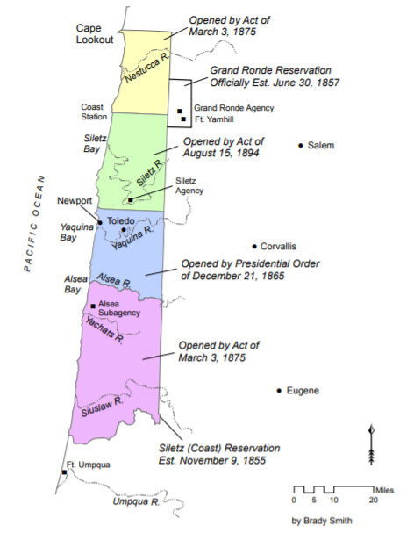
Reservation reductions
Yaquina Tract (200,000 acres) opened to white settlement by a presidential executive order of Andrew Johnson in 1865 (blue)
Congress removed an additional two-thirds of reservation lands (700,000 acres) in 1875 (yellow and purple)
Most of the remaining reservation land (green) lost through allotment and termination (described in other lessons)
Image source: Confederated Tribes of Siletz Indians.
Notes:
Say: This slide shows the reductions of the Siletz Coast Reservation as a result of presidential and congressional actions.
The Yaquina Tract (200,000 acres), represented in blue on the map, was opened by a presidential executive order of Andrew Johnson in 1865.
Congress removed an additional two-thirds of reservation lands (700,000 acres) in 1875 in two chunks north (yellow) and south (purple) of the reservation headquarters at the present-day city of Siletz.
Remaining Siletz Coast Reservation lands (the green section on the map) were later taken away by Congress through policies called “allotment” and “termination.” These are described at length in other Siletz history lessons.

Slide 8
Land losses (acres)*
Original Siletz Coast Reservation (1855) | 1,125,000
President Andrew Johnson executive order (1865) | -200,000
Reductions by Congress (1875) | -700,000
Remaining reservation land after 1875 | 225,000
*Approximations for illustrative purposes.
Source: Wilkinson, C. (2010). The people are dancing again: The history of the Siletz Tribe of Western Oregon. University of Washington Press.
Notes:
[Action] Display this slide (“Land losses (acres)”) and review with students the data presented on the land loss suffered by the Confederated Tribes of Siletz Indians due to the reservation reductions. Ask for a volunteer to calculate the size of the land losses as a percentage (Answer: 80 percent).

Slide 9
Current Siletz Tribal land ownership
Notes:
[Action] Point students to the copy of the current Siletz landholdings in the map packet. Ask students to discuss in their groups what they notice about the map and if they can identify any familiar landmarks that are on or near Tribal land, and then share the following key points.
Say: In 1980, the federal government gave back to the Tribes some tiny pieces of the original reservation land, and the Tribe later bought additional land. It now manages some 4,700 acres of reservation land and has a total land base of nearly 16,000. These land holdings are a testament to the perseverance and resourcefulness of Siletz people.

Slide 10
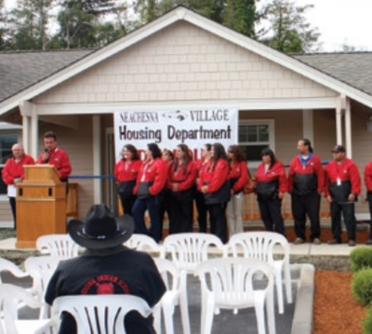
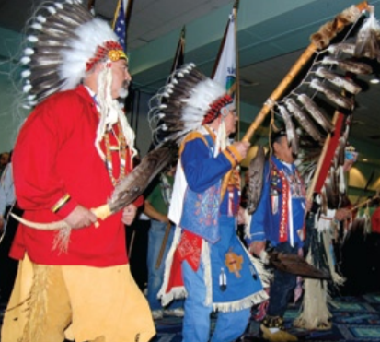
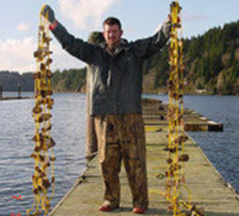
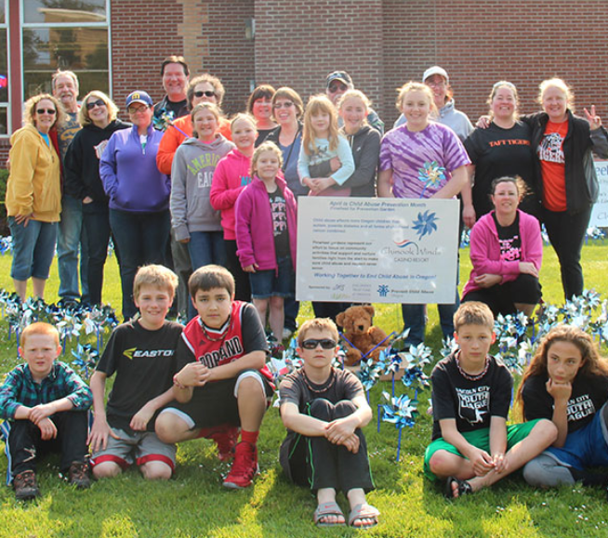
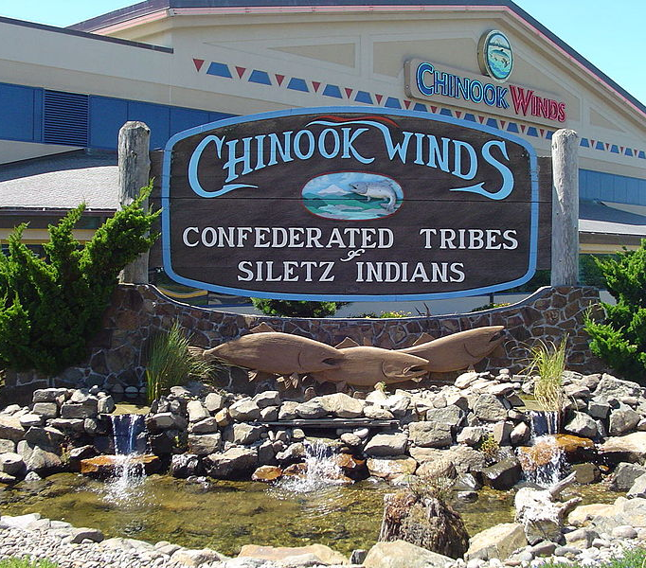
Making the best use of Tribal lands today
Member Housing and Services
Gatherings and Celebrations
Environmental Conservation
Image sources: a) 1–4, Confederated Tribes of Siletz Indians. b) “Chinook Winds: Becherka.” Public domain via Wikimedia Commons.
Philanthropy
Economic Development
Notes:
[Action] Discuss with students how the Tribe is using its land and other resources to serve its members and Oregon coastal communities and to help the Tribe survive and thrive into the future.
Say: The Confederated Tribes of Siletz Indians has demonstrated its characteristic persistence and resourcefulness in making the best use of its lands and other resources. The Tribe has built housing for elders and other members on its reservation, as well as the Chinook Winds Casino on land the Tribe owns north of Lincoln City to generate revenue for the Tribe. The reservation hosts cultural and educational programs and community celebrations. The Tribe actively manages natural resources by issuing hunting, shing, and firwood-cutting permits on its lands and participates in local and regional environmental restoration projects, including enhancing depleted native oyster beds in Yaquina Bay, managing a Tribal fish hatchery, restoring salt marshes and riparian zones, and working to revive lamprey populations. Many Siletz families continue to retain ties to important places throughout the original reservation boundaries and the rest of their ancestral territory, annually traveling hundreds of miles to traditional gathering places, sacred sites, and ancestral villages to pass those connections down to their children and grandchildren.

Slide 11
Primary and secondary sources
Primary sources | Secondary sources
Benefits
Evidence of what happened in the past. Bits of history that reveal how people from the time lived and what they thought about the world. | Help us interpret or make sense of primary sources. Tell how an event fits into history. Can include related facts about other events that happened at the same time or at other times.
Challenges
May be difficult to read or understand. May only tell one point of view. | May tell a story from only one point of view. May be a biased representation of the story.

Slide 12
Point of view (perspective)
The position or attitude from which something or someone is observed. Everyone has a point of view. Sometimes in history, one person’s or group’s point of view is judged to be more accurate or important than other points of view. Different points of view can be misunderstood, forgotten, or intentionally left out. History can be missing “the other side of the story.”
Image source: Pixabay. pixabay.com/photos/glasses-reading-glasses-spectacles-1246611.

Slide 13
Bias
Prejudice in favor of or against one thing, person, or group compared with another. Sometimes people who observe or interpret an event in history make judgments that are based on their own biases.
Image source: Pixabay. pixabay.com/illustrations/horizontal-pan-balance-weigh-2071320.

Slide 14
Reading analysis instructions
Together with your group, read the primary and secondary source texts provided in your handout pertaining to the federal actions that deprived the Siletz Tribes of promised reservation land:
1865 executive order reservation reduction
1875 act of Congress reservation reduction
Answer the reading reflection questions provided on the next slide
Be prepared to share what you learn with the whole class

Slide 15
Reading analysis questions
Who created the document(s)?
What voice(s) are represented in the document(s)? What voice(s) are missing?
Why did the author(s) create the document(s)?
What were their motivations and goals?
What claim(s) does/do the author(s) use to make their point(s)?
How does/do the document(s) help you understand the land losses experienced by the Confederated Tribes of Siletz Indians?

