Slide 1
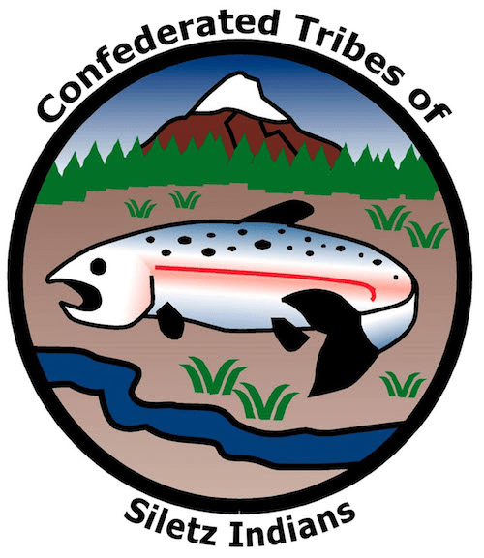
GRADE 5 Salmon Habitat Restoration

Slide 2
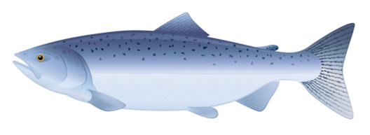
Salmon essential facts
Ray-finned fish native to tributaries of the North Atlantic and Pacific Oceans
Related to trout, char, grayling, and whitefish
Are usually (but not always) anadromous: they hatch in fresh water, migrate to the ocean, then return to fresh water to reproduce
Are keystone species—plants or animals that are critical to the survival of other species
Image source: iStockPhoto
Notes:
Salmon is the common name for several species of ray-finned fish in the family Salmonidae that are native to the rivers and streams flowing into both the North Atlantic and Pacific oceans. Salmon are typically—but not always—anadromous, which means they hatch in fresh water, migrate to the ocean, then return to fresh water to reproduce. That means they depend on many different habitats—or ”homes”—throughout their lives. Salmon are often called a keystone species, a living organism that helps sustain an entire ecosystem. Without its keystone species, an ecosystem would be very different or even disappear, as no other species can fill the missing niche. That is, without salmon, many other animals can’t find the nutrition that they need to be healthy and thrive in their homes.

Slide 3
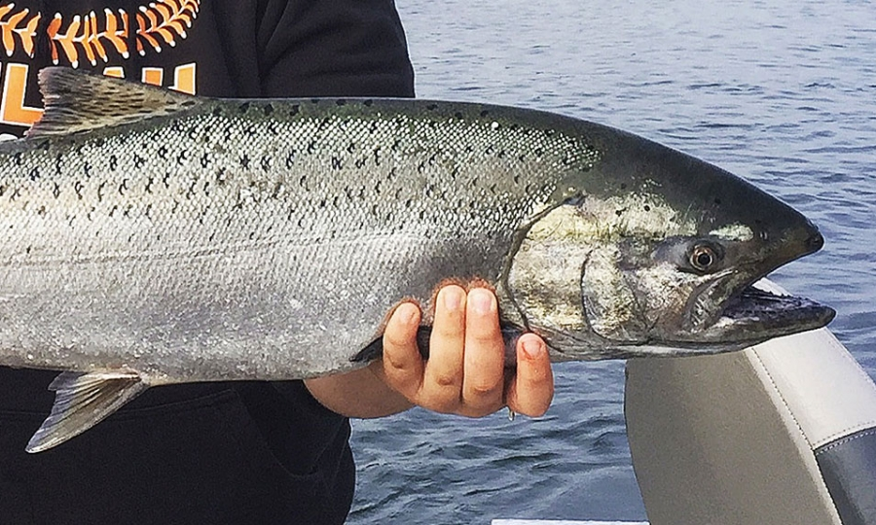
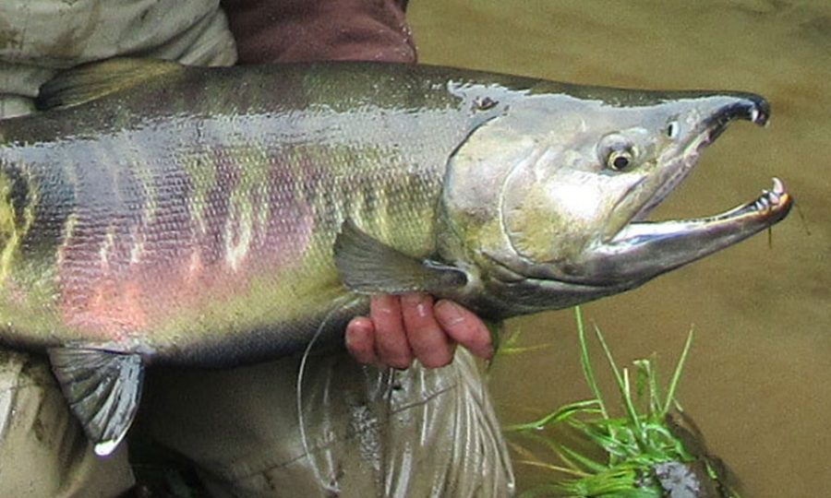
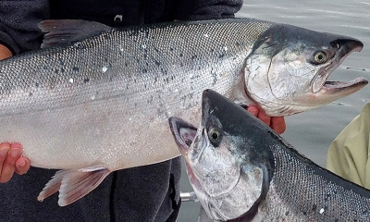
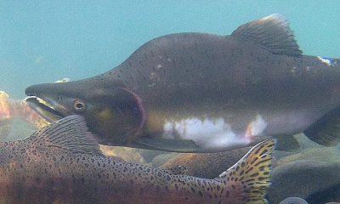
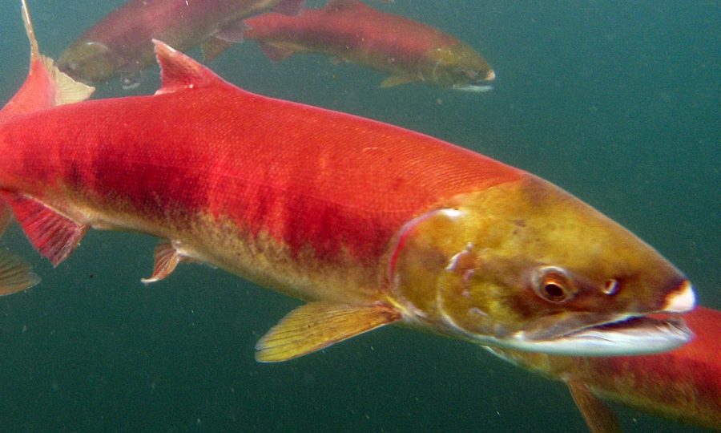
Salmon in Oregon
Chinook/king salmon
Chum/dog salmon
Coho/silver salmon
Dan'-dee-ni
Dan'-xvt luu-k'e
Pink/humpback salmon
Sockeye/red salmon
Image source: Oregon Department of Fish & Wildlife
Notes:
There are five species of Pacific salmon native to Oregon. Three—chinook (or king), chum (or dog), and coho (or silver)—are common. The other two, pink (or humpback) and sockeye (or red), are seen less often, although kokanee, land-locked sockeye salmon, can be found in some Oregon lakes and rivers where natural or human-created barriers prevent them from migrating to the Pacific Ocean. Many Native languages in western Oregon have distinct names for all of the fish runs. For example, Athabaskan- speaking peoples from southern Oregon/northern California call the spring run of Chinook dan’-dee-ni and the fall run dan’-xvt luu-k'e.

Slide 4
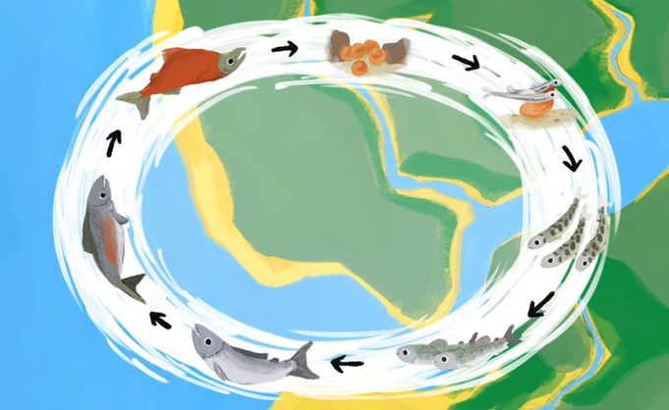
Salmon life cycle
Image and video source: National Marine Sanctuary Foundation and Pacific Northwest College of Art Animated Arts (via YouTube)

Slide 5
Healthy salmon habitat
Image source: National Oceanic and Atmospheric Administration Fisheries

Slide 6
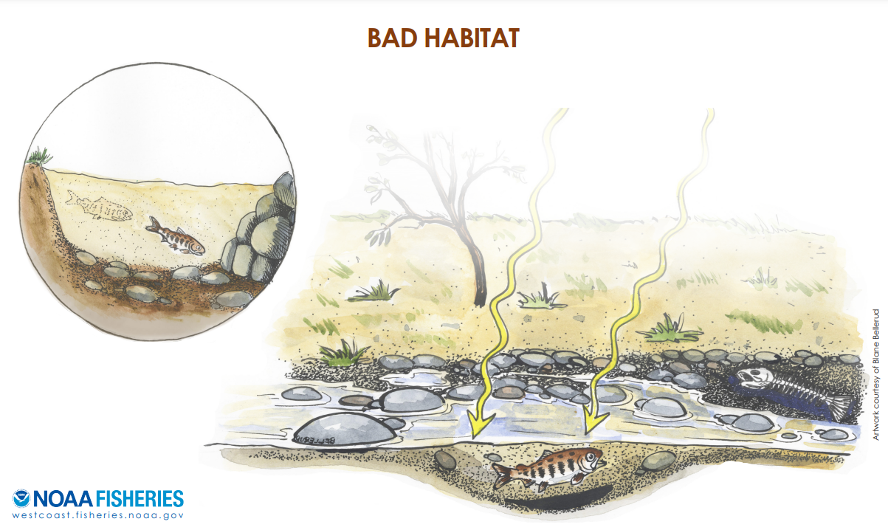
Unhealthy salmon habitat
Image source: National Oceanic and Atmospheric Administration Fisheries

Slide 7
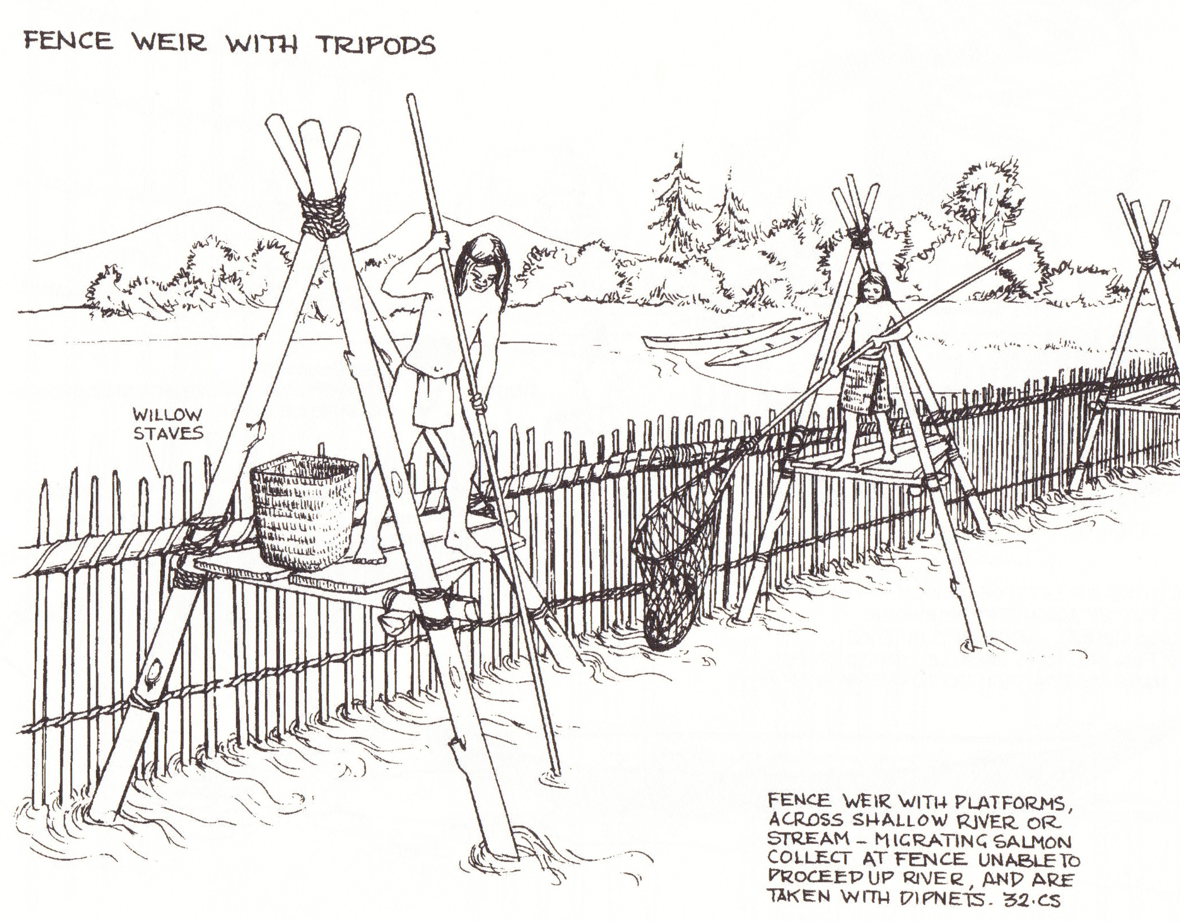
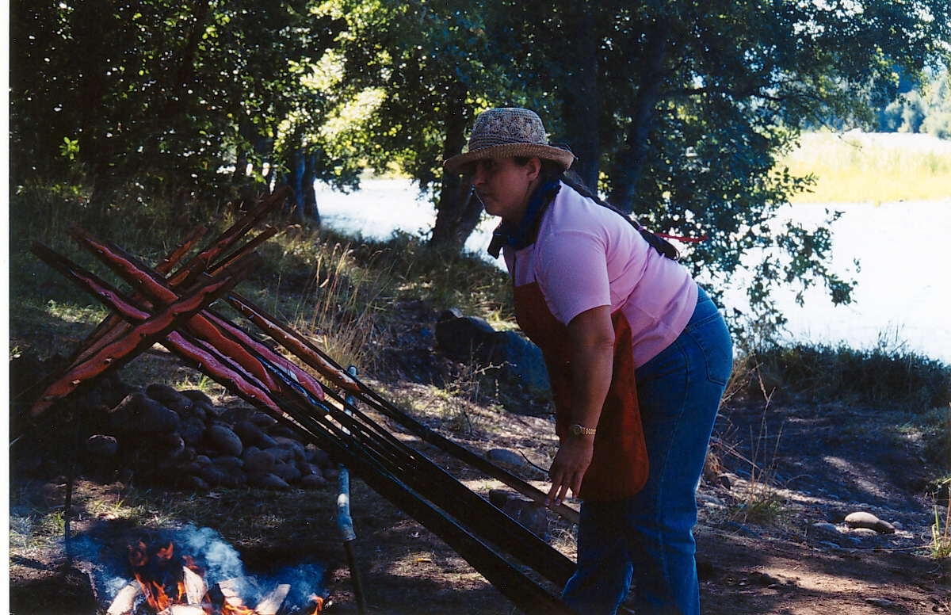
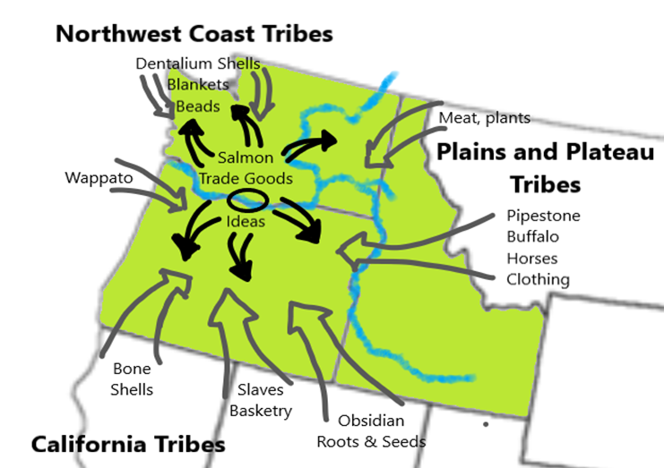
Salmon and humans (Part 1)
Image sources: 1) Salmon cooking: CTSI 2) Fish weir: Stewart, H. (2008). Indian fishing: early methods on the Northwest Coast. D & M Publishers. Used with permission. 3) Pre-contact trade network: Education Northwest map based on Indian trade network map from Nch'i‐Wána, “The Big River”: Mid‐Columbia Indians and Their Land (Eugene S. Hunn).
Notes:
Pacific salmon have been important to humans who live in the Pacific Northwest for thousands of years. Indigenous people in Oregon call salmon a “first food,” one of the traditional sources of nutrition that have sustained Native societies since time immemorial, but salmon are seen as more than just a food source. Many Siletz peoples understand salmon to be their relatives and have passed down important knowledge about the best way to ensure that salmon are treated with respect. This includes teachings about how to not waste fish, when to fish, how much to harvest, and the negative consequences of ignoring these teachings.
For example, many Siletz peoples from western Oregon fished with weirs—fences built across a river that channel fish to one opening as they run—making it easier to catch them. Some of these structures could be quite large, requiring whole families or villages to build, operate, and maintain. Nonetheless, these practices and technologies remained rooted in a value system that emphasized balance, sustainability, and avoiding waste. The people building weirs knew that they had a responsibly not just to catch fish but also to let enough fish pass through to feed villages upriver and to be sure that enough fish would survive the journey to spawn.
This way of thinking about salmon helped ensure healthy salmon runs for thousands of years. Many oral histories talk about a time when the salmon runs were so plentiful that people could walk across rivers on the backs of the fish. By creating and sustaining this relationship with fish, Tribal people in the Pacific Northwest were able to thrive and prosper. The past and continuing importance of salmon to the Native peoples of Oregon is reflected in the representation of salmon in the logos or emblems of several of the nine federally recognized Tribes in the state, including the Confederated Tribes of Siletz Indians.

Slide 8
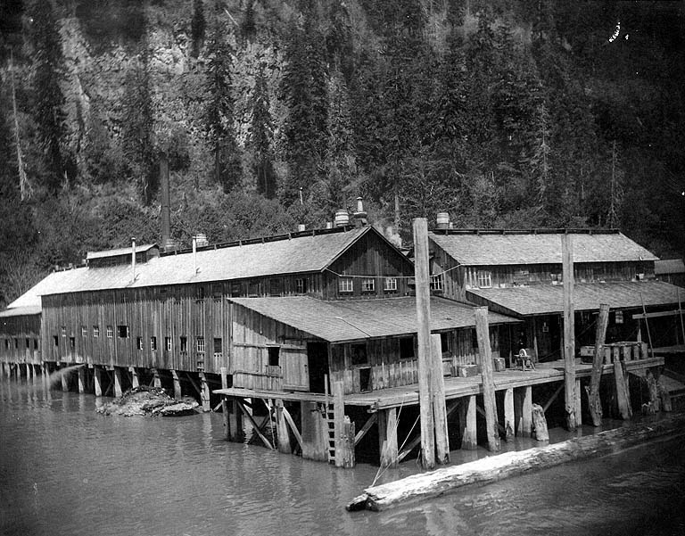
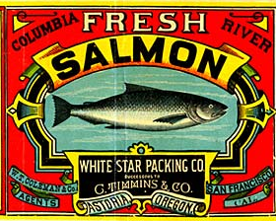
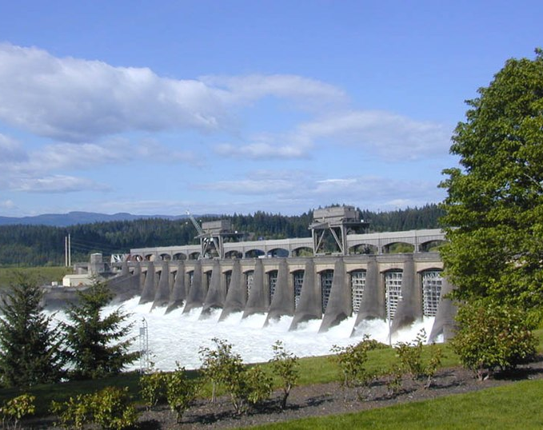
Salmon and humans (Part 2)
Image sources: 1) Salmon cannery: University of Washington (Fair use statement) 2) Canned salmon label: Oregon Secretary of State 3) Bonneville Dam: Eric Guinther (via Wikimedia Commons, licensed under CC BY-SA 3.0)
Notes:
In the late 1700s, explorers, fur traders, and settlers began coming to the Pacific Coast. Like the Native peoples, they also saw the value of salmon. However, settlers brought a different understanding of the natural world that ultimately caused harmful impacts to salmon and the Native peoples who depended on them. Settlers came from a society that saw the land, waterways, plants, and animals as “natural resources”—assets to be owned and controlled by individuals and “developed” to become more “productive.” Settlers pushed Native people away from their homes and made it illegal for Indigenous people to fish in the ways that they had for generations. Settlers established canneries to process salmon to be eaten around the world, introducing industrial technologies and a profit-seeking mindset to the salmon fishing that led to overharvest. Other industries decimated the habitats that salmon rely on to spawn and grow by polluting the water, straightening river and stream channels, damming rivers, and removing plants along the riverbank. In just a couple of generations, settlers managed to all but destroy one of the most productive fisheries the world has ever known.

Slide 9
Salmon and humans (Part 3)
Human-caused threats to salmon habitats
Drainage
Dredging Stream channelization
Filling
Diking and damming
Tilling for crop production
Levees
Logging
Mining
Construction
Stormwater runoff
Air and water pollutants
Nutrient pollution
Releasing toxic chemicals
Invasive species
Livestock grazing
Fragmentation
Water withdrawals
Vegetation cutting
Recreational over-use
Overharvesting
Climate change
Image source: National Park Service

Slide 10
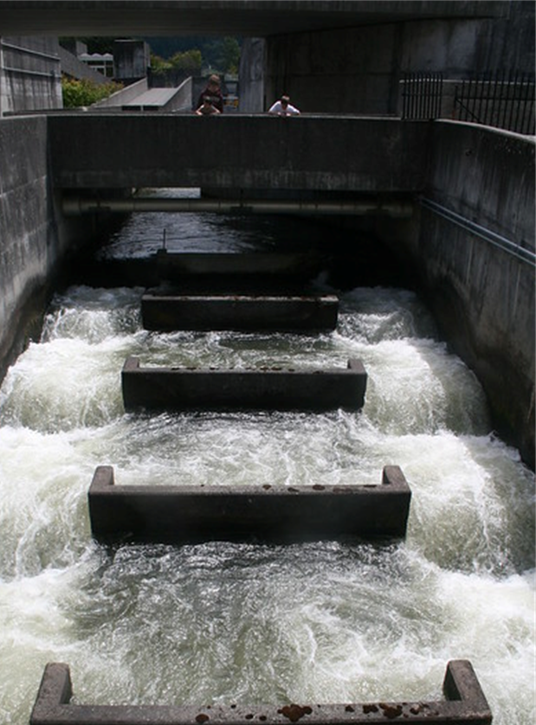
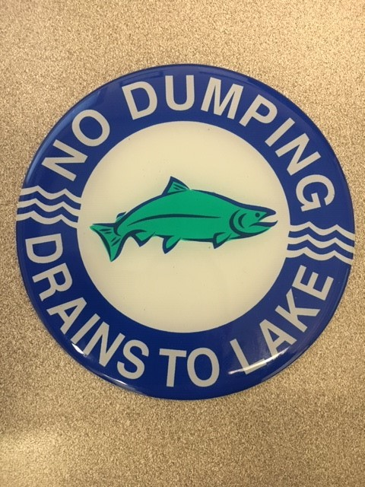
Humans helping salmon
Improving fish passage
Fish hatcheries
Restoring salmon habitats
Pollution prevention
Image sources: 1) Fish ladder: Wikimedia Commons 2) Fish hatchery: Wikimedia Commons 3) Salmon habitat restoration: CTSI 4) Salmon safe curb stamp: University of Washington

Slide 11
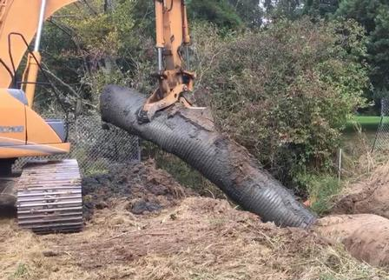
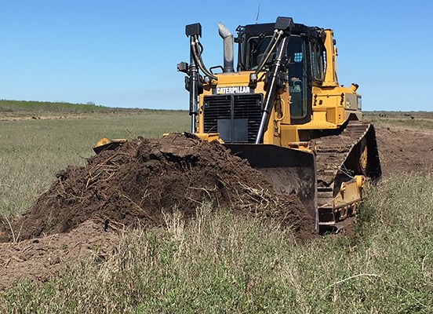
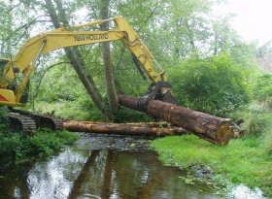
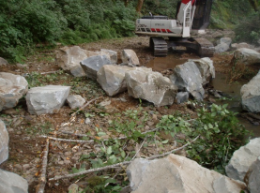
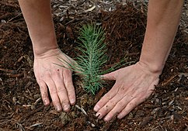
Salmon habitat restoration activities
Removing barriers(or building ways around them)
Adding rocks (boulders and gravel)
Adding (or removing) soil
Adding logs
Adding (or removing) plants
Image sources: 1) Culvert removal: City of Portland 2) Adding/removing soil: National Park Service 3) Adding logs: Oregon Department of Forestry and Oregon Department of Fish & Wildlife 4) Adding boulders and gravel: Oregon Department of Forestry and Oregon Department of Fish & Wildlife 5) Seedling planting: U.S. Department of Forestry (via Wikimedia Commons)
Notes:
Removing barriers refers to demolishing, removing, adjusting, or improving water-control infrastructure that hinders or prevents salmon (and other fish) from moving up or down stream. Barriers include large structures such as dams and smaller structures such as culverts under roadways. For example, many dams have fish ladders that help fish swim up and over or around dams. Ask students if they have ever seen a fish ladder, such as the one at Bonneville Dam.
Adding (or removing) soil can reshape a stream or river channel to improve fish passage and/or restore the waterway to its original (or at least a more natural) shape and flow. Adding soil might add more curves to a channelized river or stream, slowing down the current and creating pools and places where salmon can rest, find food, and spawn. Removing soil might remove fill dirt to restore a flood plain, get rid of polluted soil, or restore a stream or river to its original or a more natural shape.
Adding logs creates pools that protect young salmon from predators, provide rest stops for migrating salmon, and support populations of insects that salmon like to eat.
Adding rocks (boulders and gravel) improves salmon habitat by slowing the stream or river flow to provide rest stops for salmon (boulders) and provide them with nesting material for building their redds for spawning (gravel). Boulders may also be used to anchor logs in place to redirect water flow and/or provide larger eddies and pools where salmon can rest or hide.
Adding (or removing) plants refers to adding grasses, bushes, and trees to provide shade to rivers and streams to keep water temperatures cool, provide hidings spots for young salmon, and host insects for salmon to eat. It may include first removing excessive and/or non-native vegetation to make room for the planting or re-growth of native plant species.

Slide 12
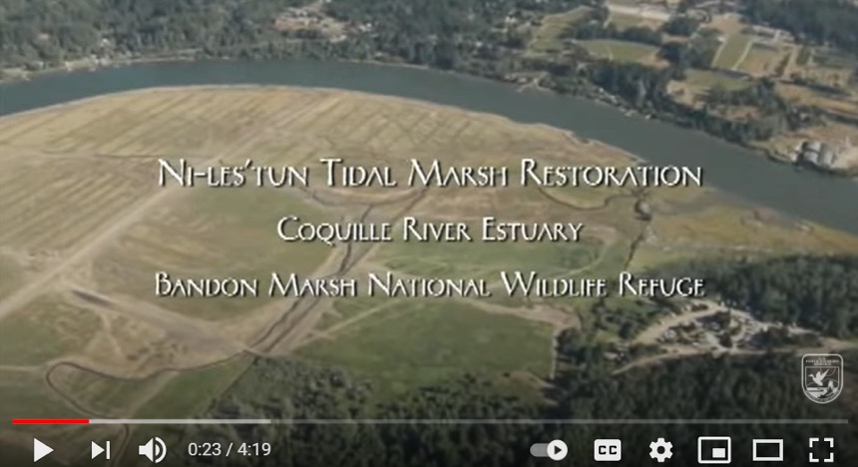
Restoration example
Image and video source: U.S. Fish & Wildlife Service (via YouTube)
Notes:
Recognizing the ecological and cultural value of salmon for human life in Oregon, the Confederated Tribes of Siletz Indians and others are collaborating to restore water and land resources to support healthy habitats for salmon throughout their life cycle. Tribal people are guided by their understanding about the best way to care for fish that have been passed down for thousands of years. But Tribal people also recognize that today they can’t repair salmon habitat alone. The Tribe undertakes its own salmon habitat conservation and restoration activities and partners with other Tribes, public and private organizations, and landowners to restore thriving populations of Pacific salmon and a robust and resilient ecology in the Pacific Northwest for the benefit of current and future generations.
Restoring salmon habitat can be hard work! It means undoing decades of harmful modifications to rivers and streams. Making rivers better homes for salmon again often requires using large construction equipment. Check out this video showing some of the work that the Confederated Tribes of Siletz Indians has been doing in the Coquille River estuary.

