Slide 1
GRADE K-1 Seasonal Monoprint Activity (Examples)

Slide 2
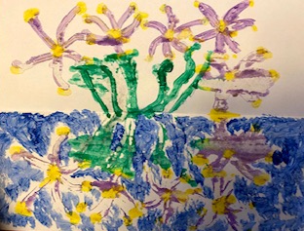
Example 1: Spring camas

Slide 3
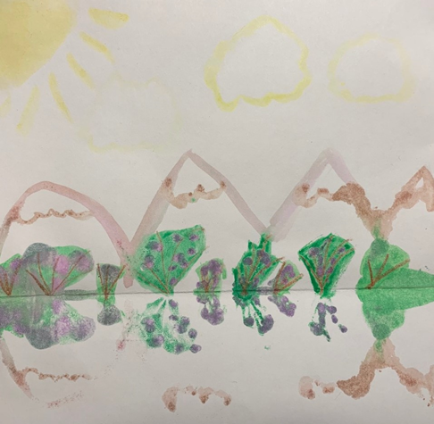
Example 2 : Summer berries

Slide 4
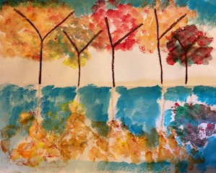
Example 3: Leaves of fall season

Slide 5
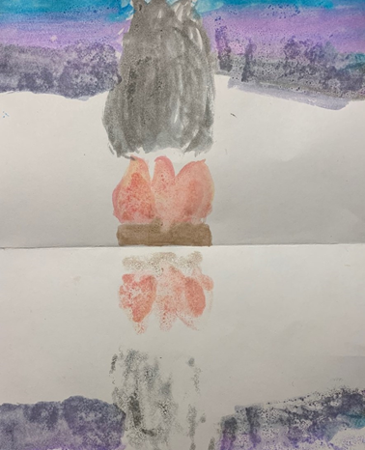
Example 4: Winter fires

