Slide 1

The Confederated Tribes
of Siletz Indians
Seasons Flipbook
Our People
Seasons
Dan’ Nast-li~’ (Spring)
Shin-dvn (Summer)
Dan’-xvt-dvn (Fall)
Xii-dvn (Winter)
Notes:
Say: Knowing the seasons means understanding not just the length of the day or weather but also the patterns of how animals and fish behave, how plants grow, and how the land needs to be cared for during different times of the year. Dee-ni people have always paid close attention to the seasons because they live in close relationship with the land.

Slide 2
Siletz ancestors—family members who have come before—came from many different Native Tribes living in what is now called Western Oregon. Settlers and the U.S. government removed these different Tribes from their homelands and forced them to live together on what is now called the Siletz Reservation.
Our People
Home
Seasons
Dan’ Nast-li~’ (Spring)
Shin-dvn (Summer)
Dan’-xvt-dvn (Fall)
Xii-dvn (Winter)

Slide 3
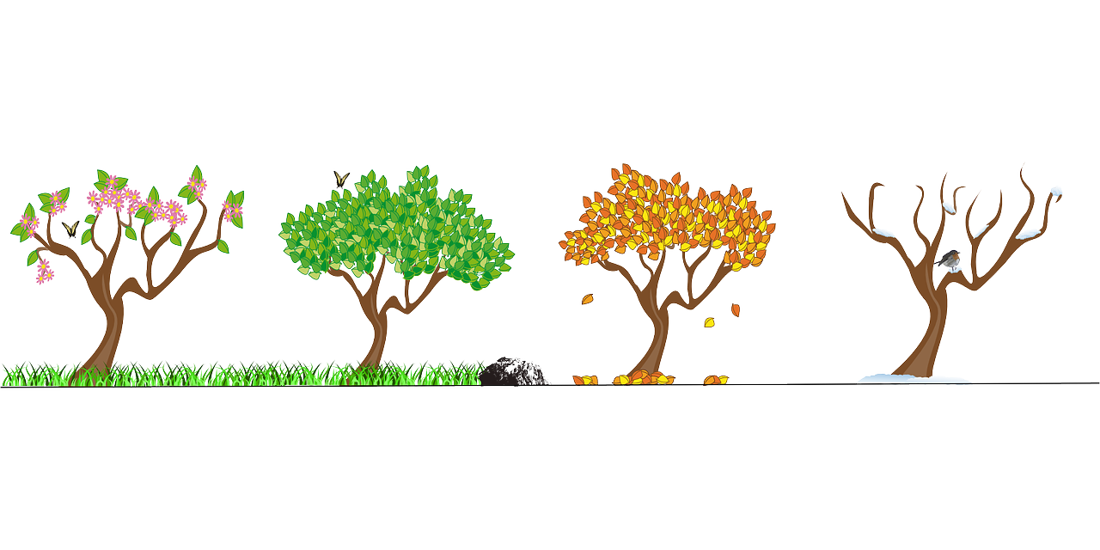
For the ancestors of Siletz people, and many Siletz people today, the seasons (fall, winter, spring, and summer) have always been important. Understanding how the land is changed by each season has helped Siletz people do well. Today we will learn about one of the Tribes made to go to the Siletz Reservation called the Dee-ni people from Southern Oregon and the Northern California coast. We will learn how their lives changed each season.
Seasons
Home
Dan’ Nast-li~’ (Spring)
Shin-dvn (Summer)
Dan’-xvt-dvn (Fall)
Xii-dvn (Winter)

Slide 4
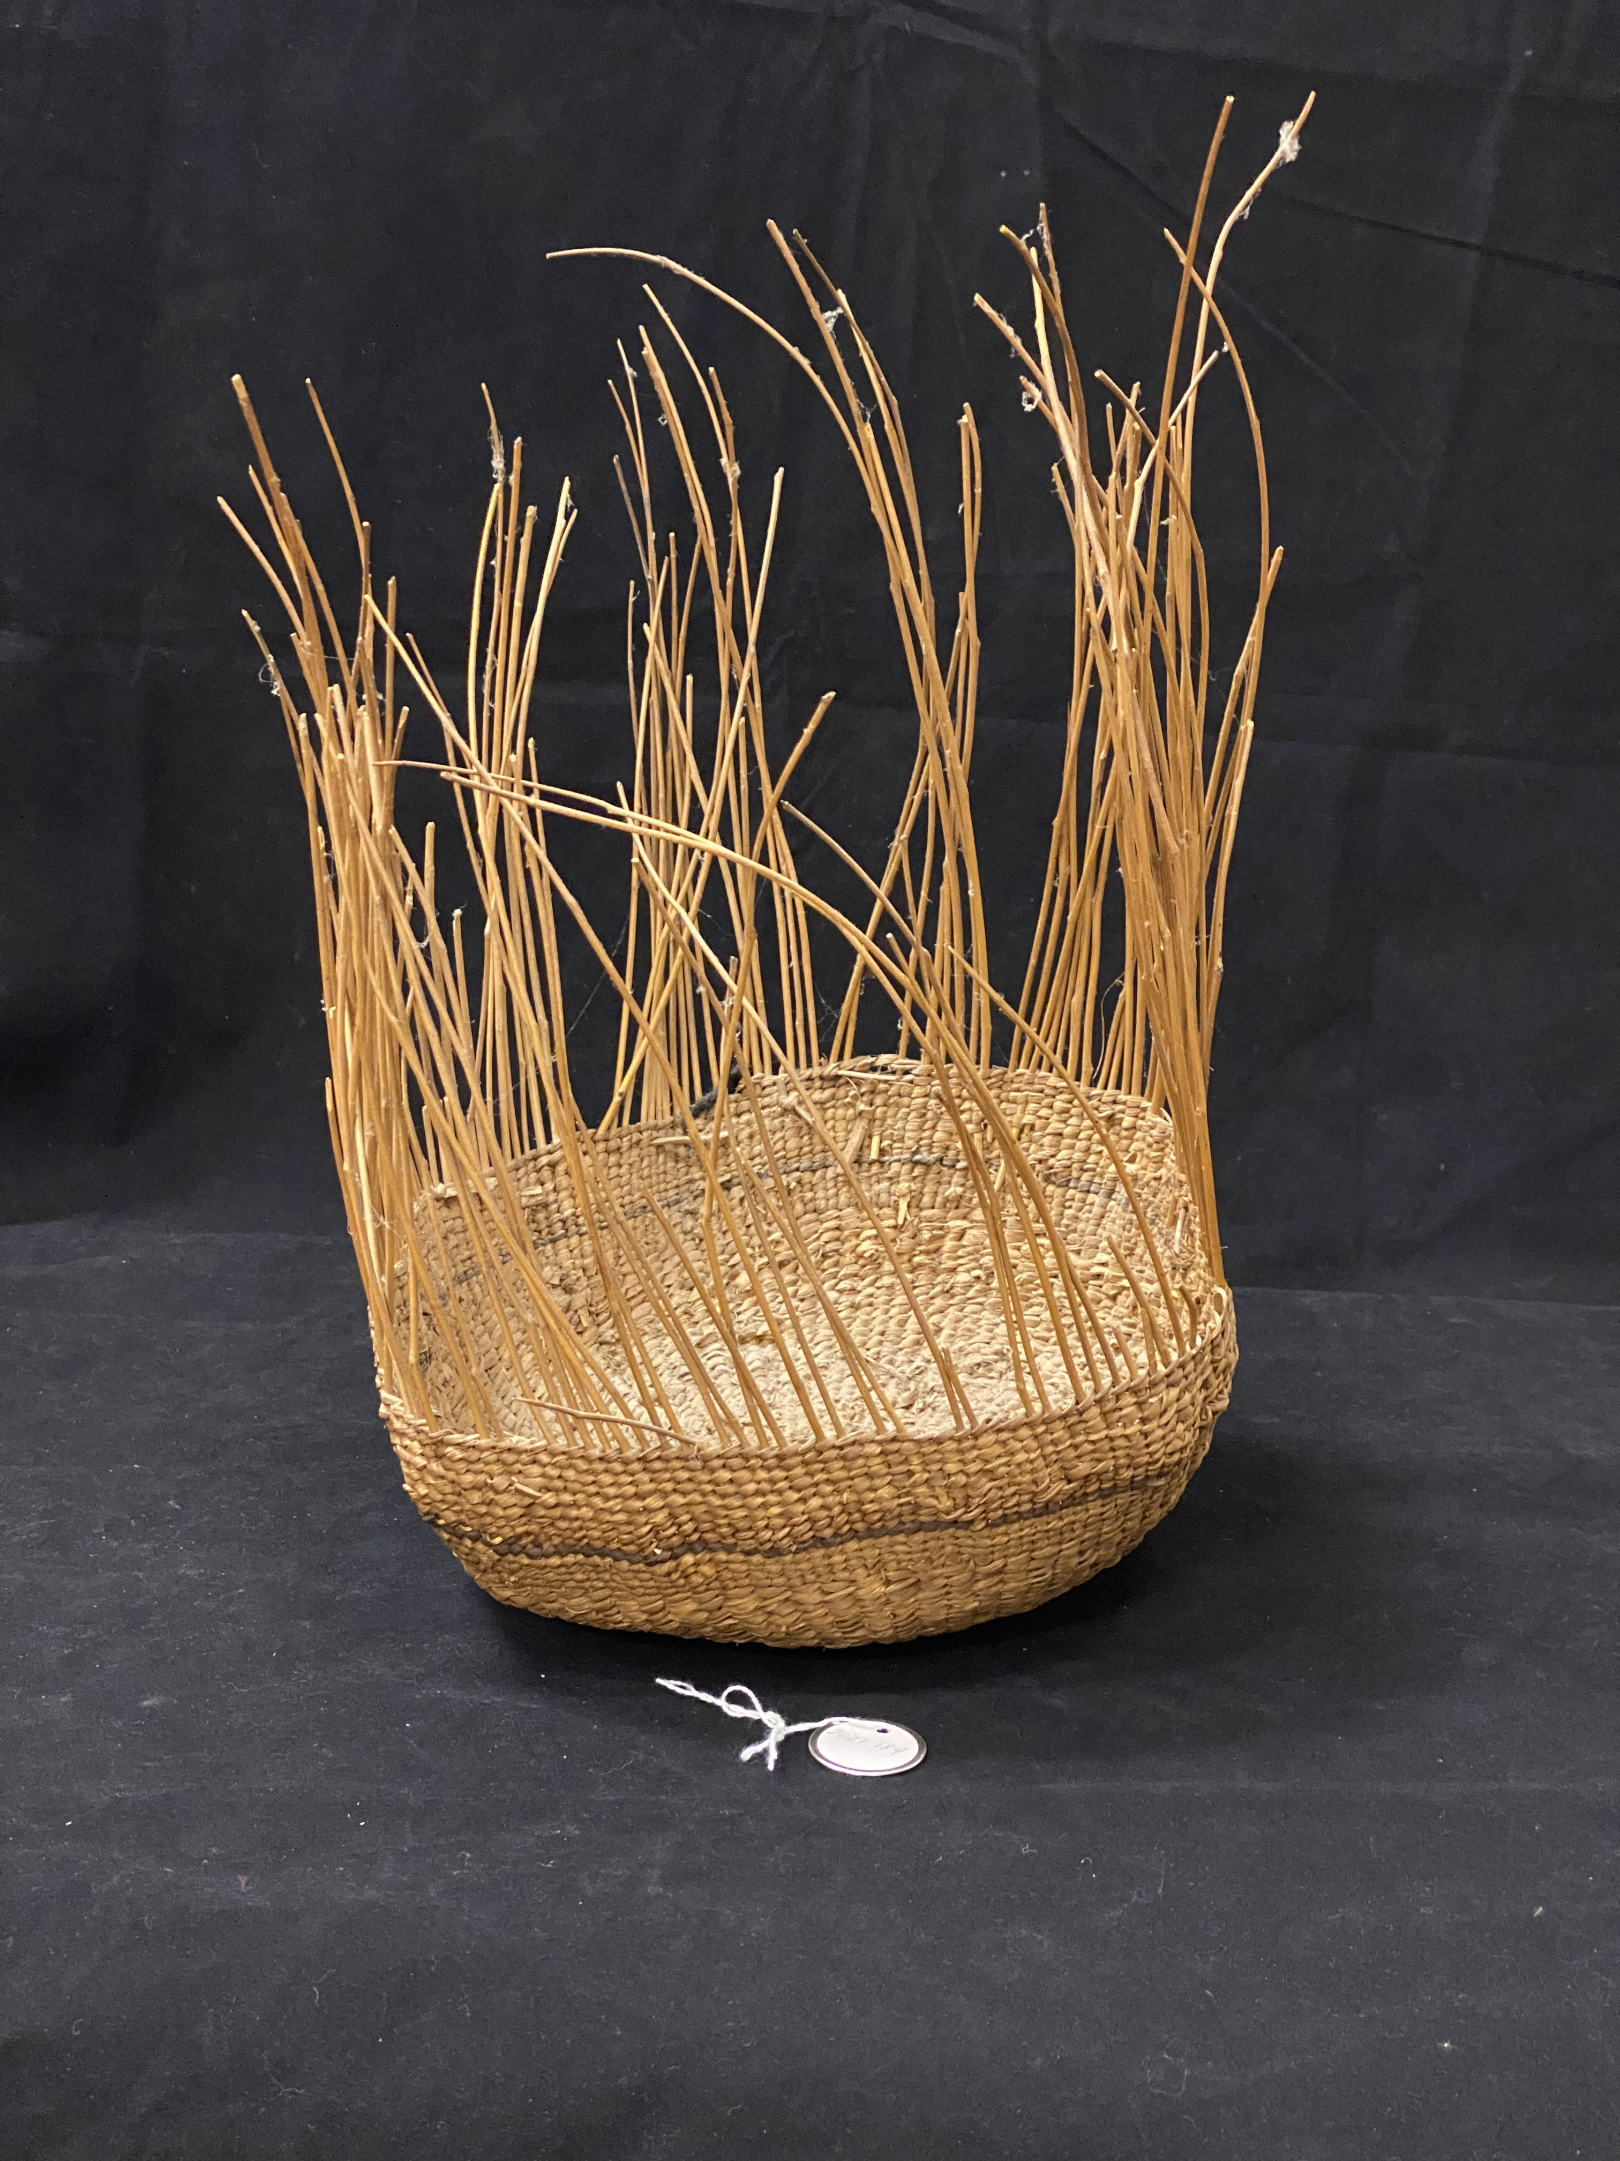


Spring (Dan’ Nast-li~’) is when all the good things that the Dee-ni people need come back from their wet, chilly winter sleep.
New leaves and branches are forming on plants, and spring is time to make them into useful tools. For example, spring is the time to peel long strips of inner bark from maple trees to make clothing. The sap running up new shoots of hazel brush makes them easy to peel—perfect straight bendy sticks to make into baskets for carrying, storage, and even hats!
By late spring, the camas are growing tall and showing purple flowers. After cooking, the bulbs make sweet, nutritious food.
Dan’ Nast-li~’ (Spring)
Home
Shin-dvn (Summer)
Dan’-xvt-dvn (Fall)
Xii-dvn (Winter)

Slide 5

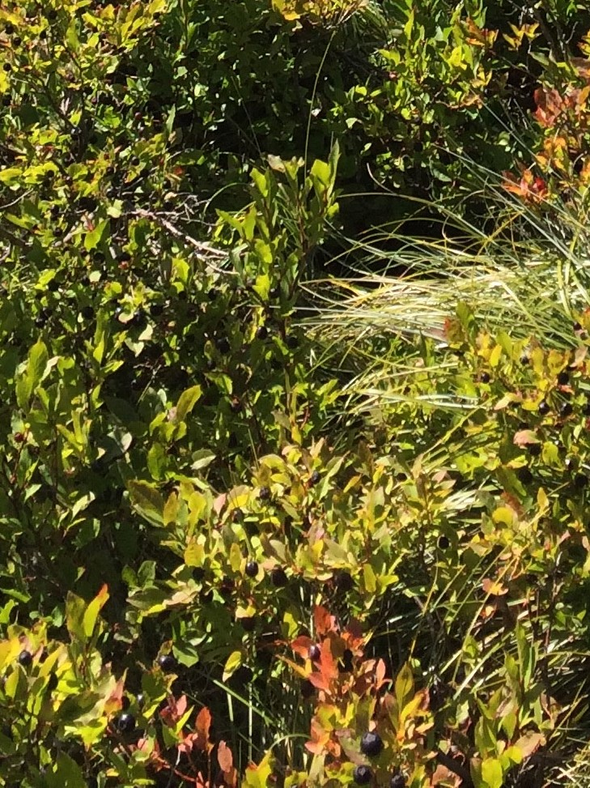

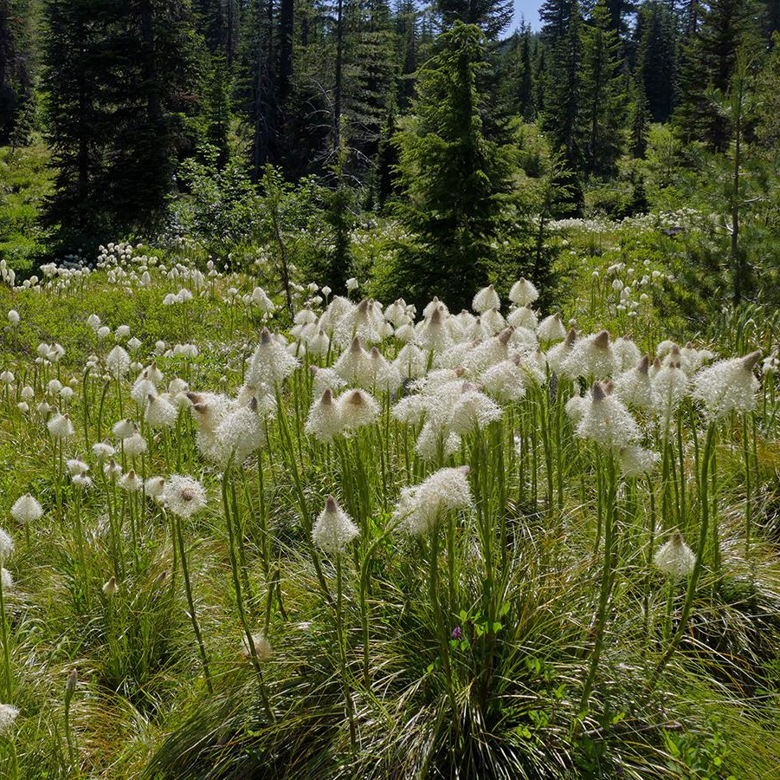
Summer (shin-dvn) is the time when the Dee-ni people gather berries when they are sweet and ripe.
Some plants are gathered in late summer, like beargrass (right) and maidenhair (left). These plants are used to decorate baskets.
Pleasant weather makes summer a good time to take long trips to visit friends and family and to trade for things. Summer is also a time to work on big projects outside, like building new homes, canoes, or fish nets.
Shin-dvn (Summer)
Home
Dan’-xvt-dvn (Fall)
Home
Xii-dvn (Winter)
Home

Slide 6
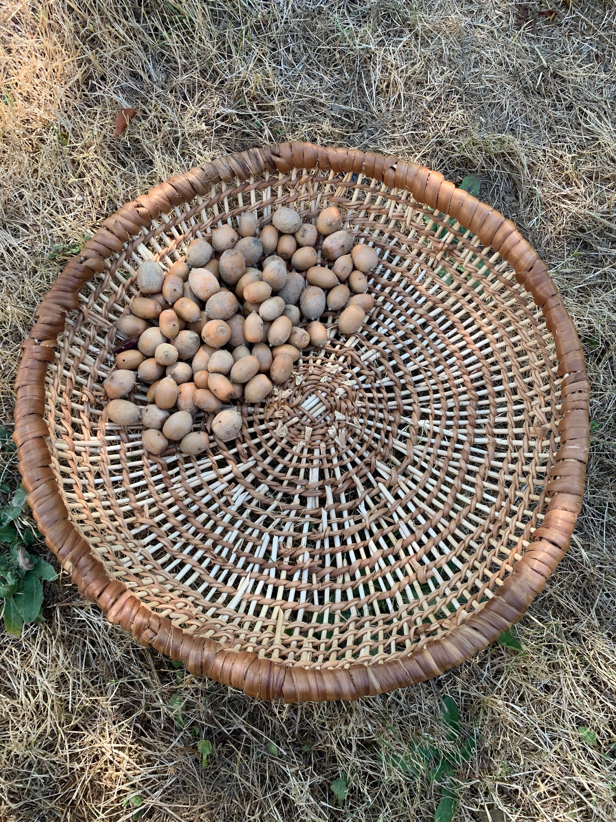
Fall (Dan’-xvt-dvn) is the time put food in storage to use for living through the winter. For example, the chinook salmon that run in the rivers in the fall can be dried on racks and tied in bundles to keep in the house. The oak trees drop acorns in the fall, which can be stored in big baskets to grind up for thick soup in the winter.
In the fall, the deer and elk are also getting ready for winter and are fat and healthy. This is the best time to hunt them for the many things they provide: meat for food; hides for clothing, shoes, or drums; and antlers for making sturdy tools that last a long time (like spoons and needles).
In the late summer and early fall, the Siletz people cared for the land by lighting fires that would burn away unwanted brush. This would clear space for new plant growth that the people and animals will use next year.
Dan’-xvt-dvn (Fall)
Home
Xii-dvn (Winter)
Home

Slide 7
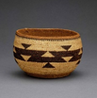
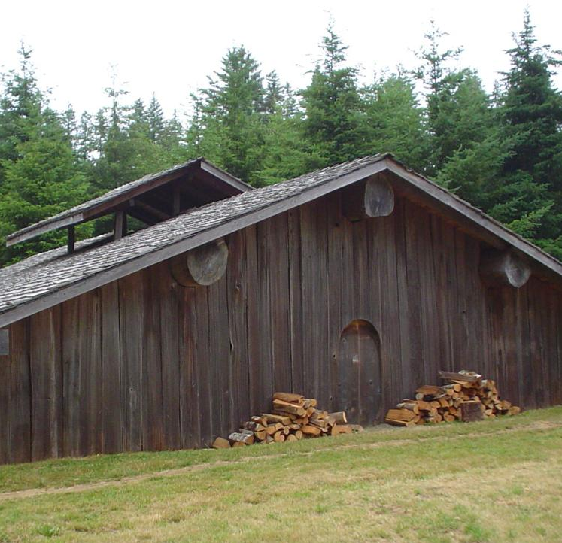
Winter (xii-dvn) in Dee-ni homeland is cold and dark and there is less food to be had. It
is a time to gather with friends and family in
the house and enjoy all the food that has been prepared. It is also a time to work on indoor projects like making baskets and traditional clothing to wear for ceremonies next year.
Winter is the time that Dee-ni people gather to pray, hold special dances, and tell stories. In fact, winter is the only time that many stories are told. Siletz people believe that telling stories out of season is dangerous and can hurt our community or the person telling the story.
Today, many Siletz people continue to pay close attention to the seasons to gather food and materials for baskets. They continue to hold ceremonies at the correct season to help ensure that people and the land will be strong and healthy in the future.
Xii-dvn (Winter)
Home

