Slide 1
GRADE 5 Living Language: Language Change and Survival
Notes:
This lesson is called “Living Language: Language Change and Survival.” Today, we’re going to compare English and Dee-ni’ Wee-ya’. We’ll see how these languages evolved over time by loaning, borrowing, expanding, and creating new words.

Slide 2
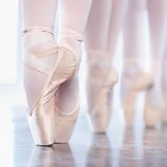
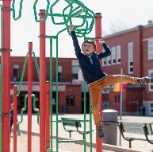
Other languages “loan” some of their words to us so that we can use them in English
These are called loan words
Here are some examples of loan words you might know
ballet
fiesta
kindergarten
Notes:
What does it mean to loan something to someone? (If you have something that someone else needs, you can “loan” it to them. It allows that person access to something or the ability to do something they may not otherwise be able to do.)
Let’s take a look at some different loan words. These are words that we “borrow” in English. (Click and read through the slide’s animated items as you read the text on the slide.)
(Click.) Here are some examples of loan words you might know.
(Click again and students will see an image of ballet dancers.) Does anyone recognize this image? Yes, “ballet.”
(Click and the word “ballet” appears below the image.) Does anyone know which language loans us the word “ballet”? (Give students a moment to answer.)
Ballet is a loan word from French. As you know, it is a form of dance.
(Click again and students will see an image of a party.) These people are at a party. Does anyone know another word for party?
Give students a moment to answer, then click and the word “fiesta” appears below the image.) What language loans us the word “fiesta”? (Spanish)
(Click again and students will see an image of a child on a playground.) This child is in the first year of elementary school. Any idea what that word is?
(Give students a moment to answer, then click and the word “kindergarten” appears below the image.)
Any ideas about which language loans us the word “kindergarten”? (German) “Kindergarten” is a loan word from German. It literally means “child garden.”
Can you think of other words from French, Spanish, German, or another language that we use in English? (Examples of additional loan words from French: café (coffeehouse); cul-de-sac (literally means “bottom of the bag”); bureau (office, for example Bureau of Land Management).
Examples from Spanish: patio, siesta, Montana. Examples from German: iceberg, sauerkraut (which means “sour cabbage”). What do you think it means to “loan” a word to a different language? Why might a language need to “borrow” words from another language?
The primary reason for the borrowing and lending of words is the blending or mixing of different cultures and populations of people. (We will go deeper into this later in the lesson.)
Other reasons include introducing something new to a culture, such as a “latte” (from Italian) or a “croissant” (from French). Sometimes we borrow a word because we don’t have a word in our own language to accurately (and succinctly) describe something.
Is anyone familiar with the expression “déjà vu”? (Allow time for students to answer.) This is an expression used to describe the feeling that you’ve seen something or been somewhere before, although you’re not sure where. Do you know which language we borrow it from? (French.)
Or sometimes you’ll see the letters “RSVP” on an invitation. Does anyone know what that means, what it’s used for? (Allow time for students to answer.) The host of a party or event might use this abbreviation when they want you to let them know if you will be at the party or not. RSVP is also French. It stands for “Répondez, S’il Vous Plaît” (“ray-pon-day, see voo play”).
Listen to that phrase again: “Répondez, s’il vous plait” (“ray-pon-day, see voo play”). What do you notice about it? (Allow time for students to answer.) Maybe it sounds more interesting—or even more elegant—in French than simply saying, “Respond, please” in English.
Today, we’re going to be studying languages and learning some vocabulary in Dee-ni’. Listen closely as you learn some new words. You will find that Dee-ni’ is a beautiful language

Slide 3
Indigenous languages loan some of their words to English, too
Can you think of any words you know that come from Indigenous languages?
Some examples...
“hammock”
Hamaca – a loan word from the Taíno language
“barbecue”
Barbacòa – also comes from the Taíno language
“kayak”
Qajaq – a loan word from the Inuktitut language
Notes:
Indigenous languages also loan some of their words to English. (Click once and a hammock appears.)
Does anyone know the word for this image? Yes, it’s called a hammock. (Click again and the word “hammock” appears above it.)
Hammock comes from the word, “hamaca.” Its original definition was a “stretch of cloth.” (Click and the word hamaca and an explanation appear below the image.)
This word comes from the Taíno language, which is now a “sleeping” language, but was once spoken by the Indigenous people of the Caribbean islands.
Do the same for two more images: (Click and a barbecue appears.) Does anyone know the word for this image? Yes, it’s a barbecue.
(Click again and the word “barbecue” appears above it.) Barbecue comes from the word, “barbacòa.” Its original definition referred to “grilling on a raised wooden grate.”
(Click and the word barbacòa and an explanation appear below the image.) This word also comes from the Taíno language.
(Click and a kayak appears.) Does anyone know the word for this image? Yes, it’s called a kayak.
(Click again and the word “kayak” appears above it.) Kayak comes from the word, “qujaq.” It is a narrow boat built to handle rough ocean waters and windy conditions.
(Click and the word qujaq and an explanation appear below the image.) This word comes from the Inuktitut [In-NOOKtuh-tut] language of the Inuit people of the Arctic regions of Greenland, Canada, and Alaska.
How do these words help us express ourselves in English? (For example, they help us identify objects.)

Slide 4
Think – Pair – Share | English loan words in Dee-ni
With a partner, can you match the words with the images below?
1. ken-di
2. pap
3. tii-bii
4. sdaa-k’vn
A
B
C
D
Notes:
English loans some of its words to the Dee-ni’ language. Looking at these Dee-ni’ words, can you match them to one of the images below?
Think-Pair-Share: Arrange students in pairs to discuss which word they think matches the image and why. This can be done informally with the closest person to them. (Answers are shown on slide 6.)
Debrief the activity: Would anyone like to explain how they matched the words with the images? What similarities between the two languages did you notice? There are no right or wrong answers at this point.

Slide 5
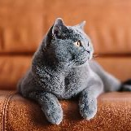
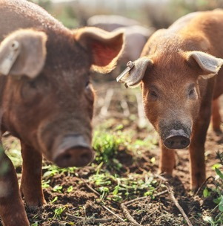
These words might be a little more challenging, but can you try to match them with an image?
5. buu-sri
6. haa-k’vs
7. gaa-be
E
F
G
Notes:
Now let’s look at some words in Dee-ni’ Wee-ya’. These words may be a little more challenging for you to recognize, but they’re all loan words from English into Dee-ni’ Wee-ya’. Can you and your partner figure out which image goes with each Dee-ni’ Wee-ya’ word? (Answers are on slide 6.)

Slide 6
Using English, you may have been able to figure out several loan words in Dee-ni’ that come from English
Listen and repeat to learn how they’re pronounced
1. ken-di
(candy)
2. pap
(pop)
3. tii-bii
(TV)
4. sdaa-k’vn
(sock/stocking)
5. buu-sri
(cat)
6. haa-k’vs
(hog/pig)
7. gaa-be
(coffee)
Notes:
Here are the Dee-ni’ words with the corresponding image.
(Give students a chance to read the slide for a moment.)
Answer key: 1. B (ken-di/candy) 2. D (pap/pop) 3. A (tii-bii/tv) 4. C (sdaa-k’vn/socks or stockings) 5. F (buu-sri/ cat) 6. G (haa-k’vs/pig or hog) 7. E (gaa-be/coffee)
Now, you’re going to hear the Dee-ni’ words out loud.
Repeat each word after you hear it and look at the way it’s spelled. (Click to hear audio.)
Does it sound like the English word? (Yes, sometimes.) Is it spelled in a similar way? (No, not really).

Slide 7
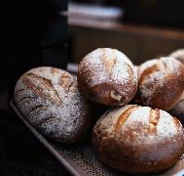
Chinuk wawa is an Indigenous language that also loans words to Dee-ni'
Listen and repeat to learn how they’re pronounced
saa-bee-li
(bread)
guu-shu’
(pig/pork)
Notes:
English isn’t the only source of loan words in Dee-ni’. Chinuk Wawa, a widely used trade language in the Pacific Northwest, has also loaned some words to Dee-ni’ and vice versa.
Chinuk Wawa was initially a trade language among different Tribes in the Pacific Northwest that allowed people speaking different languages to communicate with each other and with European-Americans when colonization began. When people from multiple Tribes (each with its own language) were removed to the reservation at Siletz, Chinuk Wawa became an important tool of communication, and many children grew up learning it. Both Chinuk Wawa and Dee-ni’ words began to be loaned freely between the Tribes of Siletz.
Here are a couple of examples: (Click to hear audio.

Slide 8
English in Indigenous languages
Speakers of Indigenous languages faced pressures of colonization that devalued Indigenous ways of knowing and speaking and actively sought to suppress Native beliefs and language. Throughout all these challenges, Siletz people kept on speaking their languages. To do so, they had to adapt the languages to express new ideas and words that were introduced due to colonization. One way that speakers did this was to borrow words from English and other languages. Another thing speakers did was to expand the meaning of existing words.
Notes:
Languages loan words to each other so that people can identify new objects, express new ideas, and communicate with one another despite speaking different languages. In the case of Indigenous languages, the contact with English-speaking people was accompanied by pressures of colonization that devalued Indigenous ways of knowing and speaking and actively sought to suppress Native beliefs and languages. Teachers at boarding schools and Indian agents on the reservation punished Siletz people for speaking their language and continuing their traditions. Throughout all these challenges, Siletz elders and ancestors kept speaking their languages. To do so, they had to adapt the languages so they could express new ideas and words that were introduced due to colonization. One way that speakers did this was to borrow words from English.

Slide 9
Expanded meanings
Words in both English and Dee-ni’ have expanded meanings.
Notes:
Another thing Indigenous speakers did was “expand” the meaning of existing words in the language to cover new technologies or ideas. What does the word “expanded” mean, in general? (Something that stretches, becomes wider, larger, bigger.) So, when something becomes bigger, it can cover more space, right? What do you think it might mean if a word has an expanded meaning? (Expanding or broadening a word means it can have more than one meaning or apply to more than one term.

Slide 10
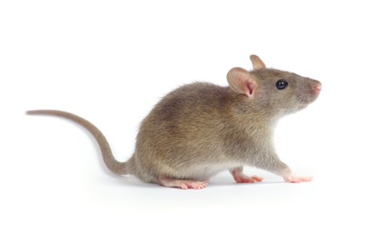
English words with expanded meanings
Mouse
Notes:
We’re going to start with an activity on words with expanded meanings in English. I’d like you to close your eyes for a moment … and think … what comes to mind when you hear the word “mouse”?
(Double click so the word mouse appears in a circle on the screen.) When you have an image in your mind, open your eyes.
(Click once and a mouse [animal] appears.) Ok, raise your hand if you pictured this type of mouse—an animal that you might find outside or maybe have as a pet.
Let’s consider some other meanings of the word mouse.
(Click again and a computer mouse appears.) Raise your hand if you pictured a mouse like this—one that you might find near a computer.
So, we know that the word “mouse” has come to have multiple meanings. Before computers, the word mouse mostly referred to an animal, but once computers were invented, people expanded the meaning of the word to include a computer mouse. Maybe because in the old days, computer mice had cords that looked like tails.

Slide 11
Expanded meanings in English
Cloud
Notes:
Again, close your eyes for a moment. What do you picture in your mind when you hear the word “cloud”? (Double click so the word cloud appears in a circle.) When you have an image in your mind, open your eyes.
(Click once and a weather cloud appears.) Ok, raise your hand if you pictured this type of cloud—a cloud in the sky.
We know another meaning of the word “cloud.” (Click and a computer cloud appears.) It can also refer to space to store data using the internet.

Slide 12
Words with expanded meanings
Mouse
Cloud
Notes:
Mouse and cloud: These are two examples of words with expanded meanings in English. Do you think “expanded” is a good term to use for these words? (Allow time for answers.)
So, if there are a few different meanings for things like, say, “mouse,” how do we know which “mouse” people are referring to when we are in a conversation? (Wait for students to respond.) We know by the context of the conversation, meaning the setting or environment in which the conversation is taking place.
For example, if someone’s talking about their pet “mouse,” we can assume they’re referring to the animal. (You can point to the animal on the screen.) If someone complains that their “mouse” isn’t working, we can figure out they’re talking about a computer mouse. (Point to the other image on the screen.)

Slide 13
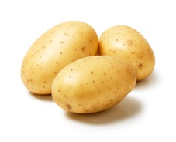
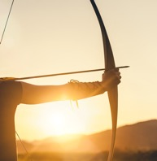
The Dee-ni’ language includes words with expanded meanings, too
Why do you think these are considered expanded words?
Potato: gus (camas)
Clock: ch’aa-ghvtlh-sri~ (moon)
Boat: xee-nvs (canoe)
Gun: tvt-k'vsh
Notes:
The Dee-ni’ language adapted to the arrival of European-American settlers by expanding the meaning of words to include new objects and ideas. Looking at these words and images, what do you notice about the expanded meanings of the words listed? (Read aloud the words on the list. Students might say something like, the word for clock is the same as the word for moon.)
Why do you think the word “ch’aa-ghvtlh-sri~” might have been expanded to mean both clock and moon? What do these things have in common? (For example, they both have to do with how we keep track of time.)

Slide 14
The Dee-ni’ language includes words with expanded meanings, too
Listen and repeat to learn how these expanded words are pronounced.
potato: gus (camas)
clock: ch’aa-ghvtlh-sri~ (moon)
boat: xee-nvs (canoe)
Notes:
Read the words on the slide and repeat them after you hear them. (Click on the audio.)

Slide 15
Expanded meaning New words
Expanding words can apply new meaning to a word or create a whole new word.
Basket
Notes:
As languages evolve, they expand upon words that already exist and they create new words and new meanings. As you can see on this slide, there are two different types of baskets.
The word originated as something that can be used for carrying things, such as laundry in this case. (Point to the laundry basket on the screen.) We know there are other types of baskets as well. (Point to the basketball hoop.) This meaning of the word “basket” began with the invention of basketball. Notice that “basketball” is a slightly different word from just basket. This is considered a new word.

Slide 16
Expanded meaning New words
Expanding the meaning of a word can create a new word.
Bluetooth
Notes:
There are some words that came into our vocabulary more recently. For example, the word “Bluetooth.” (Double-click and the word “Bluetooth” appears in a circle.) If you were born a long time ago, say, in the year 1900, if you heard the word “Bluetooth,” you would probably picture a blue tooth, in the literal sense— a tooth that is blue.
In today’s world, we know that Bluetooth means what? (Allow students time to answer. Then click and a Bluetooth image appears.) Yes, it’s a wireless gadget that is used to exchange data across different devices. A name was needed for this new gadget, so a new word was created

Slide 17
More new words
Social distancing
FaceTime
Selfie
Notes:
Here are some examples of other words that are fairly new to our vocabulary: FaceTime, selfie, social distancing. You are probably very familiar with these words. Which one is the most recent one you’ve learned? (Probably “social distancing,” due to the pandemic.)

Slide 18
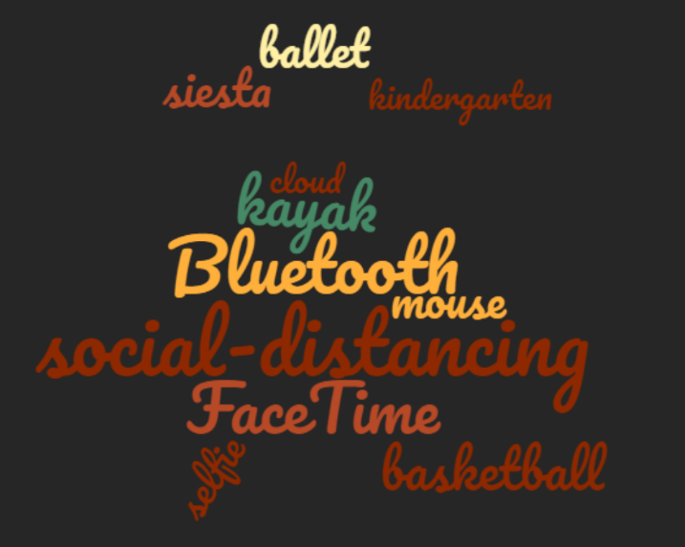
The evolution of language: New words
What are some reasons for why and how new meanings and words are created?
Notes:
As we talked about before, sometimes languages evolve due to the blending of different cultures and populations. Sometimes we need a word or expression that doesn’t exist in our own language, so we “borrow” it from another language.
Looking at the words in this word cloud, what are some reasons new meanings and words are created?

Slide 19
Identifying classroom objects
If you look around the classroom, what items do you see?
What part of speech are they?
Noun = person, place, or thing
Notice that all the items you identified were talked about as things, or nouns.
Notes:
We’re going to learn some more words in Dee-ni’. But before we start, let’s talk about how words generally work in English. If you look around the classroom, what items do you see? (Students might name things like clock, books, window, desk.) Does anyone know what part of speech these words are?
Nouns. What is a noun? (Person, place, or thing). Notice that all the items you identified were talked about as things, or nouns.

Slide 20
Describing classroom objects
If you wanted to describe an object in the classroom without using the actual word, what would that sound like?
What part of speech is used in these descriptions?
Verb = an action, someone or something doing something
Notice that the items you described were talked about as actions, or verbs, (rather than “things”).
Notes:
But, if you wanted to describe an object in the classroom, without using the word for that object, what would that sound like?
You can offer an example or two, such as: “It’s something you use to access the internet.” Students guess what it refers to (computer). Or: “It’s something you use to enter or exit the classroom” (door). And so on.
Does anyone want to try describing an object in the room without using the word? (Allow students to volunteer three or four times as examples. See if the rest of the class can guess the object they’re describing.)
What are some differences that you notice about the word versus the description? They mean the same thing, right? (Students might say that the descriptions are longer, may apply to more than one word, require more thought, involve actions/verbs, and so on.) We want to steer them toward understanding the difference between noun-based words, as in English, versus verb-based words, as in Dee-ni’.)

Slide 21
Activity: Catch Phrase
Notes:
To practice these differences, we’re going to do an activity called Catch Phrase. Are you familiar with this game? (If a student knows it, ask them to describe it for the class.)
If not: Catch Phrase is a game in which players are given a word that they have to describe to their partner without using the actual word. Their partner tries to guess the word based on the description

Slide 22
Activity: The classroom version of Catch Phrase
PAIRS: You and your partner will be face to face.
The person whose first initial is closest to the letter Z faces the board (The Speaker).
The other person will have their back to the board (The Listener).
Board/PowerPoint Listener Speaker
Notes:
Students will work in pairs, with one person facing the PowerPoint and seeing the list of words, and the other with their back to the board so they can’t see the list. (There is a visual of this arrangement on the slide.)

Slide 23
Activity: The classroom version of Catch Phrase (continued)
ROLES: The Listener will have their back to the board. The Speaker will be facing the board.
The Speaker will describe a word on the list without using the word.
The Listener will guess the word based on the description without looking at the board.
When everyone is done, you will switch roles. (Wait for your teacher’s instructions.)
Notes:
Once students are settled into their appropriate position, have a “speaker” in the class read the directions on the screen. Remind students: Speakers, if you need to use your hands to help your partner guess the words, almost like charades, that’s fine. Just be sure that you are also speaking/using verbal language to give your description. Do your best to keep the conversation between you and your partner. You may need to speak somewhat quietly.

Slide 24
Activity: Catch Phrase (Directions for Speaker)
Directions for the Speaker
In a moment, you will see a list of words having to do with school.
Describe them to your partner and see if they can guess the word.
You may NOT use the word in your description!
If you finish before the rest of class, try to continue the activity by describing a word that has to do with school but is not on the list.

Slide 25
Pair activity: Catch Phrase
Board/PowerPoint Listener Speaker
Notes:
Take a look around to make sure students are seated properly to engage in the activity.
OK, are you ready to go?

Slide 26
Activity: Catch Phrase
Describe these words to your partner without using the word:
Book
Desk
Teacher
Board (dry erase, etc.)
Pen
Ruler
Door
TV
Eraser
Math
Locker
Library
Backpack
Computer
Bookcase
Window

Slide 27
Pair activity: Catch Phrase (switch roles)
Nice work! Now it’s time to switch places! The Listener becomes the Speaker and the Speaker becomes the Listener.
When you have traded places with your partner, give each other a high-five and keep your hands together and raised to show your teacher you’re ready to go.
Board/PowerPoint Listener Speaker

Slide 28
Activity: Catch Phrase (Directions for New Speaker)
Directions for the (new) Speaker
In a moment, you will see a list of words.
Describe them to your partner and see if they can guess the word.
You may NOT use the word in your description!
If you finish before the rest of class, try to continue the activity by describing a word that has to do with school but is not on the list.

Slide 29
Activity: Catch Phrase
Describe these words to your partner without using the word:
Scissors
Lunch
Paper
Recess
Pencil
Student
Report card
Physical Education (PE)
Mouse (for a computer)
Calendar
Chair
School
Class photo
Principal
Internet
School bus

Slide 30
Debrief
So, what does this activity have to do with Dee-ni’?
Noun-based words/things
(as in English)
Verb-based words/actions
(as in Dee-ni’)
Pencil
Backpack
One writes with it
One carries books and school supplies in it
Notes:
What does this activity have to do with the Dee-ni’ language? After all, we were doing the activity in English. Any ideas?
As we talked about earlier, English tends to be a noun-based language. (Click and the word “pencil” appears.) For example, the word “pencil” is a noun or a thing, just like the words listed on the board in the activity you just completed. The word “pencil” doesn’t describe what a pencil is or how it’s used. (Click and an arrow appears on the screen.)
Dee-ni’, on the other hand, is a verb-based language, so it’s more like the descriptions you gave. In a verb-based language, instead of just saying “pencil,” you might say what? (Click and “One writes with it” appears.)
Another item to consider is a “backpack.” (Click and “backpack” appears on the screen.) In English, we have one word, a noun, for a backpack. (Click and an arrow appears on the screen.) If you were using a verb-based language, how would you describe what a backpack is? (Click and “One carries books and school supplies in it” appears on the screen.) You might describe it as something that you use to carry books and school supplies.
Pencil and backpack: These are what part of speech? Yes, nouns/things. (Click and that heading “Noun-based Words/Things” appears above the first column.)
On the right side, you see the words “writes” and “carries” in bold. These words are all what? Yes, verbs/actions. (Click and the heading “Verb-Based Words/ Actions” appears above the second column.

Slide 31
New words in Dee-ni’
me’-naa-tr’a’-‘a (into it one talks)
mvlh-ch’ee-tr’a (with it one eats)
gaa-be me’-‘vtlh-sri (one makes coffee inside it)
k’wvt-daa-tr’vs-da (one sits in it)
me’-‘aa-wvtlh-ts’it (one learns inside it)
ghu’-mvlh-naa-tr’vlh-de (one cleans their teeth with it)
‘ee-k’wvt-nalh-da (it runs over the ground)
ch’aa-bay-yu-min’-sla (flowers are located inside it)
Notes:
Listen and repeat the words you hear. (Click for audio.)
(Optional) Does anyone have a “favorite” word on the list? Maybe you like the way it sounds? How it’s written? What it means?

Slide 32
New words in Dee-ni’
me’-naa-tr’a’-‘a (into it one talks)
mvlh-ch’ee-tr’a (with it one eats)
gaa-be me’-‘vtlh-sri (one makes coffee inside it)
k’wvt-daa-tr’vs-da (one sits in it)
me’-‘aa-wvtlh-ts’it (one learns inside it)
ghu’-mvlh-naa-tr’vlh-de (one cleans their teeth with it)
‘ee-k’wvt-nalh-da (it runs over the ground)
ch’aa-bay-yu-min’-sla (flowers are located inside it)

Slide 33
Partner activity (both people facing the board)
Step 1: Find out whose birthday is closest to January 1. That is Partner A.
Step 2: Partner A chooses a word from the list (out of order) and reads the description in English.
Step 3: Partner B finds and pronounces the bolded word in Dee-ni’, as well as the word in English.
Step 4: Partner A confirms that their partner found the correct word.
Step 5: Switch roles after each word.
Notes:
With a partner, you’re going to take turns. One person reads the description in English, and the other person will read the corresponding word in Dee-ni’. It’s more interesting if you don’t go in the same order as the list. Do your best to pronounce these words as they are written on the slide. Let’s also remember to be respectful as we practice because this language is very important to the Tribe and its people.
(You might provide an example just to make sure it’s clear. Read “It runs over the ground.” See if a student can find and say “ee-k’wvt-nalh-da.” Confirm: Yes, this is the Dee-ni’ word for “train”—it runs over the ground.)

Slide 34
Partner activity (both people facing the board) (continued)
me’-naa-tr’a’-‘a (into it one talks)
mvlh-ch’ee-tr’a (with it one eats)
gaa-be me’-‘vtlh-sri (one makes coffee inside it)
k’wvt-daa-tr’vs-da (one sits in it)
me’-‘aa-wvtlh-ts’it (one learns inside it)
ghu’-mvlh-naa-tr’vlh-de (one cleans their teeth with it)
‘ee-k’wvt-nalh-da (it runs over the ground)
ch’aa-bay-yu-min’-sla (flowers are located inside it)

Slide 35
Exit ticket
As you leave the classroom, please tell me one new word in Dee-ni’ and what it means.
The list is here to guide you. Write the word on a slip of paper and hand it to me on your way out.
me’-naa-tr’a’-‘a (into it one talks)
mvlh-ch’ee-tr’a (with it one eats)
gaa-be me’-‘vtlh-sri (one makes coffee inside it)
k’wvt-daa-tr’vs-da (one sits in it)
me’-‘aa-wvtlh-ts’it (one learns inside it)
ghu’-mvlh-naa-tr’vlh-de (one cleans their teeth with it)
‘ee-k’wvt-nalh-da (it runs over the ground)
ch’aa-bay-yu-min’-sla (flowers are located inside it)
Notes:
As you leave the classroom, please tell me one new word in Dee-ni’ that you learned today and what it means. The list is there on the board for you to use. Write the word in Dee-ni’ on a piece of scrap paper and read it to me on your way out. (Collect the slips of paper.)

