Slide 1
GRADES K–1 Dee-ni Wee-ya’ The People's Words

Slide 2
What is language?
Words and how they are said, used by a group of people called a community.
Made of sounds and hand or body movements.
Notes:
This morning we’re going to talk about language. Language is the words used by a group of people called a community, and it includes how those words are said. Language is made of sounds (and even hand or body movements) that have a meaning. What am I saying when I make this gesture?
[Wave your hand as if to say “hello/goodbye.” Allow students to share out the answers]

Slide 3
What words do you like to say …
When you see a friend on the playground?
When you meet a new friend?
When you want to tell someone how you feel?
Notes:
[Engage student discussion]: What words do you like to say when:
1. you see a friend on the playground?
2. you meet a new friend?
3. when you want to tell someone how you feel?
Now I’m going to give you a question that I want you to first think about, then talk about with your thinking partner, and then share with our whole group.

Slide 4
Why is language important?
Think
Share with a partner
Share with the class
Notes:
[engage discussion]: Why is language important?
[Possible responses: Language is important because I can tell a family member or friend that I love them
Language is important because I can tell someone how I feel, and I can listen to someone tell me how they feel
Language is important because I can tell my dog to sit and stay
Language is important because it helps me listen to stories
Language helps us sing our songs
Language helps us learn our history]
Great ideas everyone! Language is about who we are as a group of people. It helps us express how we feel (sad, angry, happy), it lets us share information with those around us, and it helps people (like family and friends) connect to each other. Language is part of our tradition, like the songs we sing and the names of foods we enjoy eating. Language helps us express our culture, which is the way we do things that are important to us and teach each other lessons passed down from our ancestors.

Slide 5
Confederated Tribes of Siletz Indians
Notes:
We’re going to learn about the Confederated Tribes of Siletz Indians and a language called, Dee-ni' Wee-ya' (“The People’s Language”)
A confederated tribe is made up of many different tribes
The Confederated Tribes of Siletz Indians includes dozens of tribes and bands of Native Americans from across what is now western Oregon and northern California.
These Tribes were forced by the U.S. government to leave their homeland and move onto the Siletz Indian Reservation—a piece of land where the U.S. government said these Tribes had to stay and live.

Slide 6
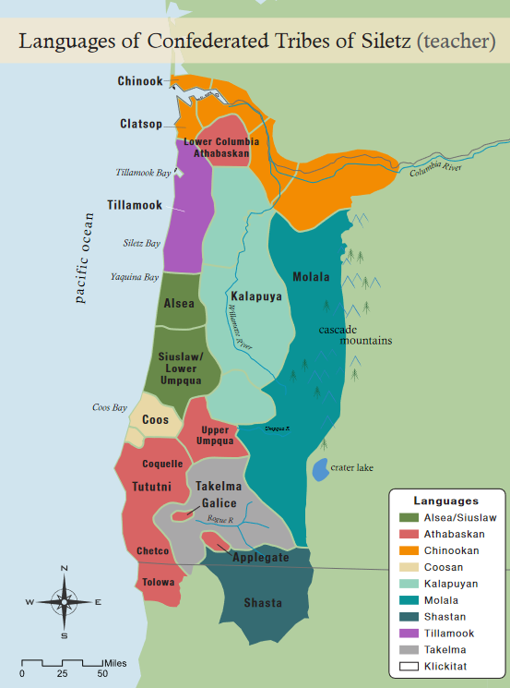
Languages
Source: Wilkinson, C. (2010). The people are dancing again: The history of the Siletz Tribe of western Oregon. University of Washington Press.
Notes:
The ancestors of the Tribes of Siletz spoke many different languages. Each Tribe had their own unique culture and ways of living. On this map, each color represents a different language spoken by the ancestors of the Tribes of Siletz.
[Point to reddish area indicated with the arrow]
Ancestors of the Siletz people living in Southwest Oregon and Northern California spoke a language from the Dené (Athabaskan) language family. Athabaskan languages on the Pacific Coast are sometime called “sleeping” languages because there are few people alive today who grew up speaking to them as a child. Along with other Tribal groups, the Siletz Tribe has started to awaken these sleeping languages. They have created a dictionary online, and they are writing books and teaching their kids and grandkids using the words in their language to sing songs, tell stories, and in everyday life.
In this next activity, we’re going to learn more about awakening Dee-ni Wee-ya' by learning words for many animals that have always lived on the ancestral lands of the Tribes of Siletz.

Slide 7
LHUK (fish/salmon)

Slide 8
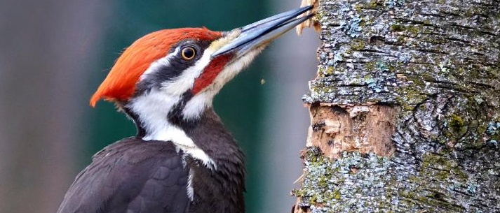
CHAA-XEE-NI (pileated woodpecker)

Slide 9
SRI’-SREE-NVSH (seal)

Slide 10
CH’VS-K’I (butterfly)

Slide 11
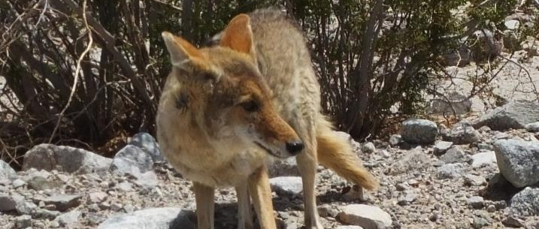
SK’WII-TS’E (coyote)

Slide 12
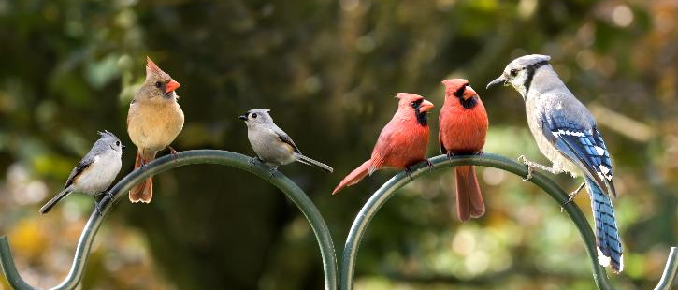
CH’EE-YASH (bird)

Slide 13
K’WVN-SHAN’ (raccoon)

Slide 14
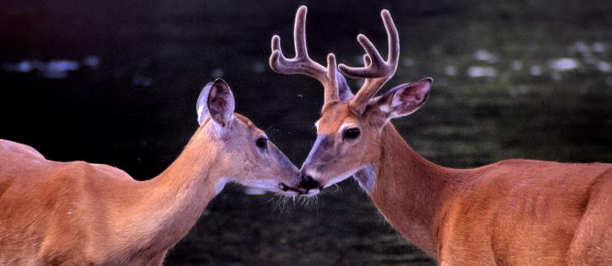
MEE-CHAN-TR’VLH-NI (deer)

Slide 15
SV-GHVS (black bear)

Slide 16
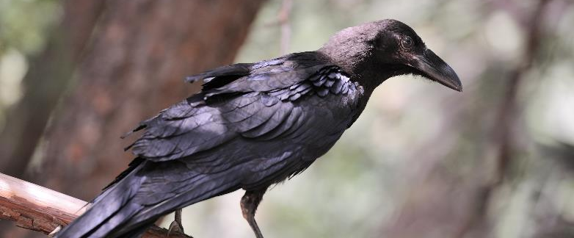
DA’-TS’AS (raven)

Slide 17
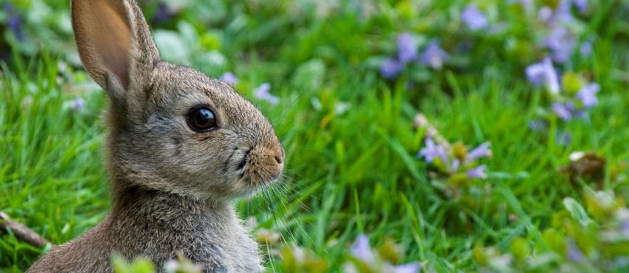
GAA-MA’SR (rabbit)

Slide 18
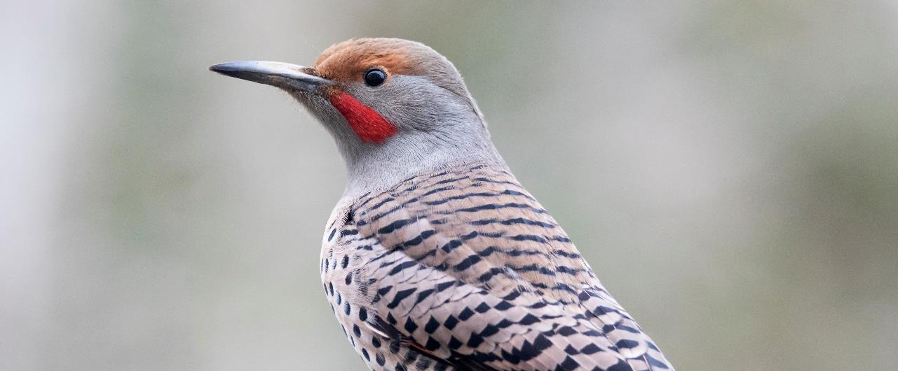
TR’U~K (flicker/yellowhammer)

Slide 19
TEE-LA~ (whale)

