Slide 1
GRADE 6 Housing

Slide 2
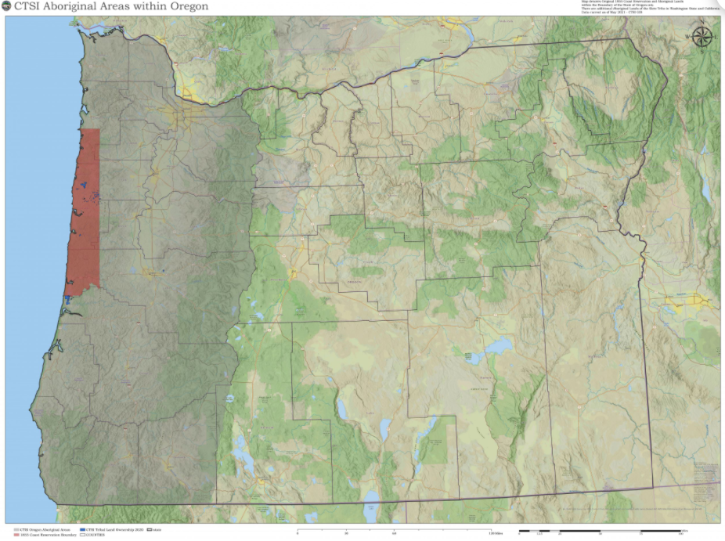
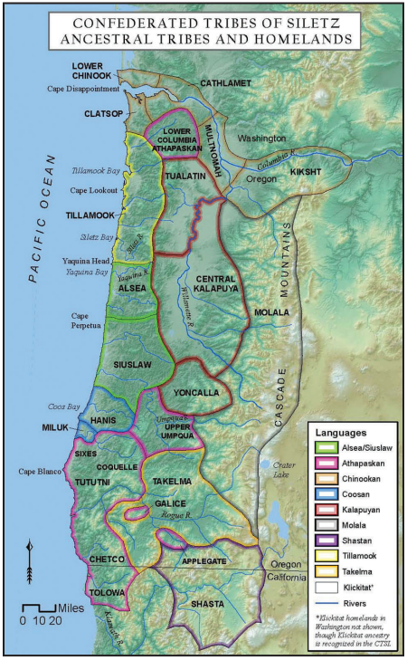
Siletz homelands
Images source: CTSI
Notes:
In what ways is a place a “home?”
How does a place shape how people see themselves and the world?
What do you notice and wonder about the map?
Siletz ancestors came from many different Tribes living in what is now Western Oregon, Northern California, and Southern Washington. The Tribes shared some common practices for living in the Pacific Northwest—such as building plank houses and harvesting salmon for food—but each Tribe also had its unique ways of living and different cultural practices shaped by the specific places in which they lived. Euro-American settlers backed by the U.S. government forced the different Tribes off their lands and forced them to live together on reservations. The U.S. government later took away the reservation lands, refused or neglected to fully honor the treaties it signed with the Tribes, and eventually terminated its relationship with the Tribes. Despite all this, the people of what became the Confederated Tribes of Siletz Indians survived and persisted, eventually winning back federal recognition. The Tribe has worked to regain control or ownership of small parcels of land within its peoples’ traditional homelands to help its members retain a connection to and continuity with traditional lifeways and cultural practices, provide resources to support Tribal members, and steward resources for the benefit of future generations.

Slide 3
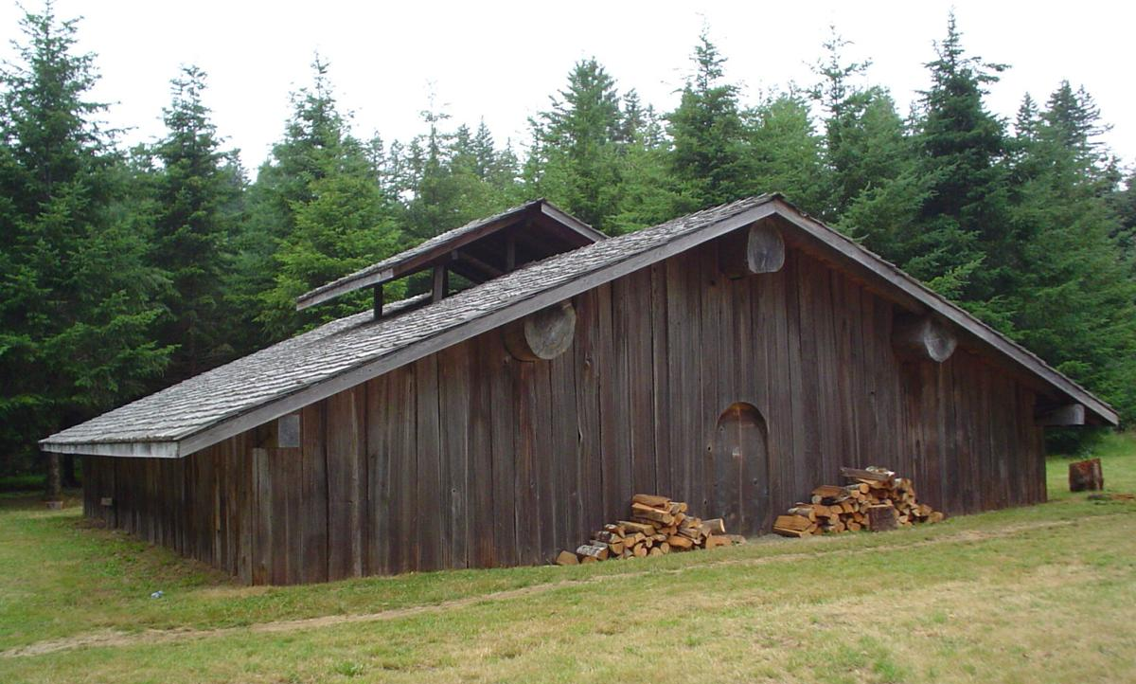
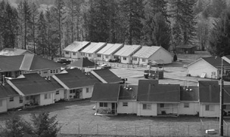
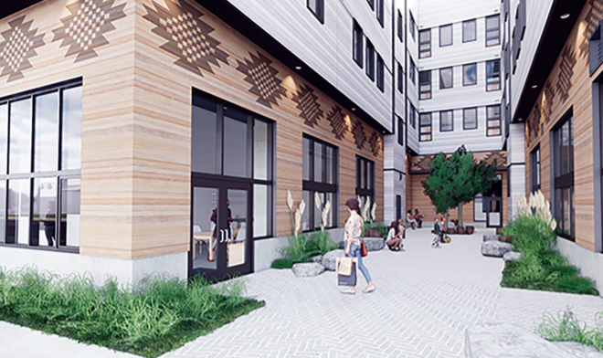
Siletz Housing
Cedar plank house on Siletz Reservation
Siletz, OR
Housing on Siletz Reservation Siletz, OR
Mamook Tokatee apartments
Portland, OR (design rendering)
Images source: CTSI
Notes:
In what ways is a space a “home”?
What types of housing structures are you familiar with? (Examples: houses, apartments, condos, mobile homes)
What do you notice and wonder about the different types of housing shown on the slide?
What does the size and shape of housing tell you about who is meant to live there? (Examples: individuals, single families, multiple families)
A main type of housing for many Siletz ancestors was plank houses made from cedar or sugar pine with a hearth area at least slightly below ground level. In the northern area of the ancestral homelands along the Columbia River and the north coast, these plank houses could be more than 100 feet long and house multiple families. Depending on the exact location, plank-house villages sometimes served as winter quarters and a home base for many Tribes, who also lived in temporary structures or camped out under the open sky at other times of the year as they ventured out in seasonal rounds to hunt and harvest food and supplies.
During and after the removal and reservation period, members of what became the Confederated Tribes of Siletz Indians lived in housing similar to that of Euro-American settlers because reservation authorities suppressed the construction of traditional structures. Some of this housing was built by the U.S. government’s Bureau of Indian Affairs (BIA), some was built by the Tribe, and some was built by individual Tribal members. The BIA also built multi-family and dormitory-style buildings in which some Tribal members lived.
Today, like other Oregonians, Siletz members live in a mix of housing types that include single-family homes, multi-family apartments, mobile homes, and social housing facilities such as college dormitories, nursing homes, and assisted living facilities. Approximately a quarter of the Tribe’s members live on or near the Tribe’s reservation in Lincoln County, Oregon, but many others live in an 11-county service area administered by the Tribe through offices in Salem, Portland, and Eugene and many other places across Oregon and beyond.

Slide 4
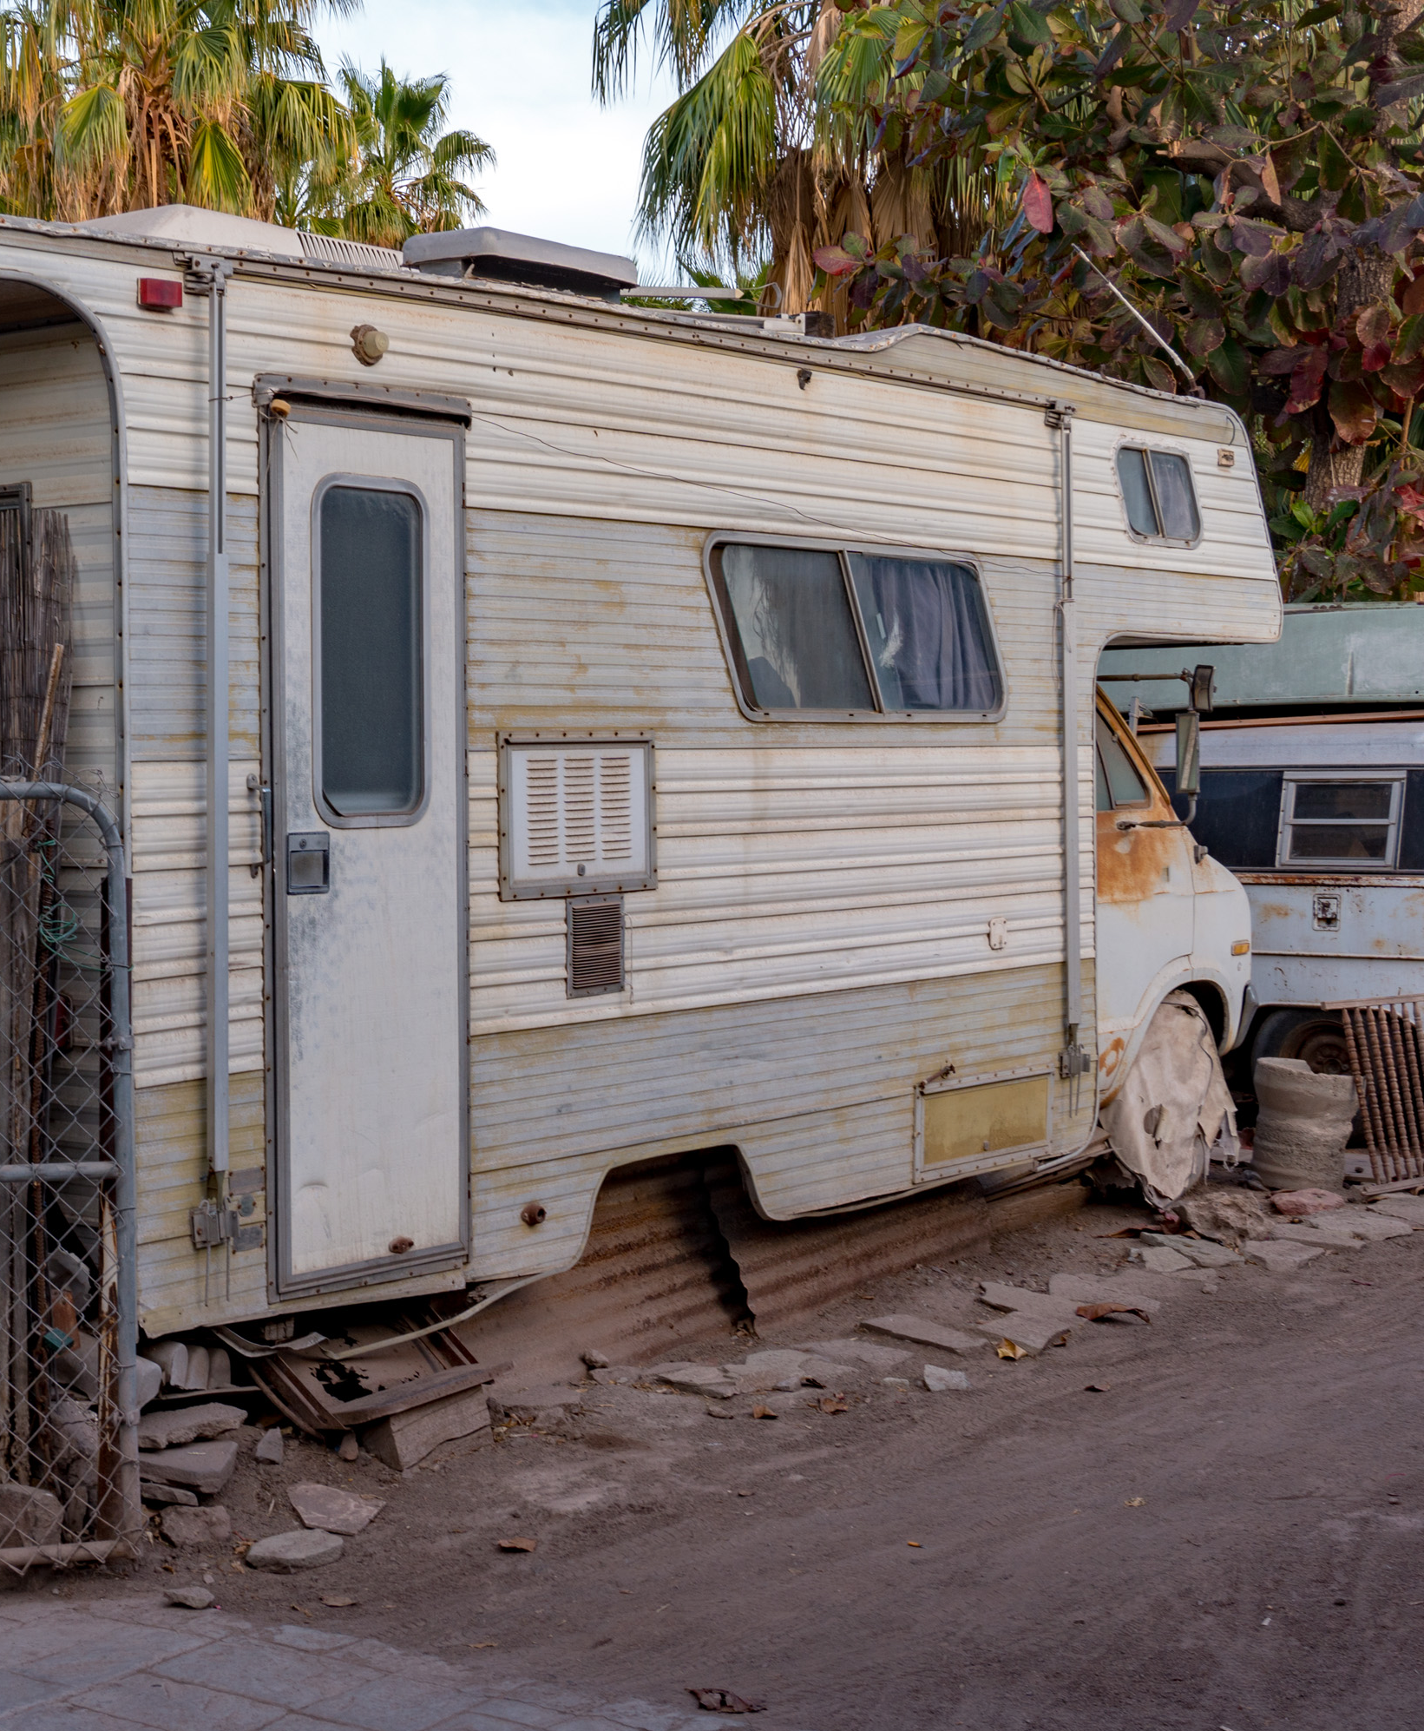
Housing Challenges
Poverty
Income inequality
Gentrification
Lack of affordable housing
Unsafe and unhealthy housing
Eviction/foreclosure
Homelessness
Images source: iStockPhoto
Notes:
Unfortunately, many people and families in Oregon struggle to find and keep a safe space to live. Some don’t make enough money to afford to buy or rent housing in the area where they live, or they have to live in unsafe or unhealthy housing. [Pause here to explain or ask students to brainstorm examples of unsafe or unhealthy housing, such as housing located in challenged neighborhoods or polluted areas or housing with lead paint or poor indoor air quality.] Others, many of whom are also struggling with addictions and mental illness, are houseless. These problems are made worse by gentrification and income inequality—in which people with higher incomes displace people with lower incomes—and poverty, in which individuals and families do not earn enough money to fully support themselves in the areas where they live.
For Siletz people and families, like other Native Americans, these challenges can be linked to and are made worse by oppression, discrimination, and mistreatment by settlers and the U.S. government. Nationwide, Native Americans have the second-highest rate of homelessness (after Native Hawaiians/Pacific Islanders) when compared with other racial/ethnic groups, according to the National Alliance to End Homelessness.

Slide 5
Siletz Tribal Housing Department: Mission
With funds provided by the Native American Housing Assistance and Self-Determination Act and other resources, the Confederated Tribes of Siletz Indians (CTSI) will continue the operation of a housing program whose overall mission is to ensure that low-income Siletz Tribal Members have the opportunity to obtain housing that meets their needs, is affordable, and provides a safe, healthy living environment.
Images source: CTSI website (accessed August 2021)
Notes:
Among other goals, the Siletz Tribe is committed to supporting the health and well-being of its current and future citizens. This includes helping members find safe and healthy housing wherever they live, whether on or near the Tribe’s lands in Lincoln County, in the Tribe’s 11-county service area, or elsewhere in Oregon and beyond. In a moment we will explore the many ways the Siletz Tribal Housing Department works to achieve this goal.

Slide 6
STHD Housing Help
Emergency Housing
Supportive Housing
Affordable Housing
Renter Assistance
Homeowner Assistance
Housing Expense Assistance
Emergency housing, shelters and support for individuals/ families in crisis or homeless.
Short-term housing and services for individuals/ families getting back on their feet.
Long-term housing for low-income individuals/ families.
Resources to help individuals/ families pay their rents.
Resources to help individuals/ families buy and pay for their own homes.
Resources to help individuals/ families maintain healthy and safe housing.
Notes:
The handout and slide identify different types of help individuals and families sometimes receive to help them find and keep affordable, safe, and healthy housing. This help can come from family and friends—such as when a family lets relatives stay with them after they must flee a flood or wildfire or gives a family member money to help them buy a house—and it can also be offered by agencies and organizations, including Tribal governments, as we’ll see in a moment.

Slide 7
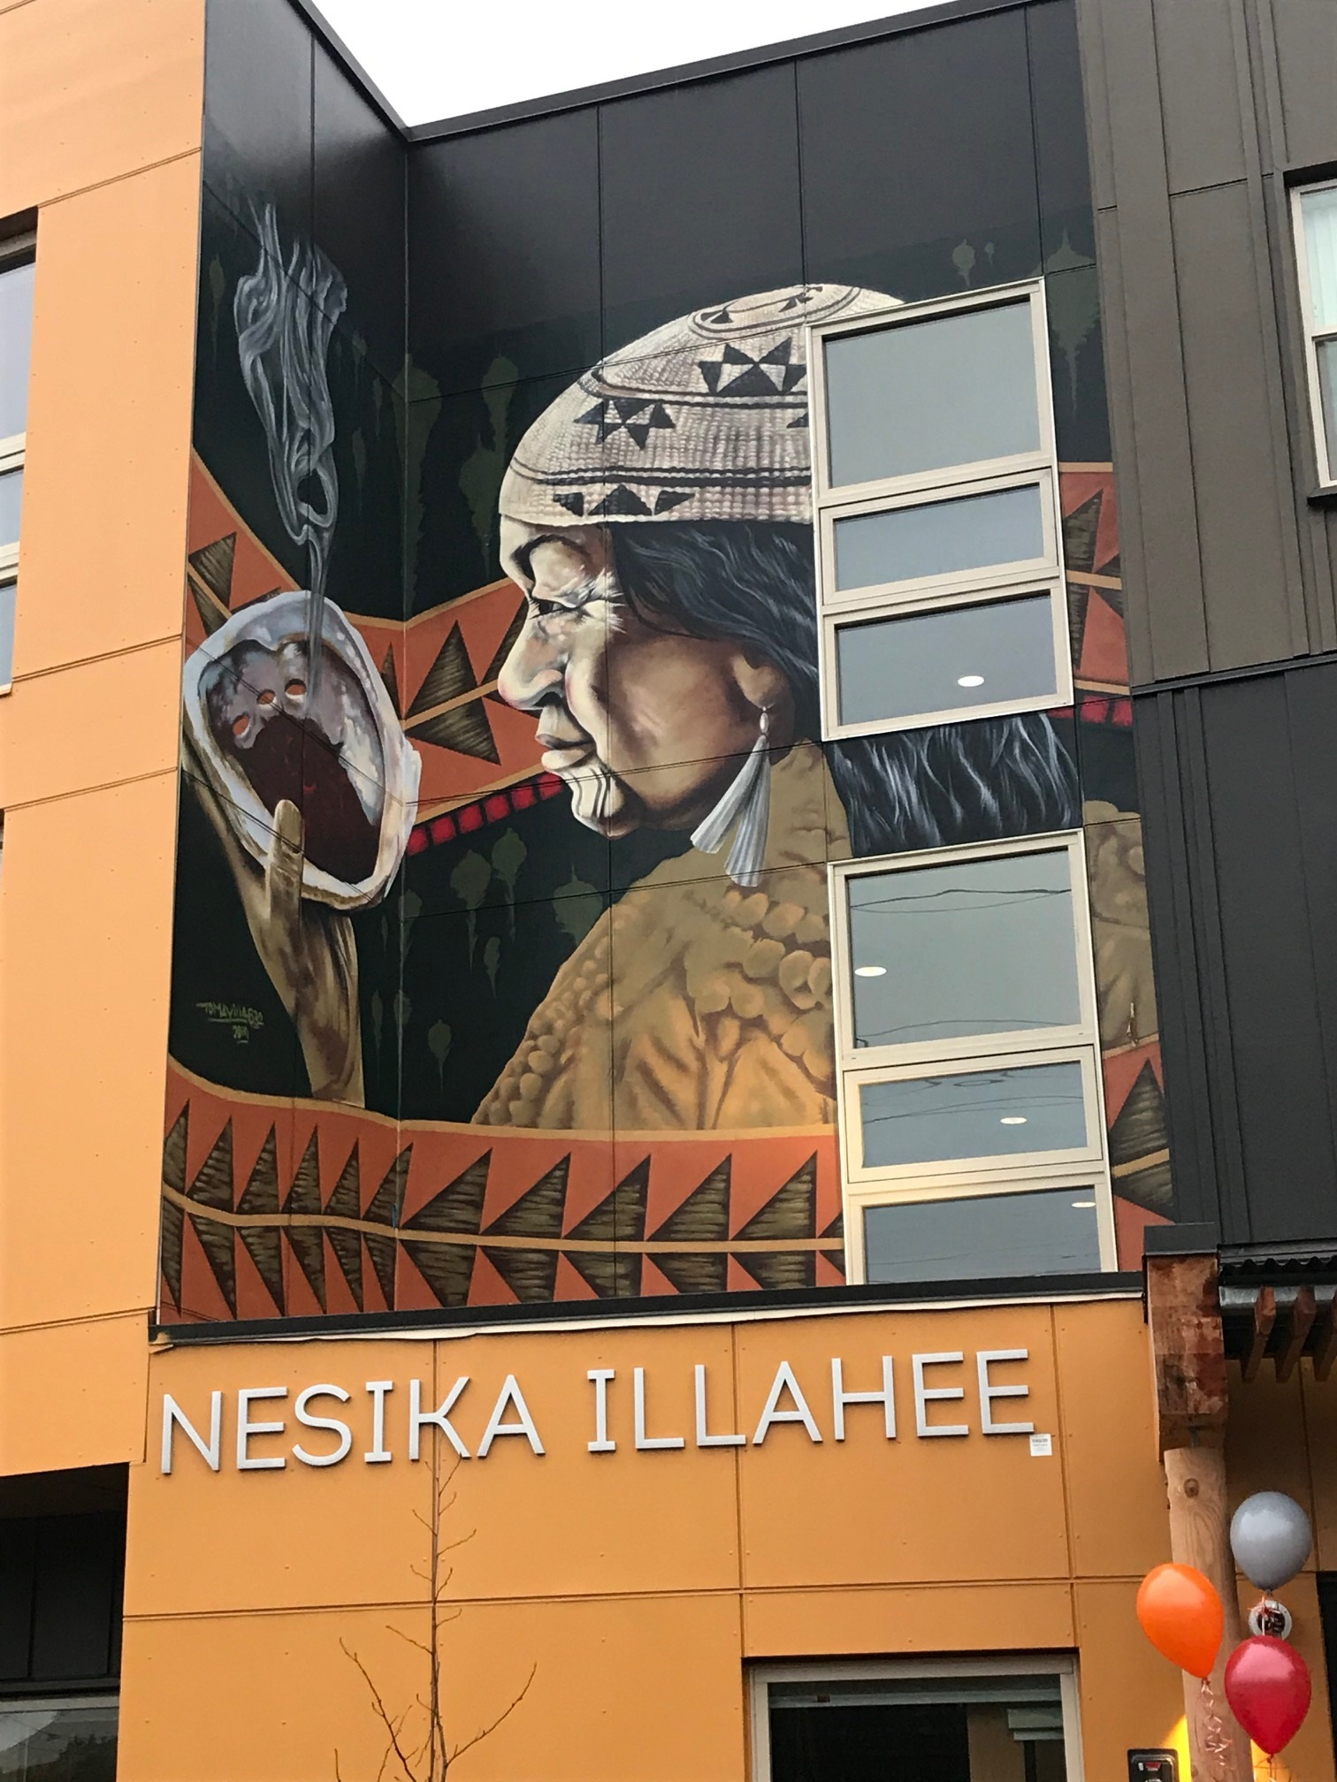
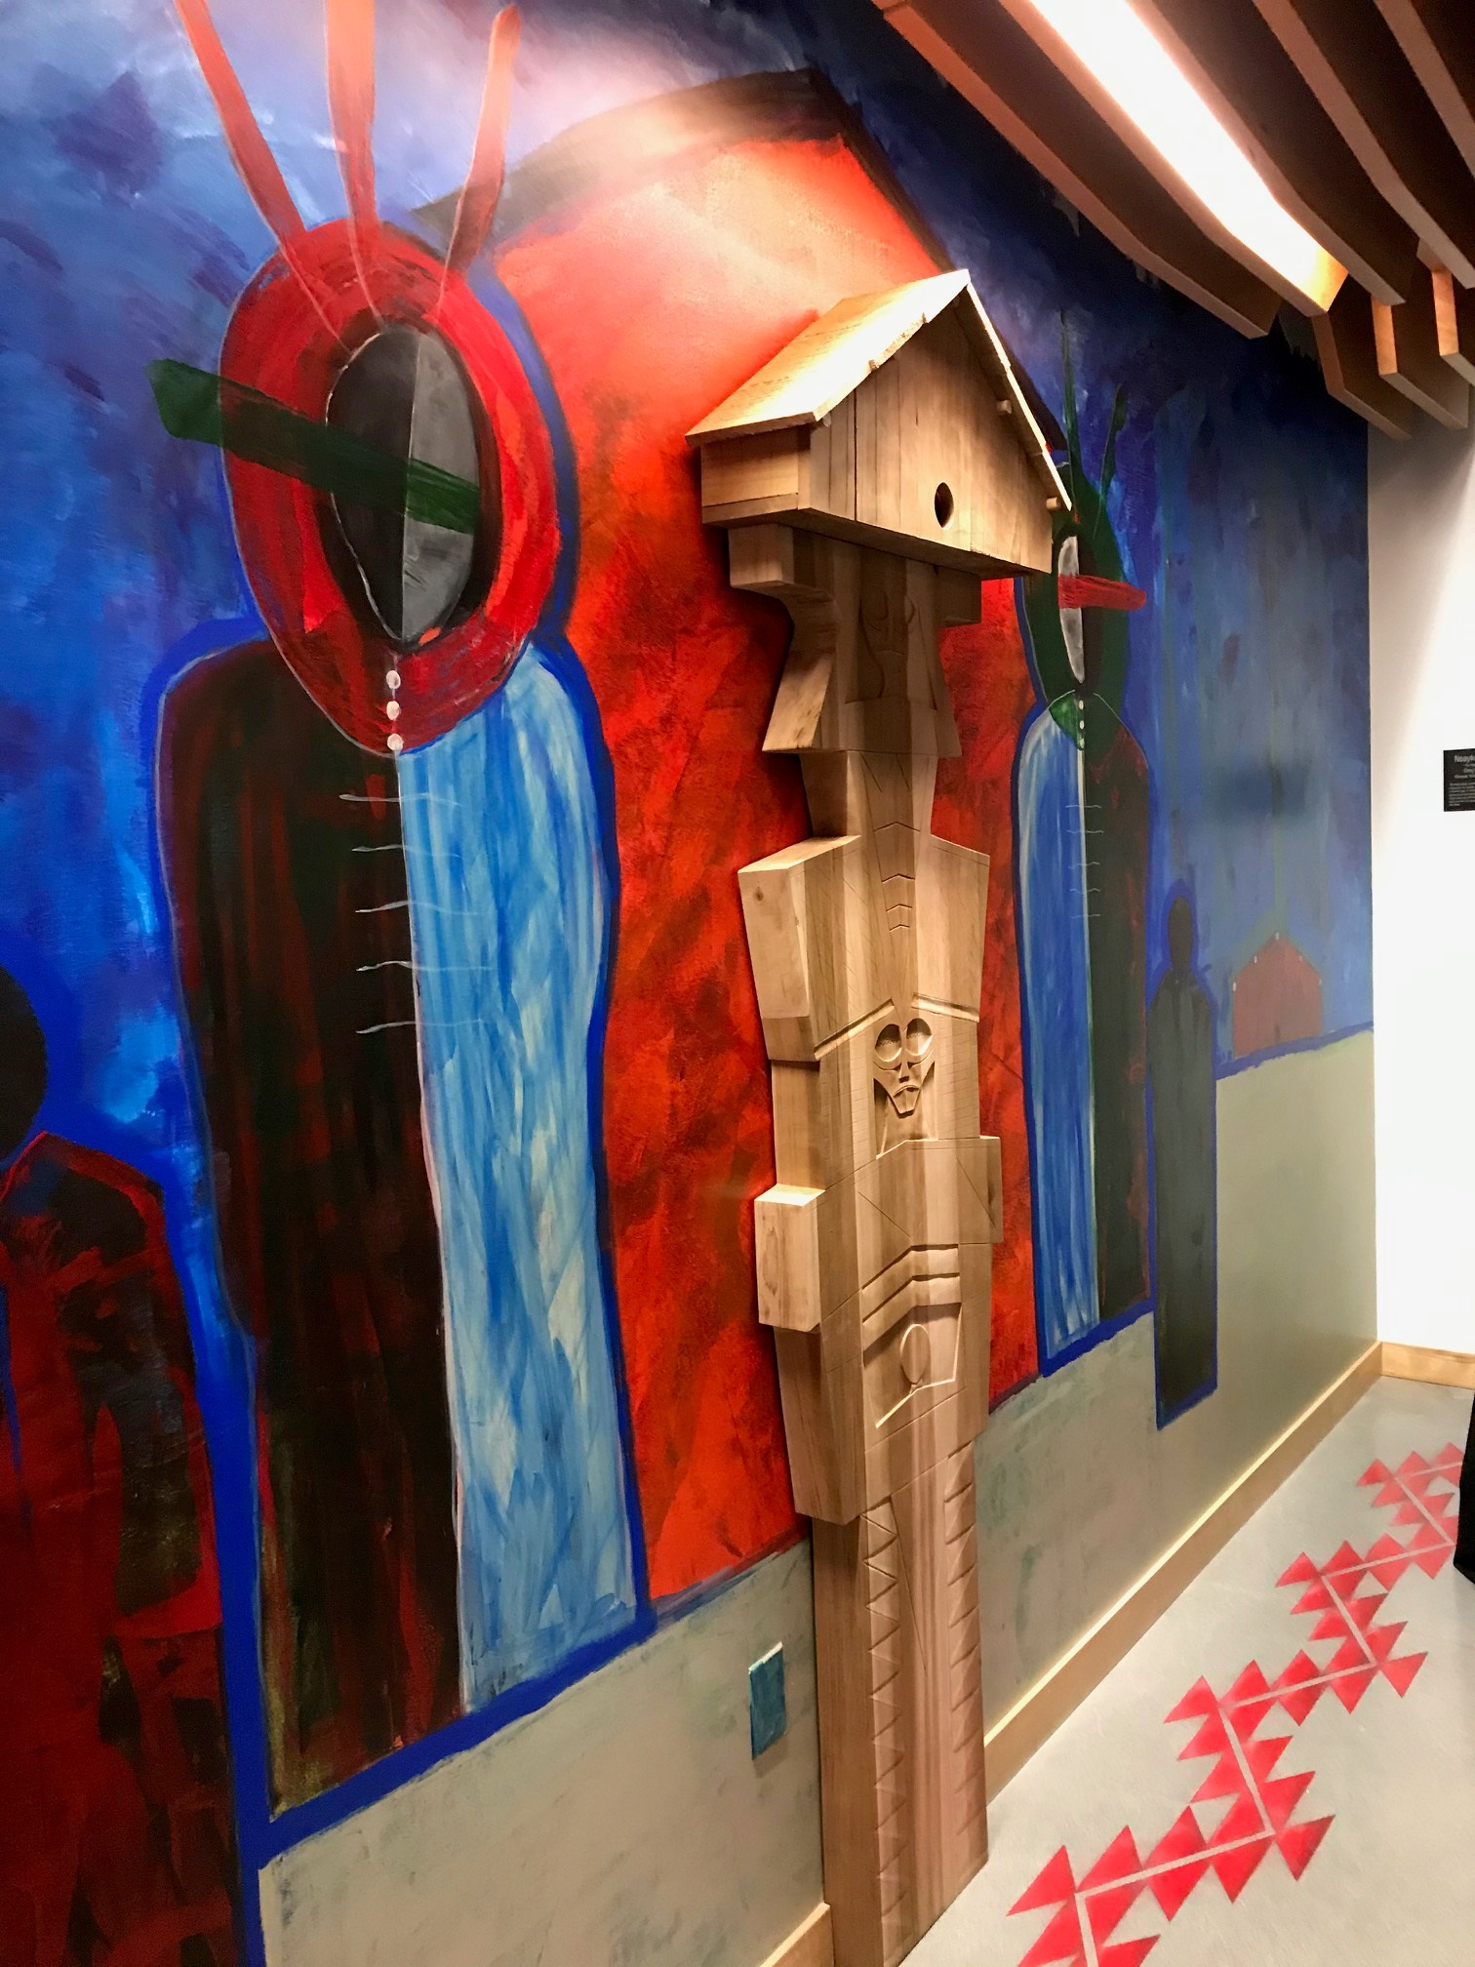
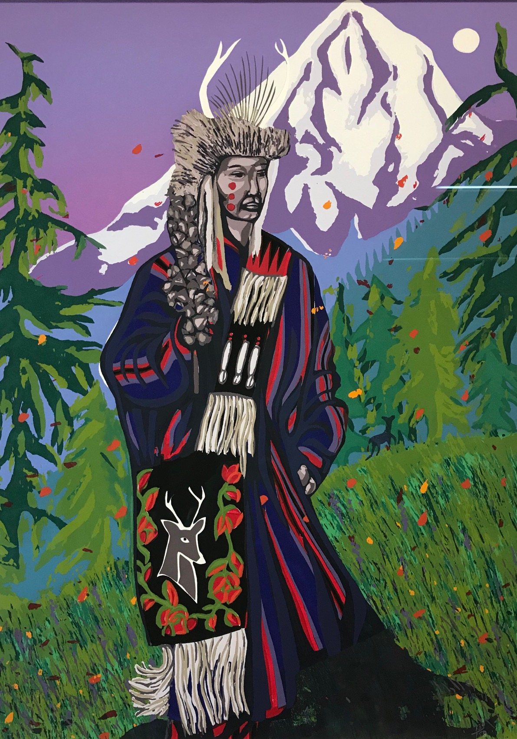
Case Study: Nesika Illahee Apartments
Images source: CTSI
Notes:
We’ve discussed some of the challenges that Siletz people and others in Oregon face in finding and keeping safe, healthy, and affordable housing, especially when they are struggling with poverty, addiction, and other challenges. We now know more about what the Siletz Tribe is doing to help its members overcome those challenges. Over time, the STHD adapts its programs and services and creates new ones, as it responds to members’ changing housing needs. For our last activity, we will take what we learned from our research and discussions and use that knowledge to analyze a unique housing solution developed by the Siletz Tribe and partners in Portland, Oregon. We’ll see what lessons it might offer other Tribes and anyone interested in tackling tough housing issues like homelessness, gentrification, and inequality.

