Slide 1
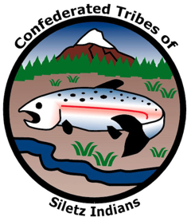
GRADE 11 From Homelands to Homesteads: Understanding the Legacy of Allotment

Slide 2
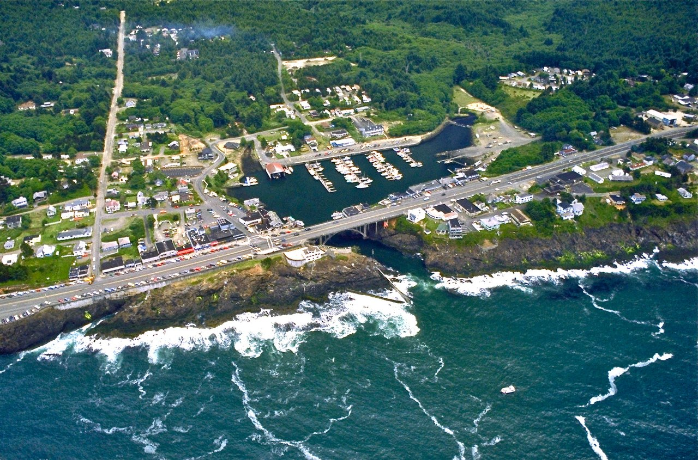
Warm up
Have you ever visited Depoe Bay, Oregon?
What did you see and do while you were there?
What do you know, if anything, about the history of the city?
Image source: Bob Heims, U.S. Army Corps of Engineers via Wikimedia Commons (Public Domain)

Slide 3
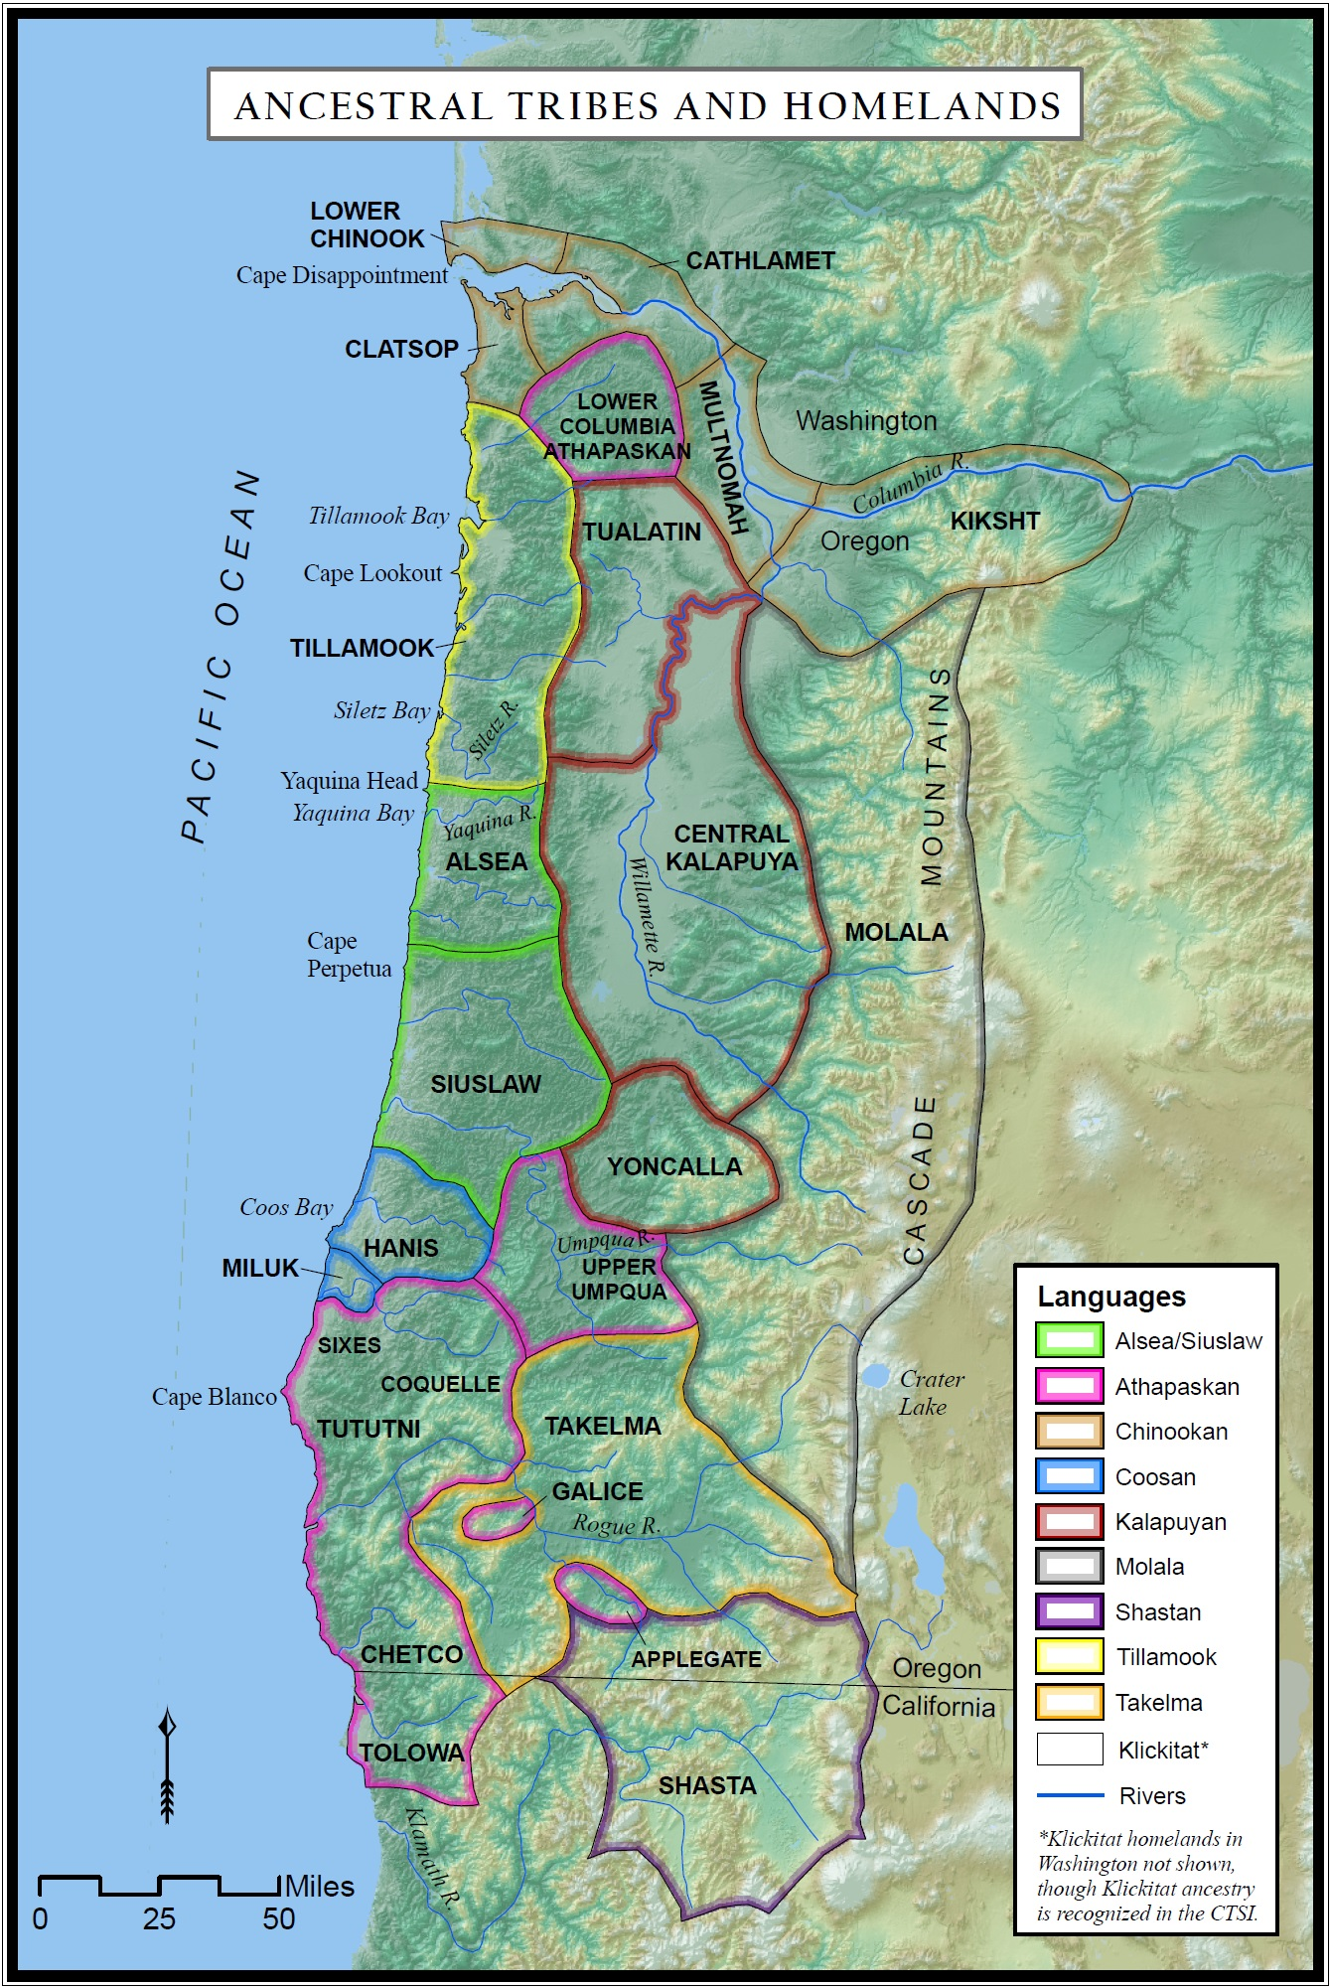
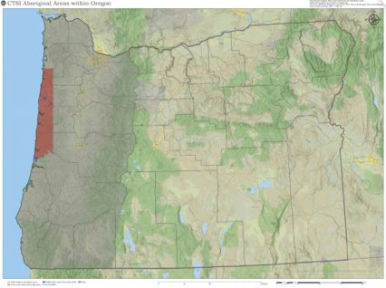
Siletz ancestral homelands and languages
Image source: CTSI
Notes:
Siletz ancestors come from many different groups of Native American people from across what is now Western Oregon, Northern California, and Southwest Washington. Beginning in the mid-1850s, the U.S. government forcibly removed dozens of these groups from their ancestral homelands and concentrated them on the 1.1-million-acre Coast (Siletz) Reservation, a large strip of land that initially encompassed close to a third of the Oregon coastline.

Slide 4
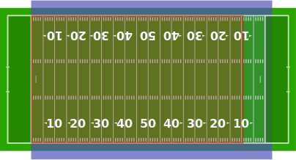
What is an acre?
A measure of an area of land that equals:
“1 furlong by 1 chain” (660 feet x 66 feet) [land survey measurement terms]
4,046.86 square meters
4,840 square yards
43,560 square feet
1/640th of a square mile
Almost as big as a football field (green) or soccer pitch (blue)
As big as 16 tennis courts
Image sources: a) “Acre Superimposed Over Football Fields.” Jc3s5h via Wikimedia Commons. en.wikipedia.org/wiki/Acre#/media/File:Acre_superimposed_over_football_fields.svg. b) “Eye View Diagram Outline.” Clker Free Vector Images via Pixabay. pixabay.com/images/id-40326. c) “House Icon Symbol Architecture.” janjf93 via Pixabay. pixabay.com/vectors/house-icon-symbol-architecture-2492054.
As big as 18, 2,400 square-ft houses

Slide 5
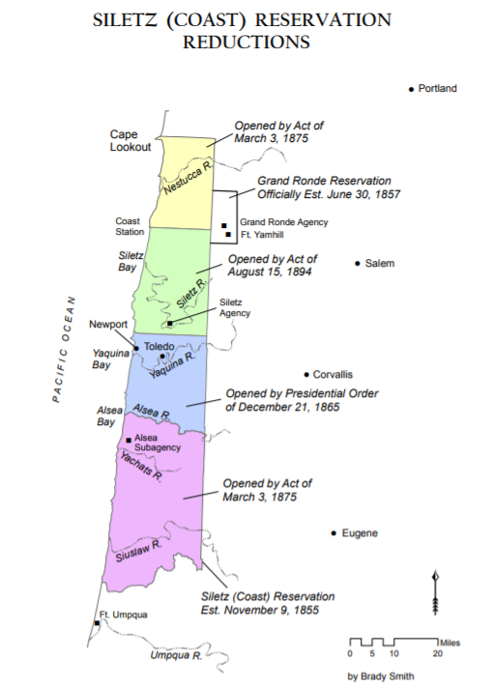
Reservation reductions
Yaquina Tract (200,000 acres) opened to white settlement by a presidential executive order of Andrew Johnson in 1865 (blue)
Congress removed an additional two-thirds of reservation lands (700,000 acres) in 1875 (yellow and purple)
Most of the remaining reservation land (green) was lost through allotment and termination (described in other lessons)
Image source: Confederated Tribes of Siletz Indians.
Notes:
Over time, the federal government abandoned its promise to secure a “permanent home” for the people removed to Siletz and instead bowed to the demands of settlers and business interests to reduce the size of the reservation. Within 20 years of its establishment in 1855, the government had reduced the Coast (Siletz) Reservation by more than 80 percent—first in 1865 by an illegal presidential executive order that opened a 200,000-acre tract of land centered on Yaquina Bay and then by an act of Congress in 1875 that removed an additional 700,000 acres (two-thirds of the original reservation).

Slide 6
General Allotment (Dawes) Act of 1887
Sen. Henry L. Dawes of Massachusetts
Image sources: a) Library of Congress. (n.d.). Dawes, Hon. Henry L. of Mass. [Online]. Downloaded April 14, 2020 from https://www.loc.gov/pictures/item/2017895198/.
b) Lincoln County Leader, April 14, 1905, Image University of Oregon Libraries; Eugene, OR Persistent link: https://oregonnews.uoregon.edu/lccn/sn85033162/1905-04-14/ed-1/seq-4/print/image_523x817_from_603,724_to_3769,5666/
Notes:
In 1887, Congress passed the General Allotment Act, also known as the Dawes Act after its main proponent, Senator Henry L. Dawes of Massachusetts. The Act authorized the president (through the Department of the Interior’s Indian Office, later renamed the Bureau of Indian Affairs in the 1940s) to break up Native American Tribal landholdings into individual parcels, called “allotments,” that would be distributed to Native American individuals and heads of families. Any remaining Tribal land not allotted to Tribal members would then be deemed “surplus” and could be made available for sale to non-Native settlers and commercial interests. Proponents of allotment justified the Act by arguing that issuing Native people individual tracts of land would aid in the federal project of assimilation. They claimed that forcing Native people to own and manage land individually would break up Tribal ties and integrate Native people into the American economy as self-sufficient farmers and ranchers.

Slide 7
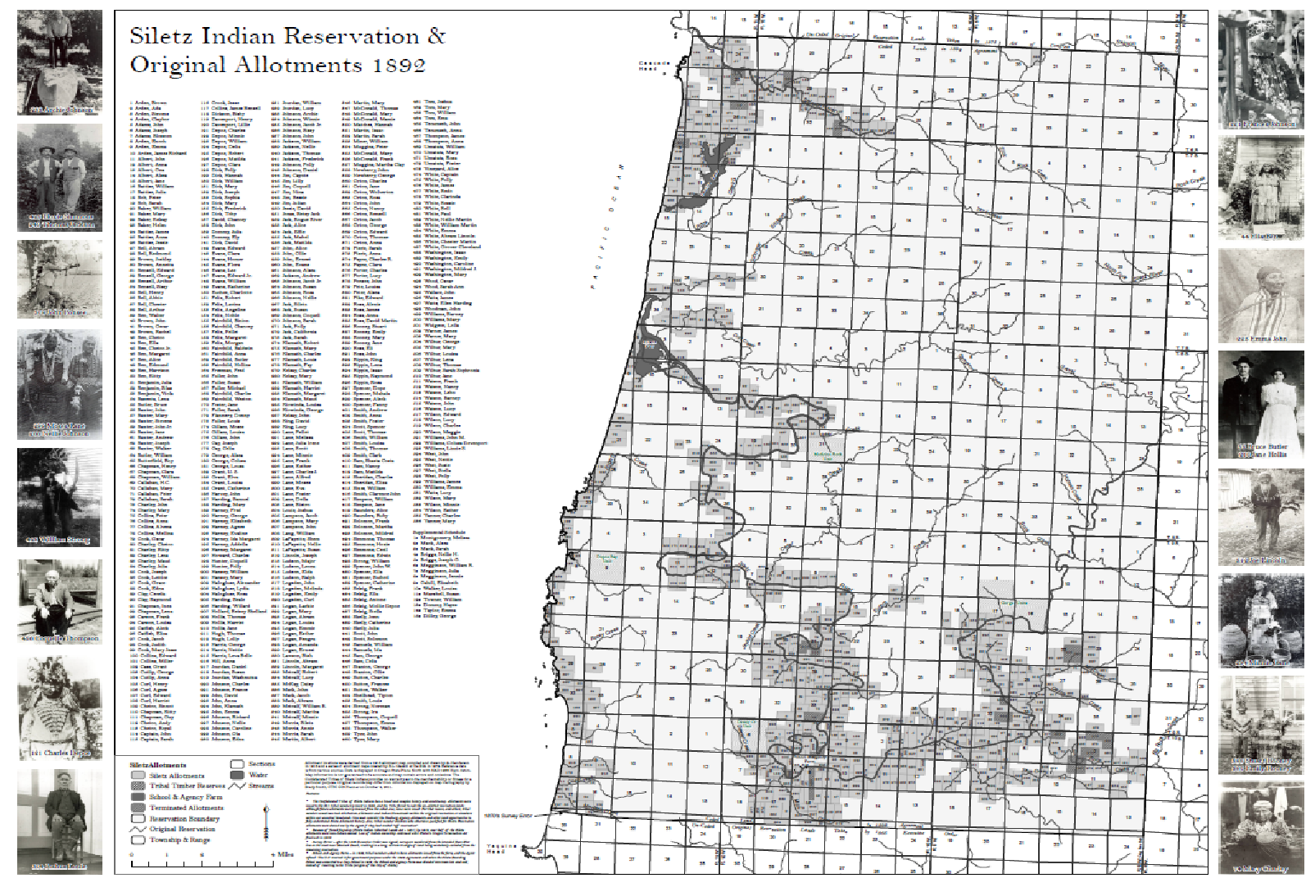
Allotment on the Siletz Reservation
1887 - Dawes Act passed
1892 - Allotments and “surplus land” agreement negotiated
1894 - Congress approves surplus land agreement
1901 - Siletz Inherited Lands Act (heirs forced to sell inherited allotments)
1934 - Allotment ended by Indian Reorganization Act
Image source: Confederated Tribes of Siletz Indians. (n.d.). Siletz Indian Reservation and original allotments. [Online]. Downloaded April 15, 2020, from http://www.ctsi.nsn.us/uploads/downloads/maps/allotment_map_2020.pdf.
Notes:
While allotment was a nationwide initiative, the way that it played out on individ-ual reservations depended greatly on local context, including such factors as the goals of the local Indian agent, attitudes of the surrounding settler community, the value and desirability of reservation land to settlers, as well as the history and experiences of Native people with the government and its promises. At Siletz, the desirability of priceless acres of old-growth timber on the reservation played a key role in motivating federal officials to use allotment to gain as much reservation land as possible—even pushing Congress to create new ways to siphon off Indian land holdings. Those methods would eventually be used on other reservations, as well.
Allotment at Siletz began in 1891 with the arrival of special allotting agent J.S. Mayhugh. Many of the Tribal people Mayhugh first encountered seemed open to the idea of allotment. Several of the treaties that Siletz people had signed in the 1850s had provisions allowing agents to allot individual tracts of lands on the reservation, so some Native leaders had been living on their own parcels for
decades. A bigger appeal was a deep distrust of federal officials fueled by the illegal reservation reductions of the 1860s and 1870s. Many people at Siletz feared that it was only a matter of time before the government would eliminate the rest of the reservation, and they saw getting individual land title as a way to hold onto at least a piece of what they had been promised.
It didn’t take long for Tribal people to realize that the promises of allotment were just as compromised as the promises of a permanent reservation. Federal officials initially announced that they would issue 40-acre allotments, only half of the amount promised in the Dawes Act, relenting to the full 80 acres only after a vigorous protest from Native people. When it came time to actually issue the allotments, however, Siletz people found themselves cut off from the most desirable land. The Indian agent at Siletz insisted on reserving large sections of the best and most productive farmland, claiming that the land was necessary to support the agency boarding school. When Tribal people and Mayhugh objected, the Indian agent convinced the Indian Office to replace Mayhugh with a different allotment agent. To make matters worse, poor surveys and other legal confusions plagued the process. In the end, some allotments seem to have been issued haphazardly on isolated and difficult to reach terrain or steep hillsides unsuitable for habitation.
From the perspective of Siletz people, this parade of allotment agents, disputes over the best land, and shifting expectations combined into a tangled mess of conflicting messages and disappointment. By the time Mayhugh was replaced, he had already promised a large number of allotments to Native people, only for his replacement to reject those allotments that included the most desirable locations. At the same time, agents at Siletz were working hard to limit the num-ber of people eligible to select allotments—ruling that Native people who had been forced to leave the reservation to support themselves were ineligible to select allotments on reservation land. Likewise, people still living in the sections ripped from the reservation in 1865 and 1875 were ruled ineligible to select land from the remaining reservation. Federal officials did eventually offer allotments from federal land to “off-reservation Indians,” but Native people found that federal regulations made actually securing an allotment very difficult. At the very least, even as the government stripped away the majority of the remaining reservation, allotment was supposed to leave each Siletz person with at least some usable land, but the government couldn’t even manage that.

Slide 8
Primary and secondary sources
Primary sources | Secondary sources
Benefits
Evidence of what happened in the past. Bits of history that reveal how people from the time lived and what they thought about the world. | Help us interpret or make sense of primary sources. Tell how an event fits into history. Can include related facts about other events that happened at the same time or at other times.
Challenges
May be difficult to read or understand. May only tell one point of view. | May tell a story from only one point of view. May be a biased representation of the story.

Slide 9
Point of view (perspective)
The position or attitude from which something or someone is observed. Everyone has a point of view. Sometimes in history, one person’s or group’s point of view is judged to be more accurate or important than other points of view. Different points of view can be misunderstood, forgotten, or intentionally left out. History can be missing “the other side of the story.”
Image Source: Pixabay (https://pixabay.com/photos/glasses-reading-glasses-spectacles-1246611/)

Slide 10
Bias
Prejudice in favor of or against one thing, person, or group compared with another. Sometimes people who observe or interpret an event in history make judgments that are based on their own biases.
Image Source: Pixabay (https://pixabay.com/illustrations/horizontal-pan-balance-weigh-2071320/)

Slide 11
Reading analysis instructions
Together with your group, read the documents provided in your handout pertaining to allotment and the Tribes of Siletz
Answer the reading reflection questions provided in the document organizer
Be prepared to share what you discuss with the whole class

Slide 12
Land losses (acres)*
Original Coast (Siletz) Reservation (1855) | 1,125,000
President Andrew Johnson executive order (1865) | -200,000
Reductions by congress (1875) | -700,000
Allotment and sale of surplus land (1894–1934) | -222,000
Remaining Tribal land as of 1934 | 3,000
*Approximations for illustrative purposes.
Source: Wilkinson, C. (2010). The people are dancing again: The history of the Siletz Tribe of Western Oregon. University of Washington Press.

Slide 13
Current Siletz Tribal land ownership
Notes:
The legacy of allotment and other historical land losses shapes the political, cultural, and economic realities of the Confederated Tribes of Siletz Indians to this day. Only a handful of Siletz families still reside on allotted land. Today, the Tribe manages some 4,700 acres of reservation land and has a total land base of nearly 16,000—a minuscule portion of the original Coast (Siletz) Reservation, to say nothing of the millions of acres of land throughout Western Oregon ceded in treaties. Nevertheless, the Tribe focuses on making the best use of their lands for the benefit of Tribal people as well as the plants, animals, and other non-human relatives that sustain the Tribal community. The Tribe has worked to regain control or ownership of parcels of land within their peoples’ traditional homelands to help their members retain a connection to traditional lifeways and cultural practices, provide resources to support Tribal members, and steward resources for the benefit of future generations.

