Slide 1
GRADE 2 The Dance House
Notes:
Say: People come from many diverse backgrounds. The way we dress, the things we like to eat, the places we like to go, and the different ways we celebrate make us unique and are passed down to us from our family and our ancestors—the family members who have gone before. Let’s think together

Slide 2
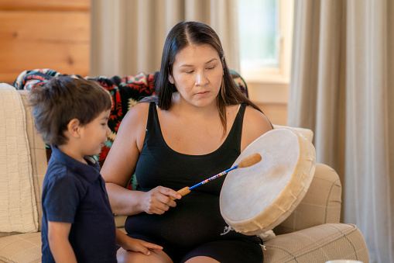
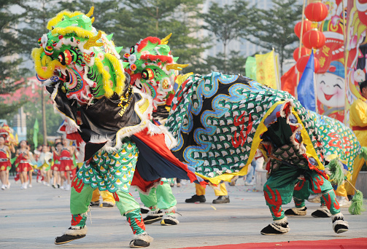
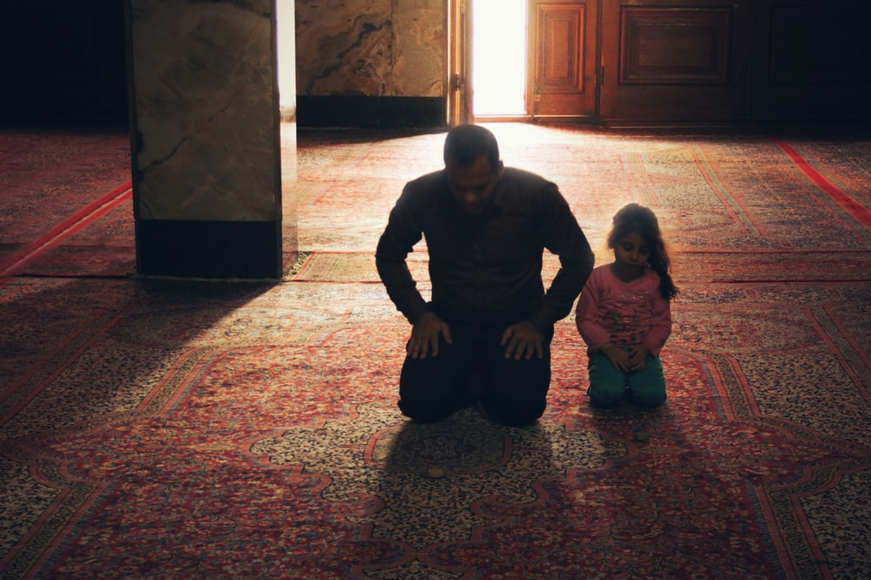
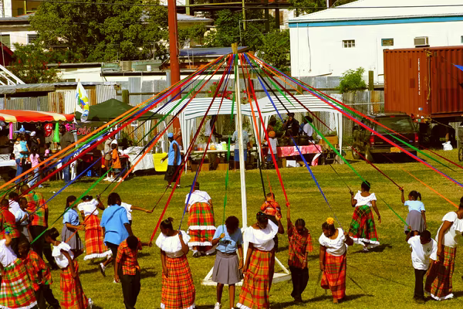
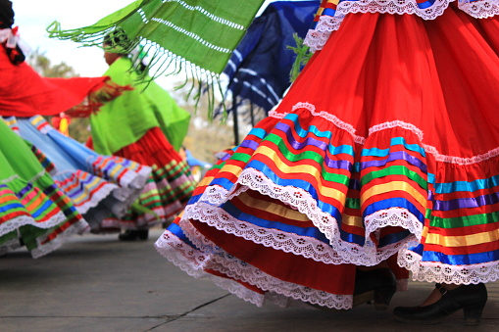
People celebrate their culture and beliefs in many ways!
Notes:
Say: Let’s recap by looking at the pictures on the slide. We found out that different people have different celebrations throughout the world and that these celebrations are often passed down by family and community. We also found out that many celebrations happen at special places. Sometimes those places are outside and sometimes they’re inside.
Ask: What do you notice about these pictures that matches up with what we have already discussed?
Photos from Unsplash (free)

Slide 3
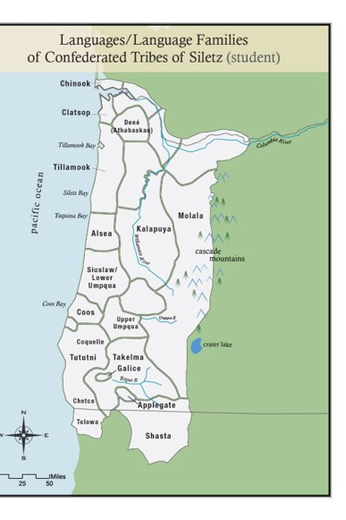
Our People
Notes:
Say: Indigenous people in Oregon are people whose ancestors come from Oregon and have always lived here. One Tribe in Oregon is called the Confederated Tribes of Siletz Indians. Siletz people come from all over Western Oregon. Check out this map. Each Tribe and band are different and have different beliefs and ways of living. Today, Siletz people follow many different faith traditions. Still, Native people from Western Oregon all have special celebrations and ceremonies—songs, dances, and stories—that have been passed down for generations. Many of those celebrations and ceremonies happen in a special place called a Dance House. A Dance House is like a church for many Siletz people—it’s where they go to pray, pass on traditions, and celebrate important occasions like weddings, funerals, or baby blessings. Today, we’ll learn more about the Dance House and why it’s so important to Siletz people.

Slide 4
Native Houses
Notes:
Say: Many years ago, only Indigenous people lived in Oregon. They had their own villages and towns and would visit each other to celebrate and for special ceremonies. In those days, these celebrations would often happen at a leader’s house or in a special place called a Dance House. Native people’s houses weren’t like houses in America today—look at this picture.
Ask: What do you notice about the house in this picture?
Say: Great discussion! These houses were big, long, and dug into the ground. They could fit a lot of people who all lived together. Siletz people call these “plank houses” but sometimes they are also called “longhouses.” The leader’s house was usually the biggest, and they would clear out their house to host all the people when it was time to come together to pray, sing, dance, or celebrate. Some villages even had special houses just for celebrating. They looked just like the other houses but were bigger so that they could fit everyone. When European people came to North America, they wanted the land that Native people were living on, and they didn’t want to share. They fought with Indian people and made them leave their homes to stay on a small piece of land called a reservation. Native people didn’t want to go, but they had no choice. A lot of Native people in Western Oregon were forced to go to the reservation at Siletz.
Ask: How do you think Native people felt when they had to leave their homes? Have you ever lost something very important to you? How did you feel? Share with your partner. (A/B partners, 2 minutes each)

Slide 5
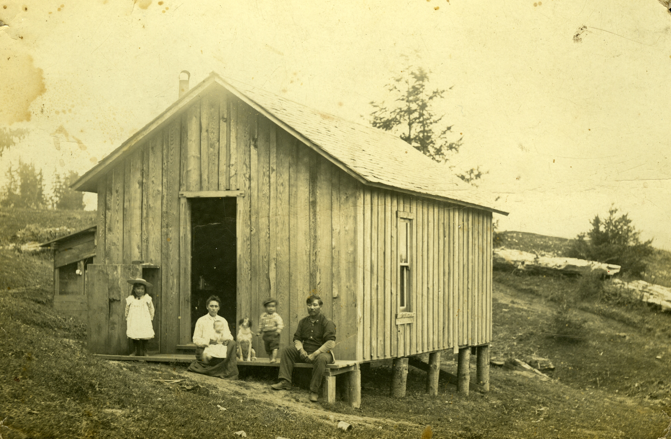
Reservation Houses
Notes:
Say: When Native people got to the reservation, there weren’t any homes for them. The soldiers and government tried to make people build homes that looked like the small houses that most people live in today—houses that only fit one family. Siletz people thought this was a strange way of living. They were used to living in plank houses with lots of extended family like grandparents, uncles, and aunts. Siletz people knew that they needed a place to continue their traditions and those small American houses would not do.
Ask: Would you like to live all together with your extended family? Maybe you already do? What do you think Siletz people did when the government told them to live in American-style homes?
Say: That’s right! Many of the people started building plank houses on the reservation. But it wasn’t easy. The soldiers and government men were trying to control people and tell them how to live. They tried to stop people from living in traditional houses.
Ask: Why do you think soldiers and the government didn’t want Siletz people to live in plank houses?

Slide 6
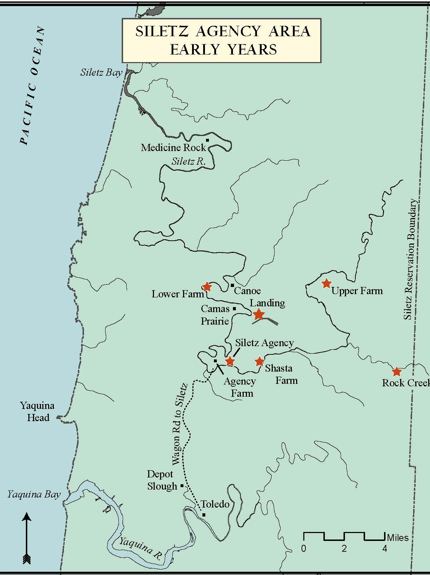
Location of Dance Houses on the Reservation
Notes:
Say: Still, Siletz people were so sad about being forced to leave their homes that they really wanted to dance and pray together. So, even though they knew the government might not like it, Siletz people began to build Dance Houses. These houses looked pretty much like other plank houses but became special places on the reservation for celebrating, praying, and gathering. They got the English name of “Dance Houses” because that’s where people danced. Here is a map. Look at all the Dance Houses that Siletz people built on the reservation.
Ask: How many Dance Houses do you see on the map? How close and far apart are they? (A/B partners

Slide 7
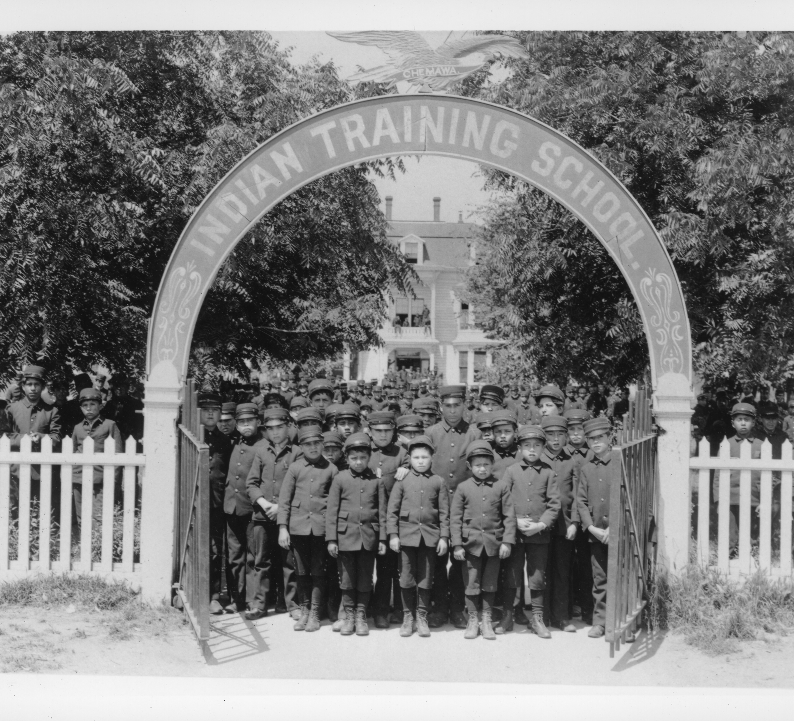
Boarding Schools
students lining up at Chemawa Indian school in salem, or
Notes:
Say: The soldiers and the U.S. government really didn’t like Dance Houses. They thought American ways of living were better than Native ways. They wanted to force Native people to give up their songs, stories, traditions, and even their language and to live like other European-Americans did. They burned down the Dance Houses and threatened to punish people if they rebuilt them. They also separated children from their families so that children would have a harder time learning their dances, songs, and language. The government wanted to stop Native people’s way of life and make them live in the European-American way. Many children were sent away to boarding schools. That’s a school where you live right on the school campus, away from your family.
Ask: How do you think little kids felt when they had to live away from their families? What tradition or celebration do you have that you would feel really sad to be forced to give up? (A/B partners or “walk and share” by finding someone in the room to share one thing they have learned so far.)

Slide 8
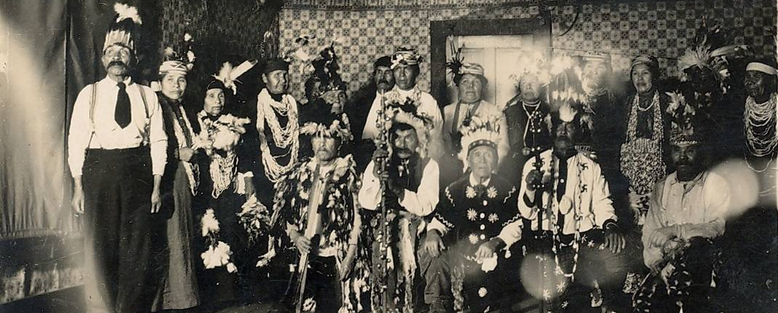
Continuing Tradition
Nee-dash at billy metcalf's place
Notes:
Say: These attacks made Siletz people scared and ashamed to build Dance Houses, but they didn’t stop dancing, singing, or practicing their traditions. They just had to do it in secret. Look at this picture. It’s a picture of Siletz people dancing a traditional dance called Nee-dash or “Feather Dance” in their American-style home on the reservation. For a long time, Siletz people had to pass their traditions down this way, without a place to come together.

Slide 9
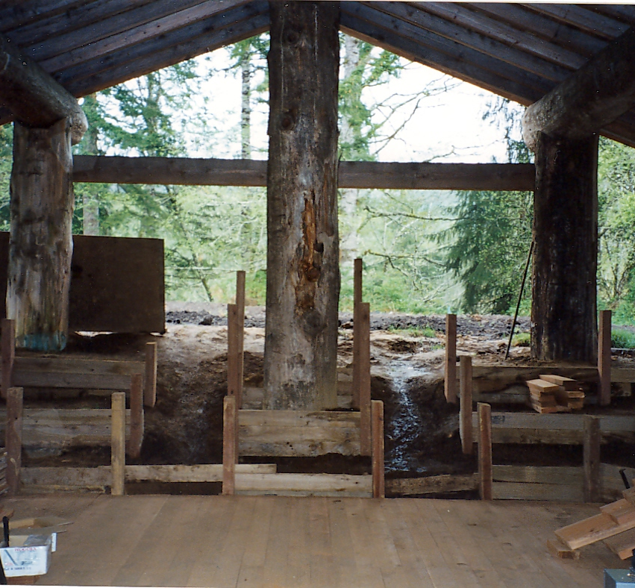
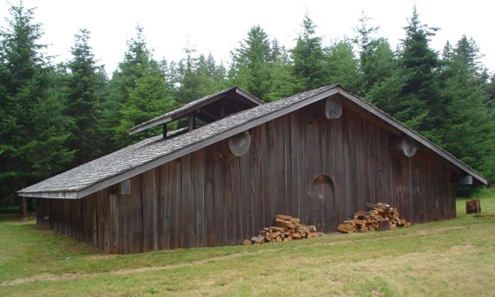
Rebuilding the Dance House
Building the Dance House in the 1990s
The Dance House Today
Notes:
Say: Years later, things began to change. Indian people across the country started to fight for their rights to practice their religion and celebrate their traditions. They organized, and eventually in 1978 convinced the U.S. government to pass a law protecting Native people’s rights to practice their religion. At Siletz, elders and leaders knew that to be a healthy community they needed a place to celebrate and gather together again. They needed a Dance House. They worked hard to teach everyone in the community about the importance of building a Dance House and continuing traditions. In 1996, after a lot of work, Siletz people officially opened a new Dance House on the reservation. Ever since, Siletz people of all ages have a place to learn and practice sacred traditions that are thousands of years old.

