Slide 1
GRADE 5 Not a Costume!

Slide 2
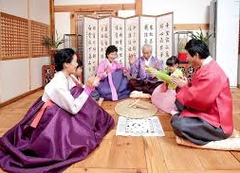
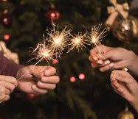
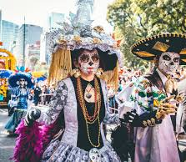
People celebrate their culture and heritage in many different ways!
Notes:
Say: We’re going to start today by learning a new word: regalia. Raise your hand if you have heard this word before. Regalia is a sort of fancy word that means special ceremonial dress. For most non-Native people, the word regalia comes up most often when talking about royalty or formal military attire. Indigenous people use the word regalia to talk about traditional clothing they wear during dances, ceremonies, and prayers. While the word regalia is rarely used in general society, it’s a common word to hear in the Native community.
Many cultures have special ways of dressing for different events, ceremonies, and traditions.
Can anyone think of any common examples of regalia in American society?

Slide 3
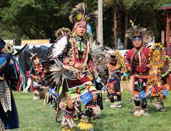
Traditions
What are some important traditions that have been passed down to you from your parents, grandparents, or community?
Notes:
Say: Maybe you have an example of a tradition shared with you by your family, caregivers, or community. What are some of the traditions or events that are important in your family or community? Are there special ways people dress at those events? Starting with partner A, please share with partner B a tradition or celebration you’ve experienced or seen others participate in, or ways important events are marked in your family and your community. Then it will be partner B’s turn to talk.

Slide 4
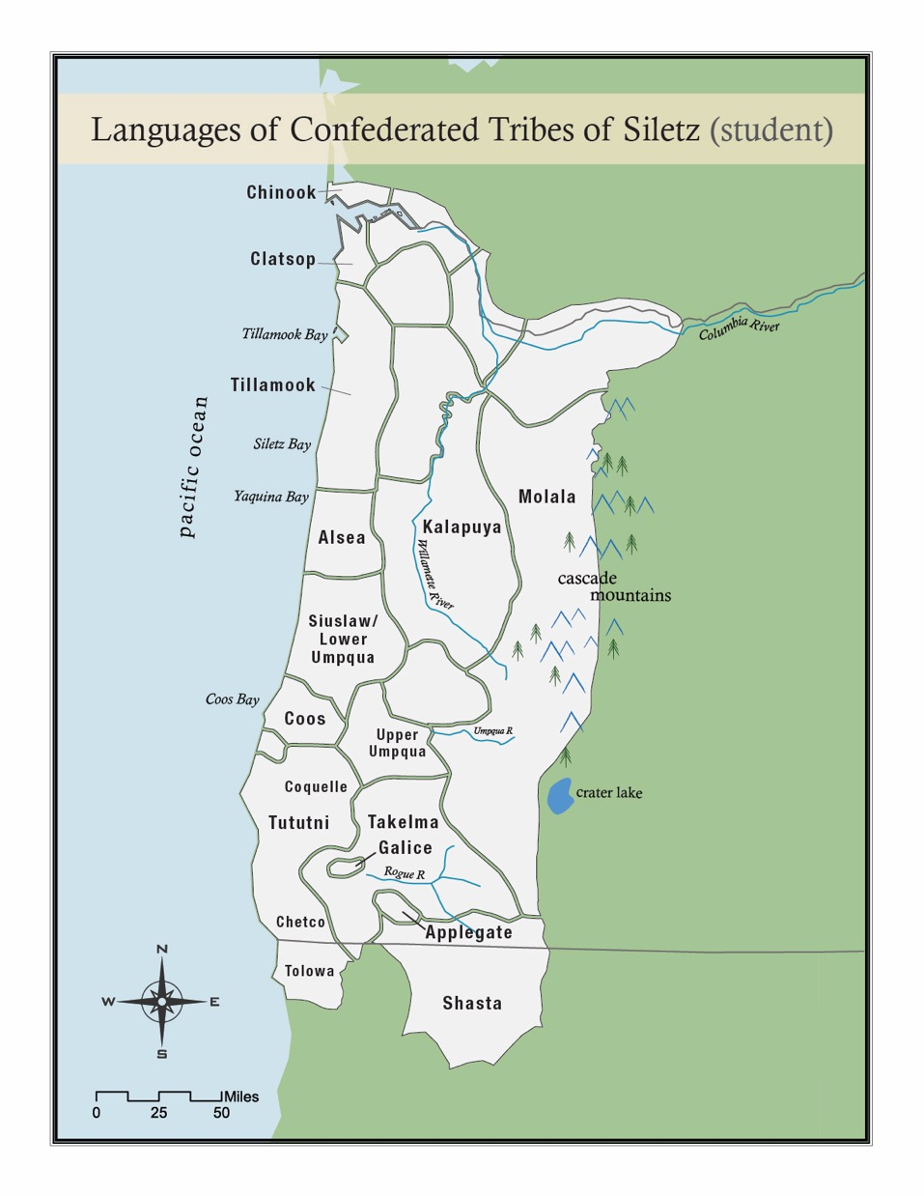
Our People
Notes:
Say: We’re going to learn more about the importance and meaning of regalia for people of the Confederated Tribes of Siletz Indians, which is a confederation of many different Tribes and bands from across Western Oregon.
Ask: Look at this map. Can you find where our town is in relation to the homelands of the Siletz people?
Say: In the 1850s, the government forced all these different Tribes onto a reservation at Siletz and made it difficult for people to continue their traditional beliefs. But Siletz people are strong and continue to carry on their traditions to this day. As part of those traditions, Siletz people continue to make beautiful regalia that is an important part of ceremonies and dances held each year. Siletz people helped to provide the information in this lesson so that you can learn a little bit about their traditions and beliefs

Slide 5
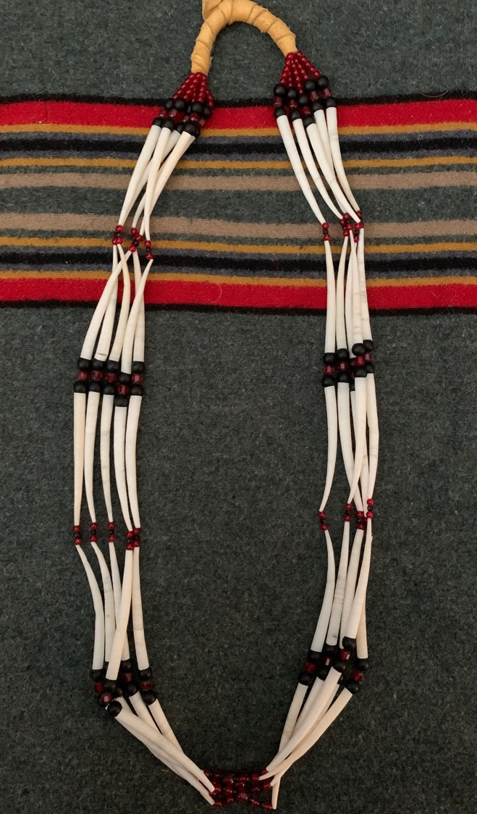
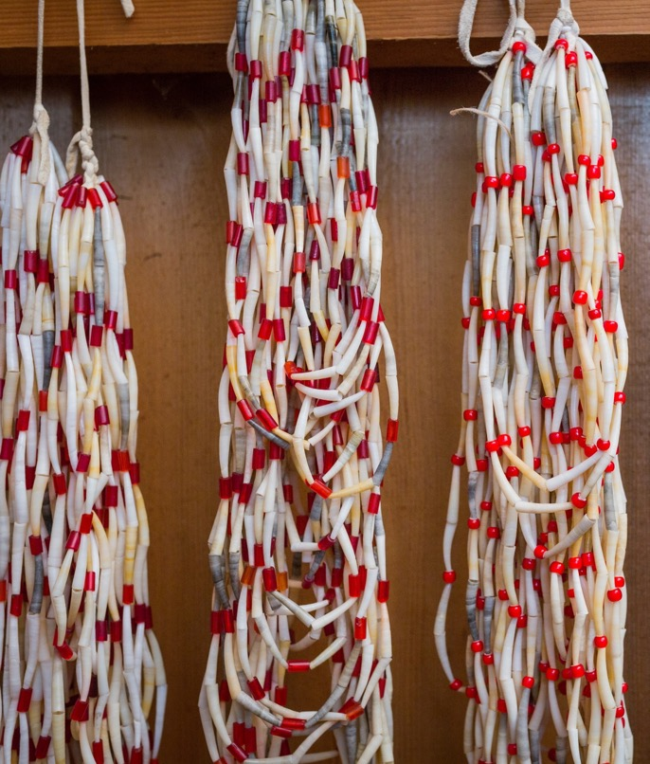
Indian Money
Notes:
Say: People who talk about and study Native cultures often view regalia as a form of wealth and sometimes even refer to certain pieces of regalia as “Indian money.” Here are some pictures of dentalium. Dentalium is a rare shell that has been traded up and down the West Coast for thousands of years. Native people string dentalium on long strands to make beautiful necklaces.
Ask: Some types of dentalium were more valuable than others. Which of these examples do you think was the most desirable?
Say: One reason that people sometimes refer to dentalium as Indian money is because in the old days, Native people used it to pay debts, arrange marriages, and resolve disputes. Things are different today, but Siletz people still exchange dentalium as ways to honor and repay each other. Even today, dentalium’s value is recognized by Natives and non-Natives alike, and it can fetch 50 cents to $2 per shell—and even more for larger shells
Photo: CTSI

Slide 6
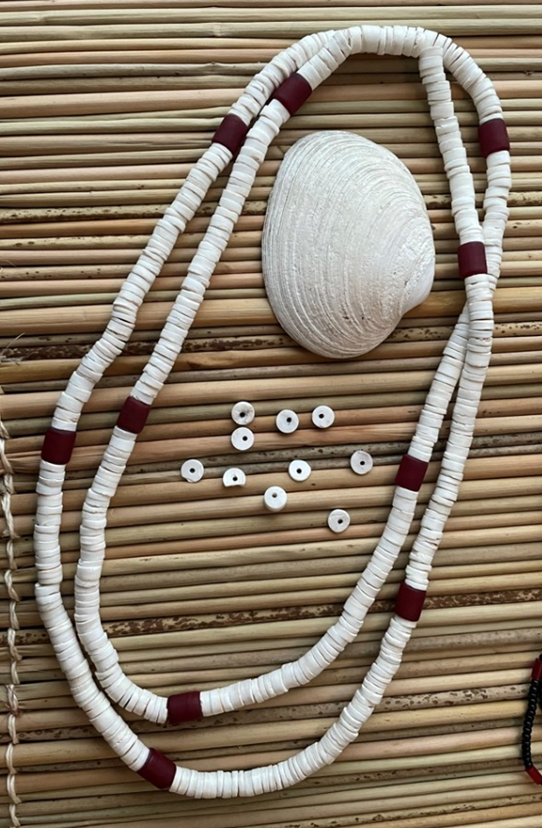
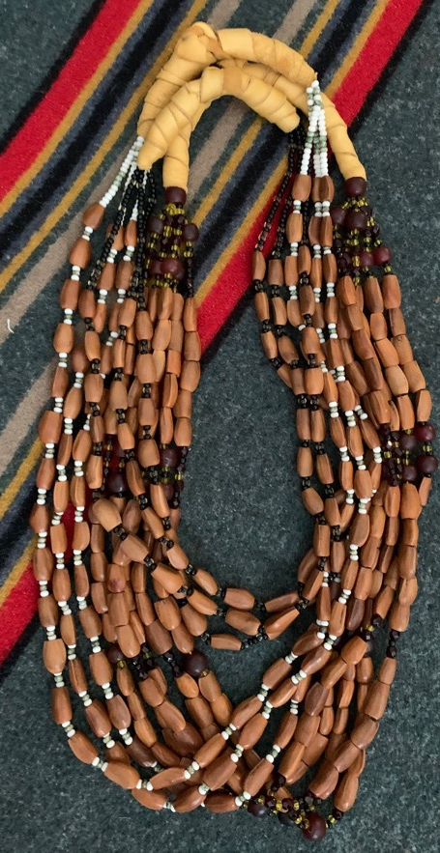
More Indian Money
Notes:
Say: Other types of regalia are also sometimes talked about as money. Beautiful headdresses made from woodpecker scalps, beads made from clamshells, and strands of beads made from pine nuts are also sometimes referred to as money. Together, regalia of all sorts is a form of wealth for Siletz people—and has been for thousands and thousands of years. But even though many people use English words like “money” and “wealth” to talk about regalia, that meaning is different than how the Tribe usually thinks of wealth.
Ask: What comes to mind when you think about the word “wealth” in American society?
Photo: CTSI

Slide 7
American Wealth
Notes:
Ask: Those are all good answers about what wealth means in American culture. Would you say that this picture pretty much sums up the meaning of wealth in American culture?

Slide 8
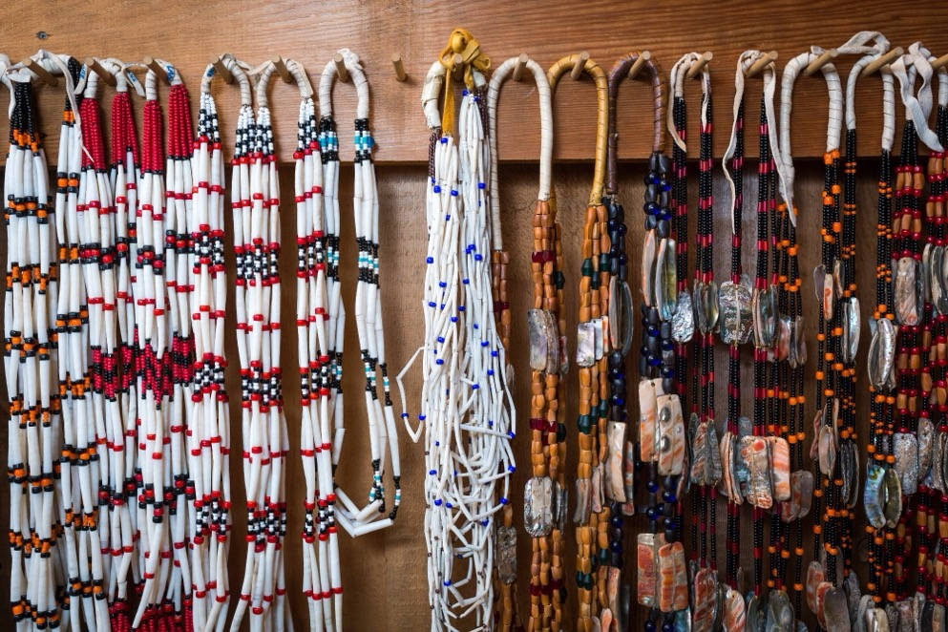
Indian Wealth
Notes:
Say: Thanks for sharing your ideas about wealth in the larger society. For many Native people, the meaning of Indian money or Indian wealth is different. That’s because regalia is not just something beautiful, something rare, or something that takes a lot of skill to make (although it is that, too). Most Native people think of wealth differently because regalia is tied to—and necessary for—ceremonies and dances that Siletz people believe keep our world strong and healthy. Regalia is a vital part of Siletz ceremonies. Having lots of regalia means being able to provide for the community by hosting these ceremonies. A wealthy person is a leader who can lend regalia to people who don’t have any so that they can participate in Siletz traditions, songs, and dances.
Photograph on left courtesy of CTSI Culture Department; Photograph on right by Frank Miller

Slide 9
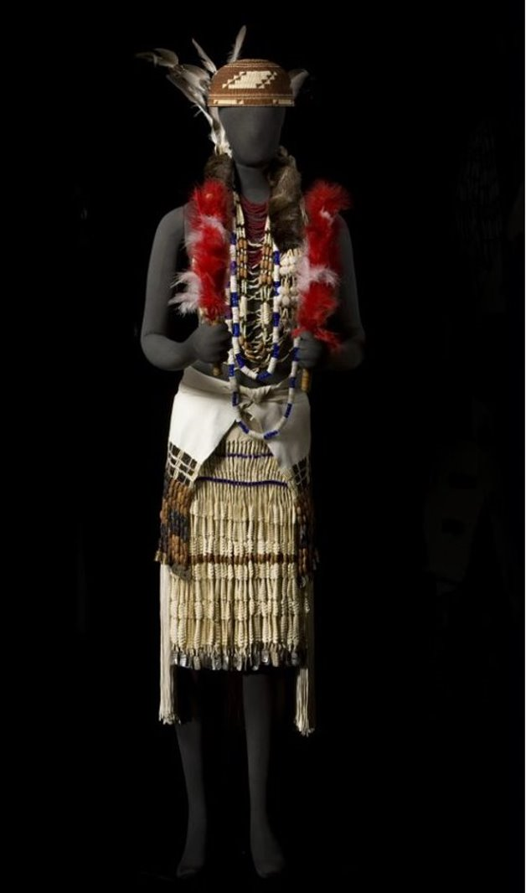
How would a museum or collector value this dance dress?
Notes:
Say: Let’s think a little more about the idea of value. Look at this beautiful dance dress made by Dee-ni families—one of the groups removed to Siletz from the Southern Oregon and Northern California coast.
Ask: How would a non-Native museum or collector value or put a price on this dress?
Say: Great discussion! In American society, value often comes from how rare and desirable something is. That can be true for Native people, too. It takes a lot of work to make these beautiful dresses. But value is more about the connections with the land and other Native people that regalia shows. To make a dress like this means collecting materials that can be hundreds of miles apart and may only be found in certain places and times of year. All these materials rely on a healthy, functioning ecosystem. You cannot make this regalia without natural resources
Photograph by Frank Miller

Slide 10
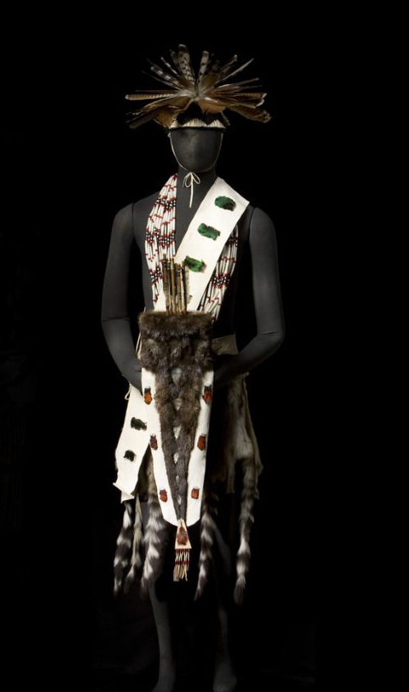
What elements from nature can you identify in the regalia?
Notes:
Say: Take a look at this regalia for a young man. This was also made by Dee-ni people and, like the dress in the last slide, is a big part of Nee-dash, or Feather Dance—an important dance and ceremony for people whose ancestors are from the Southern Oregon and Northern California coast. See if you can identify any of the things used to make this regalia.
Ask: What ecosystem do you think it might come from?
Say: Being able to make regalia like this shows that you know where to find the materials and how to care for the land, plants, and animals around you. The same is true for items that Siletz people might trade for. Beads and shells traded from afar show that Siletz people are connected to other Native people and are maintaining good relationships. I want to ask you about another thing.
Photograph by Frank Miller

Slide 11
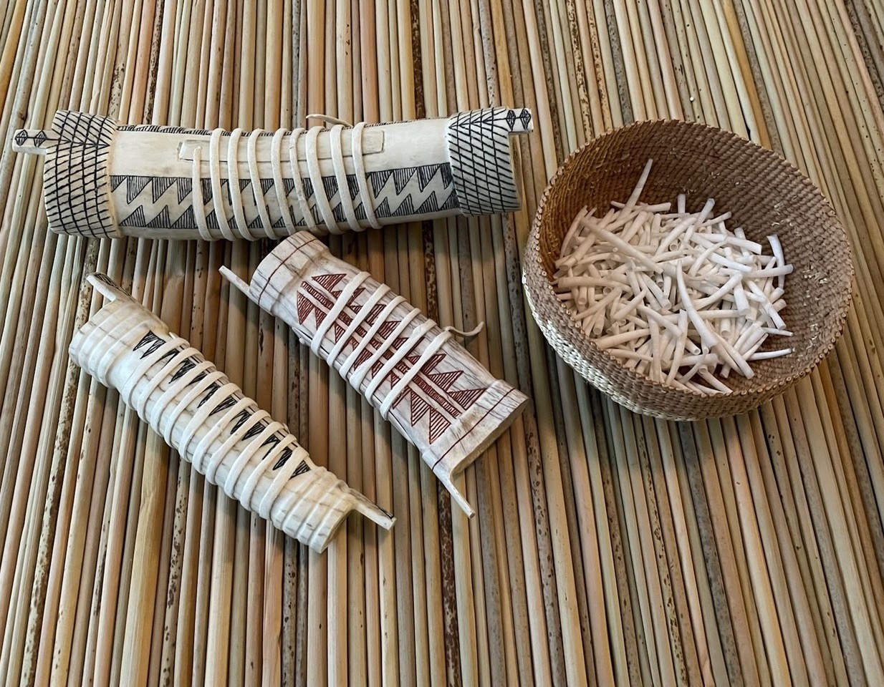
Precious Wealth
Notes:
Ask: Now that we’ve learned a little about the importance of regalia, how do you think that Siletz people take care of regalia?
Say: That’s right! Siletz people believe they have a responsibility to take care of regalia and keep it safe. This picture is of a special purse made from elkhorn that people have used to keep their dentalium safe for thousands of years. Part of taking care of regalia is making sure that it participates in ceremonial dance. When Siletz people talk about regalia, they recognize that the regalia itself needs and wants to dance. If you ever visit Siletz, you might hear, “This quiver danced last year.” Or, “That necklace needs to dance this winter.” Regalia are not just things to Native people. Hopefully, you are starting to see that while people sometimes call regalia “money,” no one today would ever try to use it to buy everyday things or services the way we use a dollar bill. Regalia is a form of wealth, but a special form of wealth that stays in families for generations. Wealth for Siletz people is about relationships and responsibilities to the community and ancestors. Regalia is about showing the finest things to connect the people today to an unbroken tradition that ties Siletz people to the land—now and for future generations.
Photo: CTSI

Slide 12
Why might it be harmful to a Native person to see someone dressing up like an Indian in pretend regalia?
What is the difference between regalia and a costume?
Notes:
Say: This often happens around Halloween, but that isn’t the only time. Sometimes even adults dress up in fake regalia at places like music festivals or sports games. Dressing up in pretend regalia hurts most Native people and makes them feel bad. To understand why this might be, let’s do some more thinking about what we’ve learned about regalia.
Ask: Why would it be harmful for a Native person to see a non-Native person dressing up like a Native American?
Say: Thank you for sharing your thoughts—I heard lots of good ideas! One way to think about this is that regalia is not a costume.
[Fade in the second question on slide 12.]
Say: Let’s think about the difference between regalia and a costume. A costume is something that you dress up in to pretend to be something you’re not. We now know that regalia is an important part of the Siletz people’s—and other Indigenous people’s—cultural and spiritual identity. And we know that dressing up in a costume and pretending to be Indian means ignoring that history and identity and pretending that it doesn’t exist. It makes Native people feel like they are being mocked and disrespected.

Slide 13
Examples
Notes:
Say: For this next activity, we’re going to design ways to educate other people about the harms of dressing up as Native American or pretending to be part of another group of people to have fun. I want you to look at these examples. These are posters that some college students made trying to convince people not to dress up as people from other cultures.
Ask: What do you notice about these posters? How do they convey their message?
Say: Now you’ll design your own poster using the information we’ve learned today. If you need ideas to get started, check out our brainstorm on the board.
Poster campaign created by Students Teaching About Racism in Society (STARS) at Ohio State University: https://www.ohio.edu/orgs/stars/Poster_Campaign.html

