Slide 1
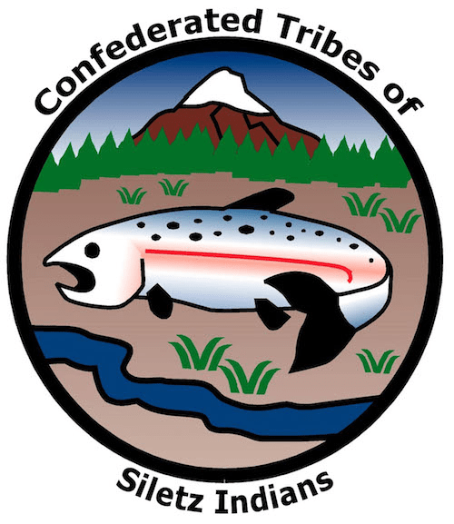

GRADE 6
Keystone Species:
Sea Otters

Slide 2
Food chains and food webs
Images source: iStockPhoto
Notes:
A food chain represents an integrated biological process through which organisms (called producers) capture energy and combine it with inorganic materials to manufacture food for themselves. Consumers are organisms that cannot manufacture their own food and thus eat producers or other consumers. Consumers that eat plants are called herbivores, while consumers that eat animals are called carnivores or predators. Consumers are called omnivores if they eat both plants and animals. Detritivores are decomposers that feed on waste and dead matter, reconverting them to inorganic materials for plants to use. A food web is a representation of the network of overlapping and cross-cutting food chains. Ecological communities with higher biodiversity form more complex trophic paths.

Slide 3
Trophic levels
Images source: iStockPhoto
Notes:
The trophic level of an organism is the position it occupies in a food chain. A food chain starts at trophic level 1 with primary producers such as plants. Herbivores are at level 2, and carnivores are at level 3 or higher, including apex predators at levels 4 and 5. The trophic systems of ecosystems are often depicted as ecological pyramids. In ecosystems where energy captured through photosynthesis enables organic life, the ecological pyramid illustrates the movement of solar energy through the trophic levels.

Slide 4
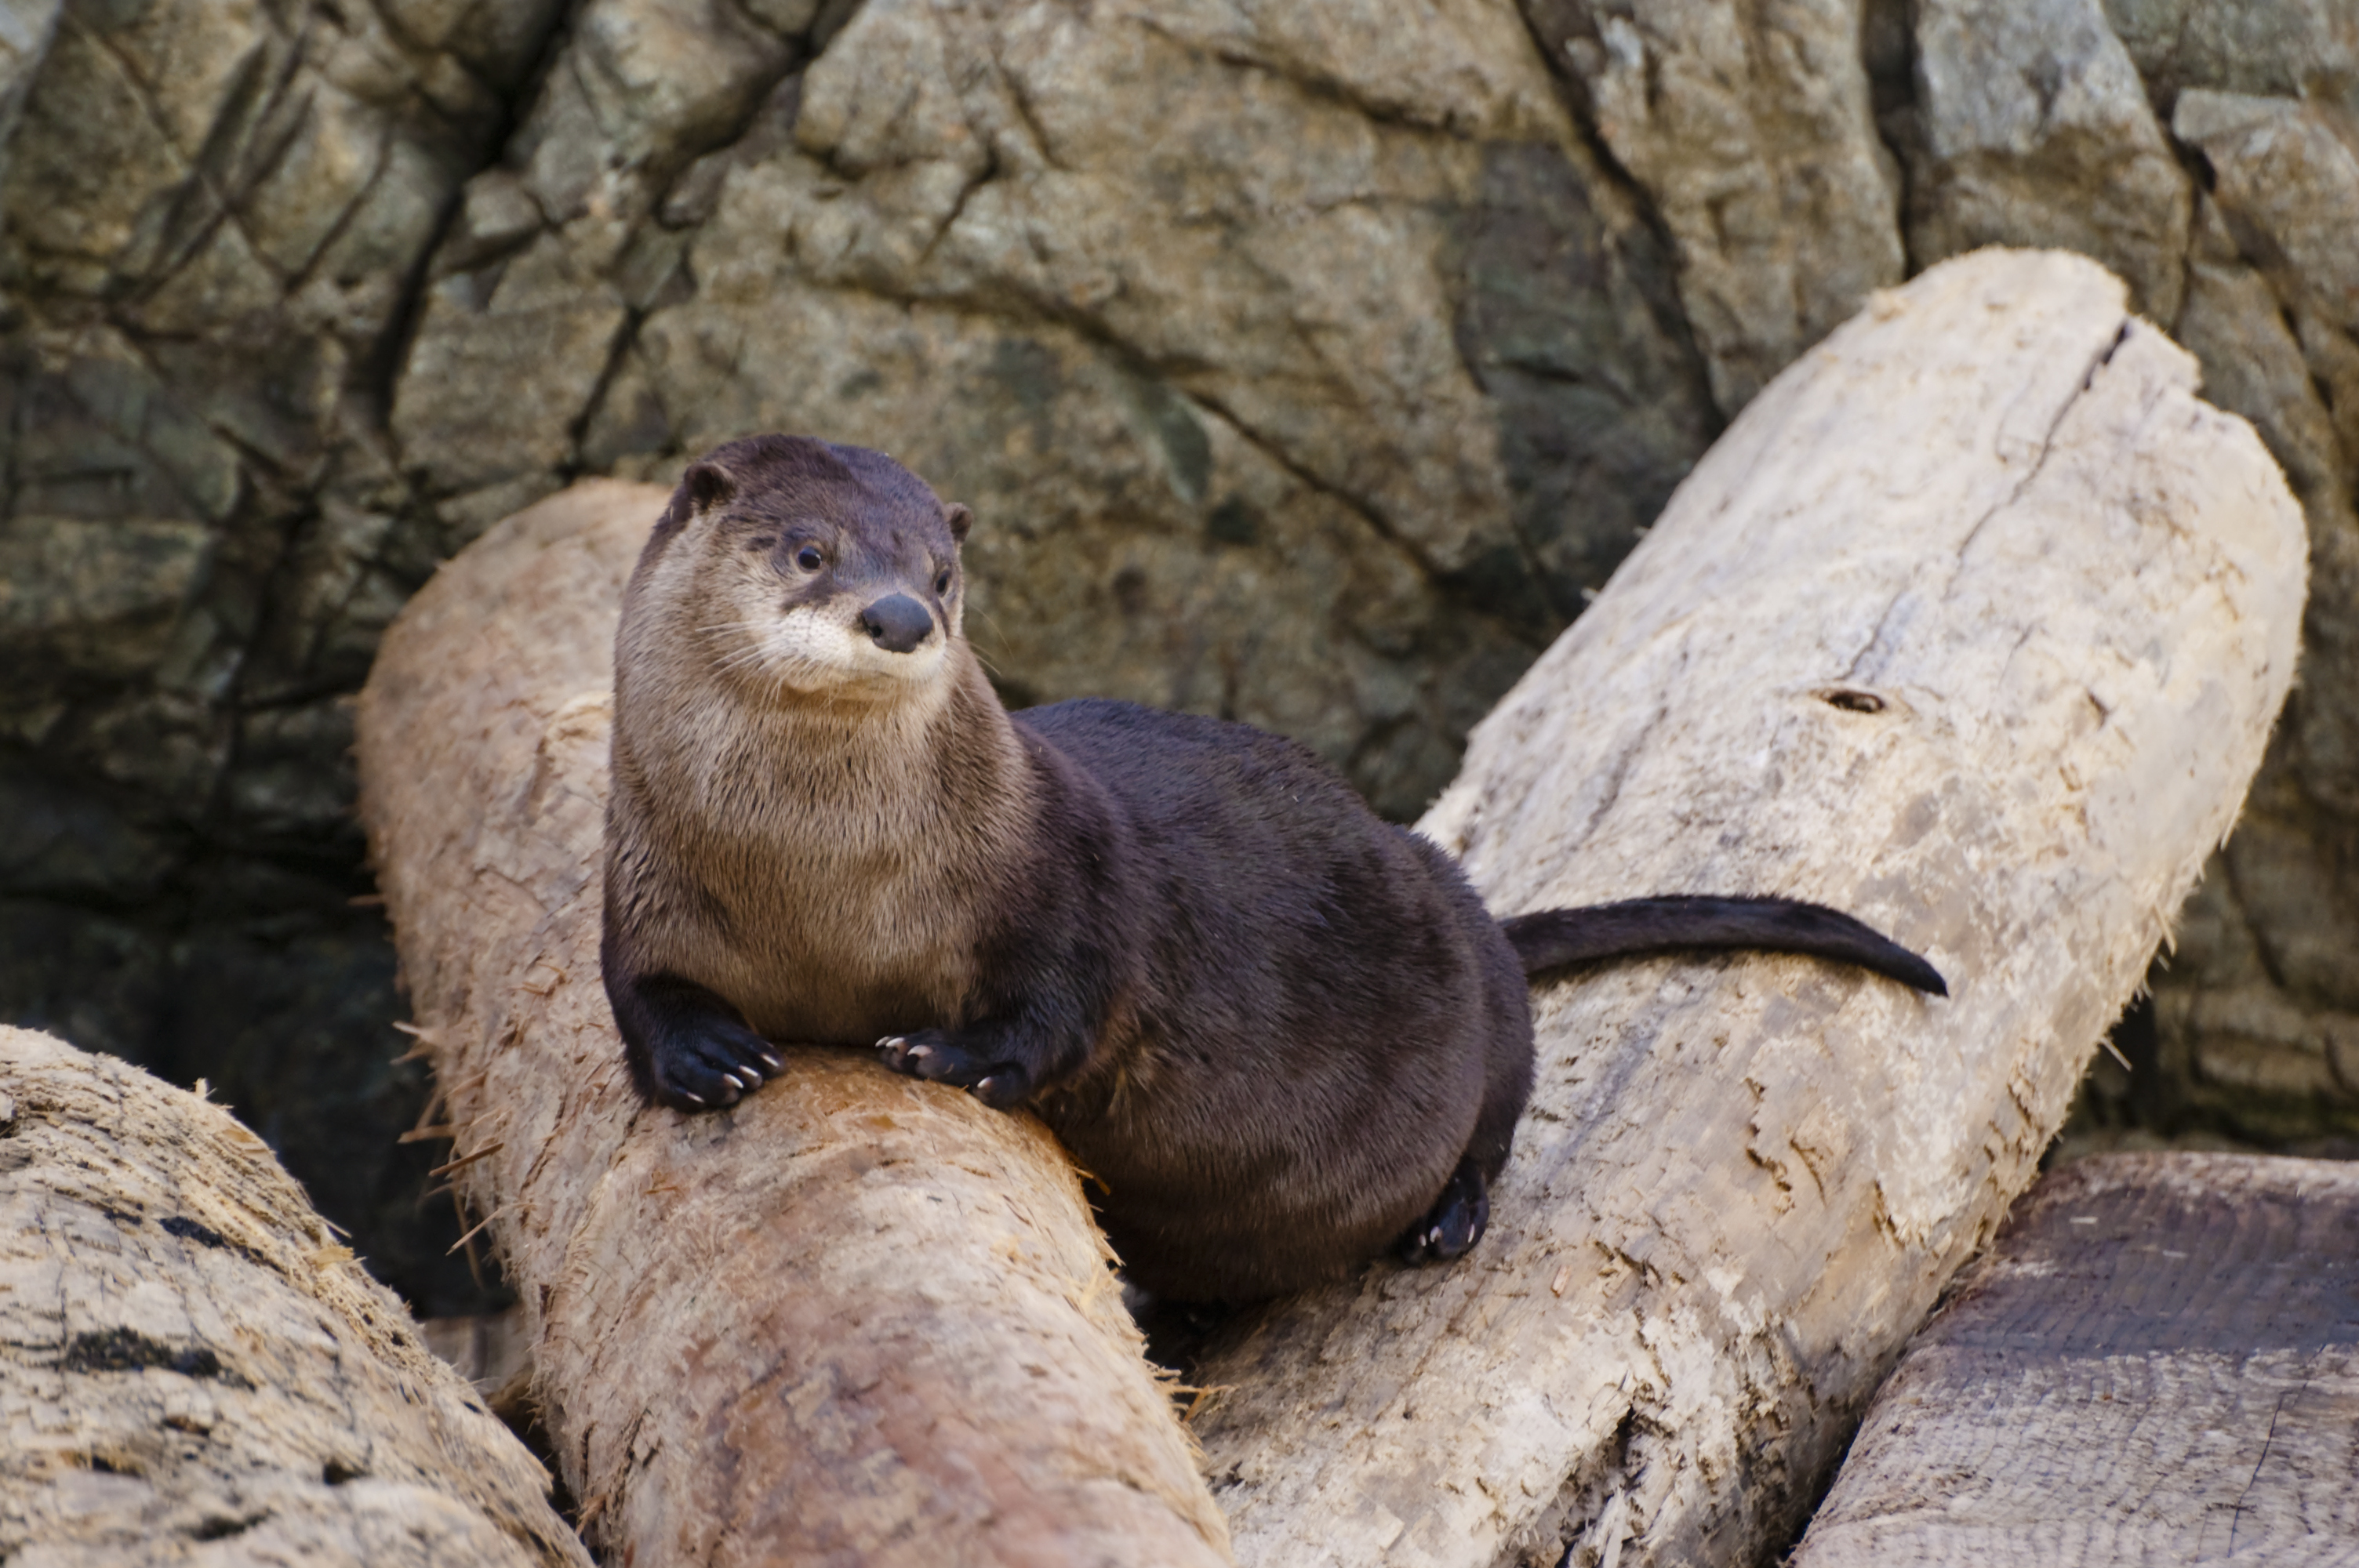
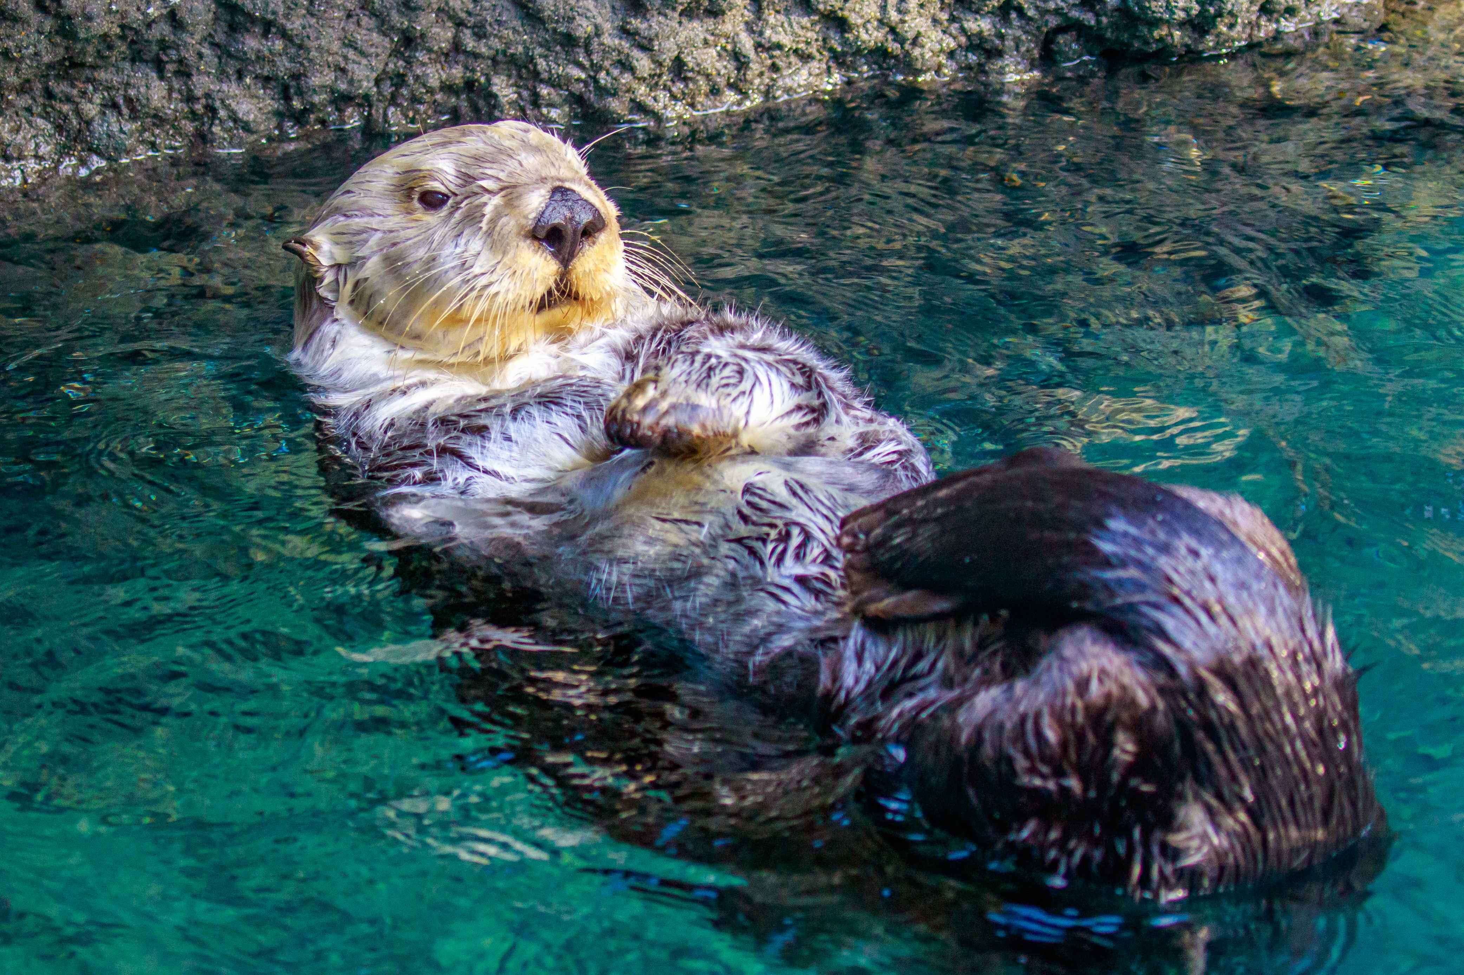
Otters in Oregon
North American River Otter
(Lontra canadensis)
Sea Otter*
(Enhydra lutris)
* Extinct in Oregon wild since circa 1910
Images source: iStockPhoto

Slide 5
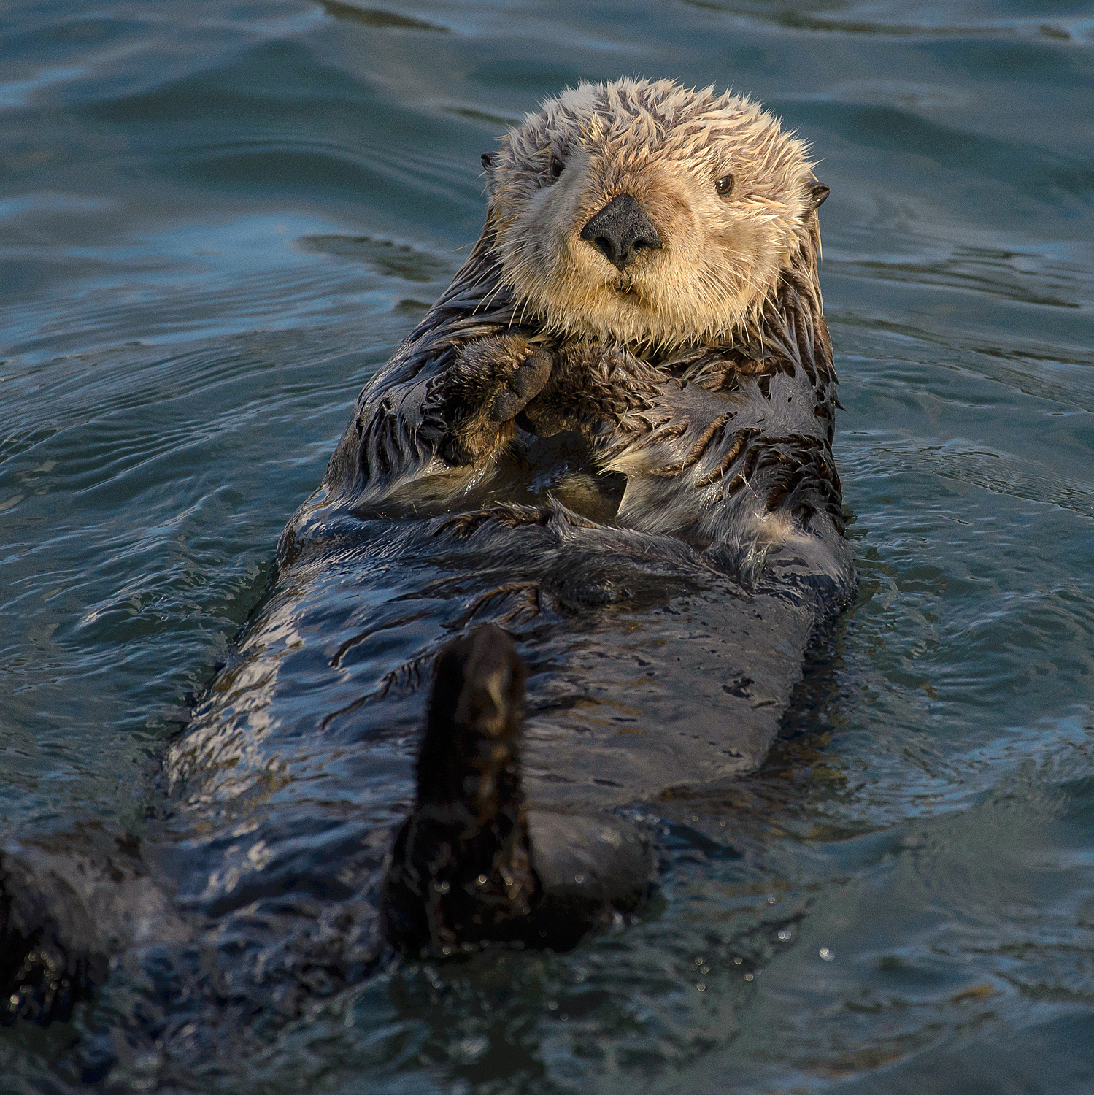
Otter essential facts
Member of the weasel family
4–4.5 feet long, 45–65 pounds
Have the densest fur of any mammal, which they rely on for insulation from cold ocean water
Very fast metabolism, eating a quarter of their body weight every day
Front paws have claws, hind feet are flipper-like for swimming
Eat crabs, clams, sea urchins, mussels, snails, abalone, sea stars, and some fish
Females normally give birth to a single pup once every one or two years
Source: Oregon Wild
Image source: Marshal Hedin from San Diego, Sea Otter (Enhydra lutris), CC BY-SA 2.0, https://commons.wikimedia.org/w/index.php?curid=64118169

Slide 6
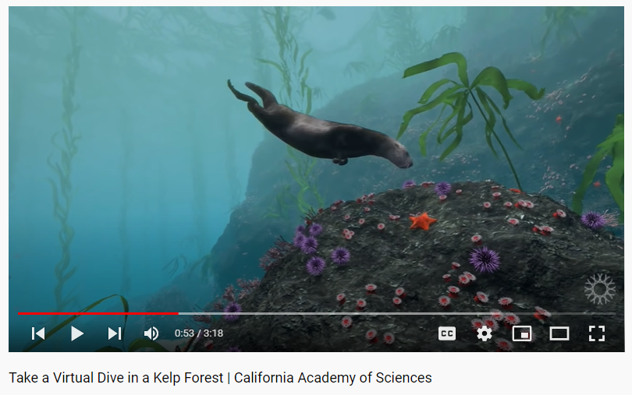
Sea otters and coastal ecology
Sea otters are considered a keystone species—a plant or animal species that is critical to the survival of other species
Sea otters help maintain ocean kelp forests by eating sea urchins that feed on kelp
Without sea otters to eat them, sea urchins can destroy kelp forests
Image and video source: California Academy of Sciences (via YouTube), https://youtu.be/HGMvPqfcDOk
Notes:
Sea otters are integral consumers in the coastal ecology of the Pacific Coast of North America. They are particularly essential to kelp forest ecosystems, where they feed on sea urchins, powerful primary consumers that can eat large quantities of kelp each day. If sea urchin populations are not controlled by sea otters or other predators, they can over-consume and destroy kelp forests. The loss of kelp deprives other species of food and shelter, reducing biodiversity and destabilizing the near-shore ecosystem. Ultimately, all life is impacted by the destruction of kelp forests since healthy kelp forests, like forests on land, capture and sequester planet-warming carbon dioxide.

Slide 7
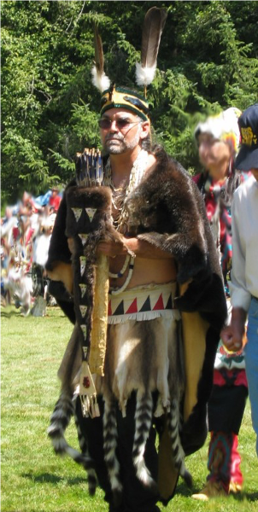
Sea otters and humans
The sea otter was once present along the entire Pacific Coast, from Northern Japan to Baja California
The thick pelt of the sea otter was a prized resource used by the Tribes of Siletz and other Native Americans to make clothing for both practical and ceremonial purposes
In addition to specific names in each Tribe’s native language, sea otters were called “elakha” in Chinuk Wawa, a trade language used by many Tribes in the Pacific Northwest
A sea otter-skin robe
Image source: Peter Hatch, CTSI
Notes:
(Same narration on slides 7 & 8) At one time there were thousands of sea otters along the Oregon Coast. But that’s not true today. Beginning in the 1700s, Europeans and later Euro-Americans began exploring the Pacific Coast. They learned about the large numbers of sea otters, beavers, and other fur-bearing animals in the region and their value in the international fur market. Early explorers traded with the coastal Tribes for pelts and brought them back to their home countries and cities, where they became a popular material for making clothing and accessories. People in China, Russia, England, Western Europe, and the Eastern United States wanted beaver hats and otter coats and shawls. Sea otter pelts were especially valuable to Euro-American merchants, who needed expensive goods that were popular in China to trade for tea, silk fabrics, and other luxury goods they could then sell in their home countries. Several Euro-American companies, such as the Russian American Company, the Hudson Bay Company, the North West Company, and the Pacific Fur Company established trading posts along the Pacific Coast to acquire fur pelts to sell. Independent merchants also struck out from ports like Boston to voyage around the world for sea otter pelts. Collectively, these ventures were called the maritime fur trade. Although Indigenous peoples on the entire Pacific Coast had hunted, trapped, and traded for sea otter, beaver, and other fur-bearing animals since time immemorial, this economic boom induced both Euro-American and Indigenous hunters to kill far beyond sustainable levels both here in Oregon and all around the Pacific Rim. From the 1740s until an international agreement outlawed the practice in 1911, sea otters were killed by the thousands and disappeared from many of their habitats. As a result, there are no sea otters living along the Oregon Coast today.

Slide 8
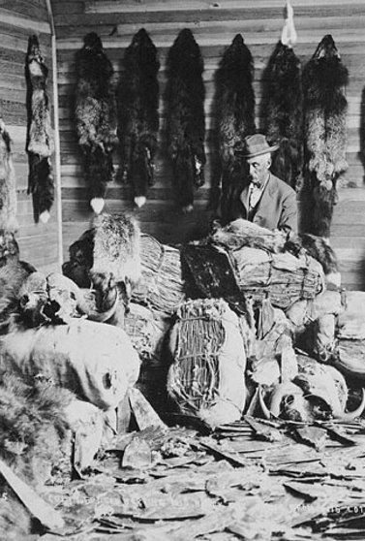
Sea otters and humans (Cont.)
Russian fur traders began large-scale hunts of sea otters in Alaska in the 1740s.
The pelts proved popular, and companies began trading and selling them all over the world.
On the Oregon Coast, the commercial sea otter trade began in 1788, when Captain Robert Gray traded with Tillamook people for sea otter pelts, which were traded for tea in Guangzhou, China
The fur trade (for sea otters and fur seals on the ocean and for beaver and river otter on land) drove European and Euro-American exploration, trade, and settlement in the Pacific Northwest for over 70 years
This had devastating consequences for many Northwest Tribes, and led to the extinction of the elakha on the Oregon Coast
Image source: Library and Archives Canada/C-001229. Public domain.
Notes:
(Same narration on slides 7 & 8) At one time there were thousands of sea otters along the Oregon Coast. But that’s not true today. Beginning in the 1700s, Europeans and later Euro-Americans began exploring the Pacific Coast. They learned about the large numbers of sea otters, beavers, and other fur-bearing animals in the region and their value in the international fur market. Early explorers traded with the coastal Tribes for pelts and brought them back to their home countries and cities, where they became a popular material for making clothing and accessories. People in China, Russia, England, Western Europe, and the Eastern United States wanted beaver hats and otter coats and shawls. Sea otter pelts were especially valuable to Euro-American merchants, who needed expensive goods that were popular in China to trade for tea, silk fabrics, and other luxury goods they could then sell in their home countries. Several Euro-American companies, such as the Russian American Company, the Hudson Bay Company, the North West Company, and the Pacific Fur Company established trading posts along the Pacific Coast to acquire fur pelts to sell. Independent merchants also struck out from ports like Boston to voyage around the world for sea otter pelts. Collectively, these ventures were called the maritime fur trade. Although Indigenous peoples on the entire Pacific Coast had hunted, trapped, and traded for sea otter, beaver, and other fur-bearing animals since time immemorial, this economic boom induced both Euro-American and Indigenous hunters to kill far beyond sustainable levels both here in Oregon and all around the Pacific Rim. From the 1740s until an international agreement outlawed the practice in 1911, sea otters were killed by the thousands and disappeared from many of their habitats. As a result, there are no sea otters living along the Oregon Coast today.

Slide 9
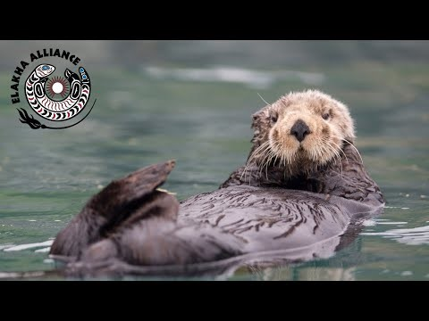
Cultural significance of sea otters
Image and video source: Elakha Alliance (via YouTube), https://youtu.be/ZyYH4KBHKU4
Notes:
The loss of sea otters has had a devasting impact on the coastal ecology of kelp forests in Oregon and on the traditional culture of Native people. Native people also valued sea otter pelts, making them into practical and ceremonial clothing that could demonstrate wealth or serve as important gifts. But sea otters were more than just a “resource” to the Indigenous people living along the Oregon Coast. In this video, Peter Hatch, a member of the Confederated Tribes of Siletz Indians explains more about the importance of sea otters to Native people and the work that Native people, and others, are doing to try and restore sea otters to Oregon.

Slide 10
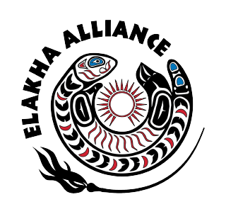
Restoring sea otters to Oregon
The Confederated Tribes of Siletz Indians and others are working together to bring elakha back
to the Oregon Coast
Tribal, nonprofit, and conservation leaders formed the Elakha Alliance in 2018
The alliance works to restore a thriving sea otter population and a robust and resilient marine ecosystem on the Oregon Coast
Image source: Elakha Alliance
Notes:
Recognizing the ecological and cultural value of sea otters for human life in Oregon, the Confederated Tribes of Siletz Indians and others are collaborating on a plan to reintroduce sea otters to the Oregon Coast. One such restoration initiative, the Elakha Alliance, takes its name from the Chinuk Wawa trading language word for the sea otter, elakha (ee-LAK-uh). The alliance was formed in 2018 by Tribal, nonprofit, and conservation leaders with a shared vision of restoring a thriving sea otter population and a robust and resilient marine ecosystem on the Oregon Coast for the benefit of current and future generations.

