Slide 1
Grade 11 Significance of Repatriation
Notes:
Say:
Repatriation is the act of returning someone or something to its place of origin. For example, many museums around the world hold objects and artifacts that were created by communities in other countries. Returning an object or work of art back to its country of origin is an example of repatriation. In this lesson, we are going to explore Native American repatriation and the return of cultural artifacts to Indigenous communities.

Slide 2
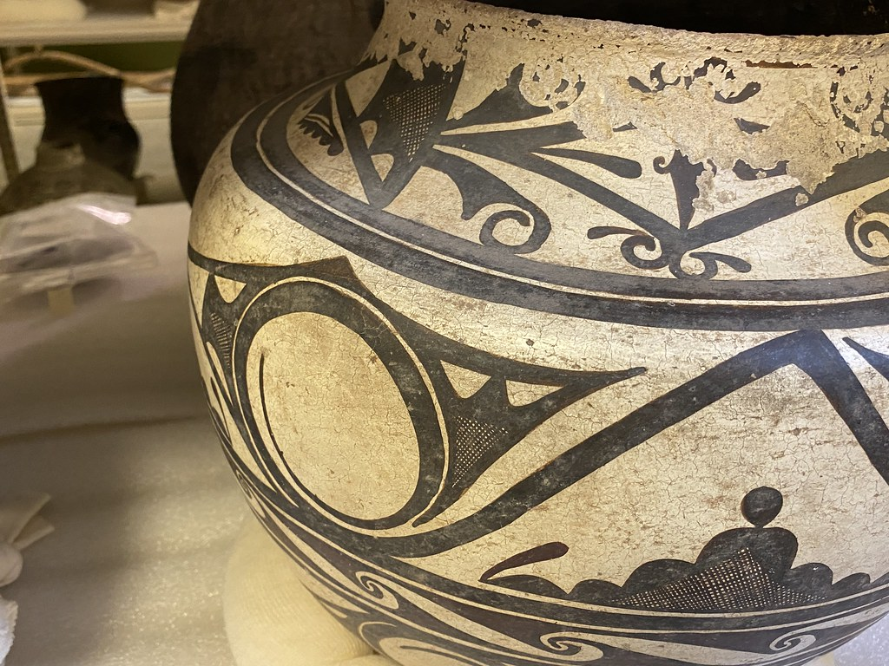
Repatriation
Repatriation - The return of someone or something back to its country of origin.
The return of Indigenous ancestral remains, their burial belongings, and sacred and cultural objects back to their original Tribes and lineal descendants.
Notes:
Say:
Repatriation is the act of returning someone or something to its country and people of origin. In this lesson, when we refer to repatriation, we are talking specifically about returning Indigenous ancestral remains, their burial belongings, and sacred and cultural objects back to their original Tribes and lineal descendants.

Slide 3
Tribal Advocacy
American Indian, Alaska Native, and Native Hawaiian peoples have been working to protect, access, and control their cultural resources for decades.
Tribal advocacy in the 1970s and 1980s led to the protection of Indian burial sites and requirements around repatriation.
Native American Graves Protection and Repatriation Act (NAGPRA) was enacted in 1990.
Notes:
Say:
American Indian, Alaska Native, and Native Hawaiian peoples have been working to protect, access, and control their cultural resources for decades. Tribal advocacy during the 1970s and 1980s led to Congress passing the Native American Graves Protection and Repatriation Act, or NAGPRA, which protects Indian burial sites and established a process for Tribes to request the return of human remains and cultural artifacts from museums and other institutions that receive federal funding.

Slide 4
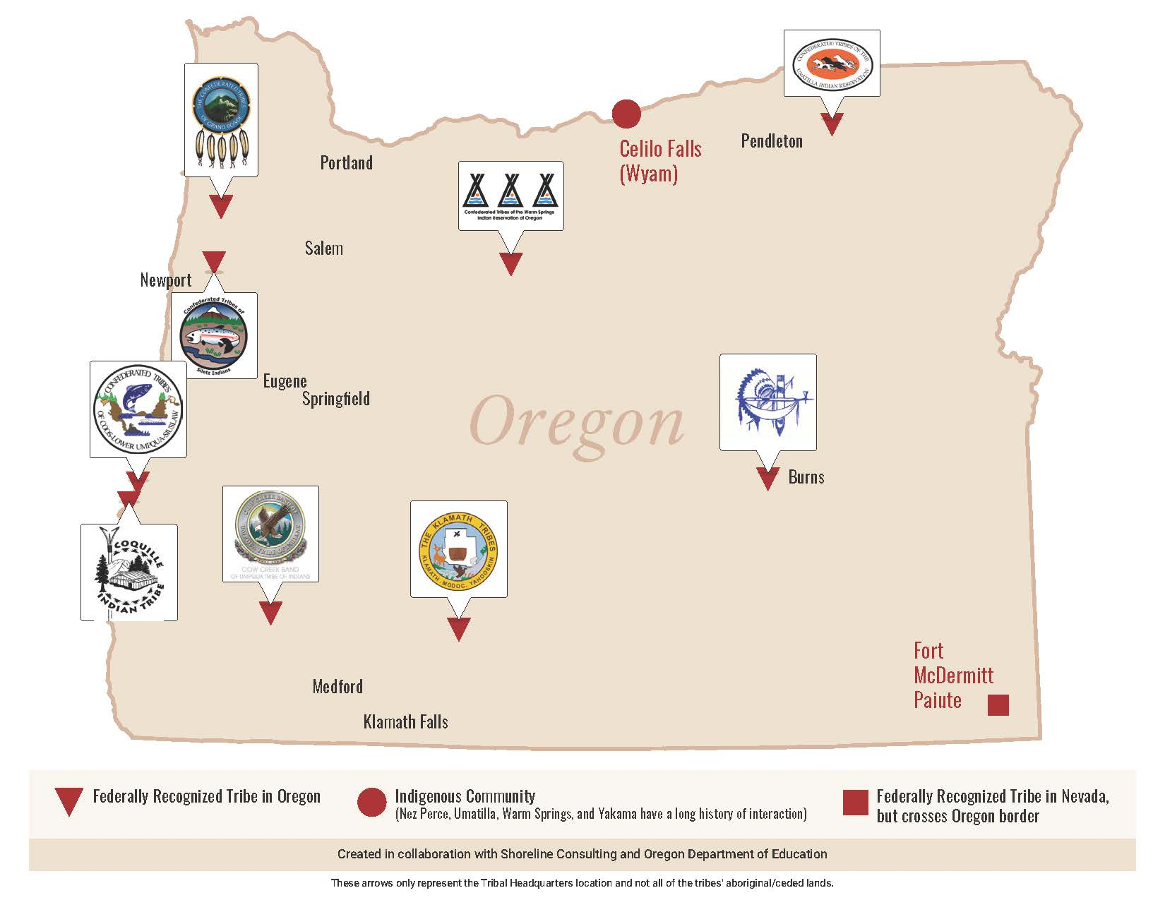
Key Concept: Tribal Sovereignty
Sovereignty - The inherent authority of a nation to govern itself.
Tribal sovereignty is the inherent right of a Tribal nation to create its own constitution, governance structure, and laws, and to negotiate government-to-government treaties and other legal agreements with other sovereign nations.
Notes:
Say:
To help us discuss repatriation, we’re going to explore two important concepts. The first is sovereignty, or the inherent authority of a nation to govern itself. Tribal sovereignty is the inherent right of a Tribal nation to govern itself—to create its own laws and legal agreements with other sovereign nations. In Oregon, there are nine federally recognized Tribal nations. When a Tribe requests the return of human remains or cultural artifacts, this request is not about returning personal property to an individual—it is a sovereign nation requesting the return of cultural resources that belong to them and that preserve their heritage and identity.

Slide 5
Key Concept: Living Culture
Native people continue to exist and thrive in the world today as individuals and Tribes. Indigenous people remain connected to their ancestral teachings, cultures, and languages and assume responsibility for the spiritual and cultural health of their communities.
Repatriation of cultural artifacts supports Indigenous communities by:
Validating the persistence of Indigenous knowledge and expertise
Supporting Native people learning and teaching about their cultures
Helping Indigenous communities recover from cultural and spiritual disruption
Notes:
Say:
Second, repatriation of cultural artifacts supports the health and vitality of Indigenous communities today. For many years, museums, movies, and popular culture have portrayed Indigenous peoples and cultures as primitive—something from the past. But Native people continue to exist and thrive in the world today, both as individuals and as Tribes. Indigenous people remain connected to their ancestral teachings, cultures, and languages, and assume responsibility for the spiritual and cultural health of their communities. Repatriation supports Native people and communities by:
• Validating the persistence of Indigenous knowledge and expertise.
• Supporting Native people learning and teaching about their cultures.
• Helping Indigenous communities recover from the cultural and spiritual disruption caused by colonization.

Slide 6
Repatriation and Cultural Heritage
“Culture is a living, dynamic, ever-changing and yet ever-constant thing—it is a story, a song, a dance performance, never a ‘dead thing’ to be represented in the form of an artifact to be looked at through glass.”
– Kalpana Nand, Education Officer of Fiji Museum
Repatriation of cultural artifacts helps Tribal nations and Indigenous communities preserve and revive cultural practices.
Notes:
Say:
Consider this quote from Kalpana Nand, Education Officer of Fiji Museum: “Culture is a living, dynamic, ever-changing and yet ever-constant thing—it is a story, a song, a dance performance, never a ‘dead thing’ to be represented in the form of an artifact to be looked at through glass.” Repatriation of cultural artifacts helps Tribal nations and Indigenous communities preserve and revive cultural practices that others attempted to erase or suppress through colonization.

Slide 7
Confederated Tribes of Siletz Indians
The Tribal cultural resources program:
Works to protect, promote, learn, and teach Siletz Tribal cultural heritage
Reclaim cultural artifacts
Support Tribal members learning and practicing Siletz culture and language
Notes:
Say:
The Confederated Tribes of Siletz Indians has worked for decades to care for cultural artifacts from their ancestors. Like many Tribal nations, they have a dedicated cultural resources program that works to protect, promote, learn, and teach their cultural heritage within the Tribal community and with the broader public in appropriate and considerate ways. This includes researching language and traditional practices (such as dance, basketry, ceremonies); reclaiming cultural artifacts; and supporting Tribal members learning and practicing Tribal culture.

Slide 8
Video Activity: Repatriation and Survivance
Watch: The Copeland Collection: Original artifacts from the Siletz Indian Reservation (0:00–13:46)
As you watch, consider these questions:
How are the regalia and other cultural artifacts described by the Siletz tribal members in the video? What is their purpose?
What is the significance of having access to these materials for the Siletz people in the video?
What impact do you think the decision to return materials to the Tribe had for Tribal people?
Notes:
Say:
We are now going to watch a video clip about the Copeland Collection—a collection of artifacts from people on the Coast (Siletz) Reservation that were part of the Lincoln County Historical Society collection but have since been loaned back to the Tribe with plans to eventually permanently return them to the Tribe. As you watch the video, consider these three questions:
• How are the regalia and other cultural artifacts described by the Siletz Tribal members in the video? What is their purpose?
• What is the significance of having access to these cultural materials for the Siletz people in this video?
• What impact do you think the decision to return materials to the Tribe had for Tribal people?

