Slide 1
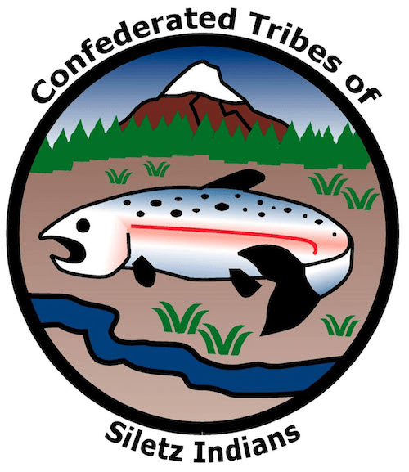
GRADE 2 Precious Canoes
Notes:
Say:
Today, we’re going to learn about how the Confederated Tribes of Siletz Indians have traveled, traded goods, and stayed connected to their rivers, the Pacific Ocean, and people living in other parts of Oregon.

Slide 2
Confederated Tribe
A confederated Tribe is composed of multiple Tribes and bands.
The Confederated Tribes of Siletz Indians includes dozens of bands of Native Americans from Western Oregon, Northern California, and Southwest Washington.
The Confederated Tribes of Siletz Indians have lived on this landscape since time immemorial.
Notes:
Say:
The Tribes of Siletz make up what is called a “confederated Tribe,” meaning a single government that is made up of multiple Tribes and bands from across Western Oregon as well as parts of Northern California and Southwest Washington. About 160 years ago, soldiers from the U.S. government and settlers forced all these groups to leave their homelands and live together on a reservation on the central Oregon coast with headquarters at Siletz. A reservation is a much smaller piece of land set aside for Indigenous people as a permanent homeland.
Today, the children and grandchildren of those people make up the Confederated Tribes of Siletz Indians.

Slide 3
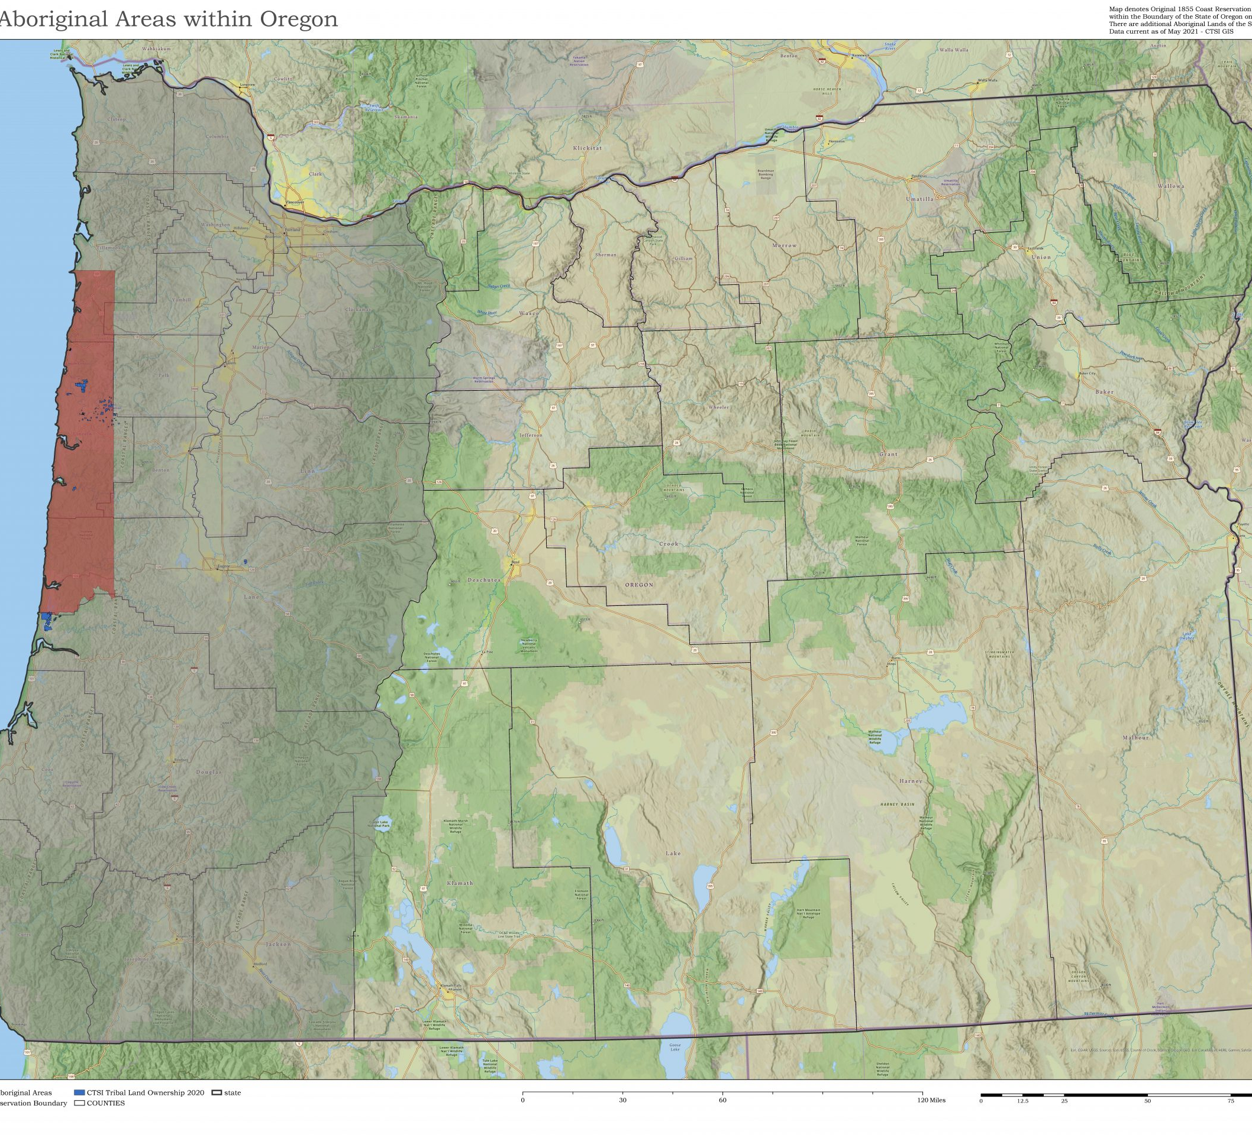
Notes:
Say:
What does this map show? [Pause and allow students to answer.]
Oregon! Every mountain, river, lake, and valley in the gray-shaded area represents the original lands where the peoples who make up the Confederated Tribes of Siletz Indians once lived.
The red part of the map shows the Coast (Siletz) Reservation where these groups were forced to move after the U.S. government made them leave most of their homelands in exchange for a new permanent home on the reservation. Some relatives from the same Tribes were also sent to live on the nearby Grand Ronde Reservation.
Before this time, the Siletz peoples lived all throughout this area as separate groups or Tribes all connected through family ties, trade, and stewardship of the surrounding land.
Does anyone know what stewardship means? [Pause and allow time for students to answer.]
Stewardship is the job of taking care of something, such as the land. As you can see, before the Tribes were forcibly moved to the reservation, they lived up and down the Pacific Coast and inland along rivers and streams. In those days, people did not use cars or airplanes to visit their friends and families. Instead, they used these waterways to get from one place to another.

Slide 4
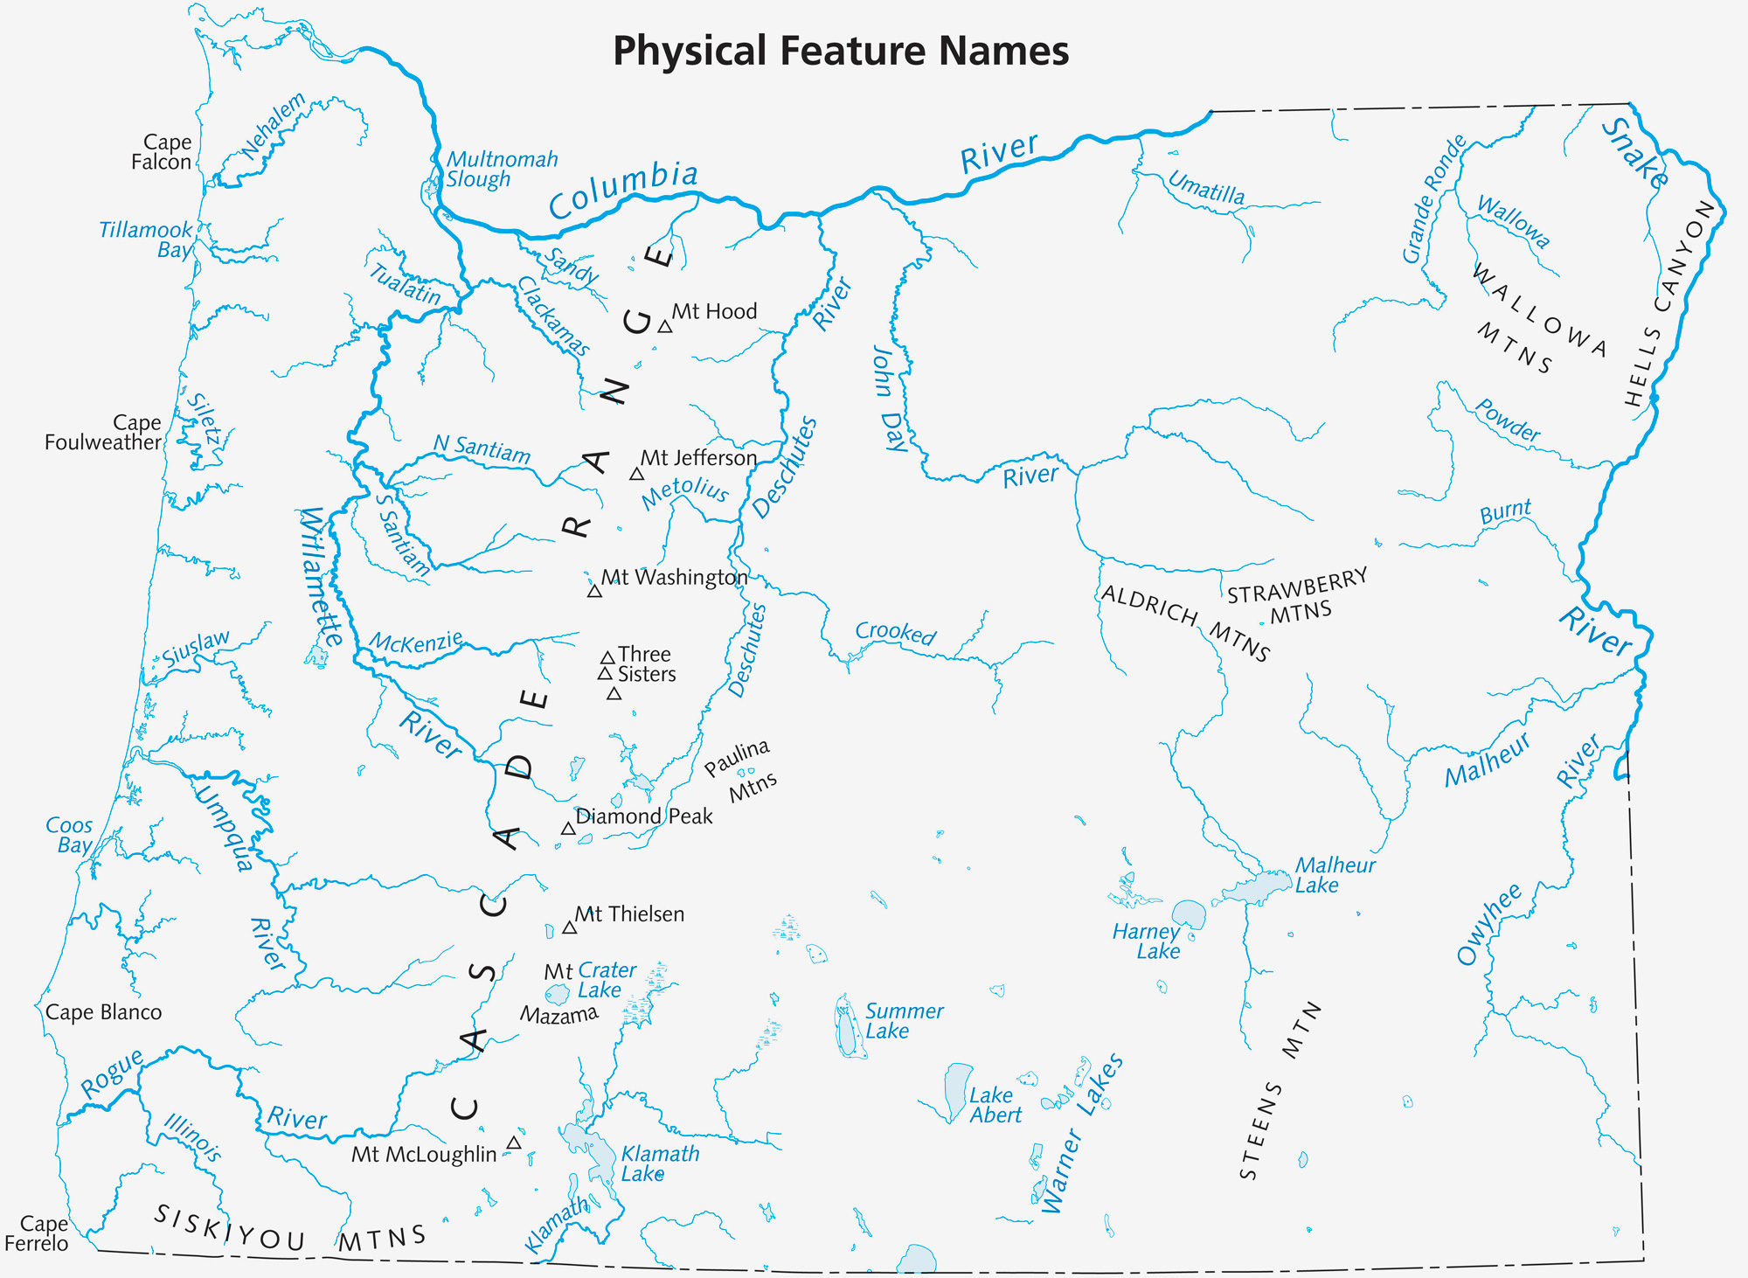
Notes:
Say:
Look at this map. Imagine if you and your family lived here at Tuu-tuu-dvn village (red circle) on the Rogue River and you wanted to visit your cousin who had just had a baby, but they lived 175 miles away up the Oregon Coast at Miit-tsuul-stik village, where Newport is now (red star).
Remember, there are no cars. How would you travel to see the new member of your family and be able to bring lots of gifts along with you?
[Ask students to turn to a classmate next to them and discuss their ideas. Invite students to share with the whole class.]
Say:
Great ideas! One way would be to travel by [Click 1] canoe. Canoes can be carried on land and can float in lakes, rivers, and oceans. Canoes are especially important to the Native people of Oregon. Before cars, trains, and planes, the lakes, rivers, and ocean were the original highways for the Tribes. Look again at this map: See how all the rivers and the ocean make it easy for people to travel long distances with canoes?
[Image source: https://sos.oregon.gov/blue-book/PublishingImages/facts/almanac/map-physical.jpg]

Slide 5
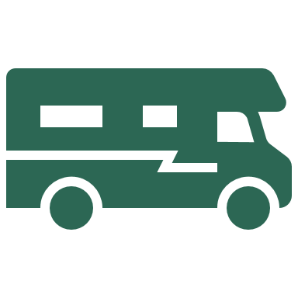
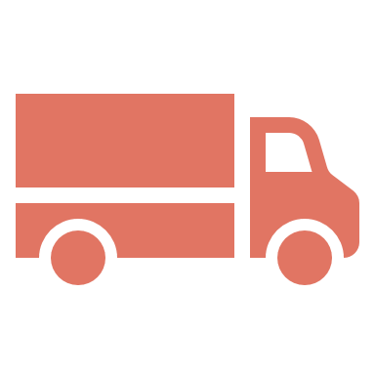
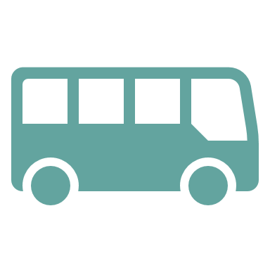
There are many types of cars for many different purposes
Visiting family across the country
Carrying a heavy load
Riding to school with classmates
Driving to the grocery store down the road
Notes:
Say:
Today, we use many types of cars for many different purposes. We might travel in an RV to visit family members who live far away; drive a truck when we are carry-ing a heavy load; ride in a school bus with our friends and classmates on our way to school; or drive in a small car to pick up groceries down the road.

Slide 6
Many types of canoes
Gathering/hunting for food
Exercising
Visiting friends and family
Trading goods with others
Notes:
Say:
Just like we have different cars for different purposes, Siletz people use diverse types of canoes for different purposes. Canoes help them gather and hunt for food, get good exercise, visit friends and family, and trade goods with one another

Slide 7
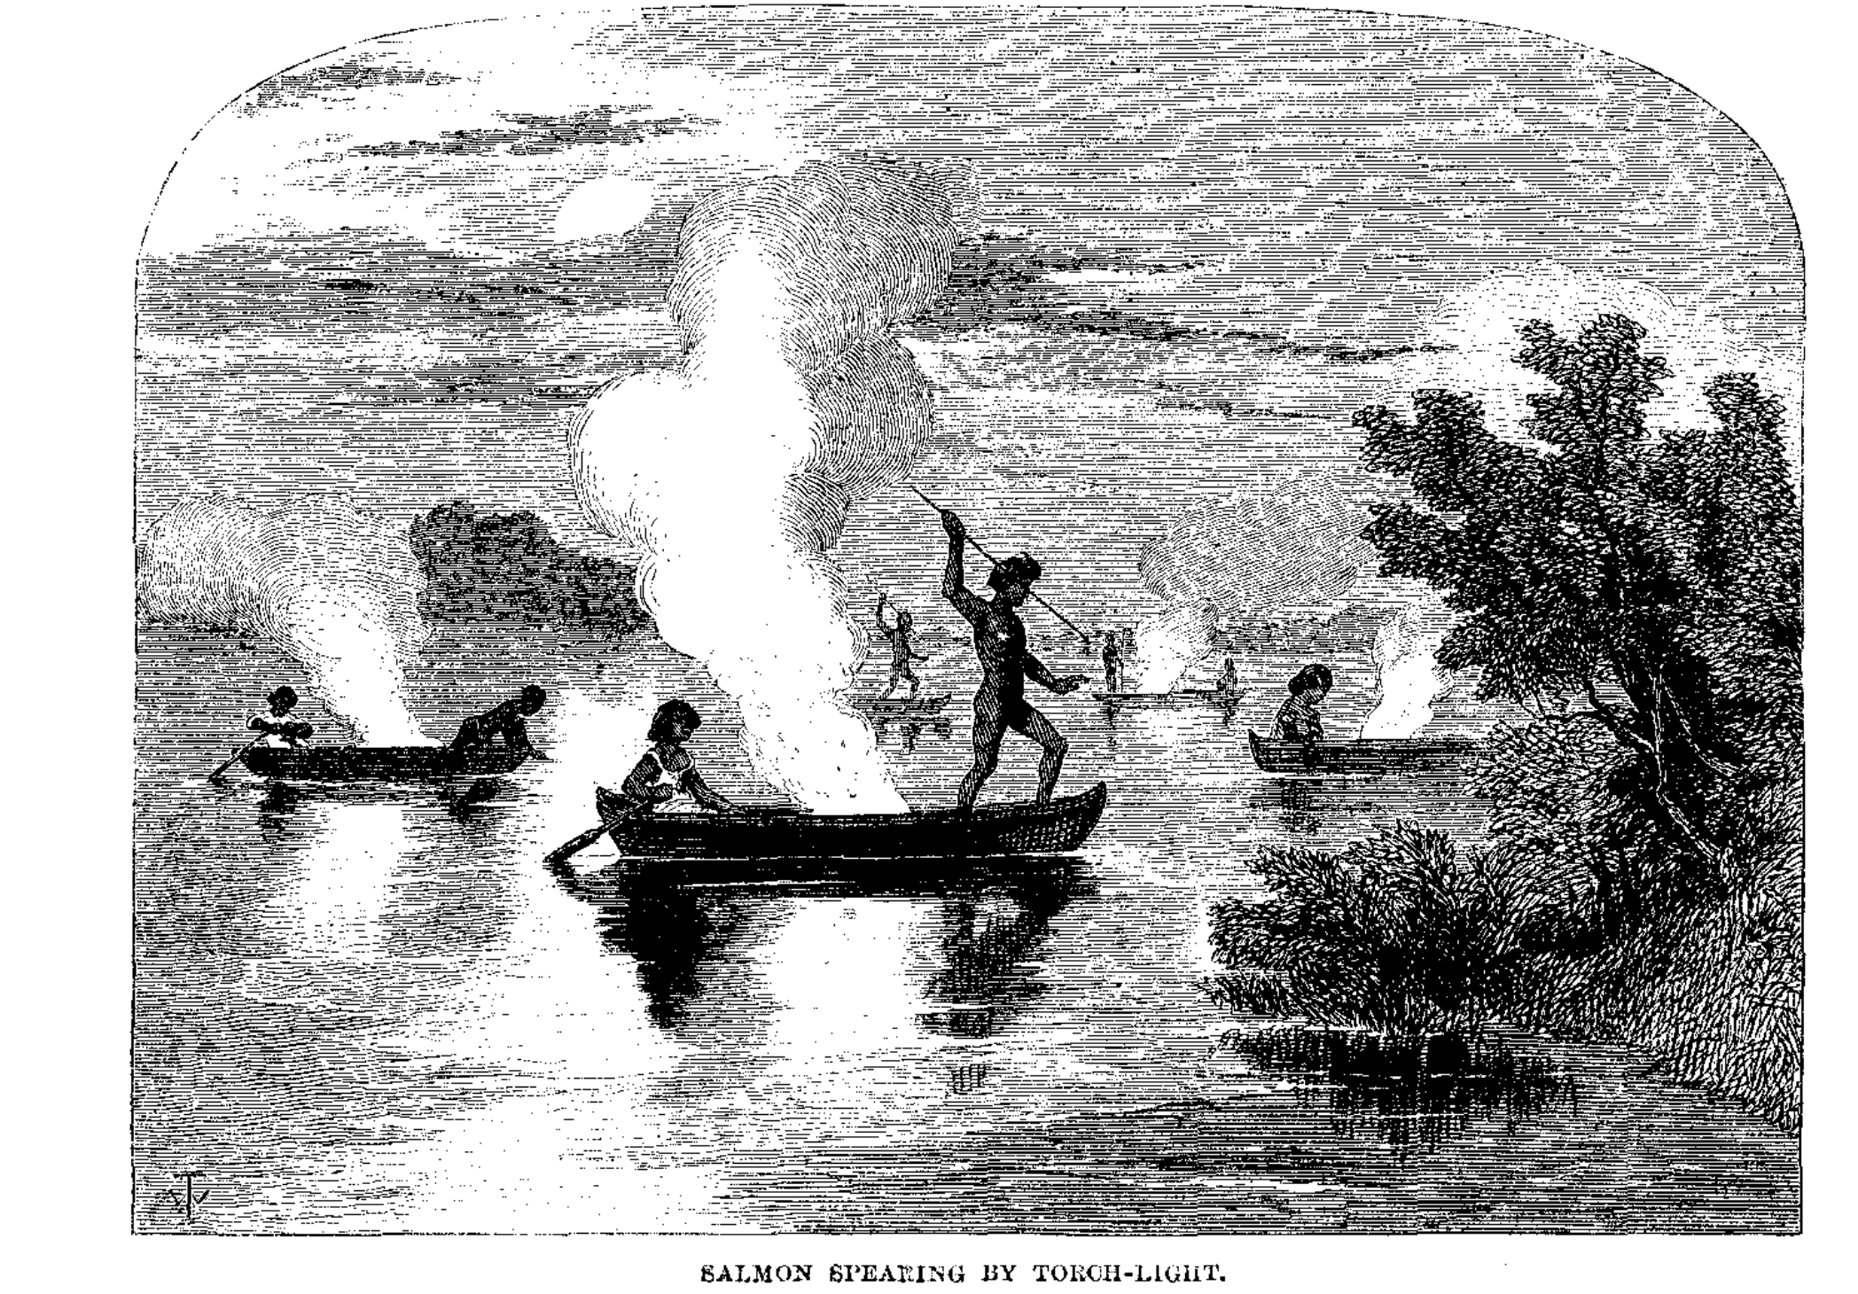
Small canoes for bays
Won’t tip easily
Operated by one or two people
The Hanis People from Coos Bay make small canoes to navigate the calm waters, hunt, search for clams, and visit friends
Artist's depiction of night fishing on Coos Bay, 1856
Notes:
Say:
Some canoes are small, won’t tip over easily, and can be operated by just one or two people. For instance, Hanis People from Coos Bay (pictured here) make small canoes to navigate the calm waters, fish, search for clams, and visit friends nearby. These canoes are good for calm waters but would not be safe in the open ocean.

Slide 8
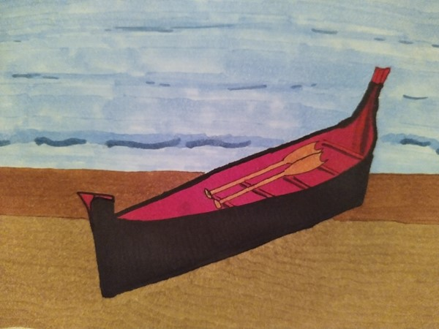
Big, ocean-going canoes
Can take more than 12 people into open oceans
Used to troll for salmon, jig for halibut, gather seagull eggs, hunt sea lion
Used for long journeys to visit relatives and trade with neighbors
Chinook-style ocean-going canoe (Zoe Gifford)
Notes:
Say:
That is why there are also big canoes. Ocean-going canoes can fit more than 12 people and can safely travel far into the open ocean. This type of canoe is used for fishing salmon and halibut, gathering seagull eggs on faraway rocks, whaling, hunting sea lions, or visiting far-off friends and relatives.
The Alsea and Chinook people from the Northern Oregon coast are famous for making this type of canoe. A long time ago they traded these canoes all up and down the coast to help other people who wanted to safely navigate the ocean

Slide 9
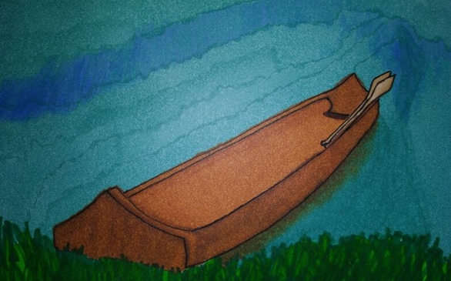
Shovel-nosed canoes for rapids
Can turn easily
Used for net fishing
Made by Dee-ni people from Southern Oregon
Rogue river canoe (Zoe Gifford)
Notes:
Say:
There are many rivers in Oregon that are full of roaring rapids. Shovel-nosed ca-noes like the one illustrated here are great for this body of water because they are easy to turn. The Dee-ni (Athabaskan) people from Southern Oregon are known for making this type of canoe, which is good for fishing with nets or short trips up and down the river.

Slide 10
Notes:
Say:
Let’s look at the canoes side by side. What do you notice about the shapes of the canoes? How are they similar? How are they different? Turn to a partner and discuss.

Slide 11
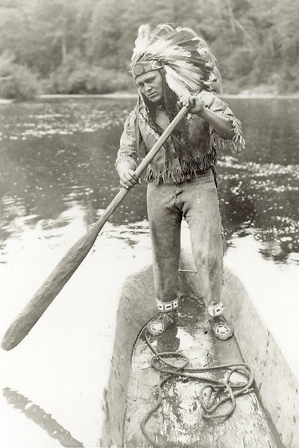
Slow-moving rivers
Used for hunting ducks
Used to carry people down river
Photo shows Siletz Elder Coquelle “Tommy” Thompson Jr. in a river-style canoe
Notes:
Say:
There are also many slow, easy-going rivers in Oregon. Some canoes are perfectly made for these. They carry people down river and are also used for hunting. This is a picture of a Siletz ancestor, Coquelle “Tommy” Thompson Jr., in a river-style canoe. An ancestor is a family member who has come before. All our relatives, going back to great-great grandparents and beyond, are our ancestors
Image Source: Confederated Tribes of Siletz Indians

Slide 12
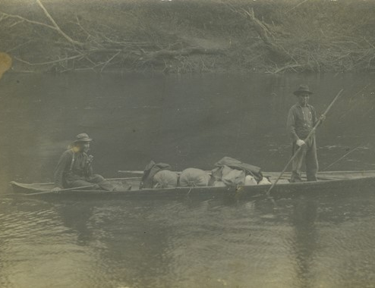
Traveling by canoe takes knowledge!
In the ocean:
Understand the different kinds of waves
See signs that the weather might change
Understand the pattern of the tides
Notes:
Say:
Your parents and grandparents need to be aware of the conditions outside when they drive. They need to know how to drive slowly if it’s snowing or raining. They need to pack the right clothes, so they don’t get too hot or cold. This is the same for traveling by canoe!
To safely travel by canoe in the ocean, you need to understand the different kinds of waves, recognize if the weather might be changing, and understand the pattern of the changing tides
Image Source: Confederated Tribes of Siletz Indians

Slide 13
Traveling by canoe takes knowledge!
To safely row a canoe on a river you need to know:
How to navigate rapids
How to avoid dangerous places in the river
How much strength is required to paddle against the river
When to carry the canoe because obstacles are too big
Notes:
Say:
To safely paddle a canoe on a river you need to understand how to “read a river” or know how the water moves, how to steer in rapids, avoid dangerous places in the river, have the strength to paddle against the river, and have the wisdom to know when to carry the canoe when obstacles are too big. In some places, children started practicing young by trying to balance in a small canoe in the surf.

Slide 14
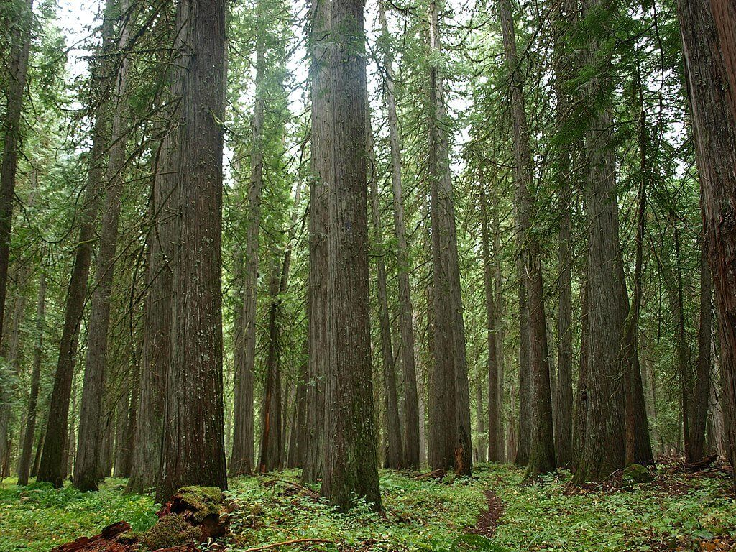
Building canoes takes knowledge!
Correct angles to carve
Right kind of wood to use
How to care for the canoe
How to avoid cutting down too many trees
Western red cedar tree is traditionally used for canoe building
Notes:
Say:
Not only do people need to know how to travel by canoe, but they also need to know how to properly carve and care for canoes. Siletz people are careful to carve the right angles, use the right type of wood, and not cut down too many trees so others can build canoes, too.
Photo source: https://www.montananaturalist.org/blog-post/the-power-of-the-western-red-cedar/

Slide 15
Notes:
Say:
Rather than learn to share the land with the Native people, newly arrived settlers were focused on the rich natural resources they could sell, like animal furs, gold, and then land, without respect for the rights of the people who already lived there. Settlers attacked Native people and forced them to leave their homes.
Remember this map from earlier? The gray-shaded area shows where many Tribes and bands of Native people who became the Confederated Tribes of Siletz Indians once lived throughout Western Oregon. After settlers came, they were forced to move to a much smaller territory called a reservation. You can see the reservation here in red.

Slide 16
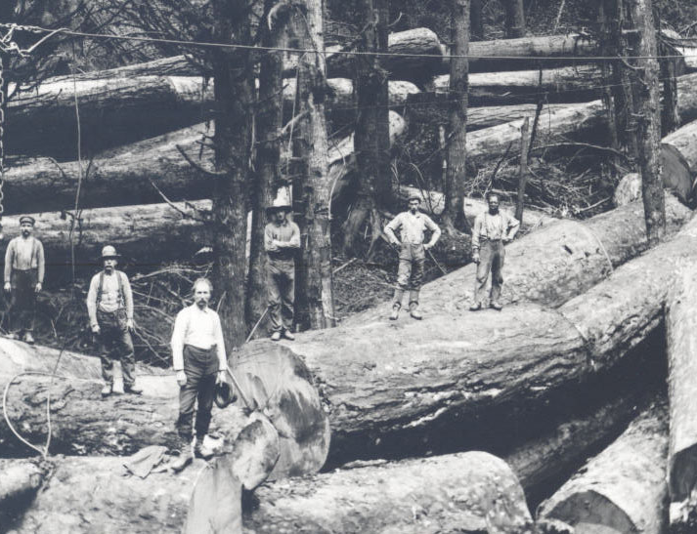
A tradition attacked
Settlers stole, burned, and sank many canoes
For more than 150 years, the Siletz people were discouraged from practicing their culture and passing along the tradition of canoe-making
Many of the biggest old growth trees in Oregon have been cut down and turned into lumber
Notes:
Say:
When settlers took Native people’s land, they also took their canoes! They didn’t want Native people to be able to travel around anymore. Settlers stole, burned, and sank many canoes. For more than 150 years it was illegal for the Siletz people to practice their culture or pass down the canoe-making tradition to their children. Sadly, many of the big logs used to make the canoes have also been cut down and turned into lumber
Image source: https://www.oregonencyclopedia.org/articles/timber_industry/#.YhMDy-jMLb0

Slide 17
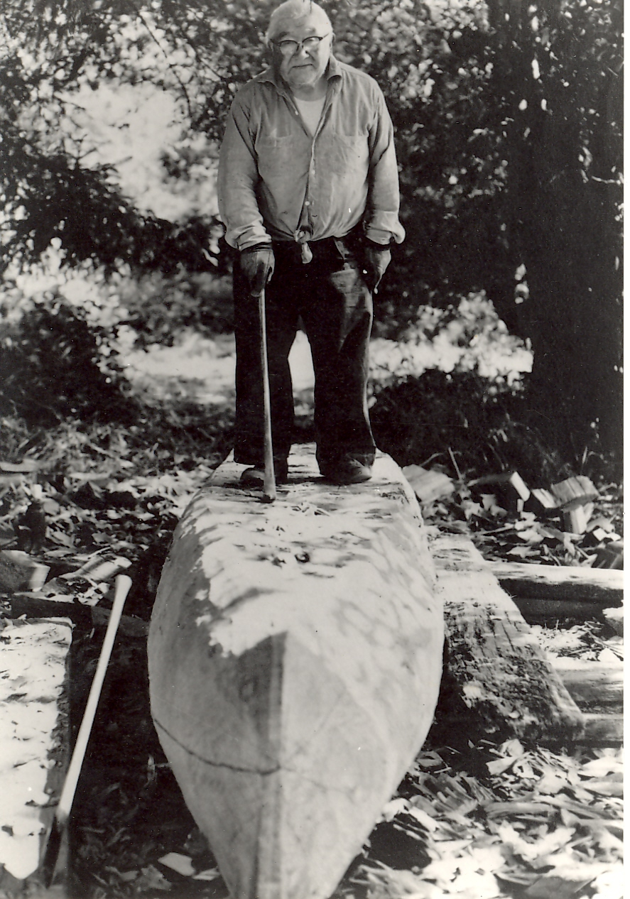
Can you imagine?
Notes:
Say:
Students, I want you to think about what it must be like to not be able to practice your traditions—the things that make you, you! Take a moment to think about the ways your family learns from each other, celebrates big occasions, gets old and young people together, or connects with what your ancestors have always done—your traditions
[Facilitate a whole-class discussion.]
Image Source: Confederated Tribes of Siletz Indians

Slide 18
Let’s review! Just as there are many types of cars for different purposes, there are many types of canoes …
Oceans
Bays
Rapids
Rivers
Notes:
Say:
Wow, we’ve learned so much today! We now know that, just like there are many types of cars for different purposes, there are many types of canoes. There are special canoes made for oceans, bays, rapids, and calm rivers.

Slide 19
Let’s review! The Tribes of Siletz need to know …
How to navigate the surrounding waters
What type of canoe they need
How to build and care for a canoe
Notes:
Say:
To safely travel by canoe, the Siletz people need to know how to navigate the surrounding waters, the type of canoe they need, and how to build and care for a canoe so it lasts a long time

Slide 20
Let’s review! Canoes are important for the Tribes of Siletz because …
They help Tribal members visit their families
They allow Tribal members to hunt for food to survive
They can be used for trade
They provide good exercise
They are a reminder of important cultural traditions
Notes:
Say:
Canoes are important to Siletz people because rivers, oceans, bays, and rapids used to be the “original highways” of Oregon. Canoes helped people visit their friends and families, hunt for food, and trade with each other. Paddling in canoes is also great exercise! Nowadays we have roads and cars for traveling, but canoes remain an important tradition for the Tribes of Siletz.

Slide 21
Notes:
Say:
Remember this map from earlier? The Siletz people have used canoes to navigate this exact route—from Cape Foulweather along the ocean to the Rogue River. What type of canoe do they need to safely navigate this trip?
[Answer: Big ocean-going canoe that can carry lots of people and stay upright in the ocean.
Image source: https://sos.oregon.gov/blue-book/PublishingImages/facts/almanac/map-physical.jpg

Slide 22
Today
Native American people from all over the Pacific Northwest want to build and see more canoes in the water
Canoes remind Native American people to stay connected with one another and remember their traditions
Notes:
Say:
Native people from all over the Pacific Northwest want to see more canoes in the water. Canoes remind the Siletz people to stay connected with one another and remember their traditions.
We have talked today about how Native people travel in canoes and a little bit about why canoes are so important. Before settlers came, Native people traveled in canoes to visit family, trade with neighbors, go to celebrations, arrange wed-dings, fish, hunt, and whale. Today, Siletz people use cars to get around most of the time or use other kinds of boats to get food from rivers and oceans or just for fun.
Many families still like to travel by canoe. Canoes remind Siletz people of their connection to the rivers, ocean, and shores of their homelands, and they help them build and maintain relationships with each other and other Native people. Plus, canoeing is good exercise! And it’s better for the environment—gas engines can leak oil and gas into the water, but paddling doesn’t. Boats are difficult to steer on to shallow beaches ... but not canoes! Canoes are still an important part of Siletz culture. Now we’re going to talk about your own travel experiences. Where have you traveled? How did you get there? Why did you travel?

