Slide 1
GRADE 2 Baskets
Notes:
Say: I want you to think about all the things you carry around in an average day—your homework, your lunch, your water. What do you use to carry these everyday items? [Pause to give students time to answer.]
We seldom think about the containers we use throughout the course of a day, nor do we think about how these items are made. Today, we’re going to learn about the essential containers used by the Confederated Tribes of Siletz Indians and how the Siletz people traditionally make and use baskets for many purposes.

Slide 2
Confederated Tribe
A confederated Tribe is a federally recognized Indian tribe composed of multiple Tribes and bands.
Notes:
Say: Let’s learn a little more about the Confederated Tribes of Siletz Indians. The Siletz Tribe is a “confederated Tribe,” meaning a single government that is composed of multiple Tribes and bands. In the case of the Confederated Tribes of Siletz Indians, those Tribes and bands came from many different places, ranging from Northern California through Western Oregon and into Southwest Washington. About 160 years ago, soldiers from the U.S. government and settlers forced all of these groups to leave their homelands and live together on a reservation on the Central Oregon coast with headquarters at Siletz. Today, the descendants of those people make up the Confederated Tribes of Siletz Indians.

Slide 3
Confederated Tribes of Siletz Indians
The Confederated Tribes of Siletz Indians includes dozens of bands of Native Americans from Western Oregon, Northern California, and Southwest Washington.
The Confederated Tribes of Siletz Indians have lived on this landscape since time immemorial.
Notes:
Say: Each Tribe and band within what is now the Confederated Tribes of Siletz Indians had its own unique traditions and history and its own ancestral territory—the place its people had lived since time immemorial. What do you think that phrase means: since time immemorial? [Pause to allow students time to think and respond]. Tribal memories and history were traditionally told through oral storytelling that goes back thousands of years, rather than through printed texts, as in some cultures. This phrase means that the Tribe’s history goes back even farther than those oral histories explain.

Slide 4
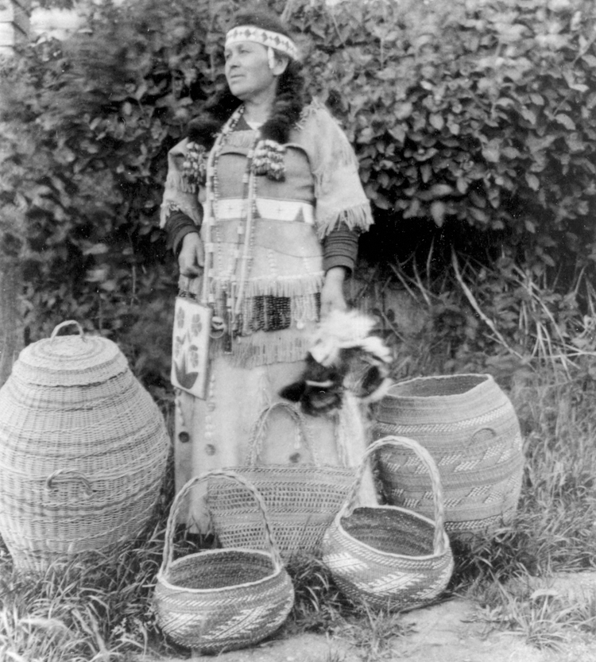
Why is this important?
Basketry is an important part of the history of the Confederated Tribes of Siletz Indians and of its culture today.
Notes:
Say: Making baskets is an important part of this tradition. Making baskets takes a lot of skill, practice, and knowledge that must be passed down to each new generation. Before the Siletz people were forced from their homelands, people used baskets for everything from moving goods to cooking—their way of life depended on baskets, and learning basketry skills was an important part of a child’s education. Today, basketry remains an important part of the Siletz people’s history, culture, and daily life. Tribal weavers carry on the traditional weaving practices to ensure the knowledge is passed on and the traditional ways of living are maintained. Learning about Siletz basketry helps to preserve the Tribe’s heritage and way of life.

Slide 5
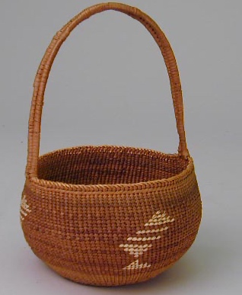
Simple and useful
Notes:
Say: Traditional baskets serve many purposes for the Siletz people. Some baskets are useful for everyday needs, such as storage containers or eating plates. One of the languages spoken at Siletz is Dee-ni Wee-ya’, a Dené (Athabaskan) language from Southern Oregon and Northern California.
Let’s listen to the Dee-ni word for storage baskets.

Slide 6
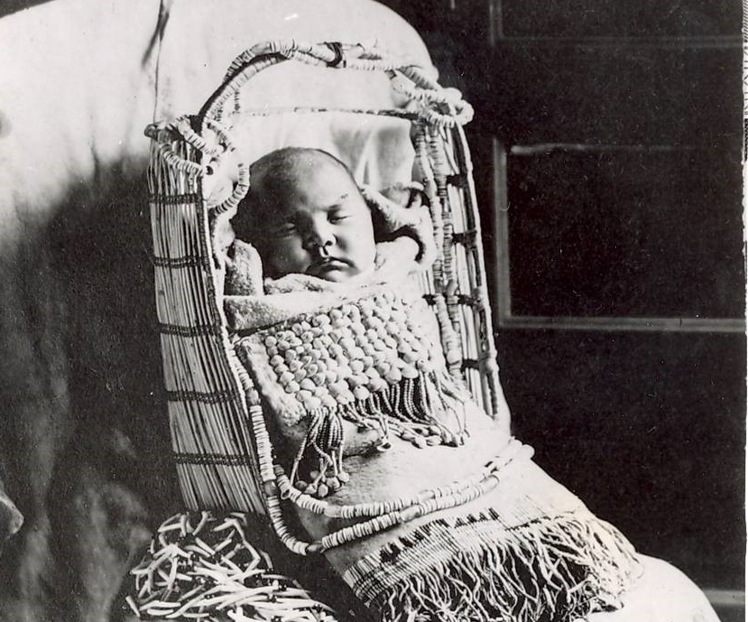
Baby baskets
Notes:
Say: Tribes throughout Southern Oregon and Northern California make and use special baskets to help care for infants. They are such an important part of infant care that a common name for baby in Dee-ni is “gay-yuu-du',” meaning the “one in a baby basket,” or “gay-yuu-ne” meaning “baby-basket person.”
Action: Play the audio for “baby basket” and “infant.”

Slide 7
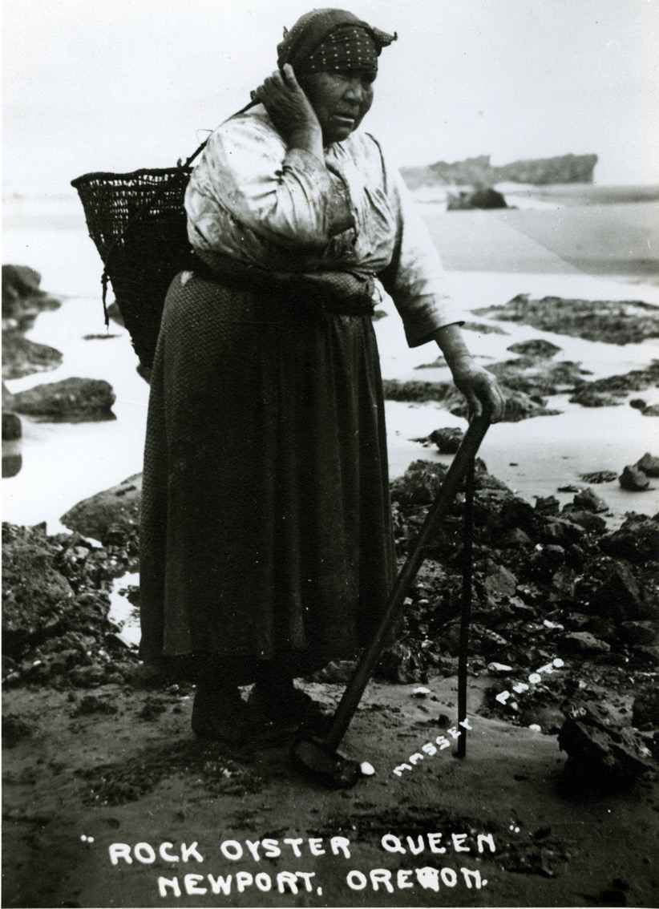
Heavy work
Notes:
Say: Some baskets are much bigger and are used for heavy work, like trapping fish and transporting things like salmon, oysters, clams, or firewood. People traditionally carry these baskets with a strap around their forehead rather than looping them around their shoulders like a backpack. Let’s listen to the Dee-ni word for “pack basket.” Action: Play the audio for “pack basket.”
Action: Play the audio for “pack basket.”

Slide 8
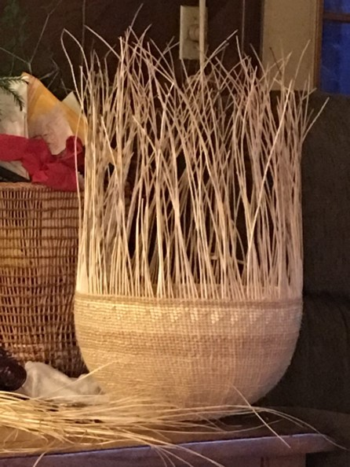
Cooking
Notes:
Say: Siletz weavers can weave cooking baskets so tight they could hold water! Cooking baskets are also strong enough to cook food in, which is done by adding hot rocks to the bottom of the basket. In Dee-ni, cooking baskets are known as ...
Action: Play the audio for “cooking basket.”

Slide 9
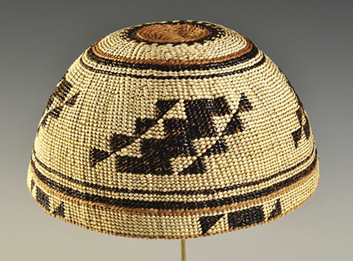
Ceremonies
Notes:
Say: Some of the most intricate baskets were worn as caps for ceremonies, such as the Feather Dance ceremony. These caps take between 50 to 100 hours to make and can last for up to 150 years!
Action: Play the audio for “ceremonial caps.”

Slide 10
What do you think this basket is made from?
Notes:
Say: What do you think this basket is made from? Turn to a partner and discuss your ideas. [Pause to allow students time for think-pair-share.] Who wants to volunteer to share with the whole group?
Action: Ask students to turn to a partner and share their ideas, then ask for volunteers to share with the whole class.
Say: Great ideas! This basket is made of plants that are collected outside during particular seasons. This process is called seasonal gathering. Let’s learn more about the types of plants used to make a cap like this.

Slide 11
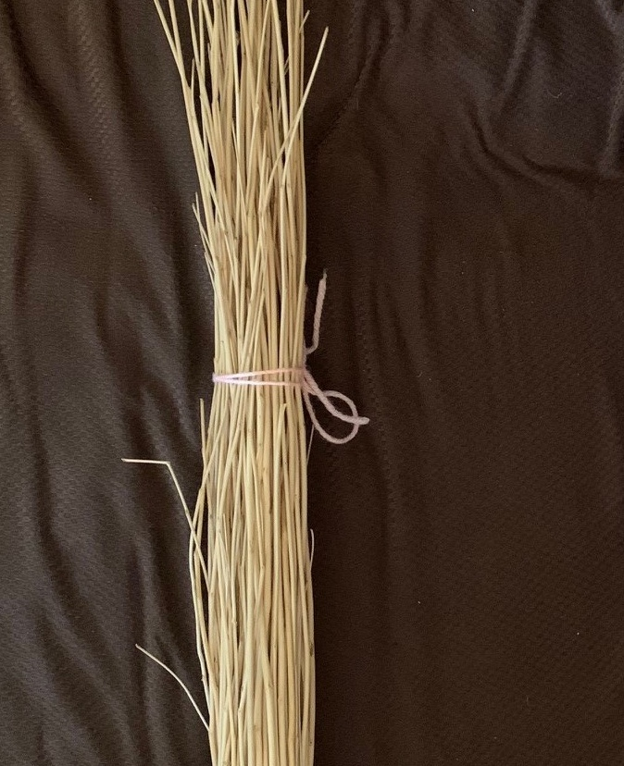
Hazel stick
Basket materials
Notes:
Say: Hazel sticks are used to create the warp—or the “skeleton”—of the basket.

Slide 12
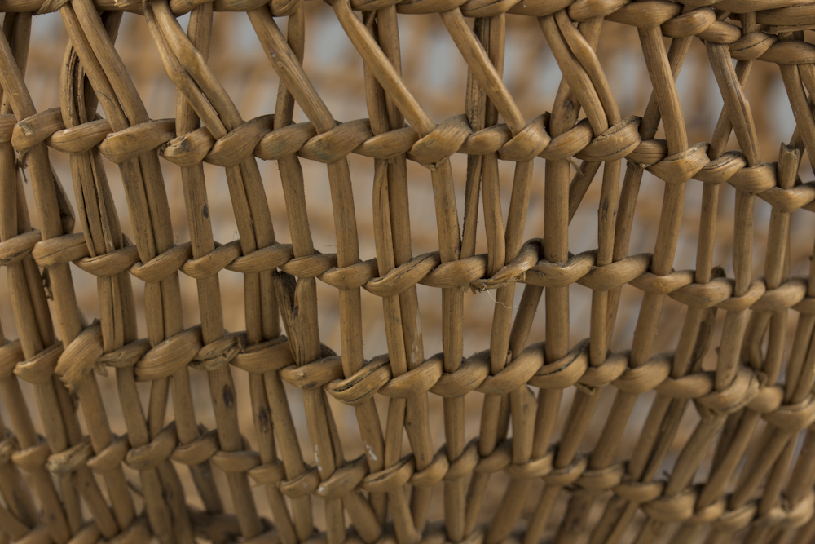
Warp
Notes:
Say: The warp element provides the shape and structure of the basket and is typically vertical (or up and down)—just like a skeleton! The arrows here are pointing to the warp of the basket.

Slide 13
When to gather
Notes:
Say: Hazel sticks are best gathered in the spring when the bark begins to slip, making it easier to peel. Weavers are careful about the number of sticks they collect because this determines the size of the basket. Once sticks are collected, members of the community—including children—help peel and straighten each hazel stick. This process is important for preparing the shape of the basket.
Action: Who would like to write hazel sticks next to their harvesting season on the board?
Action: Invite a student volunteer to write “hazel sticks” next to spring on the seasonal gathering chart.

Slide 14
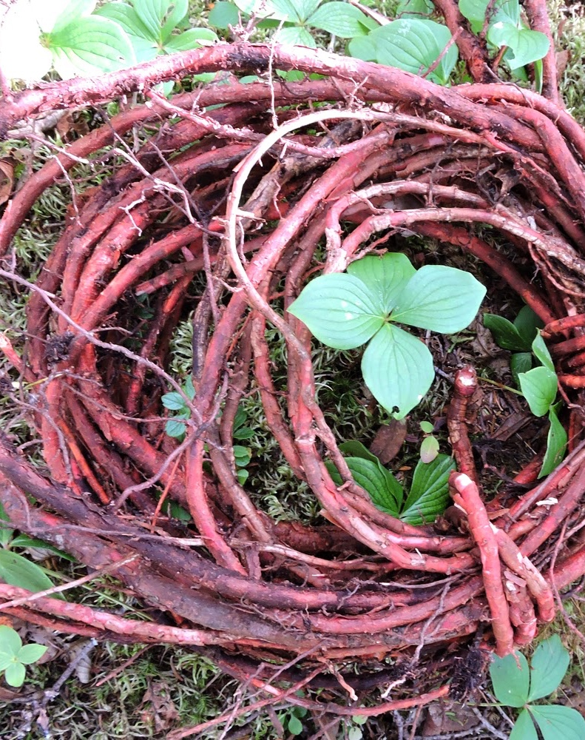
Spruce roots
Basket materials
Notes:
Say: Spruce roots are another common material. As you can see, they are long and flexible but very strong.

Slide 15
Weft
Notes:
Say: Because of this, Siletz weavers often use spruce root for the weft. The weft is the part of the basket that is woven through the warp.

Slide 16
When to gather
Notes:
Say: Spruce roots can be collected all year long but are easiest to gather in the spring or fall when the earth is moist and easy to dig. Can I have another volunteer to write spruce roots on the seasonal gathering chart?
Action: Invite a student volunteer to write “spruce roots” next to fall on the seasonal gathering chart.

Slide 17
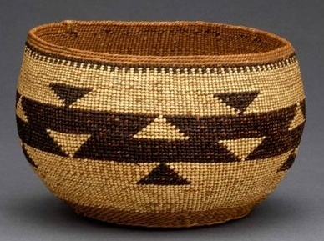
Overlay
Notes:
Say: The third main feature of Tribes of Siletz basketry is the overlay. The overlay materials are used to create an additional design element, like a pattern. Look at the overlay on this basket. This basket has a mark (or pattern) called a friendship design.
Action: Ask students to look critically at the design of the basket to identify the friendship mark.

Slide 18
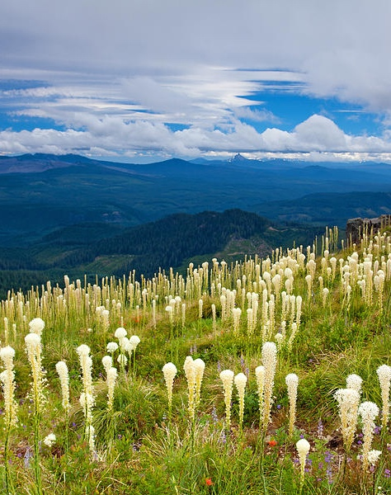
Bear grass
Basket materials
Notes:
Say: To create marks like this, Siletz weavers need to collect materials that can be used for the overlay. For example, bear grass. Weavers hike to areas that are higher than 2,000 feet to collect bear grass! Once they have harvested the bear grass, they prepare it for basket making by laying it out in the sun. This bleaches the grass white. Weavers then bundle and store the bear grass.

Slide 19
When to gather
Notes:
Say: Bear grass is usually collected in August. Who wants to write “bear grass” next to its harvesting season? Action: Invite a student to write bear grass next to summer on the board.

Slide 20
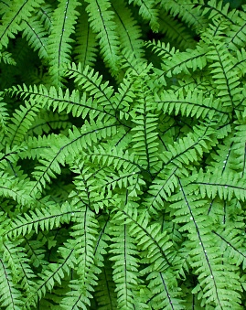
Maidenhair fern
Basket materials
Notes:
Say: Maidenhair fern is responsible for the dark color on the baskets. It is found on the north side of damp, shaded slopes. The Dee-ni word for the fern means “blue jay’s shin” because it is dark and narrow. Action: Play maidenhair fern audio.

Slide 21
When to gather
Notes:
Say: Similar to bear grass, maidenhair fern is best gathered in the summer before the stalks get too brittle. Weavers peel o the leaf and then bundle and dry the stalk to prepare the fern for basketmaking.
Action: Invite a student volunteer to write “maidenhair fern” also next to summer on the seasonal gathering chart.

Slide 22
Let’s review!
A confederated Tribe is composed of multiple Tribes and bands.
Since time immemorial means the Tribe’s history goes back even farther than oral histories do.
Notes:
Say: All right students, let’s review what we’ve learned!
Action: Read the slideshow bullets one by one.

Slide 23
Let’s review!
Baskets are important to the traditional life of the Tribes of Siletz.
The Tribes of Siletz harvest basket materials based on the seasons. This is called seasonal gathering.
The warp of the basket is the skeleton—the element that provides the shape and structure.
The weft is the woven element that goes from left to right through the warp.
The overlay is the design element that creates patterns.
Notes:
Action: Read the slideshow bullets one by one.

Slide 24
Your turn! You make a basket!
Notes:
Say: Now it’s your turn to make a basket! Or, as you would say in Dee-ni …
Action: Play the “you are basket making” audio.

