Slide 1
LESSON 4 | GRADE 8 | WAR AND REMOVAL Table Rock Treaty of 1853
Notes:
Say: As part of understanding the era of war and removal in the history of the Confederated Tribes of Siletz Indians, we’re going to create a timeline of events and then use the timeline to think more deeply about the issues. Our goal is to go beyond simply memorizing names, actions, dates, and places—the who, what, when, and where. We want to dig into how and why. What is the historical context for these events? What led to them? What followed as a result? What influenced the chain of events that took place and how might they have turned out differently? What can we learn from them that could inform future decisions?
These are big questions.
You may use the Big Questions Notes page to capture important concepts, issues, and ideas while we review these slides. You will be able to use these notes as you develop your timeline and during our discussion later.

Slide 2
It ought never be forgotten, that in all the disputes and controversies between the whites and Indians upon this Coast concerning the occupation of the soil (or almost anything else for that matter) it may be safely assumed that the latter are not in the wrong.”
- Judge Matthew Deady

Slide 3
Big Questions
What is Manifest Destiny?
What is the Oregon Donation Land Claims Act?
How did this impact Native Tribes in the 1850s in Southern Oregon?
How are treaties negotiated between sovereign nations, specifically the Table Rock Treaty of 1853?
What were the stipulations of the Table Rock Treaty?
How did the U.S. government violate the Table Rock Treaty?
How do the U.S. government’s violations of the treaty still impact the Confederated Tribes of Siletz Indians and surrounding communities?
Notes:
Say: In 1845, newspaper editor John O’Sullivan coined the term “Manifest Destiny” to describe the ideology of continental expansionism. This term describes the doctrine or belief that Americans, and specifically white American settlers, were divinely (by right of God) ordained to settle the entire continent of North America. U.S. President James K. Polk (1845–1849) is the leader most associated with Manifest Destiny; however, many U.S. government officials and others who wished to promote western expansion in the 1840s and 1850s contributed to this way of thinking. While the term “Manifest Destiny” was newly coined in the 19th century, the underlying ideas are much older, dating back to the first colonial contact between Europeans and Native or Indigenous peoples throughout the world. This ideology has been used by Europeans for centuries to justify the violent removal of Indigenous people from land on which they had lived since time immemorial.
We’re going to watch a brief video that will give you a visual sense of the realities of the massive changes that occurred across the country, and I want you to pay close attention to what happens in the Western United States. This video goes by very quickly, so I want you to keep this question in mind: What did this mean for the Tribes who had been living in the Rogue River Valley since time immemorial?

Slide 4
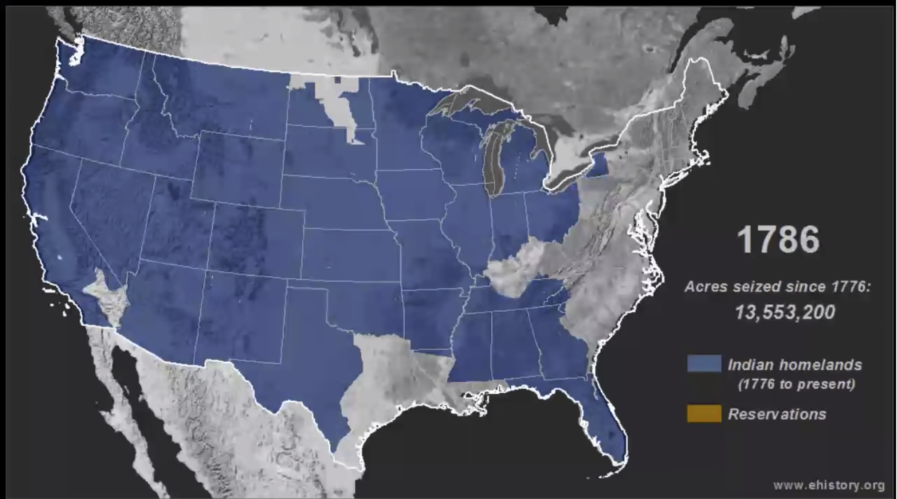
Events Leading to the Signing of the Table Rock Treaty
Manifest Destiny
Notes:
[Action] Show video: https://www.youtube.com/watch?v=pJxrTzfG2bo
Say: That’s dramatic, isn’t it? How do you think the concept of Manifest Destiny might have contributed to the rapid expansion of American settlement? I want you to consider this as you start talking through the events leading up to the signing of the Table Rock Treaty. Manifest Destiny was an attempt to provide a philosophical argument or justification for the American invasion of Indian Country.
What do we mean by Indian Country? It’s important to think about the hundreds of individual Tribal nations, each with their own ancestral lands, that had been living in all parts of what is now the United States. These Tribes were recognized under U.S. law as sovereign nations. Sovereignty is the power of a country or another independent political body to do everything necessary to govern itself, such as making, executing, and applying laws; imposing and collecting taxes; making war and peace; and forming treaties or engaging in commerce with foreign nations. As we will see, the U.S. government acknowledged the sovereignty of Tribal nations and negotiated government-to-government treaties with many of them, including many of the ancestral Tribes of the Confederated Tribes of Siletz Indians.
Historical record shows that the true motivation of western expansion was to gain control of Native land and the resources it held. Throughout the early to mid 1800s, the U.S. government took many steps to promote settlement of the West, regardless of the presence of the Native people on the land. These actions even went against many of the founding laws and policies the new U.S. government had developed over 100 years prior to the encroachment into the western lands. This desire for land—coupled with many other disconnected laws, policies, and enforcement—led to warfare, suffering, and the death of many people.
From the European-American perspective, land was something that could be bought and sold, and the legal owner of a given piece of land was said to have “title” to that land. The U.S. government was aware that the original inhabitants of Oregon held land title (or ownership), and obtaining Tribal lands was necessary before Americans could legally begin settling an area. Extinguishing Native land title became the focus of American settlement in Oregon Territory. Inevitably, this led to conflict, as Native people resisted leaving their homelands.

Slide 5
The Donation Land Claim Act of 1850
The Donation Land Claim Act of 1850 is a U.S. federal statute enacted by the Congress of the United States to promote homestead settlement in the Oregon Territory in the Pacific Northwest.
Notes:
Say: Despite ongoing conflict between Tribes and settlers, in 1850, the U.S. Congress passed the Oregon Donation Land Claim Act. The act did not directly address Indian land title. In fact, it was intended to promote further American settlement in Oregon Territory as if that title did not exist—by authorizing American settlers to claim land in Oregon as their own.
The Donation Land Claim Act had its intended result. It increased American settlement by the thousands, which in turn led to greater conflict between settlers and Indians, especially in the Willamette and Rogue River valleys in Oregon.
The U.S. government knew it could not guarantee clear title to its settlers unless Tribal nations formally ceded those lands by treaty. To cede land means to give up the legal right to it, usually in exchange for something else. As a result, the government passed the Oregon Indian Treaty Act of 1851, which authorized certain government officials to negotiate treaties with Tribal nations. This act had multiple components that took away rights from those who were already living in this place. It established the Oregon Superintendent of Indian A airs and directed that treaties must be negotiated, requiring all Tribal nations living in current-day Western Oregon to move east across the Cascade Mountains. This act would lead directly to the Table Rock Treaty of 1853.
This pattern can be seen over and over in the American West throughout the 1800s. Indian land was recognized as Indian land as long as it wasn’t appealing to settlers. Once settlers became interested in a given area, they generally moved in and held it by forced occupation until they had caused enough trouble that the U.S. government used the force of the army to coerce Tribes into treaty negotiations, claiming it was necessary to “take action to secure the rights of its citizens.” This was an unbalanced and unfair process.
In June of 1851, two major conflicts set the stage for the violence that would eventually lead to the negotiation of the Table Rock Treaty. First, the U.S. Army attacked Native villages along the Rogue River near Table Rocks, killing about 50 people and taking 30 women and children prisoner. At about the same time, a group of settlers led by Captain William Tichenor arrived by boat at what is now Port Orford with the intention of establishing a townsite near an existing Native village. Native people living on the coast resisted this intrusion. Tichenor’s crew red a cannon into the crowd, killing about 30 Native people, then fled. Violent clashes like these took place across the region and the entire Pacific Northwest.
The discovery of gold in California in 1849 sent thousands of miners spilling over into the gold-rich parts of Southern Oregon. Violent clashes continued, creating simmering tensions that often boiled over into open murder or warfare. For example, in the summer of 1852, a settler vigilante force and Takelma Tyees Joe and Sam met to resolve conflict over a miner killed in the Siskiyou Mountains. Misunderstanding each other, the miners shot their Native hostage before turning on the Takelma as they tried to swim away down the Rogue—killing 13 people.
In this way, conflicts between individual settlers and Native people, or even rumors, splashed back in deadly ways on Tribes as a whole. Rather than negotiate with Tribes, some miners and settlers urged the U.S. government to simply exterminate the Native people and take their land.
By the summer of 1853, miners were openly harassing and murdering individual Native people traveling in small groups as well as continuing assaults on larger villages. In response, Native leaders resorted to open combat with the U.S. Army and its volunteers, culminating in a ferocious battle at Upper Evans Creek in late August 1853—after which representatives from both sides agreed to meet at Table Rocks to consider peace.

Slide 6
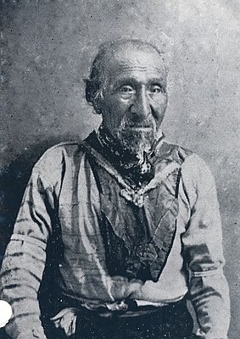
Native American Leaders Involved in Treaty Negotiations
Tecumtum or Tyee John
Notes:
Say: Tecumtum, whose name means “Elk Killer,” participated in treaty negotiations with the U.S. government. He was a Shasta leader but through intermarriage was closely allied with the Applegate River Athabaskan-speaking people (Daa-kuu-be tv-de). He was also known by various names, including Te-cum-tom, Chief John, Old John, and Tyee John. He is remembered as a powerful leader who fought for the sovereign rights of Southwestern Oregon Native peoples, and his military abilities and refusal to submit to conquest place him at the forefront of Tribal leaders in Pacific Northwest history.

Slide 7
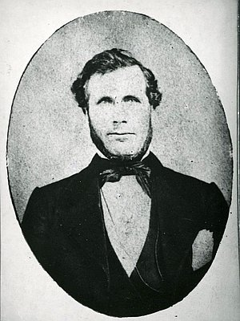
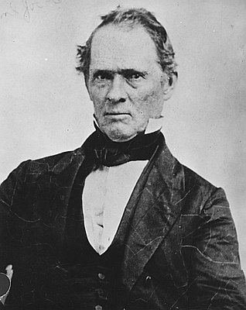
U.S. Government Representatives Involved in Treaty Negotiations
Joel Palmer
General Joseph Lane
Notes:
Say: Joel Palmer, Superintendent of Indian Affairs for Oregon Territory, was a key figure in treaty negotiations in Oregon from 1853 to 1856—the era in which most government-to-government treaties between the United States and Tribal nations in Oregon were negotiated. Under Palmer’s leadership, millions of acres of Indian ancestral territory were ceded or stolen, and the majority of Native people in Oregon were moved to reservations. Palmer was a Quaker who believed that Tribes could adapt to a changing world by assimilating and learning how to live like settlers. Other major U.S. government officials involved in treaty negotiations in Oregon Territory included General Joseph Lane and Judge Matthew Deady.
In September of 1853, Palmer began negotiations on a preliminary treaty with the major Tribes of the Upper Rogue River Valley. These initial negotiations laid the groundwork for negotiating the Table Rock Treaty later that year. The preliminary agreement described the territorial limits of the Upper Rogue River Tribes but did not identify a permanent home for them or set the terms of the sale of Tribal lands. In fact, during these preliminary negotiations, Tribal leaders, including Tyee John, flatly refused to cede title to their ancestral territory unless they received guarantees that they would retain some part of their ancestral homeland and would be allowed to hunt and fish as they always had.

Slide 8
The white man has come and will continue to come for they are as plenty away over the mountains as the trees in the woods.”
- Joel Palmer
Notes:
Say: On September 10, 1853, Palmer held another council that urged the Tribes to cede most of their ancestral land. He famously said, “The white man has come and will continue to come for they are as plenty away over the mountains as the trees in the woods” (Wilkinson, 2010, p. 89).

Slide 9
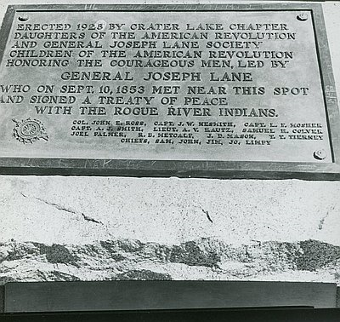
Table Rock Treaty of 1853
Signed on September 10, 1853
The first treaty to implement a new federal policy that called for permanent reservations for Tribes, “where Indian people could learn the art of agriculture and become ‘civilized’”
The Table Rock Treaty was the first ratified land treaty in Oregon Territory
Notes:
Say:
The Table Rock Treaty was signed by representatives of the Shasta, Takelma Tribes, and Upper Rogue Athabaskan-speaking Tribes, including Tyee John, and later ratified by the Senate. Ratification is a process in which both parties return to their people, present the terms that were negotiated, and gain the consent of the majority to go ahead with the treaty. For the U.S. government, this process happens in the U.S. Senate, which must ratify all treaties, and can take several months or even longer.
The Table Rock Treaty would turn out to be very important because it was used as a model for several other treaties negotiated in Oregon Territory over the next few years.
For example, it was the first treaty to implement a new federal policy that called for permanent reservations for Tribes “where Indian people could learn the art of agriculture and become ‘civilized’” (Wilkinson, 2010, p. 89). It was also unusual in that the treaty established a temporary reservation near the Table Rocks area, with a provision that a permanent reservation could be determined at later date.
The Table Rock Treaty was the first land treaty signed in Oregon Territory to be ratified by the U.S. Senate.

Slide 10
The “Right” to Land
Congress passed the Donation Land Claims Act in 1850, without addressing the issue of Indian land title. Conflicts between white settlers and Indians continued, especially in the Willamette and Rogue River valleys in Oregon.
In response to the continuing conflict, Congress passed the Oregon Indian Treaty Act so that authorized officials could negotiate treaties with Oregon Tribes, and these treaties included cessions of ancestral lands.
Notes:
Say: In negotiating the treaty, the government portrayed itself as the only protection for Native people from the violent groups of miners and other settlers who wanted to exterminate them, ignoring the fact that the government itself had encouraged settlers to enter Indian Country in the first place through policies like the Donation Land Claim Act.

Slide 11
Violating the Table Rock Treaty
The massacre at Grave Creek of a peaceful band of the Grave Creek Athapaskan Tribe took place while U.S. government representatives such as Lane, Palmer, and Deady were negotiating peace.
Local miners and settlers wanted the Rogue River peoples exterminated rather than resettled on reservations. U.S. government representatives were concerned that white miners and settlers would not uphold treaty stipulations.
Native peoples had serious concerns about the U.S. government’s inability to control their own people, the fact that treaties continued to be unratified, and the possibility that they could be removed east of the Cascades.
Notes:
Say: But the signing of the treaty did not end conflict in the region. While waiting for the treaty to be ratified, miners and settlers almost immediately began to violate its terms. They demanded access to even the small area of land set aside for the Upper Rogue River Tribes. Volunteer militias of settlers and miners continued to attack Native people, killing dozens in incidents such as the Grave Creek Massacre, where a peaceful band of Grave Creek People were murdered.
Meanwhile, Native people had serious concerns. The reservation land that had been set aside for Native people was only temporary, and they were worried that the government would ultimately relocate them to a permanent reservation east of the Cascades, far from their ancestral homeland. In addition, the U.S. government seemed unable or unwilling to control the violence of the settler militias. These tensions ultimately led to the Rogue River War, which we will study in another lesson.
Next, we’re going to use our Big Questions Notes to create a timeline of the events we’ve been learning about.

Slide 12
Table Rock Treaty of 1853
The basic and fundamental principles of the Table Rock Treaty of 1853 were used in many treaties between the U.S. government and Native American Tribes in Oregon and Washington territories.
Provisions included:
The U.S. government agreed to provide farming equipment and clothing to the Tribes and to build houses for the three principal Tyees: Joe, Sam, and John
Tribes guaranteed safe passage for whites traveling through their reservation
Crimes committed by Native Americans against whites could be tried in federal courts
The U.S. government promised to reimburse Tribes for horses and other property stolen by whites
The Rogue River people would cede the entire Upper Rogue River Valley to the U.S. government
Tribes were guaranteed a temporary reservation at Table Rock and a permanent reservation once an appropriate site could be found
Notes:
Say: Okay, in a few minutes we’re going to form small groups. Each group will review certain articles of the Table Rock Treaty [using the Four “A”s protocol] and then provide written responses to three key questions using specific examples from the text. Before we dig into the details of the treaty, however, we need a little more context.
Say: The basic, fundamental principles of the Table Rock Treaty of 1853 were used in many later treaties between the U.S. government and Indian Tribes in Oregon and Washington Territories.
Some of the treaty provisions were:
The U.S. government agreed to provide farming equipment and clothing to Indians and to build houses for the three principle Tyees: Apserkahar (Tyee Joe), Tyee Sam, and Tecumtum (Tyee John)
Tribes guaranteed safe passage for settlers traveling through their reservation
Crimes committed by Indians against settlers could be tried in federal courts
The U.S. government promised to reimburse Tribes for horses and other property stolen by settlers
The Takelma, Shasta, and Upper Rogue Athapaskan-speaking Tribes ceded most of their ancestral homelands to the U.S. government. This land transfer encompassed the Upper Rogue River Valley, including the Applegate Valley, all the way to the Cascades and Siskiyous to the east. These 2,400 square miles contained resources such as gold, mineral deposits, timber, and valley floors for farming. Tribes received $60,000, and the U.S. government held back $15,000 to pay for the property of settlers that had been damaged or destroyed by Indians during previous conflicts
The U.S. government guaranteed the Tribes a temporary reservation around Table Rocks and a permanent reservation once one could be found

Slide 13
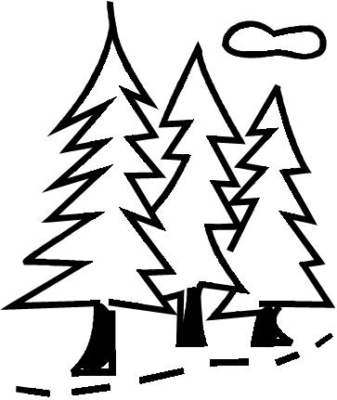
It is important to note that Tribes did not want to sell their land. They had and continue to have a relationship to the land that is not connected to white notions of farming and private ownership. Further, the original peace and friendship treaty made no mention of ceding land. The reservation land reserved for Native Americans in the Treaty of 1853 was only 100 square miles and included parts of Upper Table Rock and Lower Table Rock.
Notes:
Say: It is important to note that the Tribes did not want to sell their land. Language was a major barrier in the treaty negotiations, which were conducted in Chinuk Wawa, a regional language used to conduct trade among multiple Tribes. Further, the original peace and friendship treaty made no mention of ceding land.

Slide 14
The Table Rock Treaty, according to Charles Wilkinson, a historian that the Siletz people chose to write their history, came with a rare provision in response to the hate and violence toward Native people from white miners and settlers. The treaty stated that the Tribes “shall be allowed to occupy temporarily” the Table Rock area until a permanent home could be found. The treaty was signed by Tyees Joe, Jim, Sam, John, and Lympy for their peoples and by Joel Palmer for the U.S. government. It was ratified by Congress seven months later.
Notes:
Say: The temporary reservation land of the Rogue River Tribes was reserved from being immediately ceded and included 100 square miles in the Table Rocks area—just a fraction of the Tribes’ ancestral homeland.

Slide 15
Table Rock Treaty Reading Discussion Activity
Pass out treaty excerpts
Work in pairs after reading to fill out graphic organizers and answer the following discussion questions:
What did you notice about the language of the treaty?
What were the key agreements?
Did anything stand out to you?
Notes:
[Action] Hand out copies of the Table Rock Treaty excerpts and the Table Rock Treaty graphic organizer. Review small-group discussion questions and then monitor participation throughout the activity.
Questions for discussion:
• What do you notice about the language of the treaty?
• What were the key agreements?
• Did anything stand out for you?

Slide 16
Treaty Reading Discussion Group 1
ARTICLE 1
The Rogue River tribe of Indians do hereby cede and relinquish, for the considerations hereinafter specified, to the United States, all their right, title, interest, and claim to all the lands lying in that part of the Territory of Oregon, and bounded by lines designated as follows, to wit: Commencing at a point one mile below the mouth of Applegate Creek, on the south side of Rogue River, running thence southerly to the highlands dividing the waters of Applegate Creek from those of Althouse Creek, thence along said highlands to the summit of the Siskiyon range of mountains, thence easterly to Pilot Rock, thence northeasterly to the summit of the Cascade range, thence northerly along the said Cascade range to Pitt’s Peak, continuing northerly to Rogue River, thence westerly to the head-waters of Jump-off-jo Creek, thence down said creek to the intersection of the same with a line due north from the place of beginning, thence to the place of beginning.
Notes:
Slides 16–24 Say: Okay, now you’re going to work in small groups to read portions of the Table Rock Treaty.
Consider the following questions:
1. What does the U.S. government promise Tribal people in exchange for their land?
2. How likely is it that the U.S. government will live up to its promises? Explain your reasoning.
[Action] Divide students into four groups. Group 1 will read articles 1 and 2, Group 2 will read articles 3 and 4, Group 3 will read articles 5 and 6, and Group 4 will read the preamble and articles 7 and 8. Allow time for student groups to read, discuss, and answer the three key questions using their graphic organizers.

Slide 17
Treaty Reading Discussion Group 1
ARTICLE 2
It is agreed on the part of the United States that the aforesaid tribe shall be allowed to occupy temporarily that portion of the above-described tract of territory bounded as follows, to wit: Commencing on the north side of Rogue River, at the mouth of Evan’s Creek; thence up said creek to the upper end of a small prairie bearing in a northwesterly direction from Table Mountain, or Upper Table Rock, thence through the gap to the south side of the cliff of the said mountain, thence in a line to Rogue River, striking the southern base of Lower Table Rock, thence down said river to the place of beginning. It being understood that this described tract of land shall be deemed and considered an Indian reserve, until a suitable selection shall be made by the direction of the President of the United States for their permanent residence and buildings erected thereon, and provision made for their removal.

Slide 18
Treaty Reading Discussion Group 2
ARTICLE 3
For and in consideration of the cession and relinquishment contained in article 1st, the United States agree to pay to the aforesaid tribe the sum of sixty thousand dollars, fifteen thousand of which sum to be retained, (according to the stipulations of article 4th of a “treaty of peace made and entered into on the 8th day of September, 1853,a between Gen’l Jo. Lane, commanding forces of Oregon Territory, and Jo., principal chief, Sam and Jim, subordinate chiefs, on the part of the Rogue River tribe of Indians,”) by the superintendent of Indian affairs, to pay for the property of the whites destroyed by them during the late war, the amount of property so destroyed to be estimated by three disinterested commissioners, to be appointed by the superintendent of Indian affairs, or otherwise, as the President may direct. Five thousand dollars to be expended in the purchase of agricultural implements, blankets, clothing, and such other goods as may be deemed by the superintendent, or agent most

Slide 19
Treaty Reading Discussion Group 2
ARTICLE 3
conducive to the comfort and necessities of said tribe, on or before the 1st day of September, 1854; and for the payment of such permanent improvements as may have been made by land claimants on the aforesaid reserve, the value of which to be ascertained by three persons appointed by the said superintendent.

Slide 20
Treaty Reading Discussion Group 2
ARTICLE 4
It is further agreed that there shall be erected, at the expense of the United States, one dwelling house for each of the three principal chiefs of the aforesaid tribe, the cost of which shall not exceed five hundred dollars each, the aforesaid buildings to be erected as soon after the ratification of this treaty as possible. And when the tribe may be removed to another reserve, buildings and other improvements shall be made on such reserve of equal value to those which may be relinquished; and upon such removal, in addition to the before-mentioned sixty thousand dollars, the United States agree to pay the further sum of fifteen thousand dollars, in five equal annual instalments, commencing at the expiration of the before-named installments.

Slide 21
Treaty Reading Discussion Group 3
ARTICLE 5
The said tribe of Indians further agree to give safe-conduct to all persons who may be authorized to pass through their reserve, and to protect, in their person and property, all agents or other persons sent by the United States to reside among them; they further agree not to molest or interrupt any white person passing through their reserve.

Slide 22
Treaty Reading Discussion Group 3
ARTICLE 6
That the friendship which is now established between the United States and the Rogue River tribe of Indians shall not be interrupted by the misconduct of individuals, it is hereby agreed that for injuries done by individuals no private revenge or retaliation shall take place; but instead thereof, complaint shall be made by the party injured to the Indian agent; and it shall be the duty of the chiefs of the said tribe, that upon complaint being made as aforesaid, to deliver up the person or persons against whom the complaint is made, to the end that he or they may be punished agreeably to the laws of the United States; and in like manner if any violation, robbery, or murder shall be committed on any Indian or Indians belonging to said tribe, the person or persons so offending shall be tried, and if found guilty, shall be punished according to the laws of the United States. And it is agreed that the chiefs of the said tribe shall, to the utmost of their power, exert themselves to recover horses or

Slide 23
Treaty Reading Discussion Group 3 (Continued)
ARTICLE 6
other property, which has or may be stolen or taken from any citizen or citizens of the United States, by any individual of said tribe; and the property so recovered shall be forthwith delivered to the Indian agent or other person authorized to receive the same, that it may be restored to the proper owner. And the United States hereby guarantee to any Indian or Indians of the said tribe a full indemnification for any horses or other property which may be stolen from them by any citizens of the United States: Provided, That the property stolen or taken cannot be recovered, and that sufficient proof is produced that it was actually stolen or taken by a citizen of the United States. And the chiefs and head-men of the said tribe engage, on the requisition or demand of the President of the United States, superintendent of Indian affairs, or Indian agent, to deliver up any white person or persons resident among them.

Slide 24
Treaty Reading Discussion Group 4
ARTICLE 7
It is agreed between the United States and the Rogue River tribe of Indians, that, should it at any time hereafter be considered by the United States as a proper policy to establish farms among and for the benefit of said Indians, it shall be discretionary with the President, by and with the advice and consent of the Senate, to change the annuities herein provided for, or any part thereof, into a fund for that purpose.
ARTICLE 8
This treaty shall take effect and be obligatory on the contracting parties as soon as the same shall have been ratified by the President of the United States by and with the advice and consent of the Senate. In testimony whereof the said Joel Palmer and Samuel H. Culver, on the part of the United States, and the chiefs and headmen of the Rogue River Indians aforesaid, have hereunto set their hands and seals, the day and year aforesaid.

