Slide 1
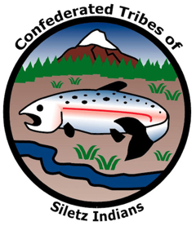
LESSON 4 | GRADE 8 | WAR AND REMOVAL The Coast (Siletz) Reservation

Slide 2
Warm up
What does the word “home” mean for you?
What role does place have in your sense of home? That is, if you lived somewhere else than where you do right now, how might that change how you think of home?
What if you were forced to leave your home, or it was taken away from you? How would that affect your sense of home and where you belong?
Notes:
Say: In previous lessons, we’ve talked about the factors leading to the forced removal of Native people from their ancestral homelands across Western Oregon, focusing on the escalating acts of violence and genocide against Tribes and bands in Southern Oregon that led to the Rogue River Wars. Today, we are going to wrap up our lessons on Siletz History by taking a step back to learn more about how the Coast (Siletz) Reservation was created. The U.S. government created the Coast (Siletz) Reservation to be a “permanent” home for Native people from all over Western Oregon. Unfortunately, unlike the Native people—who kept to their agreement to remove to the reservation—the U.S. government did not do its part to maintain and protect the “permanent” reservation lands in the following years and decades

Slide 3
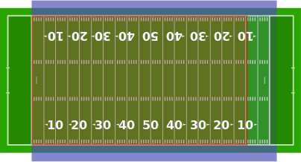
What is an acre?
A measure of an area of land that equals:
“1 furlong by 1 chain” (660 feet x 66 feet) [land survey measurement terms]
4,046.86 square meters
4,840 square yards
43,560 square feet
1/640th of a square mile
Almost as big as a football field (green) or soccer pitch (blue)
As big as 16 tennis courts
Image sources: a) “Acre Superimposed Over Football Fields.” Jc3s5h via Wikimedia Commons. en.wikipedia.org/wiki/Acre#/media/File:Acre_superimposed_over_football_fields.svg. b) “Eye View Diagram Outline.” Clker Free Vector Images via Pixabay. pixabay.com/images/id-40326. c) “House Icon Symbol Architecture.” janjf93 via Pixabay. pixabay.com/vectors/house-icon-symbol-architecture-2492054.
As big as 18, 2,400 square-foot houses

Slide 4
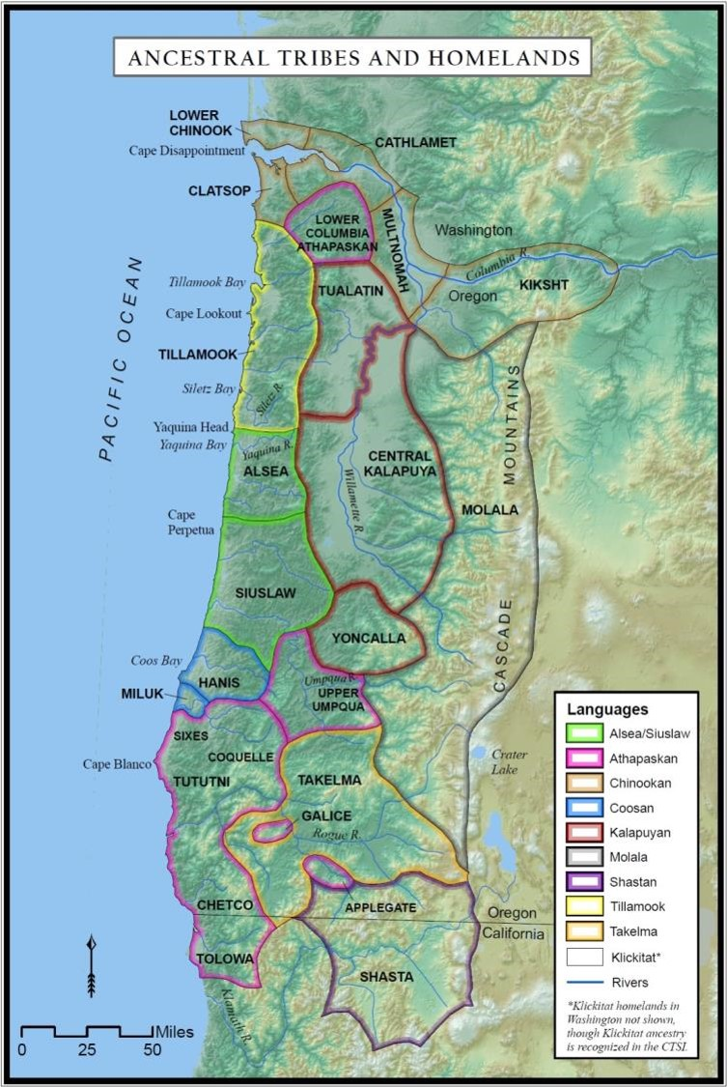
Siletz ancestral areas and languages
Image source: Confederated Tribes of Siletz Indians
Notes:
Say: Siletz ancestors came from many different groups of Native people living in what is now Western Oregon, Northern California, and Southwest Washington. These peoples shared many lifeways and customs (for example, the use of salmon as an important food source) and were and are related through kinship, trade, and marriage. But each Tribe and band has its own unique beliefs, values, practices, and relationships to their ancestral homelands. Native people in Western Oregon speak a diverse mix of languages and dialects; by some estimates, the multiple Indigenous languages of Western Oregon make it one of the most linguistically diverse regions in the entire world.

Slide 5
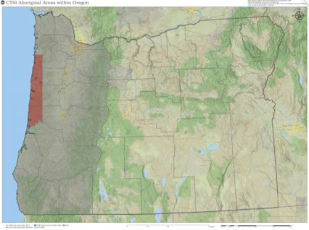
Siletz ancestral areas and 1855 reservation boundaries
Image source: Confederated Tribes of Siletz Indians.
Notes:
Say: We’ve talked about how the Rogue River Wars in the 1850s led to the removal of almost every Native person living in Southern Oregon and the ways that the violence and intimidation of the wars spread up the Coast to regions far from the fighting. In fact, in the early 1850s, federal officials began targeting people living throughout Western Oregon for removal—intending to clear out the entire region for settlement. To do this, federal officials coerced Native people to sign a series of treaties modeled on the Table Rock Treaty that we learned about in the beginning of this unit.
In these treaties, Tribes agreed to cede almost all their ancestral territory in exchange for small temporary reservations in their homelands that would later be replaced with a larger permanent reservation selected by the president at a later date. Federal officials eventually located that larger permanent reservation on the Central Oregon Coast, a large strip from the ocean to the Coast Range that ran from Cape Lookout all the way down south of present-day Florence—nearly a third of the Oregon coastline! At the time, this strip of land seemed to lack the minerals and farmland that were drawing settlers to Oregon, and so, to federal officials, it seemed like the ideal spot to isolate Native people away from settlers.

Slide 6
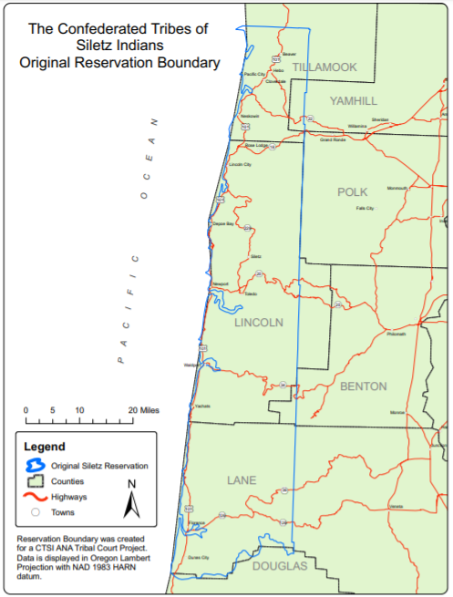
Original Coast (Siletz) Reservation,1855
Conceived of and advocated for by Joel Palmer, superintendent of Indian affairs of the Oregon Territory
Established by executive order of President Franklin Pierce on November 9, 1855
1.1 million acres, from Cape Lookout to Siltcoos River (a third of the entire Oregon coastline)
Members of dozens of Native American bands living in Western Oregon were forcibly relocated to the reservation beginning in 1856
Image source: Confederated Tribes of Siletz Indians.
Notes:
Say: The Coast (or Siletz) Reservation, as this land came to be called, was created in 1855 and was intended to be the new permanent land base for Tribes from across Western Oregon. While relatively large at 1.1 million acres, it was nonetheless a small fraction of the combined homelands of the Native Tribes and bands who would be forced to remove there from across Western Oregon. Since so many different peoples came to be grouped together on the reservation, it can be difficult to talk about a single common experience. We talked last time about the pain and violence of the removals from Southern Oregon for peoples forced to adapt to an entirely new climate and environment far from their homes. But for some peoples, like the Tillamook, Alsea, Yaquina, and Siuslaw groups, the reservation was created out of large parts of their ancestral territory. While these groups weren’t forced to remove, they saw equal amounts of disruption to their way of life as they were forced to share important hunting, fishing, and gathering sites with the arriving groups.

Slide 7
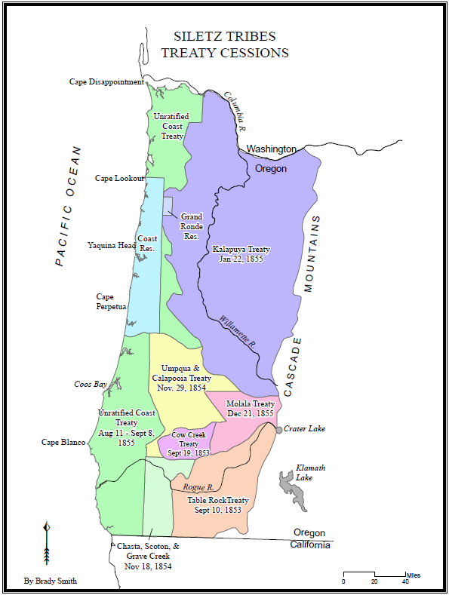
Treaties and reservation
Image source: Confederated Tribes of Siletz Indians.
Notes:
Say: As the government forced multiple Tribes and bands together into what became known as the Confederated Tribes of Siletz Indians, federal officials not only combined peoples with a variety of different lifeways, languages, and beliefs, but also peoples with different legal statuses and treaty agreements with the federal government. This map shows the treaties that we were talking about earlier— almost all ratified by the U.S. Senate.
But there is one exception. In August and September of 1855, coastal Tribes who had not previously signed treaties with the U.S. signed the Coast Treaty. Federal officials sent the Coast Treaty to Washington, D.C. by steamship, for ratification by the U.S. Senate in October. Remember, for a treaty to be legally enforceable, it must be ratified by the Senate the way that the Table Rock Treaty and other treaties throughout Western Oregon had been. Unlike the other treaties, the Coast Treaty included a provision for a reservation on the Central Oregon Coast—the reservation federal officials had identified as the best place to send Native people from across Western Oregon. Sending mail from the west coast to the east coast in the 1850s took a long time—often months! Most letters went via ship and had to travel all the way down around South America and back up to Washington D.C. When the Superintendent of Indian Affairs for the Oregon Territory, Joel Palmer, sent the Coast Treaty to D.C., he had no reason to expect that it wouldn’t be ratified as well.
Instead, something unexpected happened. Months earlier, Palmer had sent a separate request to reserve the land necessary for a reservation on the Oregon Coast via overland stagecoach—probably worried that settlers might try to claim the land while the treaties were finalized and ratified. This request reached Washington, D.C. before the Coast Treaty. Since officials in Washington didn’t know that the Coast Treaty was on its way, they acted on Palmer’s first request. On November 9, 1855, President Franklin Pierce signed an executive order creating the reservation based on this request rather than the treaty. The Coast Treaty documents arrived just days after the executive order, but the Indian Office chose not to submit them to the Senate for ratification for over a year. Ultimately, the Senate never did ratify the Coast Treaty, possibly because it thought the treaty was not needed with the executive order having already established the reservation.
It might seem like a small difference, but this sequence of events would come to have a huge impact on Siletz history. Typically, reservations established by a ratified treaty have a more solid legal basis than reservations created by executive order. Executive order reservations can be modified by future presidents at any time and for any reason. Reservation land created through ratified treaties cannot be taken away by a sitting president; only Congress can do so, and only with full compensation as guaranteed by the Fifth Amendment to the Constitution. Even though the Coast (Siletz) Reservation was clearly created to fulfill the ratified treaties signed with Tribes from across Western Oregon, future administrations would deny this connection, pointing to the unratified Coast Treaty to claim that the Coast (Siletz) Reservation lacked the legal protections of other reservations created by treaties. This left Siletz people vulnerable to subsequent presidential actions that reduced the size of the reservation over ensuring decades, even though the reservation was created to fulfill the obligations in the several treaties that were ratified by the Senate.

Slide 8
Timeline activity
What important events do we need to add to our timeline?

Slide 9
Timeline questions for students
Get into groups of two for think-pair-share and consider these questions:
How did the timing of the Coast Treaty’s arrival in Washington, D.C., affect the Coast (Siletz) Reservation?
How might this timeline differ from the perspective of people who had to move from another part of Oregon to the reservation compared to people who didn’t have to move but had to accommodate strangers being moved onto their homelands? What events would be most important for both groups?

Slide 10
Timeline questions for students (Continued)
Get into groups of two for think-pair-share and consider these questions:
What would it be like if the Siletz people’s treaty rights to their reservation (as established by executive order, pursuant to their treaties) and its resources had been fully understood and protected through time, from 1855 to the present?
What would you expect the subsistence lifeways and economic status of the Confederated Tribes of Siletz Indians and its Tribal members to be?

