Slide 1
GRADE 10 The Termination Era

Slide 2
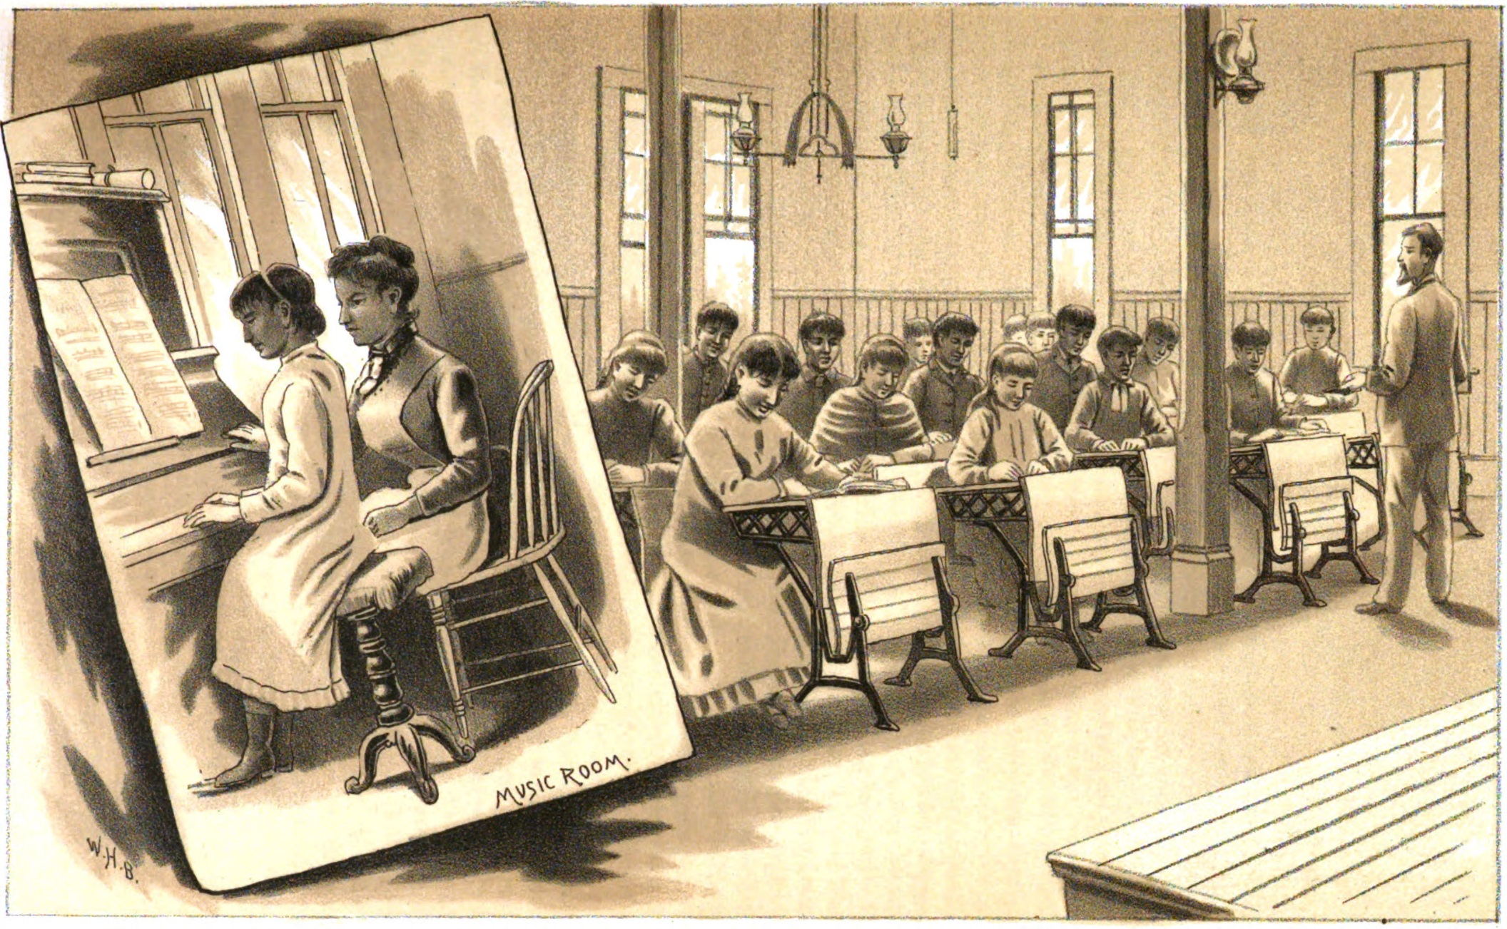
Assimilation
The belief that Indigenous people should abandon their traditional cultures and become “civilized” has been the basis of the U.S. government's policy toward Native Americans for centuries.
Notes:
Say: Assimilation is the belief that Indigenous people should abandon their traditional ways of knowing and being “civilized” by adapting American cultural, political, economic, and religious norms. This has been the basis of U.S. government policy toward Native Americans for centuries.
Federal officials often tied the push for assimilation to the desire to break up Tribal land holdings. For example, in the late 1890s Congress passed the General Allotment Act (Dawes Act)—directing federal officials to break up reservations by issuing each Tribal member a small parcel of land and declaring the remaining “excess lands” to be taken out of Tribal control. We’ll learn more about the Dawes Act in other lessons (see Siletz History: Allotment) but the big thing to understand for this lesson is that lawmakers justified taking land from Native people by claiming that it would help them assimilate to an American way of living. They argued that having individual ownership of land would force Native people to abandon Tribal bonds by separating them into discrete family units.

Slide 3
Allotment
Dawes Act of 1887 (aka General Allotment Act of 1887)- After each Tribal member present was assigned an allotment, the Secretary of the Interior could close the allotment rolls and declare the rest of the Tribe’s reservation “surplus” and force the Tribe to cede those unallotted lands.
Image: Lincoln County Leader, April 14, 1905. Image provided by University of Oregon Libraries. Persistent link: https://oregonnews.uoregon.edu/lccn/sn85033162/1905-04-14/ed-1/seq-4/print/image_523x817_from_603,724_to_3769,5666/
Notes:
Say: Allotment (the Dawes Act) wasn’t very successful at assimilating Indigenous people, but it was extremely effective at wiping out the land base of Tribes and impoverishing Native people. In just a few short decades, allotment reduced the overall land holdings of Tribes across the nation from 138 million acres to 48 million acres! By the 1930s, the harmful effects of allotment were so obvious that they forced the federal government to briefly detour from its single-minded focus on assimilation.

Slide 4
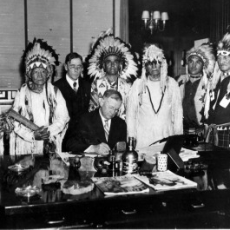
Indian Reorganization Act (1934)
Reaffirmed the U.S. government's recognition of Tribal sovereignty, including the right to self-governance, but it also perpetuated the government's paternalistic approach toward Native Americans in other ways.
Repealed the Dawes Act in recognition of the devastating effects of massive Native land losses.
To benefit from the Indian Reorganization Act, Tribes had to accept a template constitution—one that required the Secretary of the Interior’s approval. (The Siletz people ultimately chose not to do this.)
A policy of Tribal self-government was implemented.
Tribes could incorporate businesses and access credit established to further such business interests.
Education and employment opportunities were somewhat improved.
Source: Nash, J. B. (Ed.). (1938). The new day for the Indians: A survey of the working of the Indian Reorganization Act of 1934. Academy Press. (p. 13)
Notes:
Say: In 1934, President Franklin D. Roosevelt signed the Indian Reorganization Act (IRA). Pushed by prominent reformer John Collier, the IRA was designed to reverse some of the negative results of the Dawes Act by supporting the reorganization of Tribal governments, ending allotment, and giving Native Americans the opportu-nity to take advantage of federal “New Deal” jobs programs, such as the Civilian Conservation Corps. Although Siletz chose not to reorganize its government under the IRA, Tribal members took advantage of this change in federal Indian policy to pursue compensation for their unceded lands in federal court

Slide 5
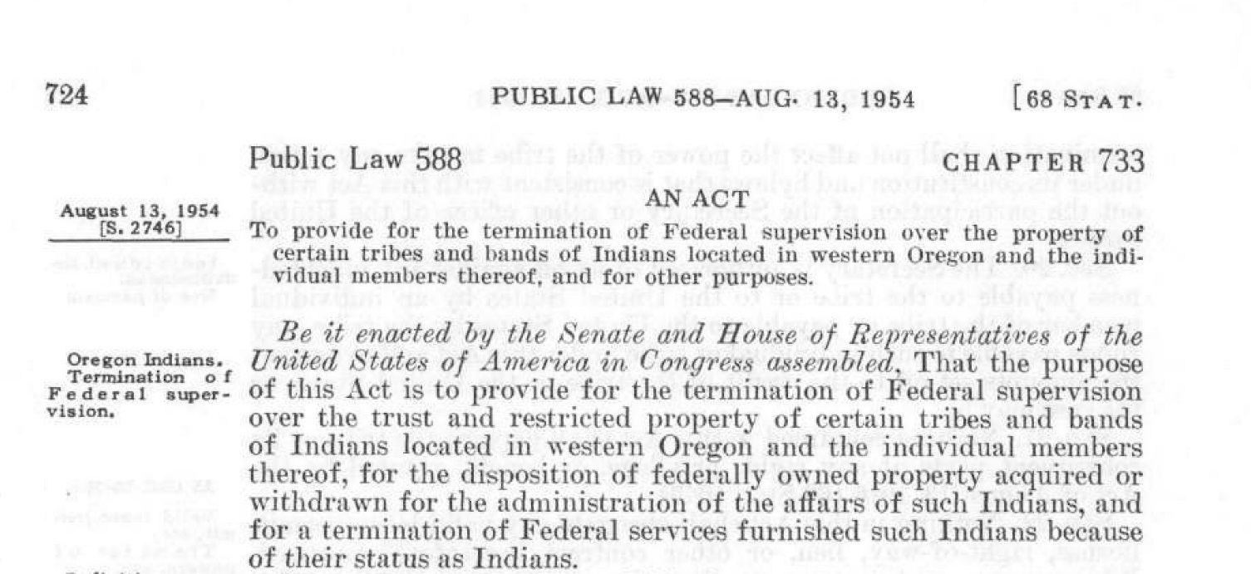
Termination
Federal policy that ended reservations and federal obligations to Tribes and dissolved relationships with Tribal governments.
Notes:
Say: This change in policy was short lived. Beginning in the mid-1940s, U.S. lawmakers and federal officials began to reject the policies represented by the IRA. Instead, they proposed an extreme new form of assimilation called termination. The idea of termination was to end all relationships with Native American Tribes including “an end of all reservations, federal obligations, and Tribal sovereign rights, including those promised by treaties (Wilkinson, p. 278).” In effect, the policy denied the Tribe’s sovereign status by no longer recognizing Tribal governments or individual Siletz people as Native peoples.

Slide 6
Behind Termination
The persistent idea of assimilation, combined with federal financial concerns, fueled the push to termination:
In 1943 the U.S. Senate survey of Indian conditions showed living conditions on the reservations were extremely poor
The Bureau of Indian Affairs (BIA) was blamed for these conditions
Congress concluded that some Tribes no longer needed federal "protection"
Notes:
Say: Like the Indian Reorganization Act, calls for termination grew from the failures of past policies. In 1943, the U.S. Senate commissioned a survey of the living conditions on Native American reservations. It found that living conditions were punishing, with widespread poverty on reservations throughout the country. The report placed most of the blame on the Bureau of Indian Affairs (BIA) and its bureaucracy—highlighting extreme mismanagement as the basis for the problems plaguing Native people. However, instead of seeking to address this mismanagement and social discrimination against Native people, Congress concluded that the real problem was that Tribes had become too dependent on the U.S. government. Proponents of termination argued that it would be better if the federal trust relationship ended, which would leave Native people no choice but to assimilate into the general U.S. population.
As with allotment, federal officials and lawmakers were motivated by self-interest. Some senators were looking to reduce federal spending and saw a chance to slash the budget of the BIA, while others had grown tired of authorizing payments for land claims in response to lawsuits brought by Tribes for the millions of acres unlawfully taken from Tribal people nationwide. Other lawmakers made no attempt to hide their desire to remove Tribal rights to reservation lands and to sell that land to non-Native people. Though most of the Siletz (Coast) Reservation had already been dismantled before the 1950s, it should come as no surprise that in general the BIA targeted Tribes with large timber reserves for termination. Just like with allotment, the self-interest of the federal government and the ideology of assimilation aligned to create an insurmountable political force.

Slide 7
(Public Law 588) Western Oregon Indian Termination Act
Passed by Congress in 1954 as part of the U.S. government's Indian termination policy.
Termination was imposed upon the Tribes of Siletz by the U.S. government in 1956.
Termination removed all relationship and support between the Siletz Tribal government and the U.S. government.
Notes:
Say: Within a decade termination had gained favor in both Congress and within the BIA. In August 1954, Congress passed a flurry of laws terminating several Tribes across the nation—including the Western Oregon Termination Act, which authorized ending the federal relationship with the Confederated Tribes of Siletz Indians and Grand Ronde. Though implementation of the act didn’t occur at Siletz until 1956 many Siletz families still remember 1954 as one of the darkest years in the history of the Tribe.

Slide 8
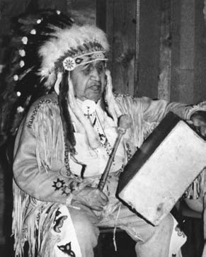
Tribal Consent?
“The vote came quickly, and I do not think that the members of the Council really understood all the things that Termination stood for.”
—Archie Ben, Siletz Tribal council member
Other Tribal members who were present at the time have said the only vote they remember was to authorize the Tribal Council to continue discussions with the BIA about termination. They do not remember a vote to accept termination ever being proposed.
Notes:
Say: Let’s look more closely at what happened at Siletz leading up to termination. Like much of Siletz history, the decision to terminate the Tribe was shrouded in secrecy and misunderstanding. Before the passage of the termination bill, BIA officials claimed to have received the agreement of Siletz Tribal members authorizing termination. And they certainty worked hard to manufacture consent, waging a multi-year campaign that promised Siletz people freedom and independence from federal meddling while also implying that desperately needed payouts won in court cases over land claims would be withheld until the Tribe accepted termination.
Some of the BIA arguments made sense to the Siletz community. Many Siletz people were tired of the BIA, especially after a century of mismanagement and unwillingness to protect the reservation land base and thought that they could perhaps do a better job managing their affairs on their own. Others chafed under state laws that prohibited Indians from marrying white people and both federal and state policies that barred Indians from purchasing alcohol or even setting foot in a restaurant serving alcohol. Soldiers returning from World War II had a new disdain for race-based restrictions and saw termination as a possible escape from unfair discrimination based on their status as Indian peoples. At the time, some stores on the Oregon Coast still proudly hung signs warning “No Dogs, No Indians” in their windows.
Federal policy in the decades leading up to termination was perhaps even more telling. Even before the push for termination, the BIA had functionally abandoned the reservation—relocating the office in charge of administering Siletz, first to Salem and then to Portland. Having liquidated almost all Tribal land holdings, the BIA didn’t have much interest in the obligations that it had made to Siletz Tribal people and made only passing efforts to help people secure health care or education. To many Siletz people, termination seemed inevitable—the BIA had already made up its mind. Additionally, in all of its presentations to Siletz leaders the BIA made no mention of the larger consequences of termination—neglecting to mention that the “freedom” from BIA supervision would be linked to the loss of land, federal services, Tribal community, and Tribal identity.
Despite all their efforts, federal officials found no widespread support for termination at Siletz. The “vote” that federal officials ultimately pointed to as Tribal “consent” to termination was held at a sparsely attended general council meeting, which many attendees left thinking was nothing more than a vote to continue negotiations with the government. With such a huge decision on the line, the BIA accepted a vote in which only 13 yes votes stood in for the consensus of a Tribe of nearly 1,000 people—less than 3 percent of all adults. For Siletz people, in the years that followed, the push for termination became just another example of how the BIA had failed in its duties to look out for the best interest of the Siletz Tribe.

Slide 9
Effects of Termination Policy
Siletz Tribal land was sold off
Siletz families and friends dispersed
Economic and social conditions worsened
The sense of Tribal identity suffered
Notes:
Say: The impact of termination policy on the Siletz people was devastating. What remained of the Tribal land was liquidated and sold. Economic conditions worsened, forcing many Siletz people to move away from the reservation in search of jobs and undermining Tribal identity.
For the rest of this lesson, we are going to take a more in-depth look at the arguments that proponents of termination used to justify termination and compare those to the experience of the Siletz Tribe after termination, as related by Tribal leaders during hearings on a bill to restore the Siletz Tribe in the mid-1970s. We will begin by reading information and historical text to identify arguments used by the U.S. government in support of termination and then take a closer look at the actual impact of termination as told by Siletz people.

