Slide 1
GRADE 10 The Restoration Movement, 1956-1977
Notes:
On your vocabulary handout you have two key terms that are essential to understanding this lesson. I’ll give you a definition, some example pictures, and a bit of an explanation about them. You will have the opportunity to research the etymology (history of the word) and to write a meaningful paragraph using each new vocabulary term.

Slide 2
Lesson Vocabulary
Notes:
In addition, you will create a simple drawing of the concept of the word, not the definition. For example, a picture of the definition of “pedestrian” is a person walking. A picture of the concept could be a foot. The concept is that deeper meaning.

Slide 3
Self-Determination
The movement by which Native Americans sought to achieve restoration of their Tribal communities, right to self-government, cultural renewal, reservation development, control of local education systems, and equal or controlling input into federal government policies and programs.
Notes:
Self-determination is a powerful term. Self-determination is the right of federally recognized Indian Tribes to self-government, including cultural renewal, reservation development, control of local education systems, and equal or controlling input into federal government policies and programs.

Slide 4
Grassroots Movement
A process of building power by involving a constituency in identifying both the problems they share and the solutions to those problems; identifying the people and organizations that could make those solutions possible; engaging with those stakeholders through negotiation, confrontation, and pressure; and developing the capacity to take on further problems.
Notes:
A grassroots movement is the process of building power by involving a group of people or a constituency in identifying both the problems they share and the solutions to those problems. This process involves identifying the people and organizations that could make those solutions possible; engaging with those stakeholders through negotiation, confrontation, and pressure; and developing the capacity to take on further problems.

Slide 5
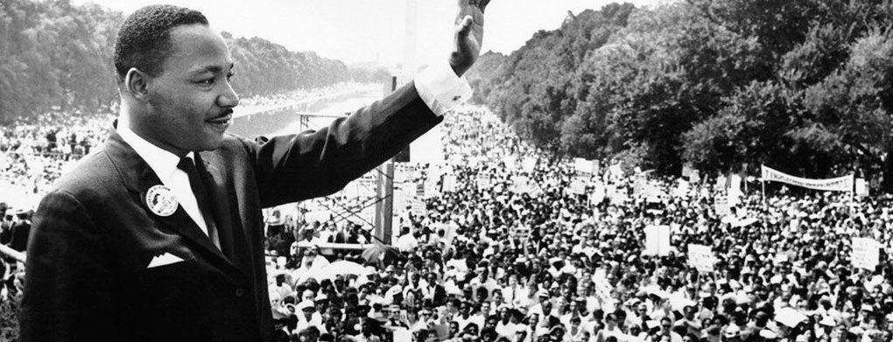
Civil Rights Movement
Notes:
When I think about the history of grassroots movements in the United States, what comes to mind are the large, historical movements, such as the civil rights movement, the women’s suffrage movement, the United Farmworkers movement, and the American Indian movement. But there have also been—and are now—thousands of small, local grassroots movements taking place in communities across the United States.

Slide 6
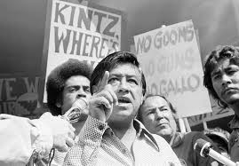
Civil Rights Moment
Notes:
In this lesson, we will have the opportunity to learn about the specific grassroots movement to restore federal recognition of the Confederated Tribes of Siletz Indians. In our next activity, we will begin to examine the key events, strategies, and leaders of this inspirational movement.

Slide 7
Termination & Restoration
Notes:
Share with students that you are going to provide them with a brief review of the termination era and an overview of the subsequent restoration of the Confederated Tribes of Siletz Indians.

Slide 8
Western Oregon Termination Act of 1954
The Termination Act ended all relations between the federal government and Native American Tribes in Western Oregon.
In 1956, the Bureau of Indian Affairs ended formal recognition of the Confederated Tribes of Siletz Indians.
Notes:
In 1954 Congress passed the Western Oregon Termination Act with the intention of ending all relations between the federal government and Native American Tribes in Western Oregon.

Slide 9
Effects of Termination
Bureau of Indians Affairs disposed of remaining Siletz Reservation parcels. Tribal members lost their allotments.
Health, education, and other benefits (under ongoing federal trust responsibility) that were supposed to be available to Tribal communities were withheld.
After termination, the State of Oregon assumed that hunting and fishing tags, licenses, and so on were required under state law for Siletz Indians, when case law affirmed ongoing rights under treaties for Klamath and Menominee Tribes after their federal recognition was terminated.
Departure of two-thirds of the Siletz people living in Lincoln County in search of employment/housing.
Notes:
In 1956, the Bureau of Indian Affairs ended formal recognition of the Confederated Tribes of Siletz Indians. This resulted in the selling or deeding of the remaining parcels of Siletz reservation land to non-Native people. As a result of termination, the Siletz people not only lost their land, but also faced economic deprivation due to the removal of federal aid and services to which they were legally entitled, as set out in the original treaties they signed with the U.S. government. Despite this hardship, Tribal members never gave up and never stopped fighting for the restoration of their federal recognition and their legal rights.

Slide 10
Chalk Way
“With no tribal business to conduct, tribal meetings lapsed and gatherings were now held by families rather than the larger tribal community. There was a lingering sadness, broken hearts, at a life with few dances, songs, and stories—and no land.”
(p. 306, Wilkinson)
Notes:
This quote captures the deep and tragic loss of Tribal community.

Slide 11
Restoration Movement
In the 1970s, Siletz families began meeting to discuss how to address the impact of termination and how to restore their federal recognition and sovereignty.
These meetings evolved into a strategic and organized grassroots campaign to restore federal recognition of the Confederated Tribes of Siletz Indians.
The Siletz Restoration Act was passed and signed into law on November 18, 1977.
The Confederated Tribes of Siletz Indians became the first terminated tribe in Oregon—and the second tribe in the nation—to regain federal recognition.
Notes:
In the 1970s, several Siletz families began meeting to discuss how to organize a campaign to restore federal recognition of the Confederated Tribes of Siletz Indians. Ultimately, the Tribe succeeded, and the Siletz Restoration Act was passed and signed into law on November 18, 1977. In the next activity, you will work in groups to become experts on specific events, people, and grassroots strategies that led to the passage of the Siletz Restoration Act.

Slide 12
Restoration Jigsaw Activity
Step 1. Divide into groups of four called “home groups.”
Step 2. Sit with your “expert group”—those assigned to the same reading segment.
Step 3. Read independently or take turns reading aloud.
Step 4. “Expert group” members discuss their reading segment, fill out Restoration Jigsaw Worksheet, and decide what and how they should present to their home groups.
Step 5. Rejoin your “home groups.” Each student is responsible for teaching their reading segment about restoration to the home group.
Step 6. All students are responsible for completing each section of the Restoration Jigsaw Worksheet and for learning all the material.
Notes:
(Distribute one copy per student of the Restoration Jigsaw Worksheet. Review with the whole class the directions for completing the restoration jigsaw activity).

