Slide 1
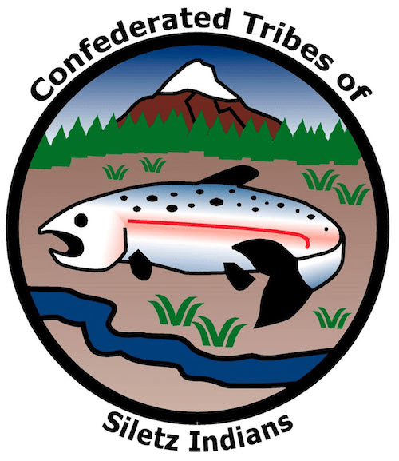
GRADE 4 Tribal Governments

Slide 2
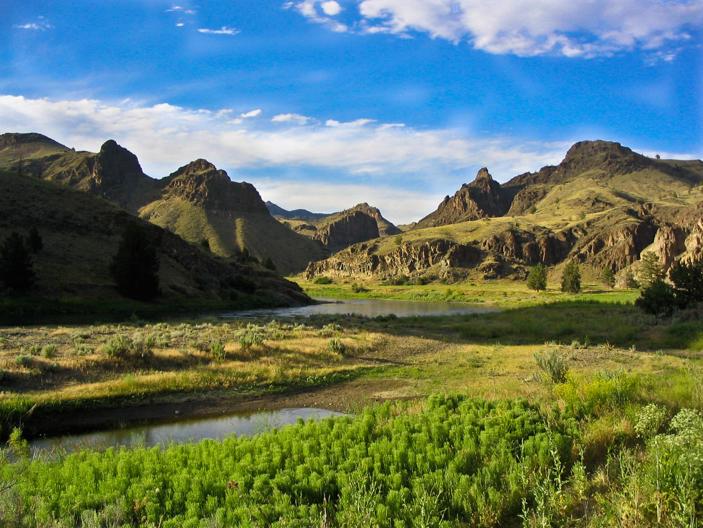
Four Corners
Choose one of the landscapes where you would like to live. After you choose, work together to list all the reasons why it is the best landscape.
Coast | Forest
Mountain | River Valley
Why would people choose to live there?
What would you do for food?
What could you use to find shelter?
What are some benefits of the land?
This Photo by Unknown Author is licensed under CC BY

Slide 3
People have been living on this land since time immemorial
The various landscapes of the region provided different resources, which resulted in different groups of people living in different ways.
Notes:
Say: Since time immemorial” means a very long time—indefinite in the record of history, or before human memory. Native people have been living in Oregon since time immemorial. Each Tribe has its own unique ways of living, governance, and relationship to the land that are shaped by the landscape, animals, and plants that provide sustenance, shelter, and other important resources for daily life. Hunting for game such as deer and rabbit is different than fishing in rivers or the ocean. The types of plants available for housing, tools, weaving, food, and medicine also vary by region, and different groups use them in different ways. For example, in the broad lowland valleys like the Willamette and Rogue, two kinds of oak trees drop their acorns every fall, making a huge bounty of food for people and animals alike to store for winter. On the coast, where oaks are rarer, acorns might be more of a special treat. At the same time, Native people in Oregon have always been connected to each other through trade, family, and marriage. While each Tribe is unique, they are also part of a larger regional culture that shares many of the same traits and ways of looking at the world.
When settlers arrived in Oregon, they found this unique and complicated world. Over time, as more and more settlers arrived in Oregon, they decided to fight against Native people. They wanted all the land for themselves and their families and considered themselves and their society to be better than Native American people. They thought that their ways of using the land (such as fur trapping, farm-ing, mining, or logging) were more important than the ways that Native people used the land to survive. Settlers pushed out, often violently, the people who had been here since time immemorial. The discovery of gold and a promise of free land from the U.S. government turned many of these conflicts into outright wars that only ended when the federal government confined almost all of the Native people living in Oregon to small reservations.
We’re going to keep this in mind—all the history and the relationship between land and Tribal ways of life—while we look at one kind of tool that tells us about land: maps

Slide 4
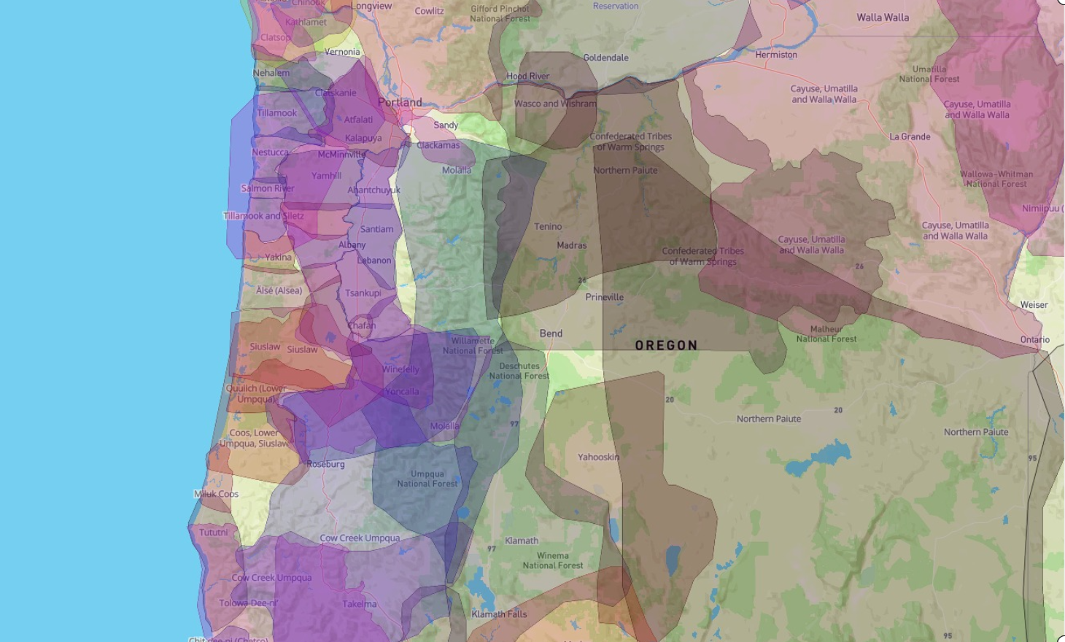
Estimated traditional territories of Tribes and bands
native-land.ca
Notes:
Say: This view of our modern-day state of Oregon is from a project called Native Land, which can be found on their website or app. Each of the different colored areas shows the ancestral territory of unique Tribes or bands. What do you notice on the map?Students may mention the large number of different colors, the irregular borders, the overlapping of borders, the fact that some areas close to the coast are smaller and some in the southeast are larger, and so on.
Many Tribes lived in areas that had different resources at different times of the year. People would travel where the resources were bountiful and trade those resources and goods among other Tribes. Those routes were so well traveled that they still make up much of our roadway system today. However, over time all these Tribes were forced into treaties that reduced these areas into smaller reservations. Many of these unique Tribes and bands, each with their own histories and ways of living, were combined into confederations. That means they were moved to the same area and recognized as a single political government, even if they were originally many different Tribes or bands from very far away. The Confederated Tribes of Siletz Indians, for example, is made up of people from across Western Oregon and even into Southwest Washington and down to Northern California.
[Highlight this area by pointing to the map.]
Say: Additionally, because of the actions of the U.S. government, some groups have been split between different modern federally recognized Tribal governments. For example, descendants of Coos people originally from the area near Coos Bay are today enrolled as Tribal members of either the Confederated Tribes of Siletz Indians; the Confederated Tribes of Coos, Lower Umpqua, and Siuslaw Indians; or the Coquille Indian Tribe. Descendants of Takelma and Shasta people from the Rogue Valley are enrolled at either the Confederated Tribes of Siletz Indians or the Confederated Tribes of Grand Ronde. In all, there are nine federally recognized Tribes in Oregon. Most are confederations of different ancestral Tribes and bands.
Just like each country has a flag to show symbols of their government and history, each Tribe also has a unique flag.Pass out the blank “Federally Recognized Tribal Map of Oregon” and a set of Tribal flags to each student. Ask students what they notice about each flag’s symbols. Have students cut flags and place them where they think the Tribal headquarters might be. After students individually place the flags, they can connect with a partner or create a triad to discuss, change, or confirm their decisions. Show students how they can glue the flags in their correct locations when they are ready.

Slide 5
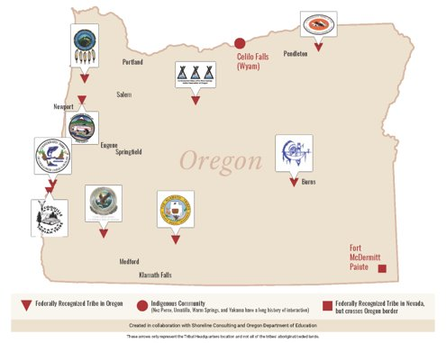
Nine Federally Recognized Tribes in Oregon
Thematic map shows a special purpose, theme, or idea
Notes:
Say: The map we’ve been looking at is called a thematic map. It is created for a special purpose or theme based on a single subject—like our map of the headquarters of the nine federally recognized Tribes in Oregon. Other thematic maps may show where there are populations of specific animals or plants. In your foldable, write the definition of a thematic map on the inside of the flap. Now let’s look at the map to see where different Tribes have their headquarters around Oregon.

Slide 6
Federally Recognized Tribes in Oregon
Confederated Tribes of Warm Springs Reservation
Confederated Tribes of the Umatilla Indian Reservation
Burns Paiute Tribe
Klamath Tribes
Cow Creek Band of Umpqua Tribe of Indians
Coquille Indian Tribe
Confederated Tribes of Coos, Lower Umpqua, and Siuslaw Indians
Confederated Tribes of Siletz Indians
Confederated Tribes of the Grand Ronde Community of Oregon
Notes:
Say: Here are the locations of each of the Tribes. Starting at the north central part of Oregon, we have the Confederated Tribes of Warm Springs Reservation. You may glue the flag in this location. Be sure to write the full name of the Tribe. You may want to put a number on the map and then the name on the side. Heading north and to the east is the location of the Confederated Tribes of the Umatilla Indian Reservation. Glue the flag in the correct location and write the full name of the Tribe on your paper. Continue following the pattern of naming the Tribal nation, having students glue the correct flag in the location, and writing the full name on their paper.
Place a star next to the Confederated Tribes of Siletz Indians. Turn to a partner and tell them at least two observations you have about the current location of the Tribe. Allow students to share. Then have student pairs share out an observation with the whole class. Say: As we go through the examples of maps, you will compare this Tribe and its cur-rent headquarters to another Tribe of your choice in Oregon. Identify the second Tribe and put a star by it. Turn to a partner and describe two observations about that Tribe’s location on the map. Allow students to share with each other, and then have student pairs share an observation with the whole class.
Now let’s go back to the types of maps and use those maps to help us think about how the different landscapes help make each Tribe unique.

Slide 7
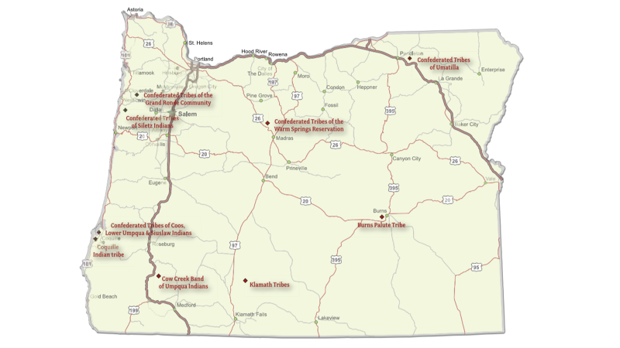
Highway map shows travel routes and highways in an area
Notes:
Say: In your foldable, write the definition of a highway map. This kind of map shows travel routes and highways in an area. They may also be called road maps. Many of the roads we use today are based on trails and pathways established prior to Oregon becoming a state. Tribes moved across all of North America to trade goods and gather resources. The ancestors of Siletz people were forced onto the reservation at Siletz from all over Western Oregon. Today, Siletz families live all over Oregon (and the world) but many still travel to their ancestral homelands to visit important sites, gather foods and medicines, and care for the land. Each fall, many Tribal members retrace the removal of their ancestors from Southern Oregon with a 213-mile community relay called Run to the Rogue that goes from Siletz to Oak Flats along the Rogue River—the longest relay in Oregon. Looking at the map, let’s think about the different routes Siletz people might use today to travel between the modern headquarters of the Confederated Tribes of Siletz In-dians and another part of Western Oregon that comprises the ancestral territory of the Tribe. Choose a location in Western Oregon and trace that path that you would use to get there from Siletz. Are there multiple roads? If you see thicker lines, that indicates a more well-traveled road. The two very thick lines are part of the interstate system across the United States. Turn to a partner and share the observations you have about the two Tribes and the highway map.

Slide 8
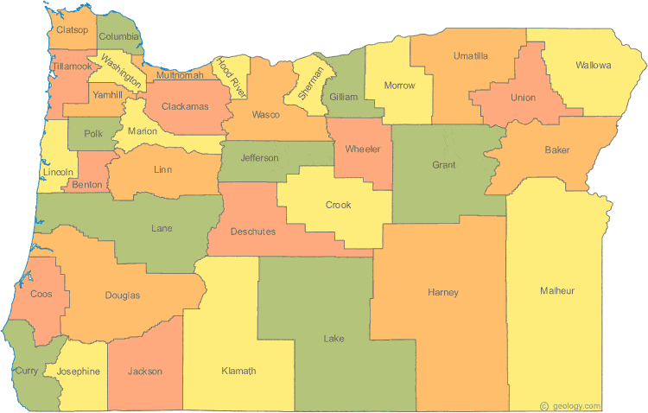
Political map shows boundaries established in order to form a county system
geology.com/state-map/oregon.shtml
Notes:
Say: In your foldable, write the definition of a political map. This kind of map shows boundaries that may be shaped by the landscape but are ultimately determined by people and governments. This particular map shows the boundaries of the counties in Oregon. You may notice that it is colored so that no two bordering counties are the same color. Remember the location of the two Tribes you have examined. Where do they fall in these boundary lines?
A big thing to remember is that Tribes are nations with equal status to a government such as the United States. These Tribes existed before the state of Oregon was even created, and the homelands of many Tribal people crossed what are now state boundaries. Some people removed to Siletz, for example, came from what is now Southwest Washington and Northern California in addition to Western Oregon. Although individual Tribal members may also be citizens of the state, county, and city where they live, Tribal governments are not a part of a state, county, or city. They are their own separate government. Turn to a partner and share your observations of the two Tribes and the political map.

Slide 9
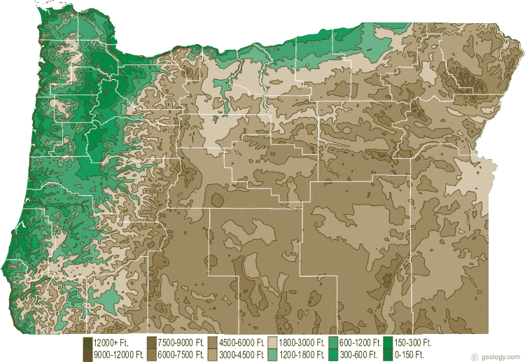
Topographic map shows the shape of the Earth’s surface with contour lines or colors to indicate elevation
geology.com/topographic-physical-map/oregon.shtml

Slide 10
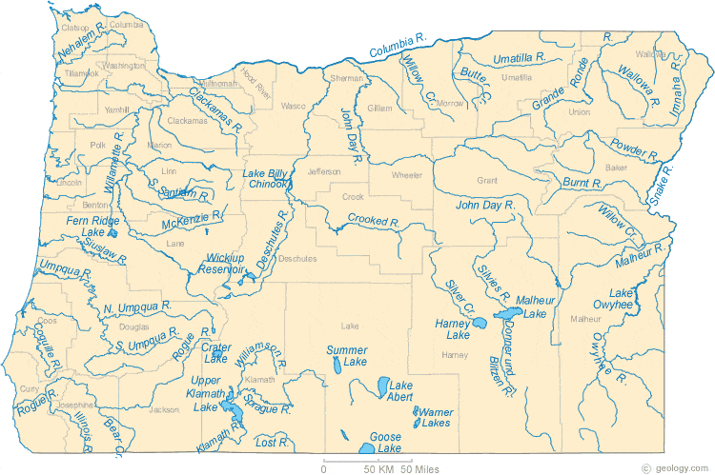
Physical map shows physical features of the land such as mountains and rivers
geology.com/lakes-rivers-water/oregon.shtml

Slide 11
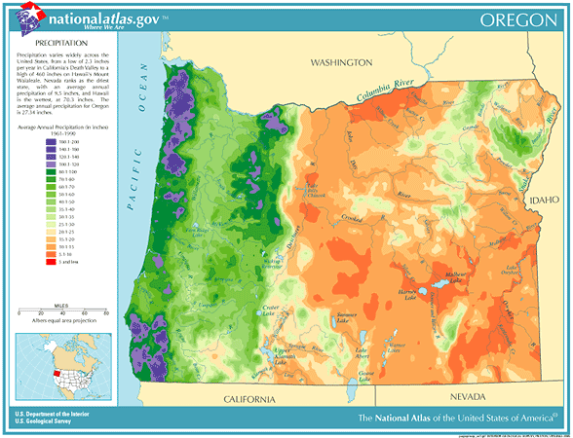
Weather map shows weather elements over time in an area, such as rain and temperature
coolweather.net/staterainfall/oregon.htm

Slide 13
Summative Assessment
Name the nine federally recognized Tribes in Oregon
What type of map shows the physical features of the land such as mountains and rivers?
What type of map shows travel routes and highways?
How do different types of landscapes shape each Tribal nation’s unique identity?

Slide 14
What types of maps are these? How do you know?
geology.com/state-map/oregon.shtml

