Slide 1
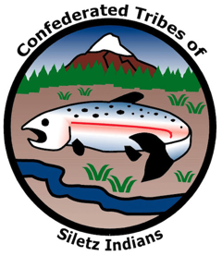
GRADE 7 Amanda's Trail

Slide 2
Activity 1. What makes a home?

Slide 3
Discuss with your partner
What makes a place a home?
Does how long your family has lived in a place change the way you feel about home?
What parts of home are most important to you?
Notes:
Say:
In this lesson we are going to learn about forced Indian Removal along the Oregon Coast. Before we begin, let’s spend some time thinking about the meaning of home and how being forced to leave home would impact a person. We can think with empathy, trying to understand people’s thoughts and feelings, even if they lived in very different times and places in the world and had very different identities than we do.
Say:
First, let’s think a little bit about the concept of home. One conception of home is a house, a place where someone lives with family and pets, keeps their clothes, cooks and eats, or sleeps at night. But Native people weren’t just forced to leave their houses—they were forcibly removed from an entire area where they had lived for thousands of years. I’m going to pass out some sticky notes for you to write some thoughts. As you write, I want you to think about what makes a place a home—both in the smaller and larger conceptions of the word. Write one thought on each sticky note and then turn and talk with a partner about:
What makes a place a home?
2. Does how long your family has lived in a place change the way you feel about home?
3. What parts of home are most important to you?

Slide 4
Discuss with your group
How would being forced to leave your home be different than choosing to move?
If someone forced you to leave your home, would you try to return even if it was dangerous? How would you make that decision?

Slide 5
Activity 2. Mapping Removal

Slide 6
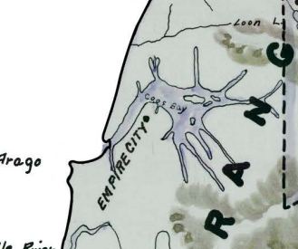
Find Coos Bay
Coos Bay
Notes:
Say:
Find Coos Bay on your map and trace it with your pen. Then draw a line out to label it.
Although settlers tended to group all Coos people together, people from the villages around Coos Bay actually spoke two different languages.
Hanis-speaking people lived in many villages with different names but one of the largest was Ha-nis-ich which became the settler town of Empire City.

Slide 7
Ha-nis-ich and Empire City
Ha-nis-ich
Empire City
Notes:
Say:
Find Empire City, which is on the southwest side of Coos Bay, on your map. Draw a line out with your pencil to label it. Then use your pen to draw a line and make a label for Ha-nis-ich.

Slide 8
Hanis homelands
Hanis homelands
Notes:
Say:
Using your blue highlighter, mark the traditional homelands of the Hanis speakers. Hanis homelands go north along the coast to a major creek which is halfway to the Umpqua River, then up to the top of the Coast Range mountains, followingthe mountains to include the eastern side of Coos Bay, then looping back toward Empire City.

Slide 9
Mi-lukw-itch and Miluk homelands
Mi-lukw-itch
Miluk homelands
Notes:
Say:
Miluk-speaking people also lived in many different villages. One of the largest is Mi-lukw-itch. Using your yellow highlighter, highlight the areas of those traditional lands. Highlight the area on the shore of Coos Bay near where it turns toward the ocean, then south along the coast a little past the mouth of the Coquille River, looping back north to include the lower few miles of the Coquille River and the very southern parts of Coos Bay. Use your pen to mark and label Mi-lukw-itch.
Looking carefully at the map, take your best guess at an outline of Miluk homelands.
Say:
These two communities and their neighbors on all sides were very close. Many people had family across these communities and spoke multiple languages. Oral tradition is very clear that Coos Bay was a busy and populous place before the many hardships, like disease, that came along with settlement. Before the 1850s not many settlers lived along the central or southern Oregon Coast. Most of the non-Native people in the area worked for fur-trading companies and only passed through the region to trade with Indigenous people for beaver and sea otter pelts. Things were not always peaceful, but fur traders had a business interest in working with Native people and forming relationships with Tribes.
That shared interest changed with the discovery of gold in the 1850s. The miners who flocked to the region weren’t interested in any peaceful interaction with Native people. Miners were greedy. They wanted gold and to get that gold they needed access to land where Indigenous people had lived since time immemorial. In their rush to claim the best spots to mine, miners (and other settlers arriving in the region to support the mining economy) aggressively harassed and attacked individual Native people, small groups, and even entire villages.

Slide 10
Nasomah
Nasomah
Notes:
Say:
Find the mouth of Coquille River and mark that area with your pen. On the central Oregon Coast, one of the most infamous of these attacks occurred in 1854 when an armed group of vigilantes massacred and destroyed the entire village of Nasomah. With your pen, draw a line to label the village with its name. Relatives of survivors recalled that entire families burned to death inside their homes or were shot as they tried to escape the unprovoked attack. This was just one example of an escalating number of massacres and attacks up and down the southern Oregon Coast and other parts of southern Oregon during this period.

Slide 11
Mining towns and U.S. forts
Port Orford
Fort Lane
Jacksonville
Notes:
Say:
Using your pencil, mark some of the U.S. military sites and mining towns from which attacks on Native people often started. One of the largest mining towns was Jacksonville in southern Oregon. Find the town, circle the name, and label it on your map. The U.S. Army built Fort Lane and another fort at Port Orford to prepare to go to war with any Native people who might try to retaliate. Use your pencil to label these U.S. military installations.
In the two years that followed the Nasomah massacre, the most brutal fighting occurred to the south—the epicenter of Oregon’s gold rush—where scattered attacks escalated to full-scale warfare between Indigenous people and a combined forces of settler militias and the U.S. Army. These were called the Rogue River Wars. This fighting included people from other Tribal nations. You’ll notice that this area is labeled “purchased from Rogue River’s.” That’s because the Tribes in this this area were promised clothes, tools, and money as part of treaties negotiated to avoid massive conflicts.
Although Indigenous people on the central Oregon Coast didn’t see the same level of warfare, they suffered under the general environment of fear and intimidation provoked by the fighting. Beginning in 1855, most Native people living near settler towns like Empire [ask students to recall the location of Empire City on the map] were rounded up at gunpoint and kept under armed guard at Fort Umpqua.

Slide 12
The Coast (Siletz) Reservation
Agency (Reservation Headquarters) at Siletz
Coast (Siletz) Reservation
Alsea Sub Agency
Fort Umpqua
Notes:
Say:
Use your pen and find the Coast (Siletz) Reservation (in pink) on your map. Trace the outline of the reservation and label it. The Coast (Siletz) Reservation is huge—over a million acres and nearly one-third of the Oregon coastline—and was intended to be a permanent location to which all the different Tribes from across western Oregon would be removed at the end of the fighting. Since the U.S. government considered this a large reservation with many people, the government set up different bases or agencies on the reservation. Find the Alesea sub-agency and label it with your pencil. The headquarters of the reservation are labeled “agency” on the map. Find agency and label it—today that is the town of Siletz. Finally, find Fort Umpqua and label it. Fort Umpqua was just south of the Coast (Siletz) Reservation boundary but it served as the southern post for soldiers patrolling the boundaries of the reservation.

Slide 13
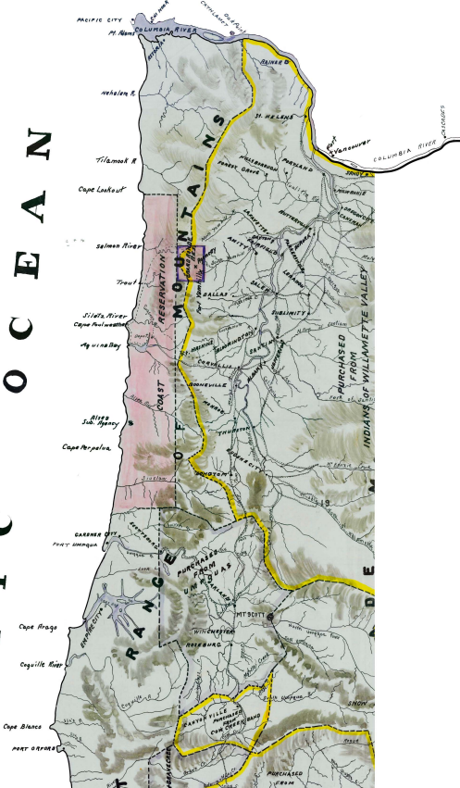
Forced march from Port Orford
By ship
Notes:
Say:
The U.S. government had forts like Fort Umpqua because they wanted to be able to control the Native people that were forced to live on the reservation. Beginning in 1856, many Native people from southern Oregon were shipped up the coast via steamship all the way from Port Orford to Portland and on to Oregon City before being forced to march over to the Coast (Siletz) Reservation.
Pause to have students trace the route in pencil.
Say:
Others, especially those deemed “troublesome” by military commanders, were forced to march straight up the coast from Port Orford to the reservation. Many Siletz families remember this as a forced death march.

Slide 14
Forced march from Fort Umpqua
Notes:
Say:
Most Coos people from the central Oregon Coast imprisoned at Fort Umpqua saw a shorter but no less traumatic trek. In 1860, they were made to walk up the coast to the Alsea sub-agency, located not far from present-day Yachats.
Direct students to find the Alsea sub-agency.
Say:
None of the people removed to the Coast (Siletz) Reservation wanted to leave their homes. Many did all they could to avoid Removal. Some people, especially women, managed to remain in their homelands by partnering with settler men. Other people hid out and continued their lives in their homelands as fugitives. Many of those forced onto the Reservation fled back to their homelands, often attempting escape multiple times after being caught and returned by the army or settler mercenaries. Although the bulk of Removal occurred between 1856 and 1860, people’s ongoing attempts to return and remain home meant that the forced Removal of people to the Coast (Siletz) Reservation continued to play out over a period of many years.
Resistance was so widespread that the government invested significant resources into capturing fugitives and returning them to the reservation. Soldiers guarded the southern boundary of the reservation from Fort Umpqua and made periodic sweeps south to hunt down and capture Native people. The government even paid mercenaries to capture and return people to the reservation—often veterans of the Indian Wars who had no qualms about abusing Native people as they brought them back to the reservation or killing Native people if they attempted to escape. To this day, many Siletz families remember this painful history of Removal and of the individual impact this loss and separation had on their families. Siletz people keep these stories alive to remember where they come from and what they endured and overcame to continue to exist as a Tribe today.

Slide 15
Location information
Notes:
Say:
Census takers didn’t just count people. They also collected information about them including where they were born and their age, sex, marital status, and race (labeled “color” at this time). Since congressional seats are allocated by state and district, the census is also careful to record where people were living. You can find the location of this census page at the top of the sheet. Where is it from? What other categories or information do you notice on this page? REMEMBER, some of the terms used in 1860 are offensive to people today. We want to be careful not to use these terms in daily speech.

Slide 16
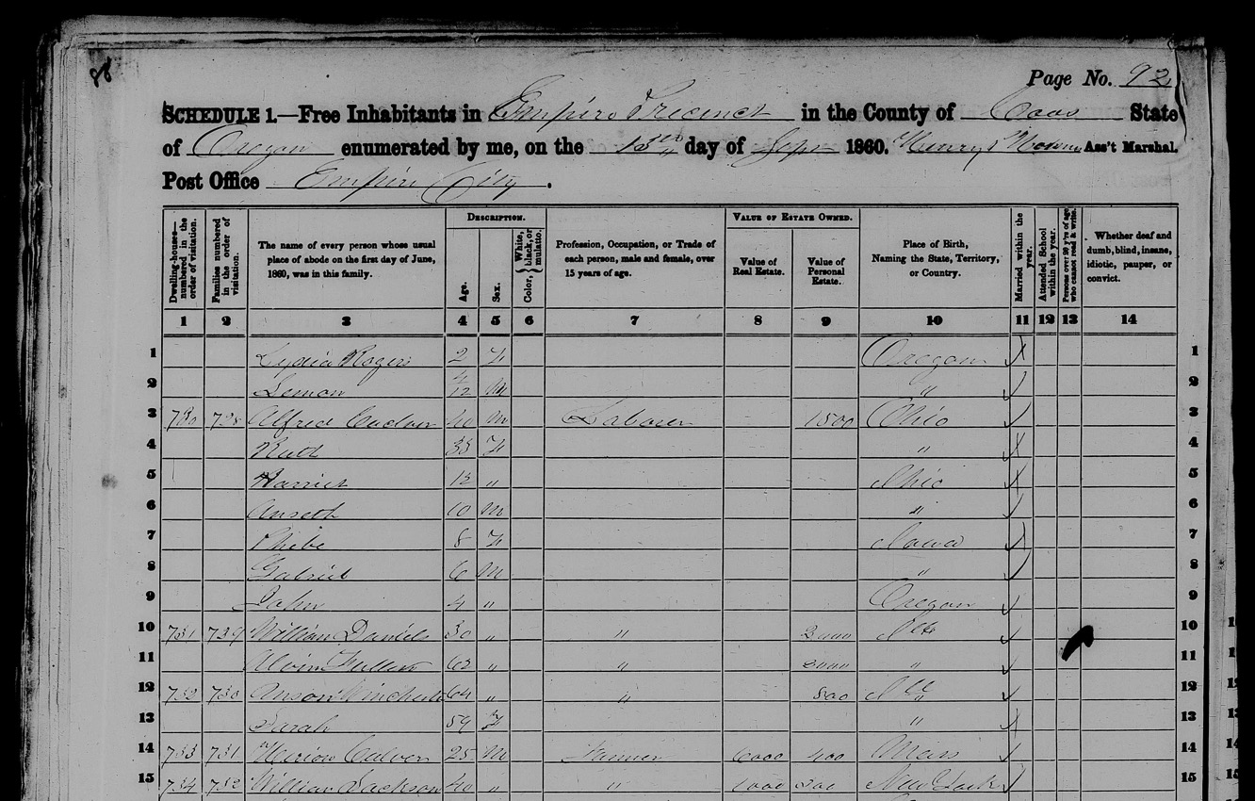
People and places
Notes:
Say:
Census takers grouped people according to household. The first column is “dwelling-houses, numbered in the order of visitation.” Each entry in that column represents a residence that the census taker visited. Each person below that entry was counted as a member of that household.
Let’s practice looking at a family. In row 3, find the 730th dwelling visited in this section. The name of the first person recorded at that dwelling is Alfred Culver. The first person listed for each household is usually whoever census takers considered to be the head of the household. Alfred is recorded as a 40-year-old male and a laborer. He reported $1500 in personal property but no real estate, was born in Ohio, and was married. Also in the house are Beth, 35, noted as female, and Harriet, 12, who was also identified as female. Note that those little quote marks mean that the information on the line above is repeated. Anseth is listed as a 10-year-old male, Phoebe as an eight-year-old female, Gabriel as a six-year-old male, and John as four-year-old male.
This information is interesting on its own, but we can also use it to try and piece together parts of the family story. For example, note that some of the people in the family are listed as born in Ohio, some in Iowa, but others in Oregon. Based on that information, can you make a guess about when the family moved to Oregon from Ohio?

Slide 17
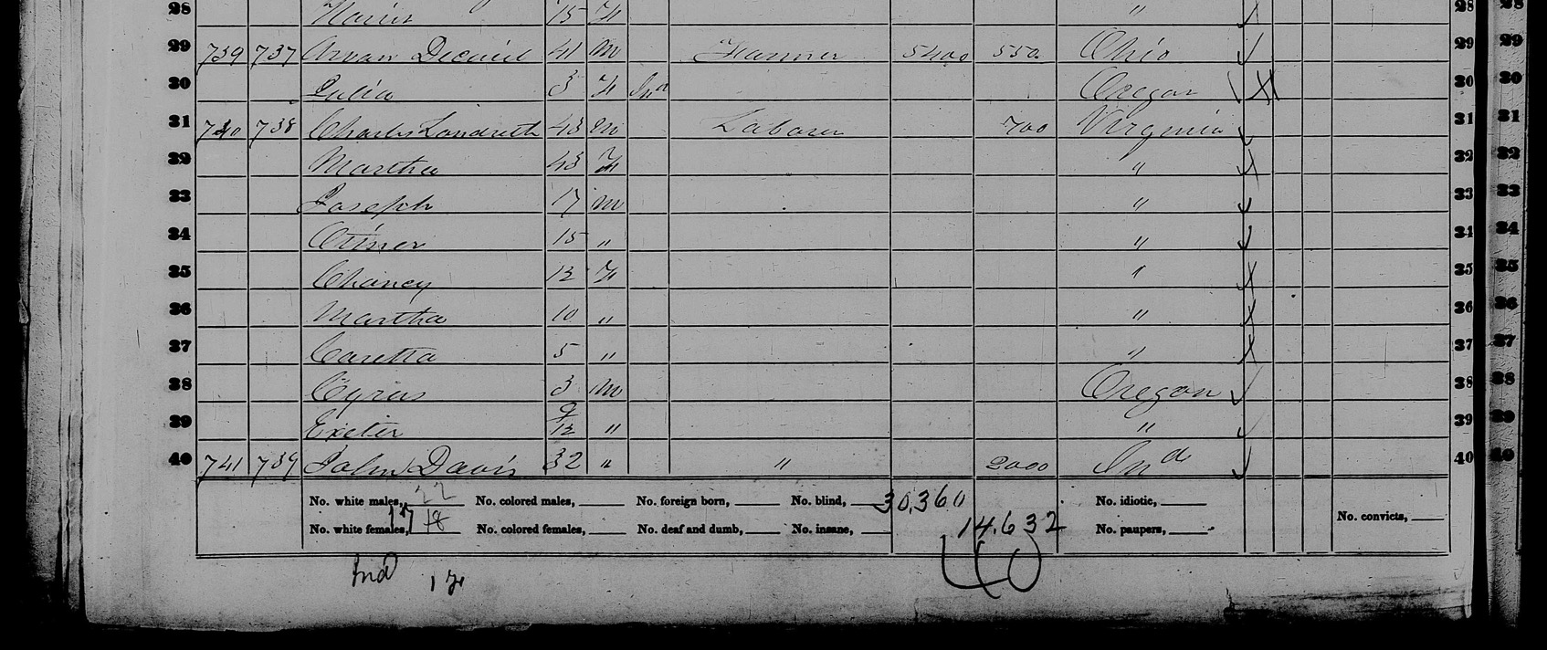
DeCuys in 1860
Notes:
Say:
Let’s turn back to the story of Amanda and Julia. See if you can find an entry on the 1860 census page that might refer to Julia and Amanda. As you begin, note that misspellings and alternative spellings are common in old documents. The last name “DeCuys” might be spelled a different way. Great! Can you find the corresponding line for the 1870 census?

Slide 18
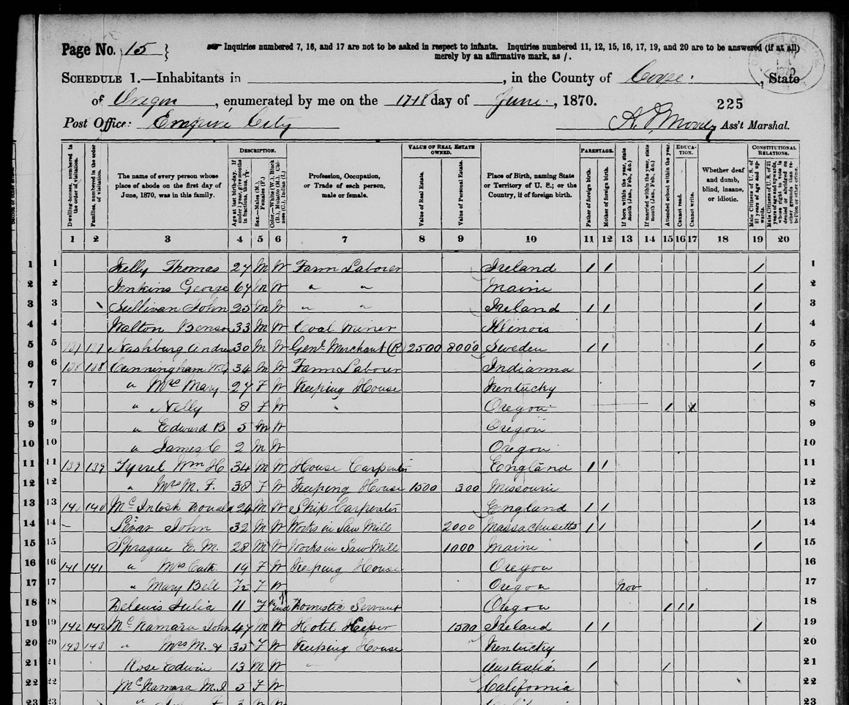
DeCuys in 1870
Notes:
Say:
In these two additional documents, we can follow Julia’s life a bit more. The documents help us to ask more questions and infer what might be happening to her. What are the things you observe from this entry and what might you infer?

Slide 19
Notes:
Say:
Now that we’ve seen Amanda’s Trail let’s talk about it! Presenting history at an individual level like this can be complicated. We’ve already talked about the tension between needing to explain the general context of an event and the power of looking and individual experiences to build empathy and understanding. This picture shows what the sign looks like at the trail. How do you think that the signage and trail design balances these two things? What might you change or add to help maintain this balance?

Slide 20
Notes:
Say:
Another danger of public history, especially history about Native people, is the impulse to historicize people—to treat people as existing only in the past, but not today. Another issue can be focusing only on the suffering and pain of Native people and not acknowledging the way that they people survived and continue to exist and thrive as a people today. How do you think Amanda’s Trail handles talking about Native people today? How might you improve or add to the signs with the information that you’ve learned so far?

Slide 21
Reflection
What are five new things you learned in this lesson?
What are some ways that public history can balance individual stories and experiences with larger stories about events?
What is one thing that you want to continue to discuss and learn more about?

