Slide 1
GRADE K–1 Let's go to a Pow Wow!

Slide 2
Activity 1. What is a Pow Wow?

Slide 3
What is a Pow Wow?
Nesika Illahee Grand Entry 2022
Notes:
Say:
Pow Wows are celebrations held at different times of the year by Native people across the United States and Canada. At Pow Wows people come together to dance, sing, and drum. Dancers wear special outfits called regalia. This is an important time because Pow Wows are one of the ways that Indigenous people stay connected with one another. People have fun and celebrate together at Pow Wows, but these gatherings also play an important ceremonial role in many people’s lives. That means that Pow Wows are one of the ways that Indigenous people pray and give thanks.
You might see different dance styles at a Pow Wow. Each one has its own very special songs, steps, and regalia. We are going to watch a video of Nesika Illahee Pow Wow at Siletz, Oregon. At Grand Entry, people enter the arena together performing all the different dance styles. As you watch, focus on what you see, what you hear, and what you feel.

Slide 4
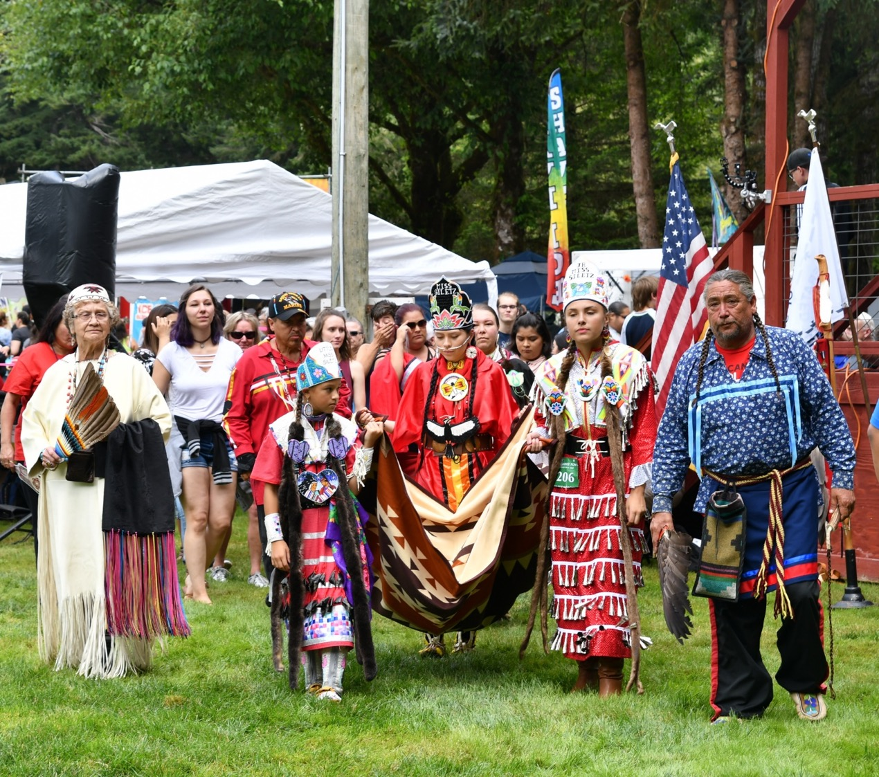
Siletz families Pow Wow
The Confederated Tribes of Siletz Indians hosts two annual Pow Wows that are free and open to the public.
The Nesika Illahee Pow Wow
The Restoration Celebration and Pow Wow
Notes:
Say:
Today, many Siletz families Pow Wow as dancers, singers, and vendors. Pow Wow regalia, songs, and dance are important parts of their lives and Indigenous identities. Pow Wows are also opportunities to come together to visit, laugh, have fun, connect, and celebrate. The Confederated Tribes of Siletz Indians hosts two annual Pow Wows that are free and open to the public.

Slide 5
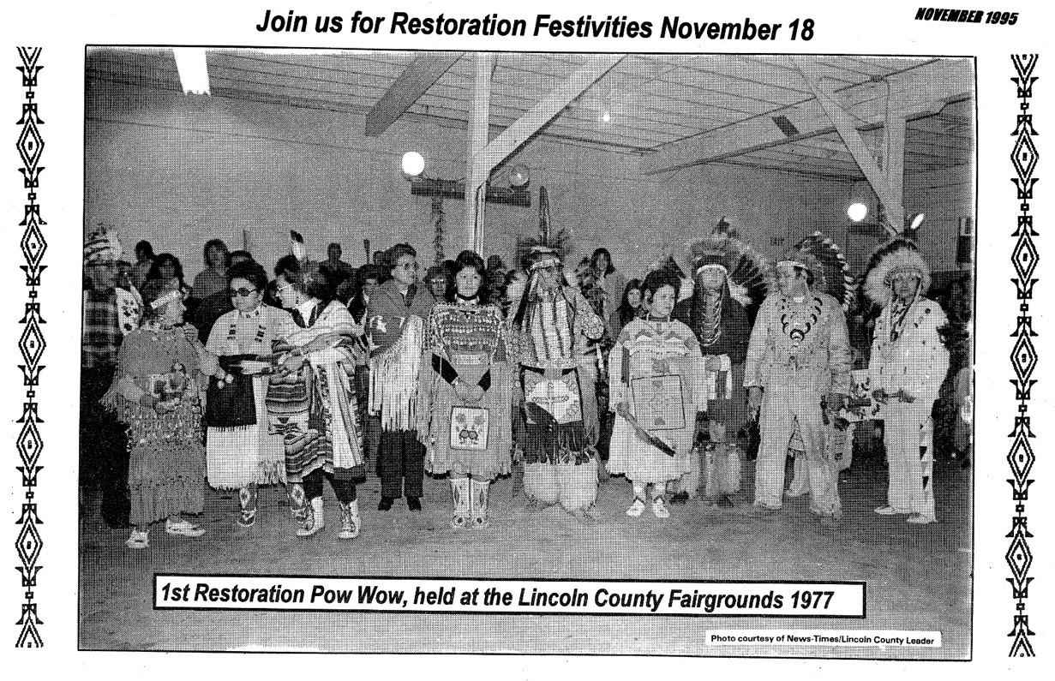
The first Restoration Celebration
Notes:
Say:
Pow Wows are intertribal celebrations. That means that many different Tribes come together at a Pow Wow. Siletz people learned Pow Wow from neighbors and relatives to the east. This is an old picture of the first Restoration Celebration and Pow Wow celebrating the Restoration of federal recognition of the Tribe in November 1977. That is a long time ago! This wasn’t the first Pow Wow put on by Siletz people, but it was one of the earliest ones. What do you notice about this picture? How does it compare to the videos we saw earlier?

Slide 6
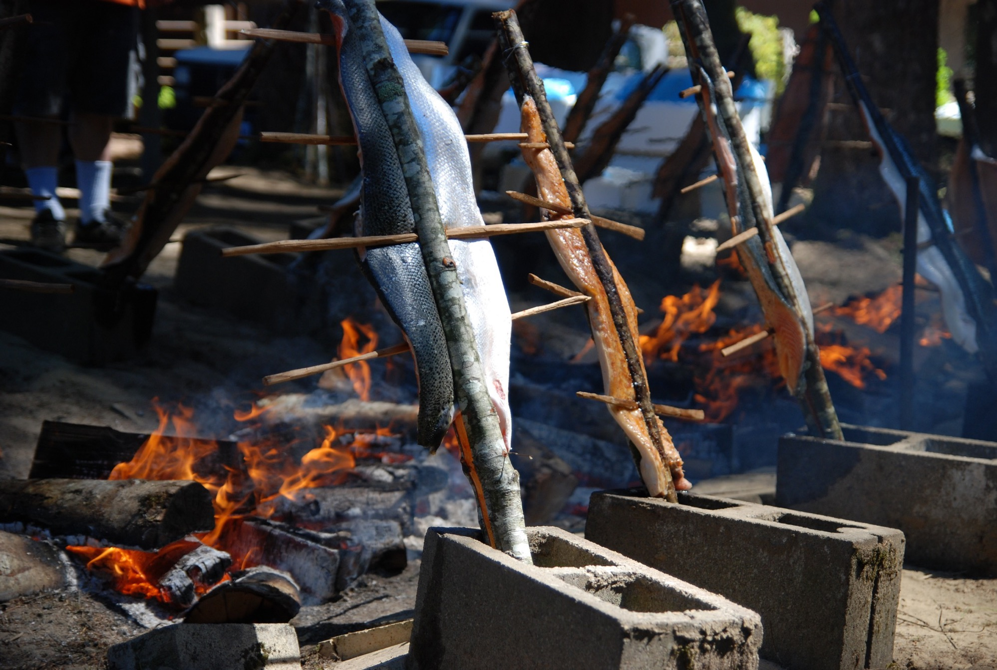
Salmon feed
Notes:
Say:
Feeding and taking care of guests is an important value in Native communities. In this picture, you can see salmon being cooked over a fire. Salmon, which is a type of fish, is a very important traditional food to the Siletz people. Siletz people want to be good hosts to the people who travel to come to their Pow Wows. One of the ways they do this is by sharing food, like salmon cooked in a traditional way, with everyone who attends the Pow Wow. Cooking salmon this way takes work, but it is a good way to show appreciation for the singers, dancers, and visitors who travel to the Pow Wow.

Slide 7
Grand Entry
https://vimeo.com/888830745/e0269cada0
Notes:
Say:
At Pow Wows people wear many beautiful outfits called regalia. Let’s practice that word: regalia. Regalia is worn during ceremonies or celebrations. It’s not a costume or something people play “dress up” in. Regalia is special clothing that is made for the person who wears it. Regalia is often made and decorated by family members and the designs hold special meaning.

Slide 8
Pow Wow expectations
Be kind and participate sincerely
Ask before taking pictures of people
Follow the direction of the announcer/emcee/whipman/whipwoman.
Only look at regalia. Never touch.
Have fun!
Notes:
Say:
During the Pow Wow there is a general arena announcer. They might be called an emcee. Their job is to tell the dancers and people watching what to do. They will announce what types of dances are happening and what is coming up next. They will tell the audience when it’s time for everyone to dance and sometimes ask the audience to stand to honor the dancers. They will also remind people how to be respectful.
The emcee works with a whipman and whipwoman to help run the Pow Wow. The whipman and whipwoman are responsible for making sure that everything runs smoothly, that everyone is safe, and that people are being respectful. You might notice these people giving directions too.
Pow Wows are open to the public and anyone can visit. When you visit it is important to follow Pow Wow expectations.
Read from slide.
Say:
Let’s think more about these expectations. How are these expectations like our school rules? How are they different?
Allow time for students to share ideas about rules in different contexts and situations.
Say:
Think about how we behave in line while waiting for lunch. We have certain rules and ways that we respect space and how we get our food. In what ways do we show respect for others while waiting for lunch?
Elicit student responses such as giving space for others, be sure to not step on feet, or apologize if we accidently bump into someone while waiting for food.
Say:
At a Pow Wow, we know people will be dancing. How might we behave to be safe and have fun without hurting others?
Assist students in sharing ideas about respectful behaviors during celebrations. Examples may include clapping or cheering nicely after each dance, asking permission before touching things, staying away from the dance areas while people are dancing, asking for help from a trusted adult when things are new, trying things with the help of friends, or not making fun of things that are different or unfamiliar.

Slide 9
Activity 2. Pow Wow regalia
Notes:
Say:
Pow Wows feature different dance styles with special regalia (outfits), songs, steps, and meanings. In this activity we will explore the different regalia and dance styles and play a matching game to help us remember them. All of these videos are from the Nesika Illahee Pow Wow held in Siletz in 2023.

Slide 10
Women’s Fancy Shawl
Notes:
Slide 10–12, Women’s Fancy Shawl and the video on slide 12, Women’s Fancy Shawl Video.
Say:
The shawl plays an important role in Women’s Fancy Shawl, also called Women’s Fast and Fancy. Beautifully decorated shawls shimmer and flutter as dancers twist and spin in matching dresses, leggings, and hair ties, gracefully keeping time with a fast beat.

Slide 11
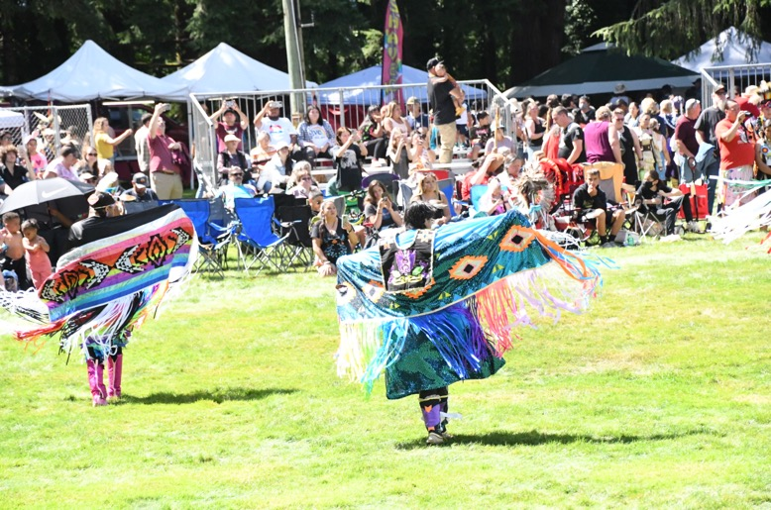
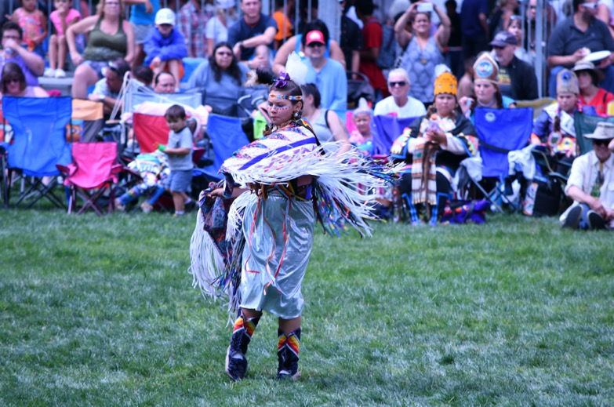
Women’s Fancy Shawl
Beautifully decorated shawls shimmer and flutter as dancers twist and spin.

Slide 12
Women’s Fancy Shawl video
https://vimeo.com/888832568/a2559cd029

Slide 13
Women’s Jingle Dress
Notes:
Slides 13–15, Women’s Jingle Dress.
Say:
Jingle Dress regalia is made of metal can lids rolled in the shape of a cone to make the jingle sound. Jingle dancers’ distinctive steps make the cones tied to their dresses sway and move in time, representing a healing prayer across Indian country.

Slide 14
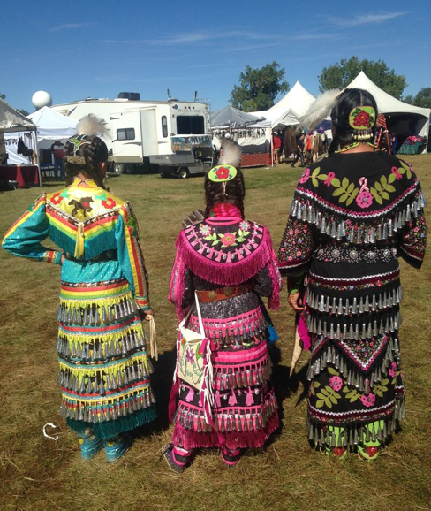
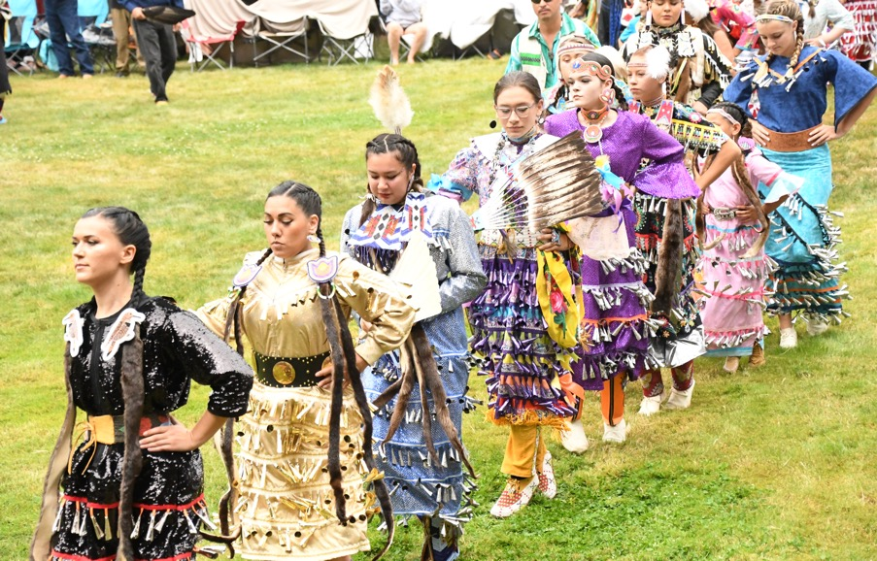
Jingle Dress
The distinctive steps of jingle dancers make the cones tied to their dresses sway and move in time.

Slide 15
Jingle Dress video
https://vimeo.com/888829779/438e136f93
Notes:
Say:
How is that dance different from the Fancy Shawl? How would you describe the sound the jingle dress makes?

Slide 16
Women’s Traditional
Notes:
Slides 16–18, Women’s Traditional.
Say:
The Women’s Traditional is a dance marked by grace, consistency, and small subtle movements. Women’s Traditional dancers often wear heavy dresses usually made from leather with long fringe that builds up momentum to sway as women dance. Other dancers might wear cloth dresses adorned with shells or beads made from elk teeth. During Women’s Traditional dances, you might see many folks in the audience stand to pay respect for the important role of women in the Native community.

Slide 17
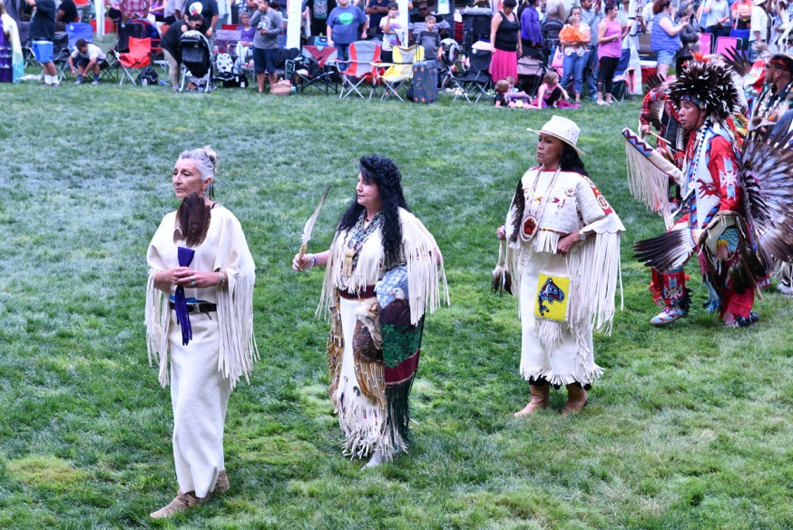
Women’s Traditional
A dance marked by grace, consistency, and small subtle movements. Dancers wear heavy buckskin dresses with long fringe or cloth dresses with shells or beads.

Slide 18
Women’s Traditional video
https://vimeo.com/888831875/2e5ebddbff
Notes:
Say:
These dresses are very heavy, but the women move slowly with purpose. They are very strong to dance and wear this beautiful regalia, even when it is very hot outside. How are the foot movements different from the other dances?

Slide 19
Men’s Fast and Fancy
Notes:
Slides 19–21, Men’s Fast and Fancy.
Say:
This style of dance is very fast with the men spinning and jumping and sometimes dropping down to their knees—and even doing the splits! The dancers’ regalia is very fancy to help show off the quick moves. This dance has the fastest beat, which means the dancers have to be very fit! They also have to listen very carefully to the music to stop dancing as soon as the drum stops. Often, drummers will try to fool dancers with a “trick song” that stops in unexpected places.

Slide 20
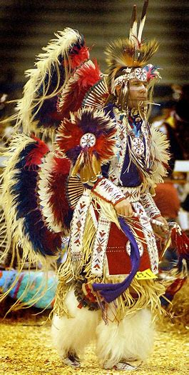
Men’s Fast and Fancy
Often called double bustle for the two bustles that dancers typically wear. This dance has the fastest beat and steps full of spinning and twirling.

Slide 21
Men’s Fast and Fancy video
https://vimeo.com/888830115/908b81098f
Notes:
Say:
What kind of moves did you see? What did you notice about the bustles?

Slide 22
Men’s Grass Dance
Notes:
Slides 22–24, Men’s Grass Dance.
Say:
Since time immemorial—which means a very, very long time ago, even before my great grandparents were around—people would prepare areas for camping or celebrations by stomping down the grass in the area. This dance recalls that tradition with the same moves of going in circles and stomping feet. The regalia often has long following yarn or ribbon representing the tall grass.

Slide 23
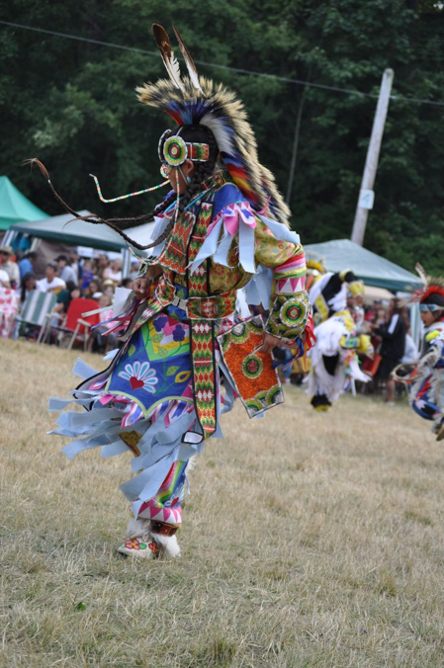
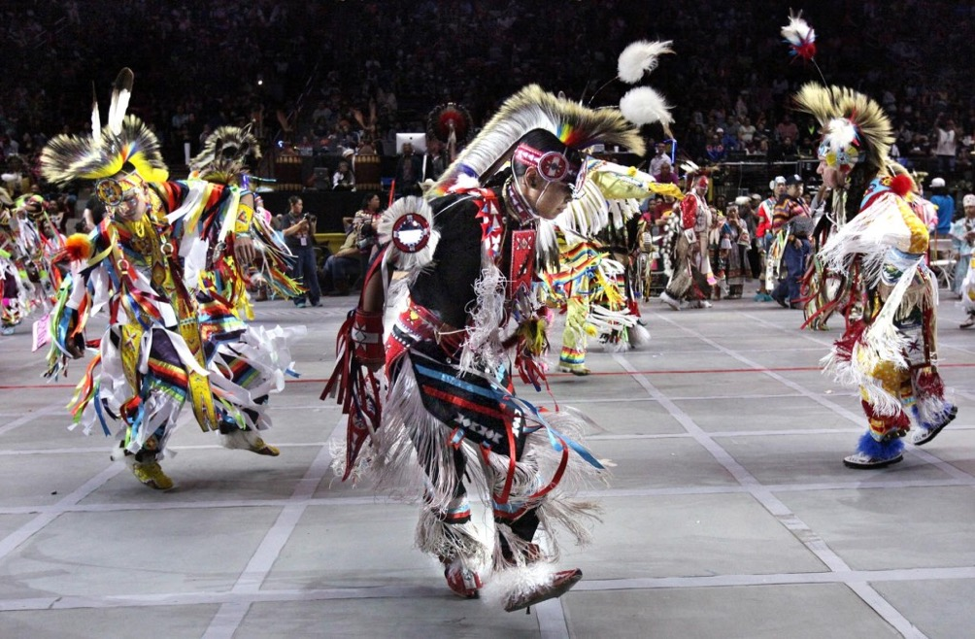
Men's Grass Dance
In the old days grass dancers would stomp down the grass to make an area ready for a camp or celebration, tucking grass into their belts as they worked.

Slide 24
Men's Grass Dance video
https://vimeo.com/888829373/99f7380132
Notes:
Say:
What was the purpose of the Grass Dance?

Slide 25
Men’s Traditional
Notes:
Slides 25–27, Men’s Traditional.
Say:
Men’s Traditional is another style of dance. Many Men’s Traditional dances show movements that are important tasks for families and the community, like hunting or protection. Men’s Traditional regalia includes more materials from the natural world and more natural colors, and dancers often carry special tools that may be used in hunting. This is usually the last category at a Pow Wow.

Slide 26
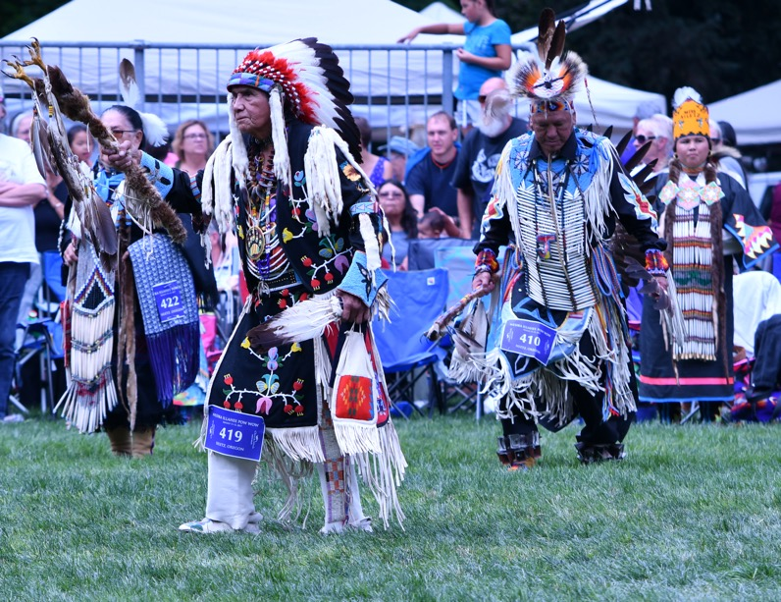
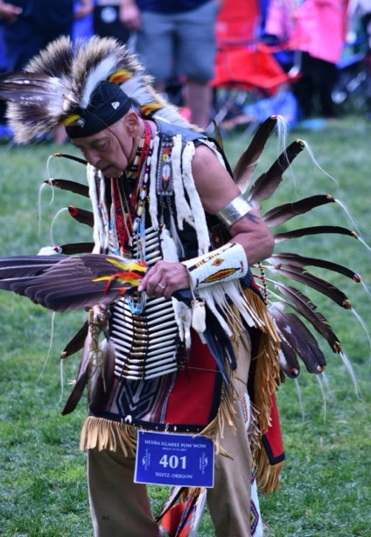
Men’s Traditional
Many individual dances have roots in hunting or battle as dancers recreate important events that keep the community fed and safe.

Slide 27
Men’s Traditional video
https://vimeo.com/888830362/bc7810991d
Notes:
Say:
What did you notice about the Men’s Traditional regalia? How was it different from other regalia?

Slide 28
Women’s Basket Cap Special
Notes:
Slides 28–30, Women’s Basket Cap Special.
Say:
Each year at the Nesika Illahee Pow Wow the Siletz Tribe hosts a special type of women’s traditional contest called a Basket Cap Special. For this dance, women wear special basket caps that have been part of Siletz culture for thousands of years. Basket caps are hats that are woven from plants. The people who make them are called weavers. These weavers use the plants to make designs in the cap. The Basket Cap Special is an example of the way that Siletz people have brought their own traditions to Pow Wow with them. Often, women from other Tribes also participate—wearing basket caps woven in the style of their peoples. The steps are similar to Women’s Traditional but only women wearing these precious basket caps participate in this dance.

Slide 29
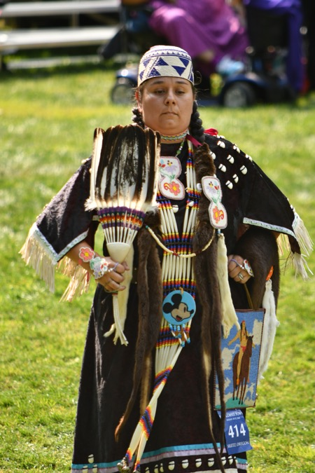
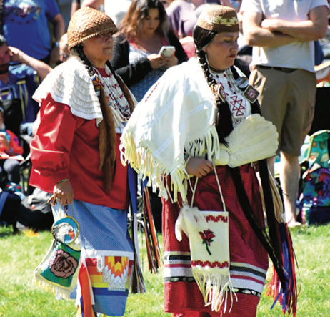
Women's Basket Cap Special
Women wear special basket caps that have been part of Siletz culture since time immemorial.

Slide 30
Woman's Basket Cap Special video
https://vimeo.com/888832234/5e73161203
Notes:
Say:
What did you notice about the different types of basket caps that you saw?

Slide 31
Matching Game
Notes:
Say:
Now that we have watched several styles of dance you might see at a Pow Wow, let’s play a game to practice what we have learned. Our game is going to have pictures hiding behind numbers. Each team will have a chance to call out two numbers to uncover to find a match. Then we will name the dance category. Practice saying the dance style aloud, so you remember the words. If you are ready for a challenge, add the Dance Style word cards and match Regalia cards with Dance Style word cards.

Slide 32
1
2
3
Word Bank
Basket Cap
Traditional
Jingle Dance
Grass Dance
Fast and Fancy
Grass Dance
Fancy Shawl
4
5
6
7
8
9
10
11
12

Slide 33
Circle Reflection
What is one thing you have learned about Pow Wows?
Notes:
Say:
We have discovered the significance of Pow Wows for Native American culture and now we can describe the different dances and regalia seen at Pow Wows. Each person will have a turn to share what they learned. If you need more time to think, you can pass, and we will come back to you after we have gone around the circle. I would like everyone to share at least one thing they learned about Pow Wows. I will model for you what this looks like and sounds like to share what I learned. I am waiting my turn. When it is my turn to speak, I will share “I learned that intertribal dances allow everyone the opportunity to dance!” Then I will pass to the person next to me in the circle for them to have a turn and share what they learned.

