Slide 1
GRADE 3 Oral Traditions: The Story of Tenas Man

Slide 2
Learning Targets and New Vocabulary
I can explain the importance of oral traditions in Indigenous communities.
I can explain the importance of first foods to Native people.
I can identify the elements of a story.
I can interpret the moral of a story.
Elder – An older member of a Tribe or community, specifically someone who teaches or leads others and shares their knowledge and experience. An elder could be a parent, grandparent, aunt or uncle, or a teacher.
First foods – Traditional foods that Native people have eaten since time immemorial. These are found in nature and are often healthier than the processed foods we eat today.
Moral – The lesson to be learned from a story or experience.
Oral traditions – Telling stories and histories to pass them along to younger generations.
Notes:
Say:
Today we are going to learn about first foods that have been important to the Native people of our region. First foods are traditional foods that Native people have eaten since time immemorial. These are found in nature and are healthier than the processed foods we eat a lot of today. What do you think an example of a first food might be? Turn to a partner and share your ideas. [Give students time to talk with an elbow partner.] I want to see who was being a good listener. Who can give me an example of a first food that your partner shared? What did your partner think? [Let a few students share.] You had a lot of good ideas. Let’s learn more about first foods and see if your ideas are correct.

Slide 3
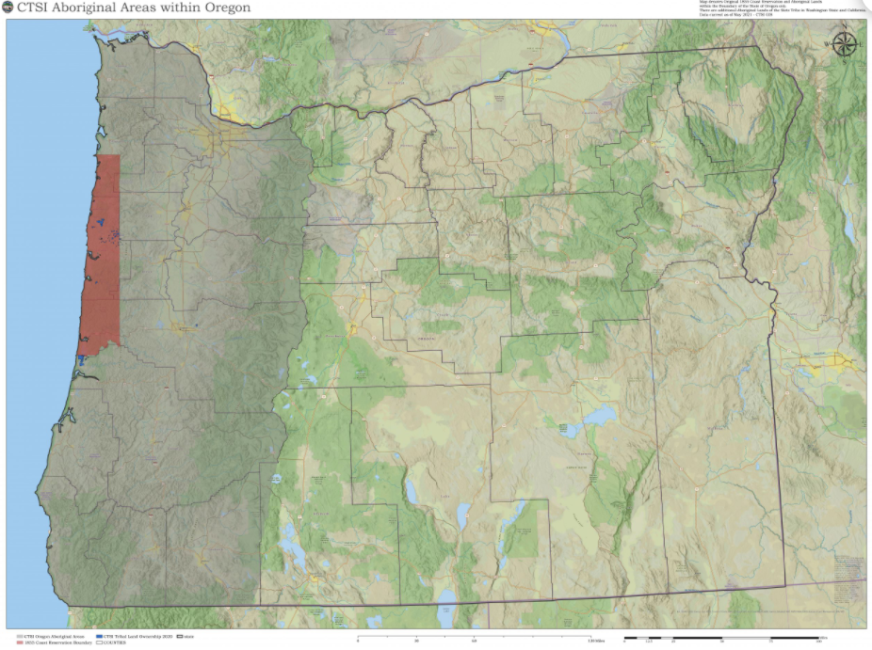
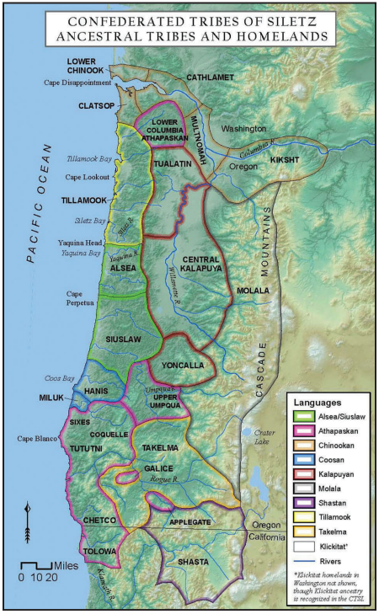
The Confederated Tribes of Siletz Indians
Images source: CTSI
Notes:
Slide 2: Ancestral map.
Source: CTSI website: https://www.ctsi.nsn.us/reservation-maps/
Note: All the land shaded in gray is the ancestral land of the Siletz people. The red symbolizes the original reservation boundary of 1855.
Say:
The Confederated Tribes of Siletz Indians are a group of Native American people who live here in Oregon. Siletz ancestors come from many different groups of Native American people from across what is now western Oregon, as well as parts of northern California and southwestern Washington. Like many Indigenous people, the Siletz ancestors were forced from their homes when new settlers arrived. They were moved to the Coast (Siletz) Reservation beginning in the mid-1850s. Before we begin, let’s look at some maps together so we understand what part of Oregon we’re talking about and how it has changed. [Point out the outline of Oregon, the shaded area that indicates what used to be Indigenous lands and what now belongs to the Confederated Tribes of Siletz Indians.]

Slide 4
Coast (Siletz) Reservation
Close-up view of Reservation centered on the agency located at Siletz. Can you find the very twisty Siletz River?
The original 1.1 million acre Coast (Siletz) Reservation
Images source: The People Are Dancing Again
Notes:
Say:
To survive, the people removed to the reservation relied on their traditional ways of finding food. For some people on the reservation, like the Siletz ancestors whose homelands are in southwestern Oregon, the reservation was a very different place. It was much rainier and colder than the homelands they knew. Different plants grew on the reservation, and others (like oak trees) were nowhere to be found. But some things were familiar, like the lamprey eels that lived in the Siletz River. Lampreys are special ancient fish that have been an important ancestral food for the people removed to the Coast (Siletz) Reservation. Lampreys—sometimes called eels—are a first food, like the ones we talked about at the beginning of this lesson. When people were brought to the reservation the lamprey run at Siletz was full and healthy. It became a lifeline for many of the families taken to the reservation. Some elders today tell stories about being sent to school with smoked eel in their pockets for lunch Instead of a sandwich.

Slide 5
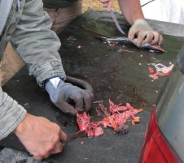
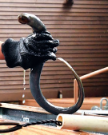
Lamprey (Eels)
Images source: CTSI Tribal Newsletter: Willamette Falls (an important eeling site for Siletz people today); Lamprey Eel; Siletz people cleaning eels
Notes:
Say:
Lampreys are special fish that have a life cycle similar to salmon’s. They are born in the rivers and creeks and then go out to sea as adults before returning to their homes in the rivers to spawn, which means to lay eggs. The time to catch eels is in early summer when they are returning from the ocean, and this was an important time for people at Siletz. The entire family and community would come together to catch eels at night. Each person in the family had a different role. Older men would catch the eels using a long hook while younger children would collect the eels in sacks for others to clean, smoke, and preserve.
Today the Siletz River has very few eels because the state of Oregon poisoned them in the 1980s. They thought that killing the lamprey would help the salmon population grow and they didn’t think to ask Tribal people about how important eels were to their community. Instead, by poisoning the eels they destroyed the first food that the Tribe had relied on for so many years. Today, Siletz people can no longer support their families with eels, but they remain committed to protecting eels and working to make sure that the runs will be healthy again in the future.

Slide 6
Story Elements
Characters | Setting
Problem | Solution
Moral/lesson
Notes:
Say:
You already know a lot about stories. Who can tell me what the “setting” of a story is? [Allow students to respond, clarifying and correcting as necessary. Repeat with the terms characters, problem, and solution.] Great! Today, you’re going to identify those elements in the story, as well as one more very important element—the moral of the story. Does anyone know what that means? [Give students an opportunity to respond.]
Say:
The moral of the story is a life lesson that you can learn from it. Traditional stories like the one we’ll hear today can give us insights into people’s beliefs and values. They might include lessons or morals or examples of characteristics that the storyteller wants to encourage in youngsters—stories are one way that Native people teach younger generations what kind of person it is good to be.

Slide 7
Story Elements: The Three Little Pigs
Characters | Setting
Problem Two of the pigs were lazy and made their houses out of straw and sticks. The wolf wants to eat the pigs and keeps blowing down their houses. | Solution The pigs hide in the third pig's brick house that is too strong for the wolf to blow down.
Moral/lesson Hard work and dedication pays off in the end.
Notes:
Say:
Now you are going to identify the different story elements we discussed. Here is an example of what you will do. [Talk through the example on the slide. Conversely, you can share the mini-lesson in the video here: https://www.readingrockets.org/classroom/classroom-strategies/story-maps.] Think about the story of Tenas Man carefully as you fill out your graphic organizer. I will play the story one more time to help you.

