Slide 1
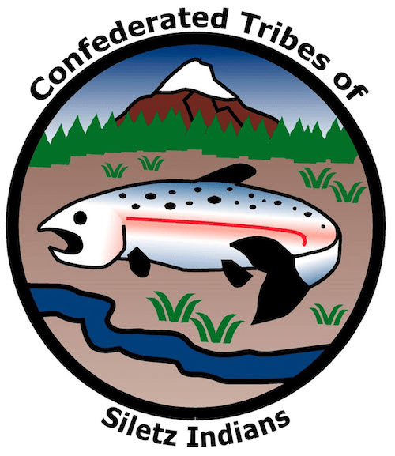
GRADE 9 Tribal Health (Part 1)

Slide 2
Warm-Up
What does it mean to be “healthy”?
What does it mean to “feel well”?
What do you need to be healthy and well?

Slide 3
Defining Health and Wellness
Health – A state of physical, mental, and social well-being in which an individual is free from illness, injury, and disease.
Wellness – A state of optimal well-being in which an individual actively pursues and achieves a balanced and fulfilling life.
Notes:
Say:
Health is a state of physical, mental, and social well-being in which an individual is free from illness, injury, and disease. It includes factors like physical fitness, mental health, and the absence of medical issues. Wellness is a state of optimal well-being in which an individual actively pursues and achieves a balanced and fulfilling life. Wellness includes physical health, mental and emotional well-being, social connectedness, and a sense of purpose and fulfillment. Health and wellness are essential because they enable us to lead happier, longer, and more fulfilling lives while giving us the tools to cope with life’s challenges and opportunities.

Slide 4
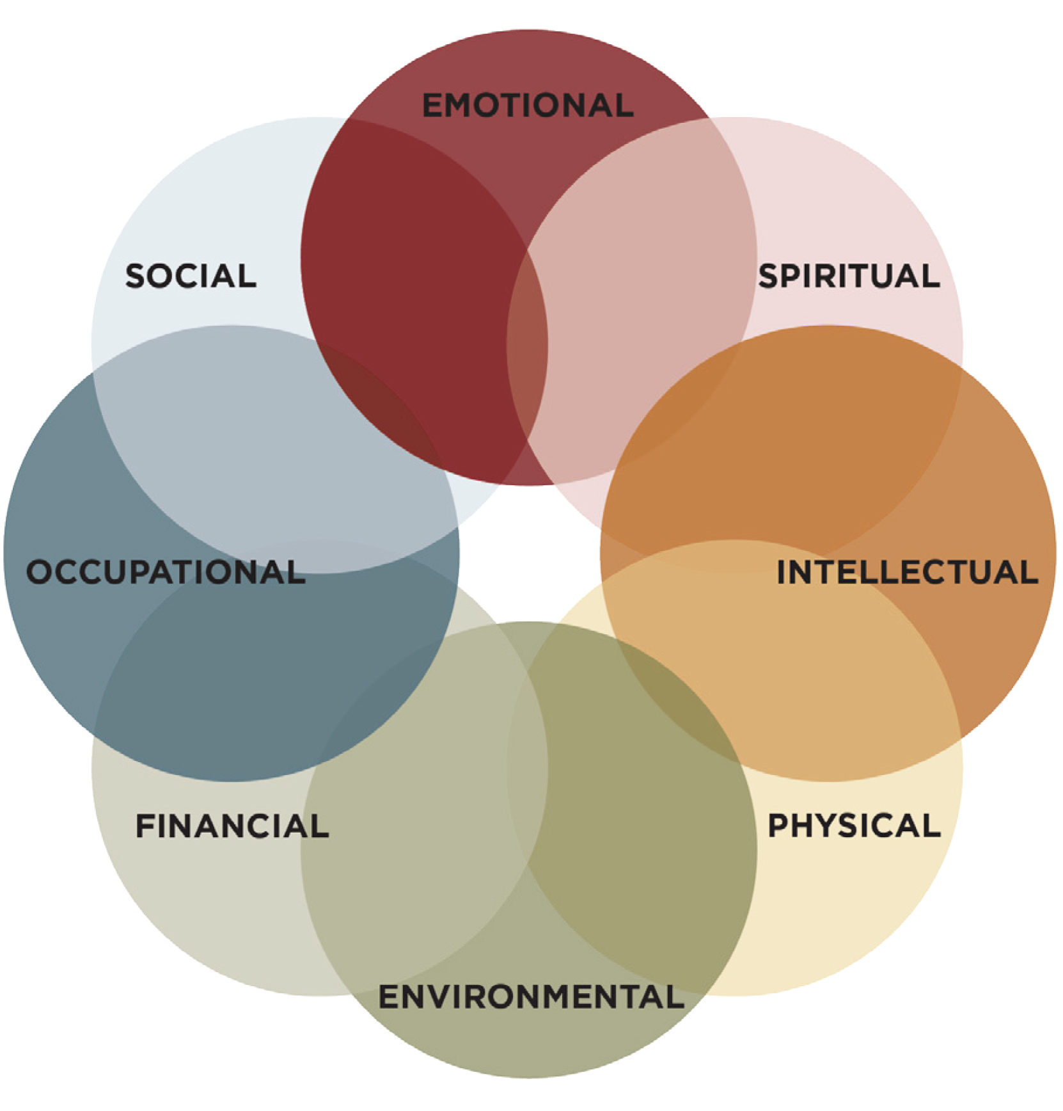
Dimensions of Wellness
Image Source: Substance Abuse and Mental Health Services Administration
Notes:
Say:
People who study and teach health and wellness often speak of many different things that contribute to people feeling healthy and well or unhealthy and unwell. These are called dimensions of health or dimensions of wellness. There are different ideas about how many dimensions there are; the example on the slide provides eight dimensions, but other models include seven, or six, or even fewer dimensions. The general idea is that different aspects of our lives—physical health, emotional well-being, social connections, and more—work together to make us feel happy and balanced. Health and wellness are holistic. Being healthy and well means taking care of your entire being, including your body, mind, emotions, and social life, as they all affect your overall health and happiness.

Slide 5
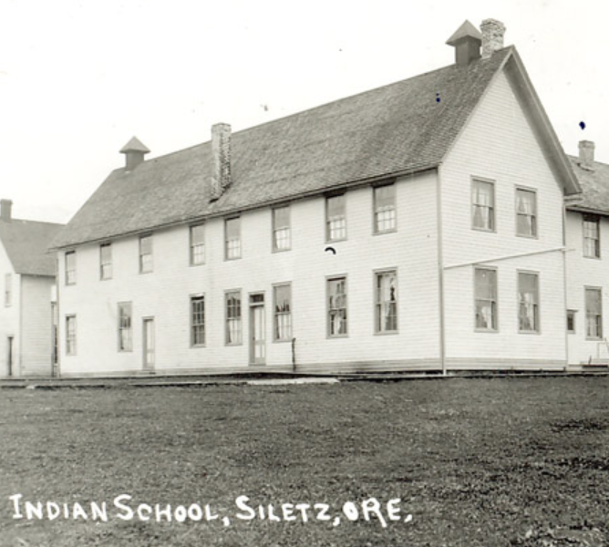
Colonization in Oregon
Disease
Stolen land
War
Forced removal
Forced assimilation
Fraud and mismanagement
Image Source: CTSI
Notes:
Say:
During colonization, Siletz and other Native Americans experienced dramatic changes to their lifestyles that harmed the overall health of both individuals and the larger population. I’m going to explain a little bit about what happened to Siletz people and then we’ll work together to anticipate the ways that colonization impacted the health of Indigenous peoples based on the learning that we’ve done so far.
First, let me tell you a little bit about colonization in western Oregon. One of the biggest impacts of the arrival of settlers was diseases brought from Europe. Often, these diseases decimated Indigenous communities before Europeans had even arrived—travelling along Indigenous trading networks that connected large parts of the continent. Because many of these diseases were unknown to Native people, death rates were extremely high—sometimes as high as 90 percent—and caused large population drops in many places in the country.
However, new diseases alone don’t explain the entire story of the impact of colonization on Native health and wellness. Typically, human populations can recover from the introductions of new diseases—even very virulent diseases. For example, the European population quickly rebounded after the Black Death in the fourteenth century. In the United States, diseases were accompanied by state policies of removal, extermination, and warfare in ways that compounded and magnified the impact of the diseases and combined to devastate Indigenous community health.
In Oregon, settlers fought a series of total wars against Native people—attacking men, women, and children in ways that we would term ethnic cleansing today. When Native people fought back, the U.S. Army joined the fighting, eventually crushing Indigenous resistance and forcing Native people onto reservations like the Coast Reservation headquartered at Siletz. People removed to reservations were forced to leave their homelands with little more than they could carry—often encountering a drastically different climate and way of life. Once arriving at the reservation, federal officials worked to force people to abandon their traditional ways of living and assimilate to the ways that settlers worked and lived. This meant encouraging farming, discouraging communal living, and removing children from homes to be educated in boarding schools.
The government promised that it would provide food, education, and shelter. But through fraud and mismanagement, it often failed to provide enough food for people to live. In later years, federal officials compounded the problem through a series of illegal reductions to the reservation land base, further alienating Native people from the places they could rely on to make a living.

Slide 6
Consequences of Colonization
Malnutrition
Trauma
Depression
Lower life expectancy
Susceptibility to disease
Susceptibility to injury and death from accidents and violence
Image Source: Pixabay
Notes:
Say:
Even though Native Americans have shown a lot of resilience, many Tribal communities still face disproportionate rates of health problems today that are linked to the history of dispossession. Siletz people still lack access to many traditional hunting and fishing areas, making it difficult to subsist on traditional foods. Access to alternative healthy foods like fresh fruits and vegetables can also be limited where many Siletz people live. As a result of these and other pressures, national statistics tell us that Native American Indian and Alaska Native people experience lower life expectancy and increased susceptibility to diseases like diabetes compared to other Americans. They are also more likely to experience injuries and death from accidents and violence that are often related to the effects of poverty, discrimination, and trauma caused by colonization.

Slide 7
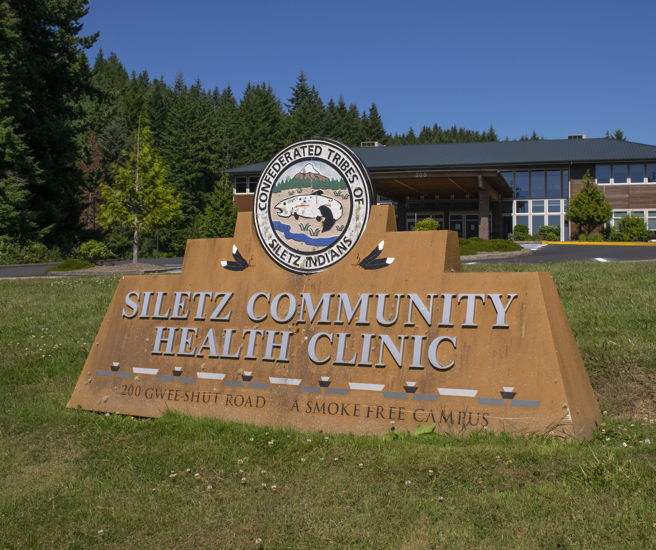
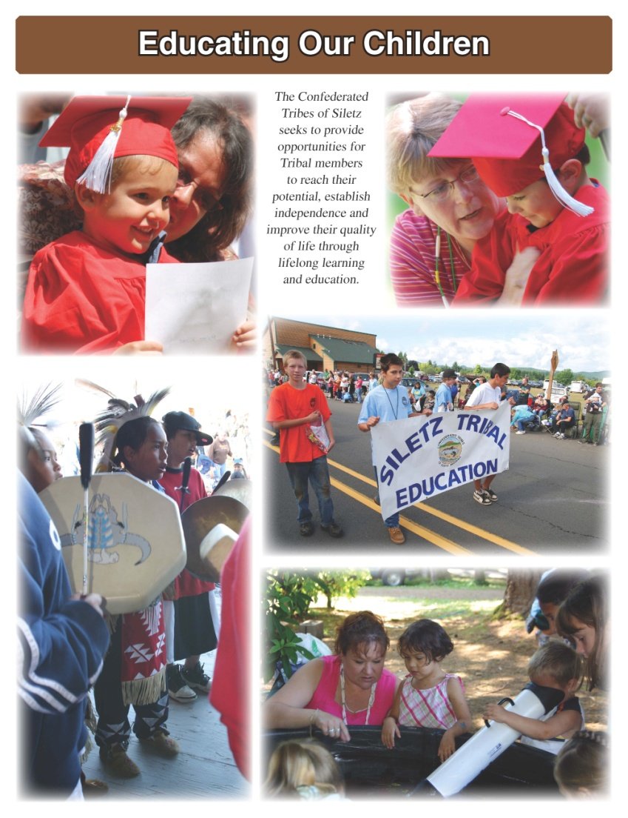
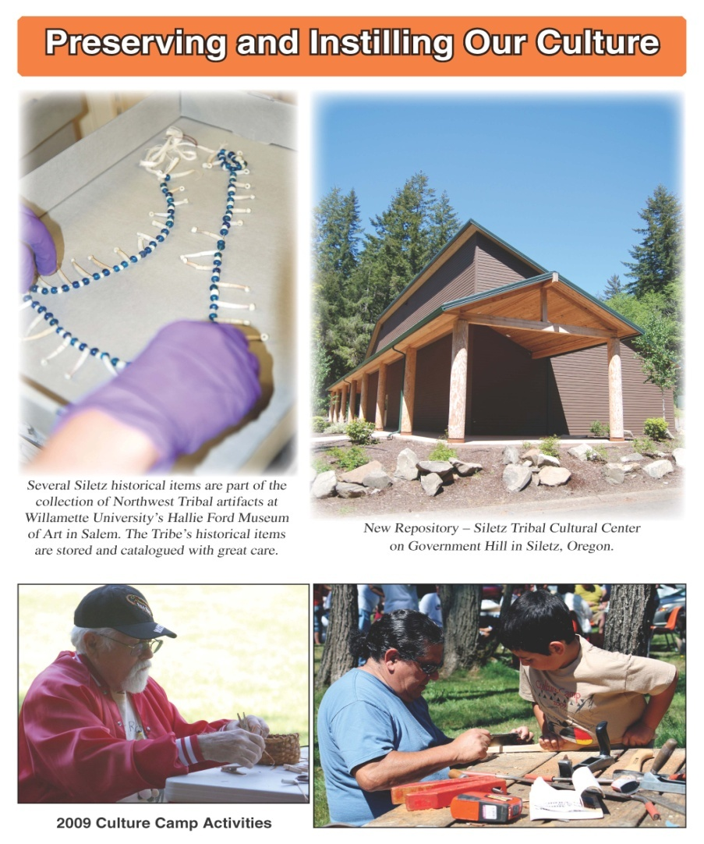
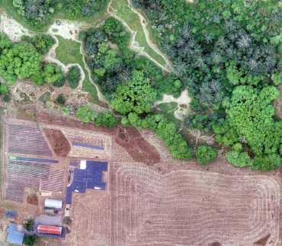
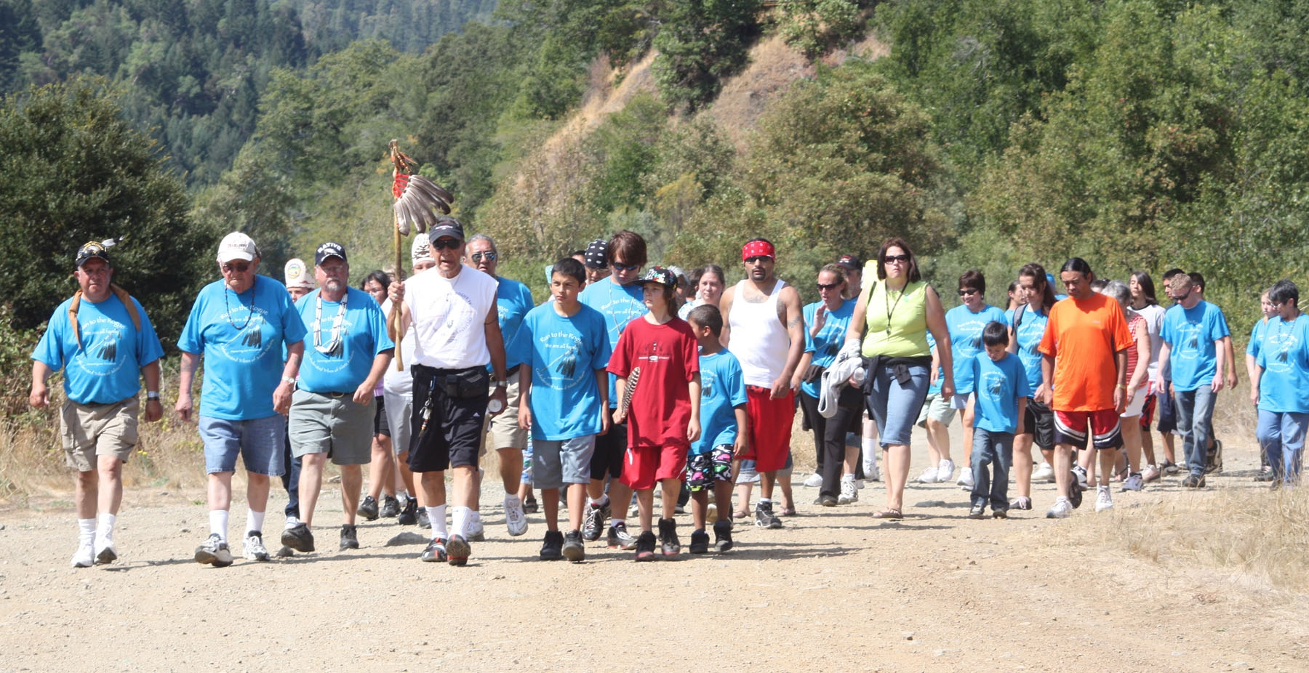
Reclaiming Health and Wellness
Siletz Community Health Clinic
Siletz Health Traditions
Education and Cultural Programs
Garden Program
Fitness Activities
Images source: CTSI
Notes:
Say:
While this is a sad and frustrating history, the Siletz people and other Native people survived and found ways to thrive over the decades. Today, they are actively working to improve the health and wellness of their citizens through a variety of initiatives.
Siletz Community Health Clinic – Like other Tribes, the Confederated Tribes of Siletz Indians, or CTSI, established its own health care facilities and programs to provide culturally sensitive and community-centered care. We’ll learn more about the Siletz Community Health Clinic in a subsequent lesson. CTSI’s desire to make its own choices in how it supports the health and wellness of its citizens was one of the reasons it pushed for restoration in the 1970s and is also why caring for community health was written into the Tribes’ constitution.
Education and Culture Programs – CTSI sponsors multiple programs to (re)connect Tribal members with their cultural heritage and help them feel pride in it. Being proud of yourself and where you come from has been shown to be a “protective factor” that helps people stay healthy and well.
Garden Program – Like other Tribes, CTSI has established a garden program to help Tribal citizens reconnect with traditional foods and their preparation. In this way, CTSI seeks to “de-colonize the diet” and support members to make healthier food choices as well as providing a place to gather traditional foods and medicines.
Fitness Activities – CTSI sponsors multiple activities that promote physical fitness for Tribal members. This includes offering a fitness center and fitness programs. CTSI also hosts “Run to the Rogue,” which promotes both physical fitness and a connection to Tribal history as members walk the route some of their ancestors took when they were removed from southern Oregon and force-marched to the Coast (Siletz) Reservation.
We’ll learn more about how Siletz people are working to secure their health in an upcoming lesson.

