Slide 1
GRADE 9 Tribal Health (Part 2)

Slide 2
Warm-Up
Suppose an older relative or neighbor asked you to help them take care of some health needs. They need to get an annual exam that will include bloodwork, get a flu shot, renew a prescription, and get examined for a new set of corrective lenses. They’d also like to get some information on fitness and recreation activities for senior citizens. They will retire soon and lose their employer-provided health care, so they want to learn more about Medicare, the Oregon Health Plan, and other ways to pay for health care.
Based on what you already know about health care systems and services, how would you go about helping your relative or neighbor get the help and care they need? How would you get started? Where would you have to take them? Who would you need to talk to?
Notes:
All people need help staying healthy throughout their lives. Human societies identify and support people to serve as healers, doctors, and teachers to help others prevent and recover from illnesses and injuries. Families and culture also play a role in helping people stay healthy as well as providing them with security, a sense of belonging, and help meeting their physical and emotional needs. For many people in the U.S., the experience of getting physical and behavioral care needs met is often complex, confusing, and expensive.

Slide 3
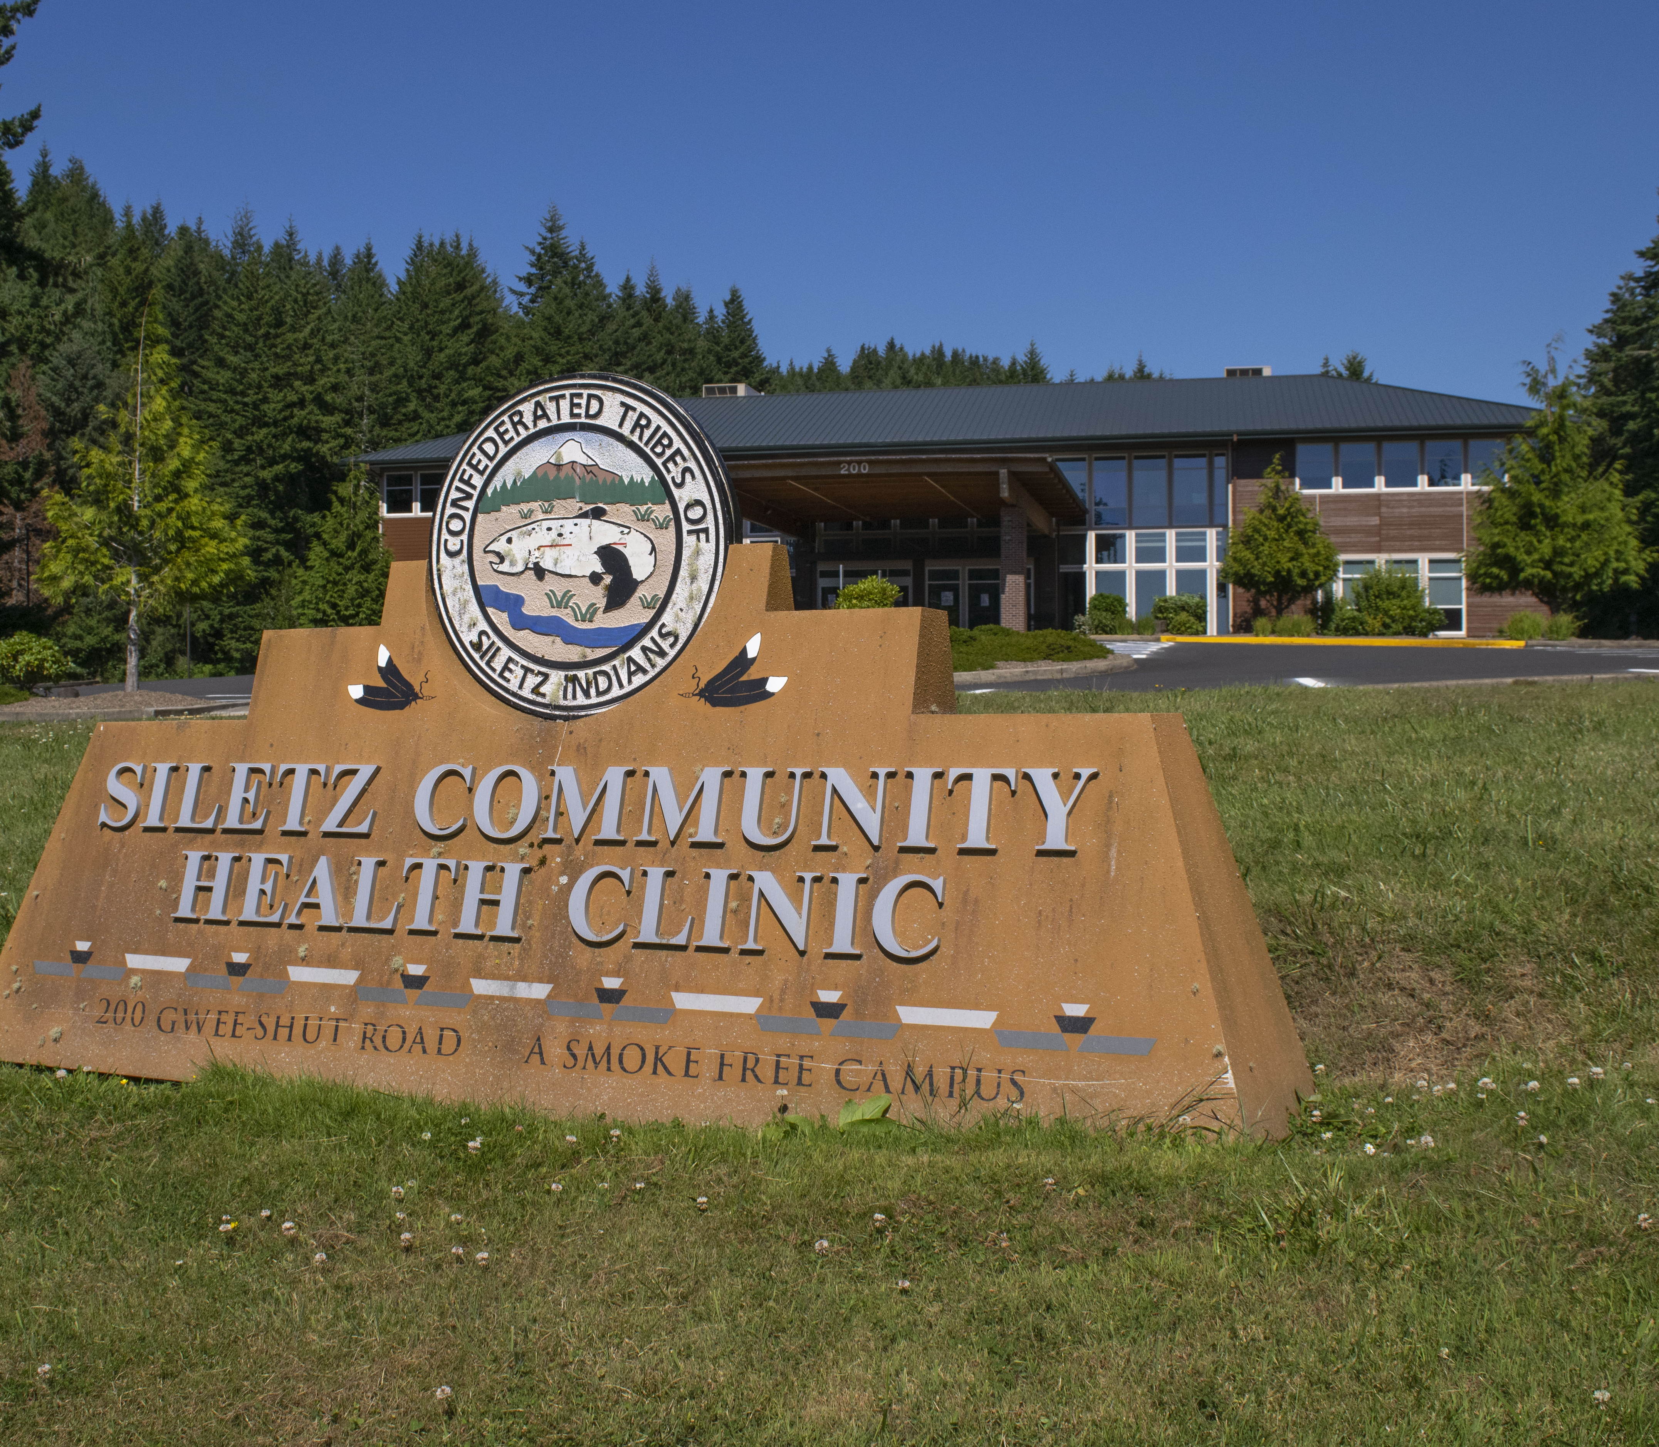
Siletz Community Health Clinic: Mission
Dedicated to the health and well-being of the members of the Confederated Tribes of the Siletz Indians and the local community.
Source: CTSI website (Accessed November 2022)
Image source: CTSI
Notes:
The Confederated Tribes of Siletz Indians is committed to supporting its citizens and other community members in protecting and restoring their health and wellness. The Siletz Community Health Clinic works to provide a “one-stop shop” that helps people access multiple types of health and wellness services. It also helps people understand and use different types of insurance plans, make healthy choices, and find classes and activities that help them stay healthy and connected to others. As a Tribally sponsored organization, the clinic also supports traditional health and wellness practices and helps Tribal members overcome the health effects of intergenerational trauma.

Slide 4
Clinic Services
Medical
Dental
Optometry
Pharmacy
Behavioral Health
Community Health
Facilities and services for diagnosing, treating, and preventing disease.
Specialized medical facilities and services for diagnosing, treating, and preventing oral disease.
Specialized facilities and services for diagnosing and correcting vision deficiencies.
Facilities and services for preparing and dispensing medicinal drugs.
Resources and services to help individuals/families improve and maintain mental well-being.
Resources and services to help individuals/families make and maintain healthy choices and improve their quality of life.
Notes:
The handout and slide identify different types of help individuals and families can receive from the Siletz Community Health Clinic to help them stay healthy and well. Some services prioritize Tribal members, while other services are available to other local community members.

Slide 5
Outreach Message
Suppose your group is a design team hired by the Siletz Community Health Clinic to create an outreach flyer or social media post to promote one of the services offered at the clinic. Using the provided poster paper and markers (or web tool), create a design for the flyer or poster that includes:
A description of one of the services offered at the clinic and instructions about how to access it
Design and visual elements that will help present information in a clear and understandable way
Information about how patients can contact or get to the clinic
Notes:
One of the challenges for public health professionals is conveying information to the public. This starts with informing people about available resources and support. To wrap up, we are going to create a social media post or outreach flyer highlighting one of the Siletz Community Health Clinic services that you’ve learned about today. As you work, I want you to think about what information you want to convey and how to make that information accessible, interesting, and clear with your post or flyer.

